Slide 1

Ubuntu OS
By team COF:
Cillian Mc Cabe
Daire Grimes
Mary Louisse Tipones
Martin Bruveris
and Andrew Owens

Slide 2
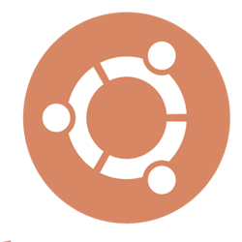
Table of Contents
Founder’s biography
Ubuntu architecture
Ubuntu desktop features and GUI
Ubuntu version history
Conclusion

Slide 3
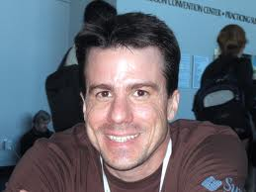
Ian Murdock
Born 28 April, 1973
Born in Konstanz, West Germany
Known for being the founder of the Debian project

Slide 4
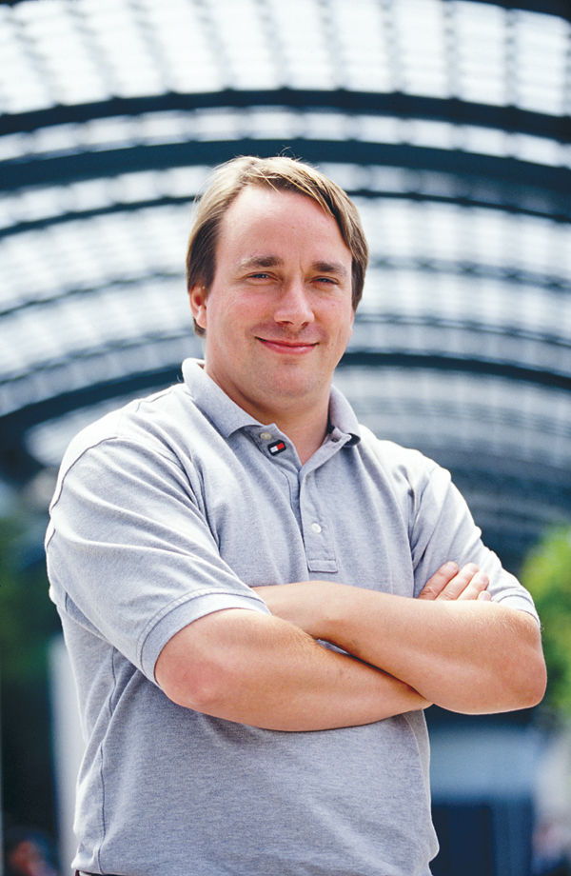
Linus Torvalds
Born December 28, 1969
Born in Helsinki, Finland
Linus is the principle force
behind the development of the Linux kernel which is the core of Ubuntu

Slide 5
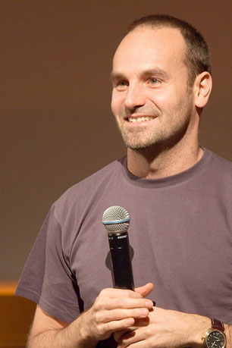
Mark Shuttleworth
Born September 18, 1973
Born in Welkom, Free State, South Africa
Mark collected a small team of developers from the Debian team project and set out to make an easy to use Linux desktop - Ubuntu

Slide 6
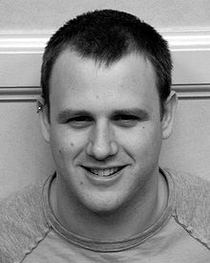
Scott James Remnant
Born July 18, 1980
Born in Sussex, England
Scott was a Debian developer for a long period of time before assuming the role of Ubuntu Developer Manager

Slide 7
Ubuntu Philosophy
Ubuntu's name is an African word meaning “humanity to others”. Their aim was to deliver this through an open-source operating system
Ubuntu aims to be free software available to everybody on the same terms.

Slide 8
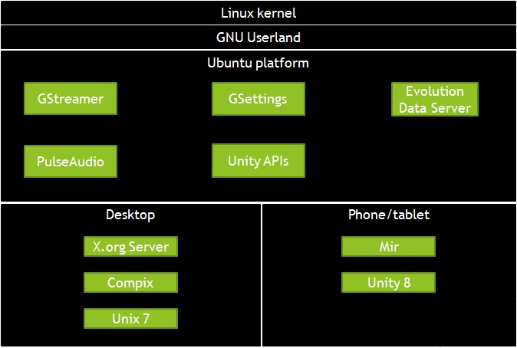
Ubuntu Architecture

Slide 9
What is Ubuntu?
Ubuntu is a general purpose, zero-cost Debian-based Linux operating system. Like other operating systems, it is designed for phones and tablets as well as desktops. This OS is designed to encourage people to use free software and study how it works, as well as distribution of the software
An installation of Ubuntu consists of a wide range of software including Firefox, Thunderbird and a number of games such as chess and Sudoku. Ubuntu is designed to make these applications right after installation without the need of any further steps

Slide 10
Some of Ubuntu Features
One example of Ubuntu’s features is called Gstreamer which is a multimedia framework written in C language. This allows a programmer to create various types of media applications such as video editors and media players
Ubuntu also provides PulseAudio which is a sound server which allows users to do things such as transfer audio to a different machine, change the sample and mixing several sounds into one sound data

Slide 11
Ubuntu UI
Desktop and mobile devices that run on Ubuntu also has Unity built in which is a graphical shell for the operating system. The user interface consists of various components such as a top menu bar, indicators (notification area) and a dash which allows the user to search for information quickly either locally or remotely
Unity is designed for touchpad, mouse and keyboard use. The recent versions include a new panel and application launcher which provides quick and easy access to preferred applications and allows the user to remove unused screen elements

Slide 12
Ubuntu UI
Launcher to launch applications
No task bar, no start button
Contains system ribbon
Highly modifiable UI

Slide 13
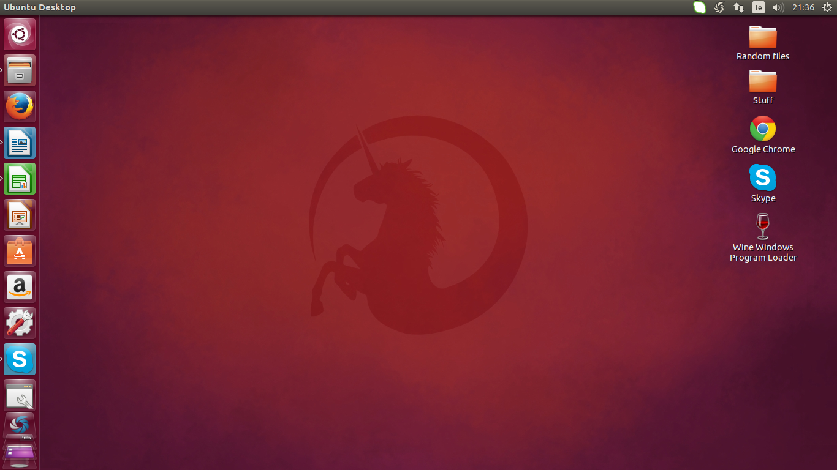
Ubuntu UI

Slide 14
Ubuntu Search
Helps to locate files on computer and online
Results can be filtered by categories and source

Slide 15
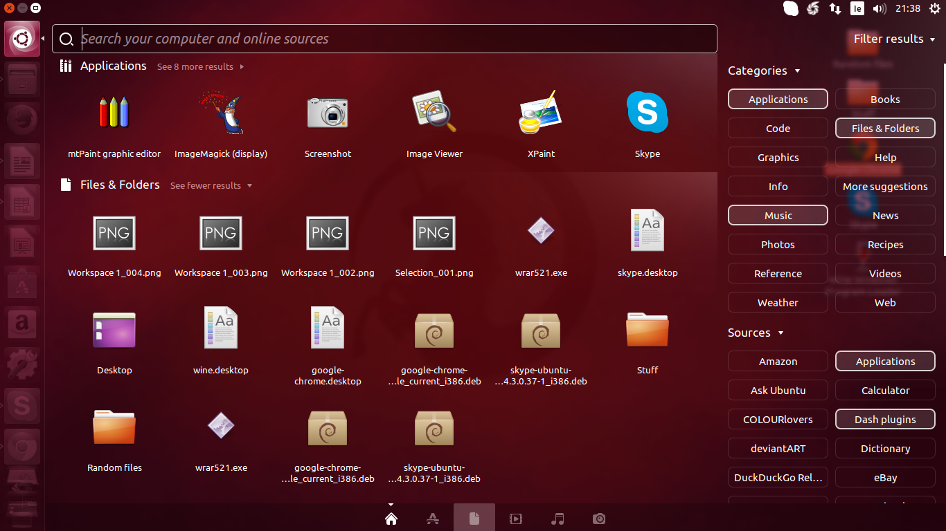
Ubuntu Search

Slide 16
Ubuntu Software Center
Thousands of applications available online
Contains free and paid applications
Install new applications from within software centre
Manage installed applications from software centre

Slide 17
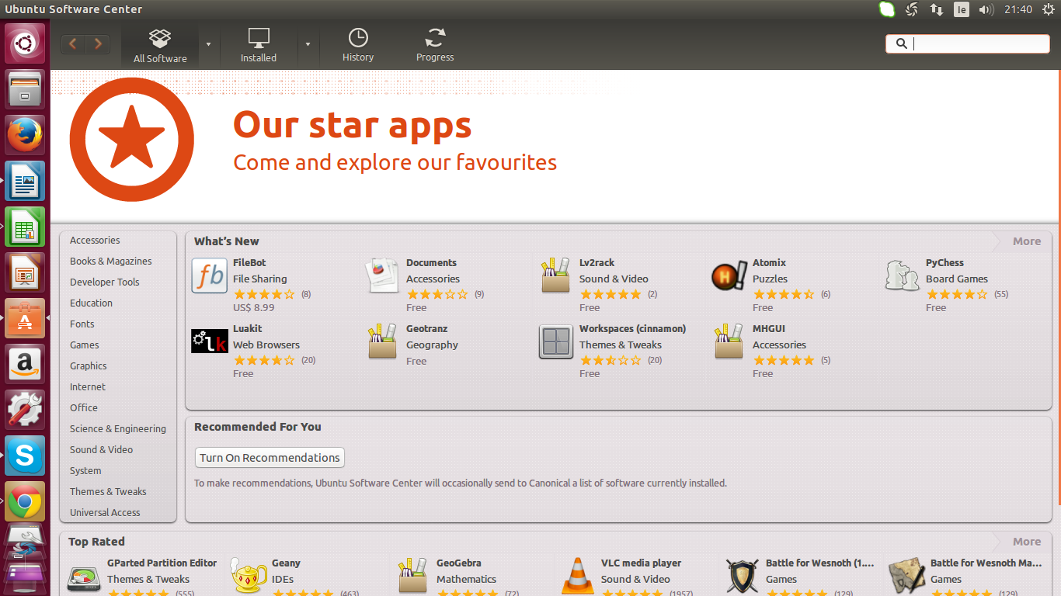
Ubuntu Software Center

Slide 18
Some Apps and Features
Libre office
Multiple desktop environment
Loads of keyboard shortcuts available
Terminal used to work in command line interface

Slide 19
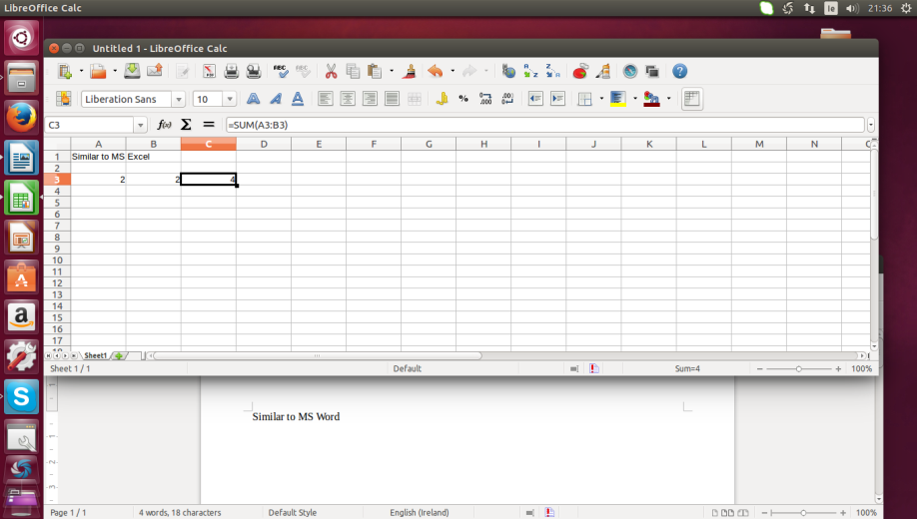
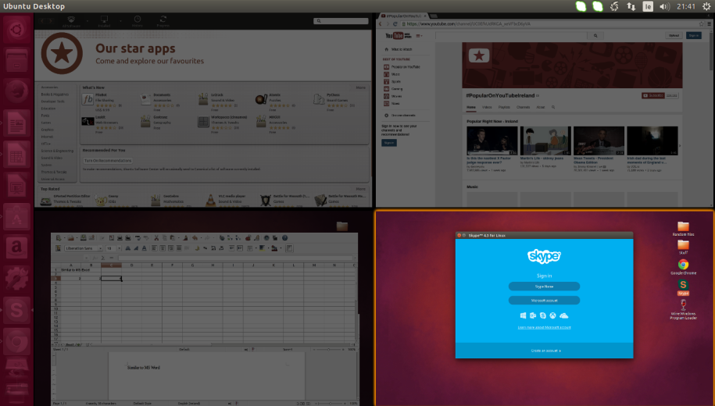
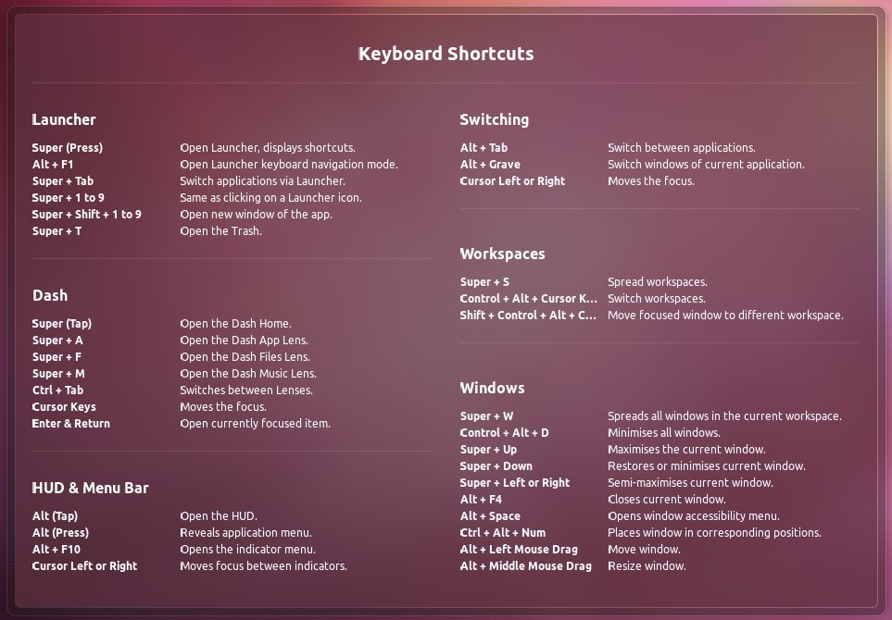
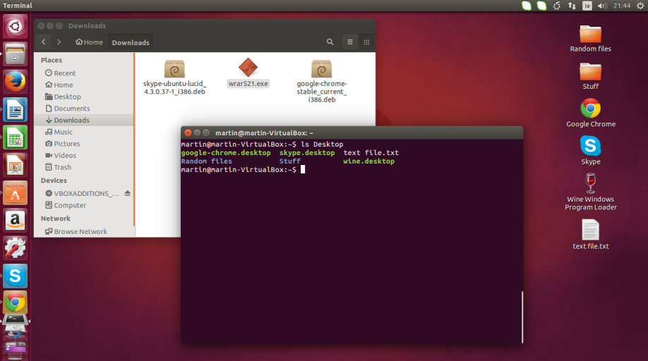
Some Apps and Features

Slide 20
Ubuntu Releases
The year and month of the release is used as a version number
Code named using adjective and animal name
New release every six months
Every fourth release is LTS (Long Term Support)

Slide 21
Ubuntu Release Timeline
Ubuntu 4.10 (Warty Warthog)
20/10/2004
Ubuntu 5.04 (Hoary Hedgehog)
08/04/2005
Ubuntu 5.10 (Breezy Badger)
12/10/2005
Ubuntu 6.06 LTS (Dapper Drake)
01/06/2006
Ubuntu 6.10
(Edgy Eft)
26/10/2006
Ubuntu 9.04 (Jaunty Jackalope)
23/04/2009
Ubuntu 8.10 (Intrepid Ibex)
30/10/2008
Ubuntu 8.04 LTS (Hardy Heron)
24/04/2008
Ubuntu 7.10 (Gutsy Gibbon)
18/10/2007
Ubuntu 7.04 (Feisty Fawn)
19/04/2007
Ubuntu 9.10 (Karmic Koala)
29/10/2009
Ubuntu 10.04 LTS (Lucid Lynx)
29/04/2010
Ubuntu 10.10 (Maverick Meerkat)
10.10.2010
Ubuntu 11.04 (Natty Narwhal)
28/04/2011
Ubuntu 11.10 (Oneiric Ocelot)
13/10/2011
Ubuntu 14.04 LTS (Trusty Tahr)
17/04/2014
Ubuntu 13.10 (Saucy Salamander)
17/10/2013
Ubuntu 13.04 (Raring Ringtail)
25/04/2013
Ubuntu 12.10 (Quantal Quetzal)
18/10/2012
Ubuntu 12.04 LTS (Precise Pangolin)
26/04/2012
Ubuntu 14.10 (Utopic Unicorn)
23/10/2014

Slide 22
Conclusion
3rd Most popular Linux desktop distribution
Very user friendly
Around 20 million users worldwide

Slide 23
Thank You.

