Slide 1

VM/CMS
Conor Murphy
Vlad Zat
Abdullah Shah

Slide 2
Contents
Section Header | Slide Number
History of VM/CMS | 3
How VM/CMS works | 11
Features of VM/CMS | 17
Advantages/Disadvantages | 23
Conclusion | 25

Slide 3
History of VM/CMS

Slide 4
Virtual Machine
Used on IBM mainframes
Developed by IBM’s Cambridge Scientific Center in 1960’s
New type of operating system, not just virtual memory but virtual machines as well
This was called the CP-40
Can run multiple operating systems under different “guests”

Slide 5
Conversational Monitor System
Developed by IBM in 1964
Designed to take the fullest advantage of VM
By far the most popular “guest” operating system
Derived from IBM CSC’s Compatible Time-Sharing System
CMS originally meant Cambridge Monitor System
VM automatically set up to use CMS when user logging in

Slide 6
VM/CMS
Combining the CP-40 and CMS IBM created the operating system CP/CMS released in 1967 to IBM customers
IBM released a revised edition of the CP/CMS in 1972 called VM/370
From 1972-1986 IBM’s VM operating systems were open source

Slide 7
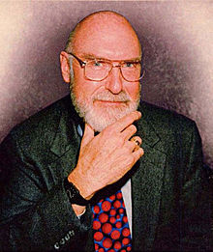
Robert Creasy
Born November 15, 1939
Died August 11, 2005
Born in Honesdale, Pennsylvania
Graduated from MIT, 1961
Worked as a programmer on CTSS and Project MAC
Quit MIT to join IBM’s Cambridge Scientific Center
Worked as project leader on the first virtualisation hypervisor

Slide 8
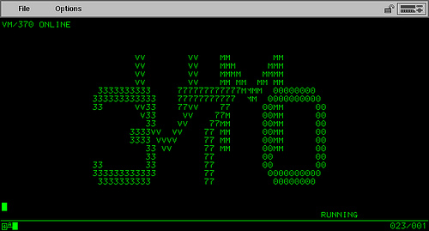
VM/370 (1972)

Slide 9
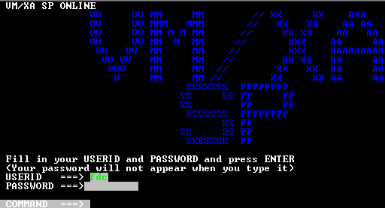
VM/XA SP (1988)

Slide 10
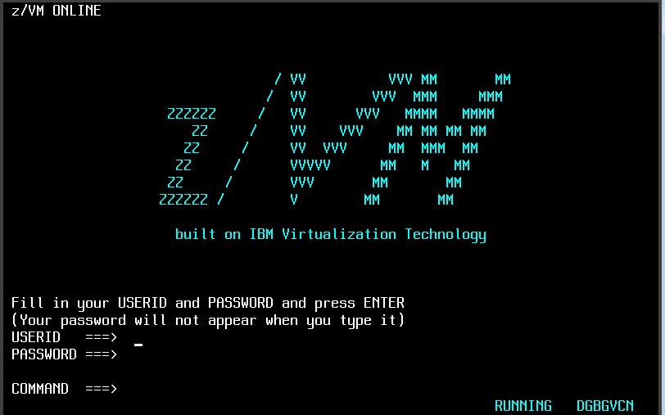
z/VM (2000)

Slide 11
How VM/CMS works

Slide 12
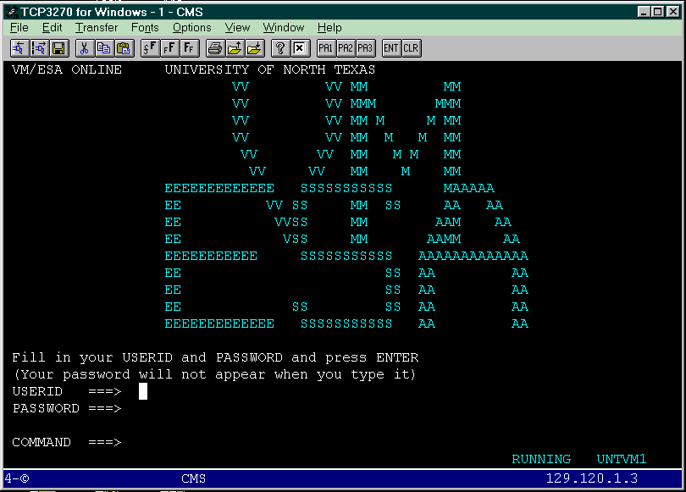
Virtual Machine
Base of the Operating System
Controls the hardware
Creates a simulated system for each user

Slide 13
Conversational Monitor System
The actual operating system
Is not a multi-user system
A new separate CMS is opened for each user

Slide 14
Control Program
Part of the Virtual Machine
Deals directly with the CMS
For example:
Printing a file
All input/output hardware

Slide 15
Architecture
VM
CP
CMS (User1)
CMS (User2)
CMS (User3)

Slide 16
Basic Commands
LISTFILE
TYPE
COPY
RENAME
ERASE

Slide 17
Features of VM/CMS

Slide 18
User Interface
Very simple graphic UI
Provides a command window for many basic functions

Slide 19
Features
Can access OS using a virtual machine
Has basic read/write functions
Copy and paste functions for ease of use
Built on memory, file, data management, but very basic

Slide 20
Features (2)
Managing data files
Creating and debugging applications
Cross-platform development
Communication with other systems or users

Slide 21
Performance
Fast and efficient
Easy to use, relative to standards of the time
Could program in many languages incl. COBAL, FORTRAN, PL/I C/370

Slide 22
Architecture
Architecture can be run using full and para virtualisation
Full: Creates muliple machines to emulate hardware
Para: Used to provide an interface, to access VM services

Slide 23
Advantages/Disadvantages

Slide 24
Advantages Disadvantages
Reliable
High security as users are isolated
Can run multiple platforms
VM/CMS is backward compatible
Been closed source since 1986
Only works on IBM mainframes

Slide 25
Conclusion

Slide 26
VM/CMS
VM=Virtual Machine
CMS=Conversational Monitor System
Creates a simulated system for each user
Used in IBM mainframes
Open source from 1972-1986 if you’re interested in checking it out

Slide 27



