Slide 1
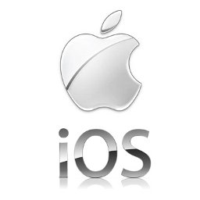

Slide 2
Group Info (iOSucks)
Ciaran Ó Nuallain
Colm Breen
Francis Lat
Eamon Tang

Slide 3

Table of contents
Biography Steve Jobs and Craig Federighi
iOS Architecture
History of IOS
iOS Jailbreaking
iOS < Android
iOS secure?
Conclusion

Slide 4
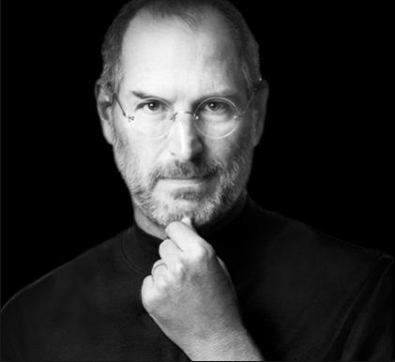
Steve Paul Jobs
Born: February 24, 1955
San Francisco, California, US
Died: October 5m 2011 (age 56)
Palo Alto, California, US
Residence: Palo Alto, California, US
Contribution: Cofounder, chairman, and CEO of Apple Inc. that oversaw the development of the iMac,iTunes, iPod, iPhone,and iPad which runs in iOS.

Slide 5
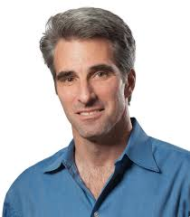
Craig Federighi
Born: 1970
Nationality: American
Known for his energetic presentations of new Apple Software at WWDC 2013
Senior Vice President of Software Engineering that oversees the development of operating system. His teams are responsible for Apple’s innovative products, including the user interface, applications and frameworks.

Slide 6
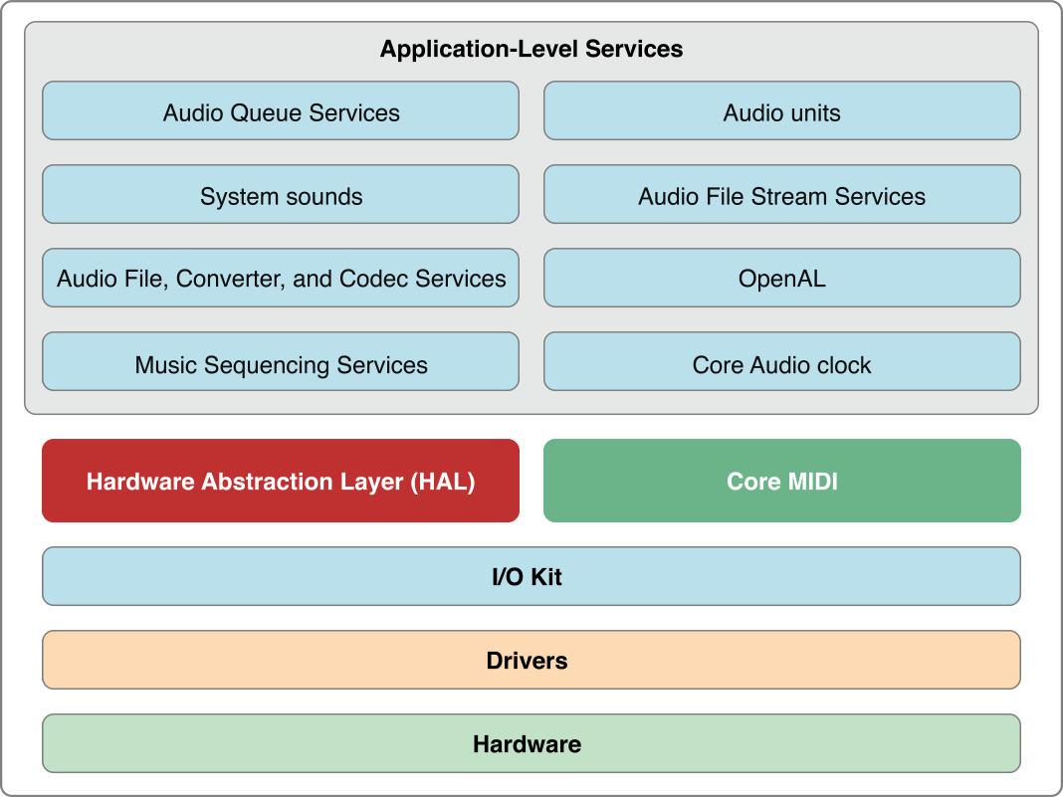
iOS architecture

Slide 7
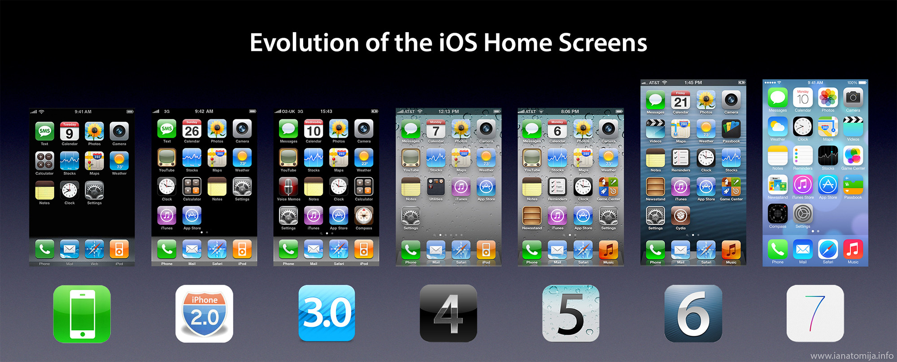
History of iOS

Slide 8
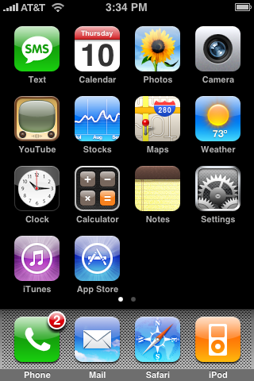
iOS 1 (Alpine)
Released June 2007
Multitouch
Safari Mobile
Widescreen
Core iOS UI
iTunes Sync
Maps
NO 3G

Slide 9
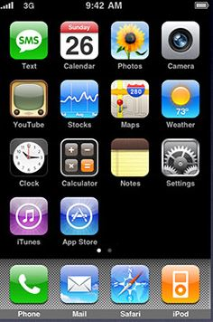
iOS 2 (Big Bear)
Released July 2008
App Store
Native 3rd Party Apps
Battery and Speed Fixes
Contact Search
Google Street View

Slide 10
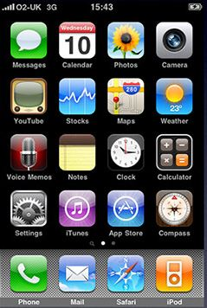
iOS 3 (Kirkwood)
June 2009
Cut, Copy Paste
Voice Control
Spotlight Search
Push Notifications
MMS
Landscape Keyboard
Find my iPhone

Slide 11
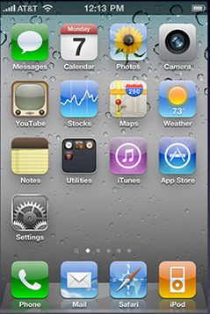
iOS 4 (Apex)
June 2010
Multi-tasking
Apps folders
FaceTime
Retina Display
Personal Hotspot (GSM)
AirPlay

Slide 12
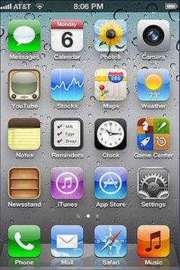
iOS 5 (Telluride)
June 2011
Siri
Notification Center
iTunes Wi-Fi sync
iMessage
iCloud
No PC required

Slide 13
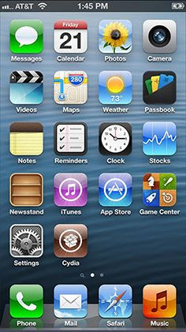
iOS 6 (Sundance)
June 2012
Apple Maps
Siri enhancements
Facebook integration
Passbook
FaceTime Over Cellular

Slide 14
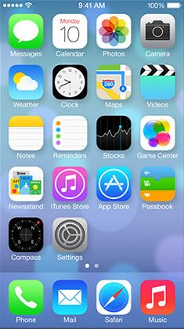
iOS 7 (Innsbruck)
June 2013
Visual overhaul
Control Centre
AirDrop
Refreshed core apps
iTunes Radio
FaceTime Audio

Slide 15
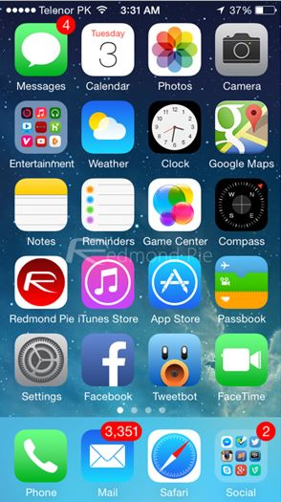
iOS 8 (Okemo)
June 2014
Continuity
Widgets
QuickType
iCloud Drive
HealthKit, HomeKit
Family Sharing

Slide 16
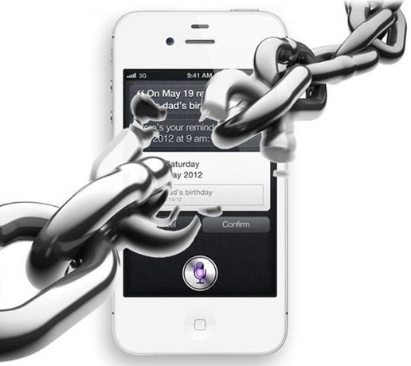
Jailbreaking
The Process of modifying the iOS on products such as the iPhone, iPad and iPod.
Allows users the ability to remove Apple imposed restrictions and install apps without the use of the official Apple store.

Slide 17
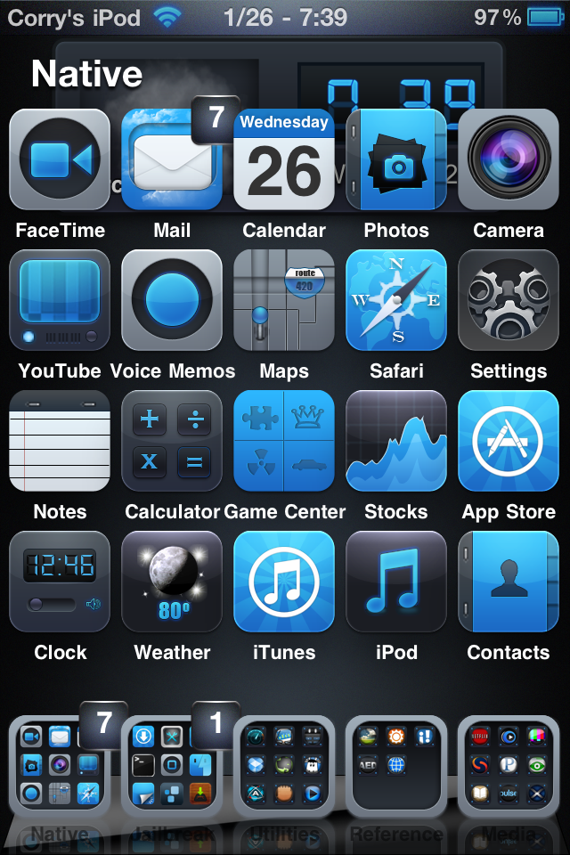
Pros and Cons of jailbreaking
Allows users access to thousands of more apps.
Allows customisation of the device.
Incorrectly jailbreaking could make the device completely useless. Until reset by restoring the device…..
Jailbreaking may reduce device stability.
Once jailbroken all warranties are void.

Slide 18

Jailbreaking - Problems for Apple
Cuts apple out of their 30% share on sales of Apps.
It makes the Apple store a less desirable option for software developers.

Slide 19
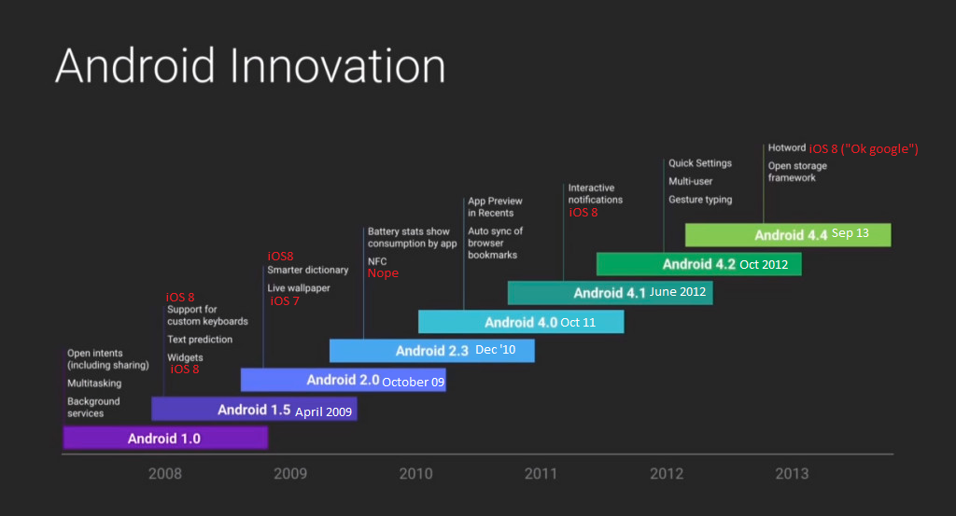
iOS revolutionary?

Slide 20
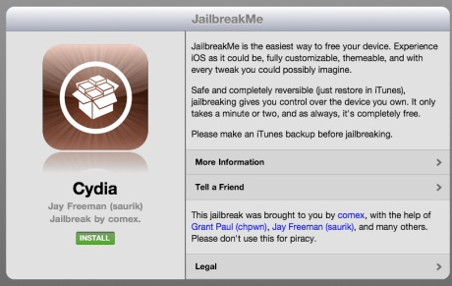
iOS made by a competent dev team?
Jailbreak me?
Easiest iOS exploit
Took advantage of safari/pdf viewer.

Slide 21
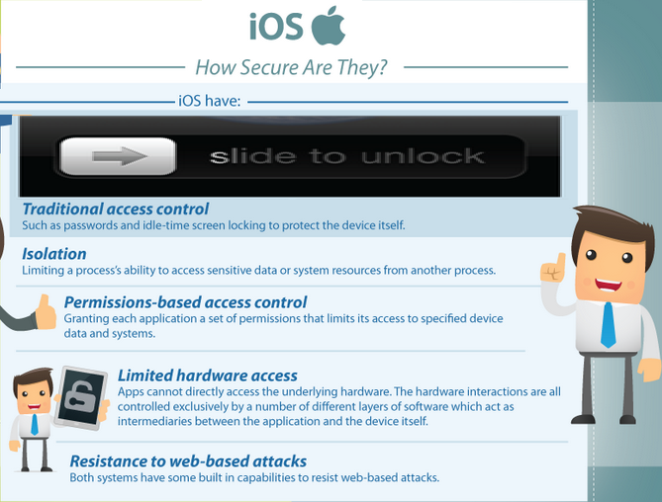
Security on iOS

Slide 22
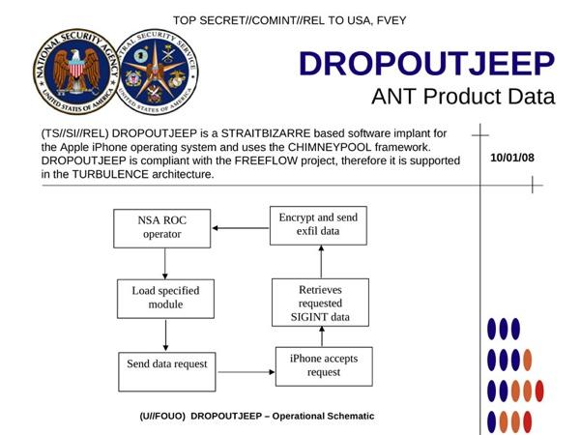
So it’s safe yeah?....

Slide 23
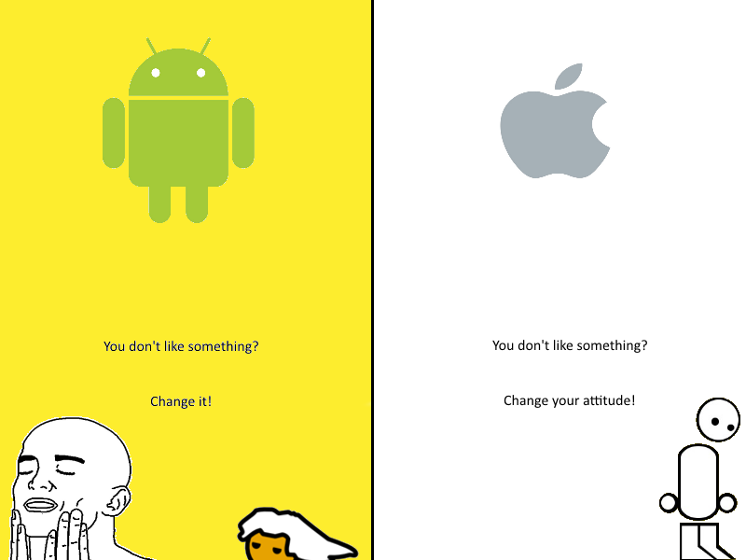
Sources:
Keller, M. (2011) Jailbreakme,
http://www.techhive.com/article/235144/JailbreakMe_30_How_Does_It_Work.html Date Accessed: March 2015.
Constine, J. (2014) Revolutionary,
http://techcrunch.com/2014/06/25/android-vs-ios/ Date Accessed: March 2015.
Kain, E. (2013) Dropout jeep,
http://www.forbes.com/sites/erikkain/2013/12/30/the-nsa-reportedly-has-total-access-to-your-iphone/ Date Accessed: March 2015.
Wiki. (-) Steve Jobs,
http://en.wikipedia.org/wiki/Steve_Jobs Date Accessed: March 2015.
Wiki. (-) Craig Federighi,
http://en.wikipedia.org/wiki/Craig_Federighi Date Accessed: March 2015.
Wiki. (-) Jailbreaking,
http://jailbreakwiki.org/Jailbreak_History Date Accessed: March 2015.
Verge Staff, (2013) iOS History,
http://www.theverge.com/2011/12/13/2612736/ios-history-iphone-ipad Date Accessed: March 2015.
Veracode, (-) Android vs iOS security,
http://www.veracode.com/resources/android-ios-security Date Accessed: March 2015.

Slide 24



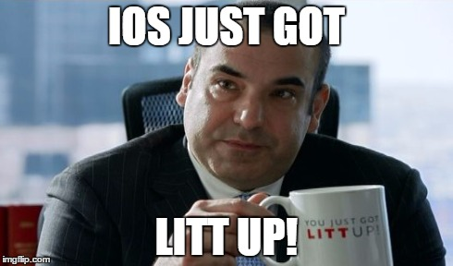
Thank you for your time!

