Slide 1
Memory Management
Damian Gordon

Slide 2
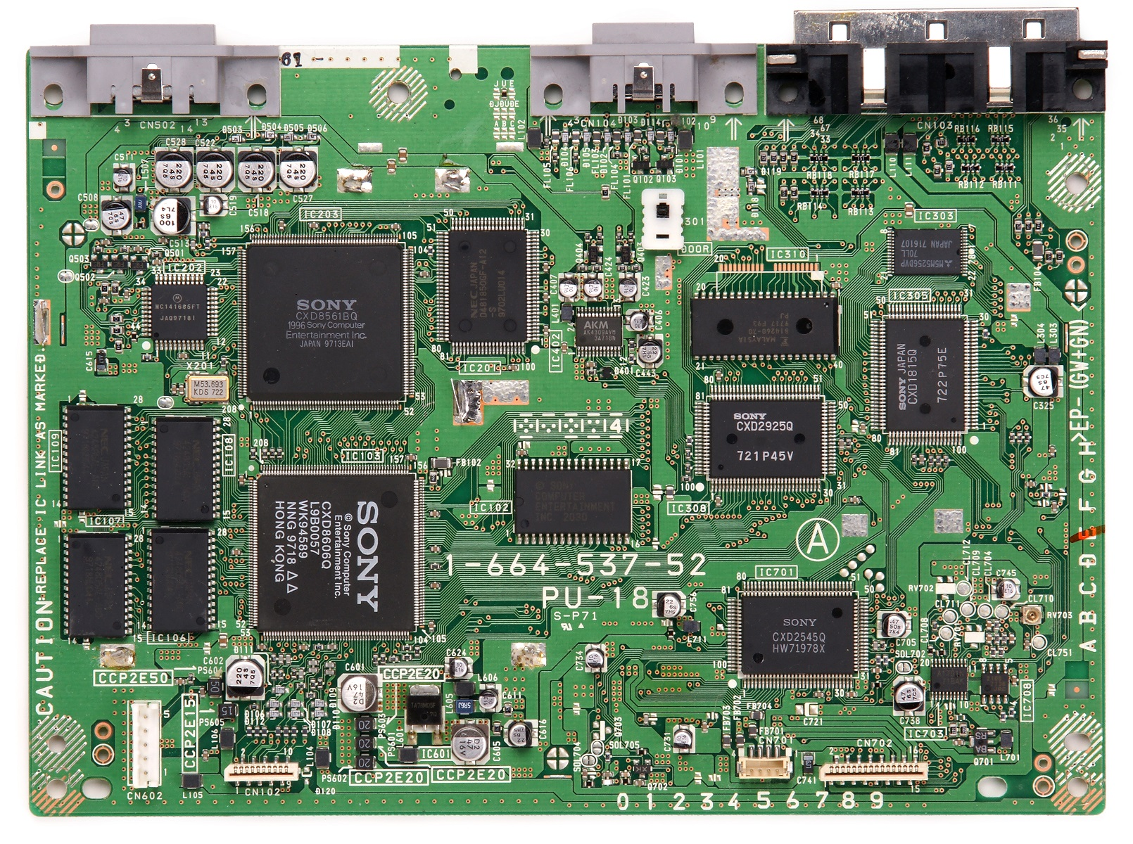

Slide 3
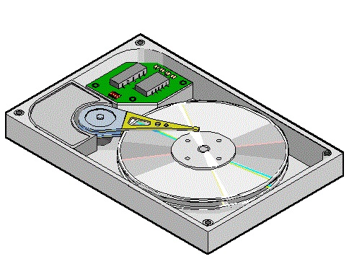
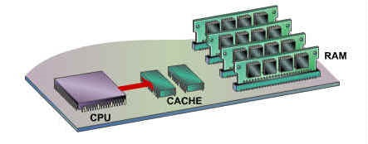
Memory Management
HARD DISK
(SECONDARY
MEMORY)
CACHE 1
(MAIN
MEMORY)
2

Slide 4
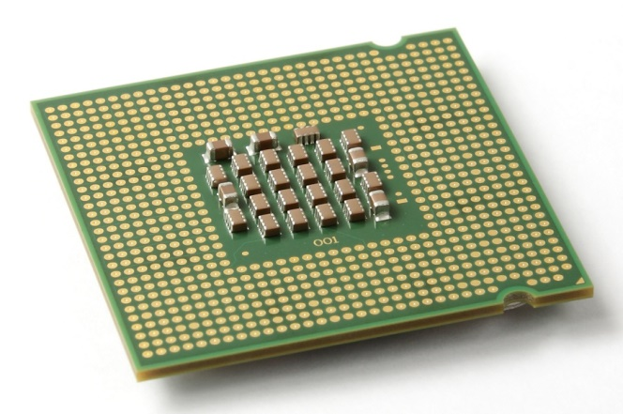
CPU

Slide 5
CPU
Cache 1

Slide 6
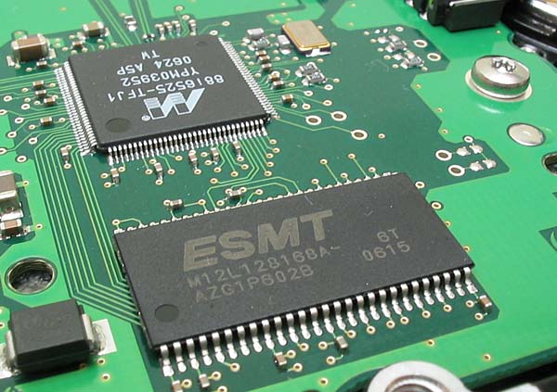
Cache

Slide 7
Cache
CPU

Slide 8
Cache
CPU
Cache 2

Slide 9
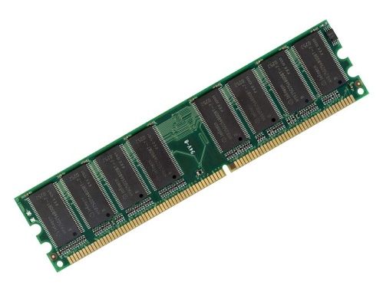
Main Memory (RAM)

Slide 10
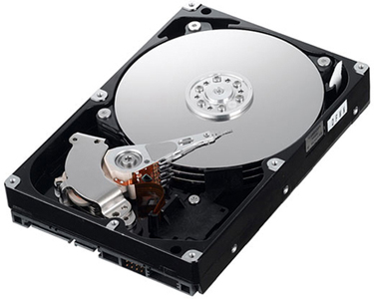
Secondary Memory (Hard Disk)

Slide 11
Memory Management
HARD DISK
(SECONDARY
MEMORY)
CACHE 1
(MAIN
MEMORY)
2

Slide 12
Memory Management
Approximate number of clock cycles to access
the various elements of the memory hierarchy.
HARD DISK
(SECONDARY
MEMORY)
CACHE 1
(MAIN
MEMORY)
2
10¹

Slide 13
Memory Management
Approximate number of clock cycles to access
the various elements of the memory hierarchy.
HARD DISK
(SECONDARY
MEMORY)
CACHE 1
(MAIN
MEMORY)
2
10¹
10³

Slide 14
Memory Management
Approximate number of clock cycles to access
the various elements of the memory hierarchy.
HARD DISK
(SECONDARY
MEMORY)
CACHE 1
(MAIN
MEMORY)
2
10¹
10³
10⁷

Slide 15
Memory Management
Let’s consider an operating system model with a single user, and how they use memory.

Slide 16
Single-User System
MAIN
MEMORY

Slide 17
Single-User System
MAIN
MEMORY
200K
available

Slide 18
Single-User System
If I create a program:
MAIN
MEMORY
200K
available

Slide 19
Single-User System
If I create a program:
MAIN
MEMORY
PROGRAM 1
200K
available

Slide 20
Single-User System
If I create a program:
to be processed, it has
to be writen entirely into
Main Memory, in
contiguous space
MAIN
MEMORY
PROGRAM 1
200K
available

Slide 21
Single-User System
PROGRAM 1
MAIN
MEMORY
200K
available

Slide 22
Single-User System
If the program is bigger:
MAIN
MEMORY
PROGRAM 1
200K
available

Slide 23
Single-User System
If it doesn’t fit in the
memory, it’s can’t be
processed.
MAIN
MEMORY
200K
available

Slide 24
Memory Management
This is the limitation of all computers, if a program is too big, we have to do one of two things:
Get more memory
Make the program smaller

Slide 25
Algorithm for Single-User System
Store first location of program in the base register (for memory protection);
Set Program Counter to the first memory location;
Read first instruction of program;
WHILE (last instruction reached OR Program Counter is greater than Memory Size)
DO Increment the Program Counter;
IF (last instruction reached)
THEN Stop Loading Program;
END IF;
IF (Program Counter is greater than Memory Size)
THEN Stop Loading Program;
END IF;
Load instruction into memory;
Read next instruction of program;
END WHILE;

Slide 26
Memory Management
To allow more than one program to run at the same time, the memory is subdivided into FIXED PARTITIONS.

Slide 27
Fixed Partitions
MAIN
MEMORY
250K

Slide 28
Fixed Partitions
PARTITION 1
100K
PARTITION 2
25K
250K
PARTITION 3
25K
PARTITION 4
50K
PARTITION 5
50K

Slide 29
Fixed Partitions
This leaves us with less memory, but at least more than one user (and their user process) can be logged into the system at the same time.
If we want to adjust the size of the partitions we need to shut down the system, go into the boot login, and then restart.

Slide 30
Algorithm for Fixed Partitions
WHILE (there are still jobs in the queue)
DO Determine the job’s requested memory size;
IF Job size > Size of Largest Partition
THEN Reject the Job;
PRINT “Job Rejected: Not Enough Memory”;
Exit; /* this iteration and get next job */
END IF;
MyCounter := 1;
WHILE (MyCounter <= Number of Partitions in Memory)
DO IF (Job Size > Memory_Partition[Counter].Size
THEN MyCounter := MyCounter + 1;
ELSE IF (Memory_Partition[Counter].Status == “FREE”;
THEN Load job into Memory_Partition[Counter];
Memory_Partition[Counter].Status := “BUSY”;
Exit; /* this iteration and get next job */
ELSE MyCounter := MyCounter + 1;
END IF;
END WHILE;
No partition available;
put job in waiting queue;
END WHILE;

Slide 31
Fixed Partitions
To make this work, the Memory manager needs to keep a Partition Table to remember the status of all the partitions.

Slide 32
Fixed Partitions
To make this work, the Memory manager needs to keep a Partition Table to remember the status of all the partitions.
Partition Number | Partition Size | Memory Address | Access | Partition Status
1 | 100K | 200K | Job1 | BUSY
2 | 25K | 300K | Job4 | BUSY
3 | 25K | 325K |  | FREE
4 | 50K | 350K | Job2 | BUSY
5 | 50K | 400K |  | FREE

Slide 33
Fixed Partitions
Which looks like this in memory:

Slide 34
Fixed Partitions
Which looks like this in memory:
PARTITION 1
100K
PARTITION 2
25K
250K
PARTITION 3
25K
PARTITION 4
50K
PARTITION 5
50K

Slide 35
Fixed Partitions
Let’s add some jobs in:

Slide 36
Fixed Partitions
Let’s add some jobs in:
PARTITION 1
100K
PARTITION 2
25K
250K
PARTITION 3
25K
PARTITION 4
50K
PARTITION 5
50K

Slide 37
Fixed Partitions
Let’s add some jobs in:
PARTITION 1
PROGRAM 1
100K
PARTITION 2
25K
250K
PARTITION 3
25K
PARTITION 4
50K
PARTITION 5
50K

Slide 38
Fixed Partitions
Let’s add some jobs in:
PARTITION 1
PROGRAM 1
100K
PROGRAM 2
PARTITION 2
25K
250K
PARTITION 3
25K
PARTITION 4
50K
PARTITION 5
50K

Slide 39
Fixed Partitions
Let’s add some jobs in:
PARTITION 1
PROGRAM 1
100K
PROGRAM 2
PARTITION 2
25K
250K
PARTITION 3
25K
PROGRAM 3
PARTITION 4
50K
PARTITION 5
50K

Slide 40
Fixed Partitions
Let’s add some jobs in:
PARTITION 1
PROGRAM 1
100K
INTERNAL FRAGMENTATION
PROGRAM 2
PARTITION 2
25K
250K
PARTITION 3
25K
PROGRAM 3
PARTITION 4
50K
PARTITION 5
50K

Slide 41
Fixed Partitions
Let’s add some jobs in:
PARTITION 1
PROGRAM 1
100K
INTERNAL FRAGMENTATION
PROGRAM 2
PARTITION 2
25K
250K
PARTITION 3
25K
PROGRAM 3
PARTITION 4
50K
INTERNAL FRAGMENTATION
PARTITION 5
50K

Slide 42
Fixed Partitions
Let’s add some jobs in:
PARTITION 1
PROGRAM 1
100K
INTERNAL FRAGMENTATION
PROGRAM 2
PARTITION 2
25K
250K
EMPTY PARTITION
PARTITION 3
25K
PROGRAM 3
PARTITION 4
50K
INTERNAL FRAGMENTATION
PARTITION 5
50K

Slide 43
Fixed Partitions
Let’s add some jobs in:
PARTITION 1
PROGRAM 1
100K
INTERNAL FRAGMENTATION
PROGRAM 2
PARTITION 2
25K
250K
EMPTY PARTITION
PARTITION 3
25K
PROGRAM 3
PARTITION 4
50K
INTERNAL FRAGMENTATION
PARTITION 5
EMPTY PARTITION
50K

Slide 44
Fixed Partitions
Selecting the correct set of partition sizes is a tricky business, too small and larger jobs will be waiting forever to run, too big and there is a lot of wasted space.

Slide 45
Dynamic Partitions
An alternative is DYNAMIC PARTITIONS, where a job is given the space it requests, if there is space available for it.
This takes care of lots of problems.

Slide 46
Dynamic Partitions
Let’s add some jobs in:
MAIN
MEMORY
250K

Slide 47
Dynamic Partitions
Let’s add some jobs in:
MAIN
MEMORY
PROGRAM 1
250K

Slide 48
Dynamic Partitions
Let’s add some jobs in:
MAIN
MEMORY
PROGRAM 1
250K

Slide 49
Dynamic Partitions
Let’s add some jobs in:
MAIN
MEMORY
PROGRAM 1
PROGRAM 2
250K

Slide 50
Dynamic Partitions
Let’s add some jobs in:
MAIN
MEMORY
PROGRAM 1
PROGRAM 2
250K

Slide 51
Dynamic Partitions
Let’s add some jobs in:
MAIN
MEMORY
PROGRAM 1
PROGRAM 3
PROGRAM 2
250K

Slide 52
Dynamic Partitions
Let’s add some jobs in:
MAIN
MEMORY
PROGRAM 1
PROGRAM 2
PROGRAM 3
250K

Slide 53
Dynamic Partitions
Let’s add some jobs in:
MAIN
MEMORY
PROGRAM 1
PROGRAM 2
PROGRAM 4
PROGRAM 3
250K

Slide 54
Dynamic Partitions
Let’s add some jobs in:
MAIN
MEMORY
PROGRAM 1
PROGRAM 2
PROGRAM 3
250K
PROGRAM 4

Slide 55
Dynamic Partitions
Let’s add some jobs in:
MAIN
MEMORY
PROGRAM 1
PROGRAM 2
PROGRAM 5
PROGRAM 3
250K
PROGRAM 4

Slide 56
Dynamic Partitions
Let’s add some jobs in:
MAIN
MEMORY
PROGRAM 1
PROGRAM 2
PROGRAM 5
PROGRAM 3
250K
WAIT
PROGRAM 4

Slide 57
Dynamic Partitions
It isn’t perfect, because the next program will go into the slot that is freed up by a completed job.

Slide 58
Dynamic Partitions
Let’s add some jobs in:
MAIN
MEMORY
PROGRAM 1
PROGRAM 2
PROGRAM 5
PROGRAM 3
250K
WAIT
PROGRAM 4

Slide 59
Dynamic Partitions
Let’s add some jobs in:
MAIN
MEMORY
PROGRAM 1
PROGRAM 2
PROGRAM 5
PROGRAM 3
250K
WAIT
PROGRAM 4

Slide 60
Dynamic Partitions
Let’s add some jobs in:
PROGRAM 1
PROGRAM 2
PROGRAM 5
250K
WAIT
PROGRAM 4

Slide 61
Dynamic Partitions
Let’s add some jobs in:
PROGRAM 1
PROGRAM 2
PROGRAM 5
250K
PROGRAM 4

Slide 62
Dynamic Partitions
Let’s add some jobs in:
PROGRAM 1
PROGRAM 2
PROGRAM 5
250K
EXTERNAL FRAGMENTATION
PROGRAM 4

Slide 63
Dynamic Partitions
So however we partition, we end up with fragmentation, one way or the other.

Slide 64
Partitions
PROGRAM 1
PROGRAM 2
PROGRAM 3
250K
PROGRAM 4
PROGRAM 5

Slide 65
Partitions
So how do we decide where to slot in a new job?
PROGRAM 1
PROGRAM 2
PROGRAM 3
250K
PROGRAM 4
PROGRAM 5

Slide 66
Partitions
So how do we decide where to slot in a new job?
PROGRAM 1
PROGRAM 2
PROGRAM 3
PROGRAM 6
250K
PROGRAM 4
PROGRAM 5

Slide 67
Partitions
Here is the first slot free
PROGRAM 1
PROGRAM 2
PROGRAM 3
PROGRAM 6
250K
PROGRAM 4
PROGRAM 5

Slide 68
Partitions
Here is the first slot free
PROGRAM 1
PROGRAM 2
PROGRAM 6
PROGRAM 3
250K
PROGRAM 4
PROGRAM 5

Slide 69
Partitions
But here’s a better fit
PROGRAM 1
PROGRAM 2
PROGRAM 6
PROGRAM 3
250K
PROGRAM 4
PROGRAM 5

Slide 70
Partitions
But here’s a better fit
PROGRAM 1
PROGRAM 2
PROGRAM 3
250K
PROGRAM 6
PROGRAM 4
PROGRAM 5

Slide 71
Partitions
So we can either add the new block to the first available slot (FIRST-FIT ALGORITHM) or we can add the new block to the most suitable available slot (BEST-FIT ALGORITHM).

Slide 72
Partitions
If the Memory Manager wants a FIRST-FIT ALGORITHM then it stores a table in order of memory locations.
If the Memory Manager wants a BEST-FIT ALGORITHM then it stores a table in order of size of memory locations.
Starts | Size | Status
315 | 40 | FREE
250 | 50 | FREE
Starts | Size | Status
200 | 50 | BUSY
250 | 50 | FREE
300 | 15 | BUSY
315 | 40 | FREE
355 | 25 | BUSY
Starts | Size | Status
300 | 15 | BUSY
355 | 25 | BUSY
315 | 40 | BUSY

Slide 73
Deallocating space
After a job is completed, there are three cases for deallocating space in memory:

Slide 74
Deallocating space
1. There are jobs either side of the freed space:
PROGRAM 5
PROGRAM 5
PROGRAM 3
PROGRAM 3
PROGRAM 6
PROGRAM 4
PROGRAM 4
PROGRAM 8
PROGRAM 8

Slide 75
Deallocating space
2. There are is a job on one side, and it’s free on the other side of the freed space:
PROGRAM 5
PROGRAM 5
PROGRAM 3
PROGRAM 3
PROGRAM 6
PROGRAM 8
PROGRAM 8

Slide 76
Deallocating space
3. There are no jobs on either side of the freed space:
PROGRAM 5
PROGRAM 5
PROGRAM 6
PROGRAM 8
PROGRAM 8

Slide 77
Deallocating space
Let’s look at the implications of each of these cases in terms of what the Memory Manager has to do to remember the FREE and BUSY memory spaces.

Slide 78
Deallocating space
1. There are jobs either side of the freed space:
PROGRAM 5
PROGRAM 5
PROGRAM 3
PROGRAM 3
PROGRAM 6
PROGRAM 4
PROGRAM 4
PROGRAM 8
PROGRAM 8

Slide 79
Deallocating space
1. There are jobs either side of the freed space:
200-250
PROGRAM 5
PROGRAM 5
200-250
250-300
PROGRAM 3
PROGRAM 3
250-300
300-315
PROGRAM 6
300-315
315-340
PROGRAM 4
PROGRAM 4
315-340
340-355
340-355
355-380
PROGRAM 8
PROGRAM 8
355-380

Slide 80
Deallocating space
1. There are jobs either side of the freed space:
200-250
Starts | Size | Status
200 | 50 | BUSY
250 | 50 | BUSY
300 | 15 | BUSY
315 | 25 | BUSY
340 | 15 | FREE
355 | 25 | BUSY
Starts | Size | Status
200 | 50 | BUSY
250 | 50 | BUSY
300 | 15 | FREE
315 | 25 | BUSY
340 | 15 | FREE
355 | 25 | BUSY
200-250
250-300
250-300
300-315
300-315
315-340
315-340
340-355
340-355
355-380
355-380

Slide 81
Deallocating space
2. There are is a job on one side, and it’s free on the other side of the freed space:
PROGRAM 5
PROGRAM 5
PROGRAM 3
PROGRAM 3
PROGRAM 6
PROGRAM 8
PROGRAM 8

Slide 82
Deallocating space
2. There are is a job on one side, and it’s free on the other side of the freed space:
200-250
PROGRAM 5
PROGRAM 5
200-250
250-300
PROGRAM 3
PROGRAM 3
250-300
300-315
PROGRAM 6
300-355
315-355
355-380
PROGRAM 8
PROGRAM 8
355-380

Slide 83
Deallocating space
2. There are is a job on one side, and it’s free on the other side of the freed space:
200-250
Starts | Size | Status
200 | 50 | BUSY
250 | 50 | BUSY
300 | 15 | BUSY
315 | 40 | FREE
355 | 25 | BUSY
Starts | Size | Status
200 | 50 | BUSY
250 | 50 | BUSY
300 | 15 | FREE
315 | 40 | FREE
355 | 25 | BUSY
200-250
250-300
250-300
300-315
300-355
315-355
355-380
355-380

Slide 84
Deallocating space
2. There are is a job on one side, and it’s free on the other side of the freed space:
Starts | Size | Status
200 | 50 | BUSY
250 | 50 | BUSY
300 | 15 | BUSY
315 | 40 | FREE
355 | 25 | BUSY
Starts | Size | Status
200 | 50 | BUSY
250 | 50 | BUSY
300 | 15 | FREE
315 | 40 | FREE
355 | 25 | BUSY

Slide 85
Deallocating space
2. There are is a job on one side, and it’s free on the other side of the freed space:
Starts | Size | Status
200 | 50 | BUSY
250 | 50 | BUSY
300 | 15 | BUSY
315 | 40 | FREE
355 | 25 | BUSY
Starts | Size | Status
200 | 50 | BUSY
250 | 50 | BUSY
300 | 15 | FREE
315 | 40 | FREE
355 | 25 | BUSY
Starts | Size | Status
200 | 50 | BUSY
250 | 50 | BUSY
300 | 55 | FREE
355 | 25 | BUSY

Slide 86
Deallocating space
3. There are no jobs on either side of the freed space:
PROGRAM 5
PROGRAM 5
PROGRAM 6
PROGRAM 8
PROGRAM 8

Slide 87
Deallocating space
3. There are no jobs on either side of the freed space:
200-250
PROGRAM 5
PROGRAM 5
200-250
250-300
250-355
300-315
PROGRAM 6
315-355
355-380
PROGRAM 8
PROGRAM 8
355-380

Slide 88
Deallocating space
3. There are no jobs on either side of the freed space:
200-250
Starts | Size | Status
200 | 50 | BUSY
250 | 50 | FREE
300 | 15 | BUSY
315 | 40 | FREE
355 | 25 | BUSY
Starts | Size | Status
200 | 50 | BUSY
250 | 50 | FREE
300 | 15 | FREE
315 | 40 | FREE
355 | 25 | BUSY
200-250
250-300
250-355
300-315
315-355
355-380
355-380

Slide 89
Deallocating space
3. There are no jobs on either side of the freed space:
Starts | Size | Status
200 | 50 | BUSY
250 | 50 | FREE
300 | 15 | BUSY
315 | 40 | FREE
355 | 25 | BUSY
Starts | Size | Status
200 | 50 | BUSY
250 | 50 | FREE
300 | 15 | FREE
315 | 40 | FREE
355 | 25 | BUSY

Slide 90
Deallocating space
3. There are no jobs on either side of the freed space:
Starts | Size | Status
200 | 50 | BUSY
250 | 50 | FREE
300 | 15 | BUSY
315 | 40 | FREE
355 | 25 | BUSY
Starts | Size | Status
200 | 50 | BUSY
250 | 50 | FREE
300 | 15 | FREE
315 | 40 | FREE
355 | 25 | BUSY
Starts | Size | Status
200 | 50 | BUSY
250 | 105 | FREE
355 | 25 | BUSY

