Slide 1
Processor Management
Damian Gordon

Slide 2
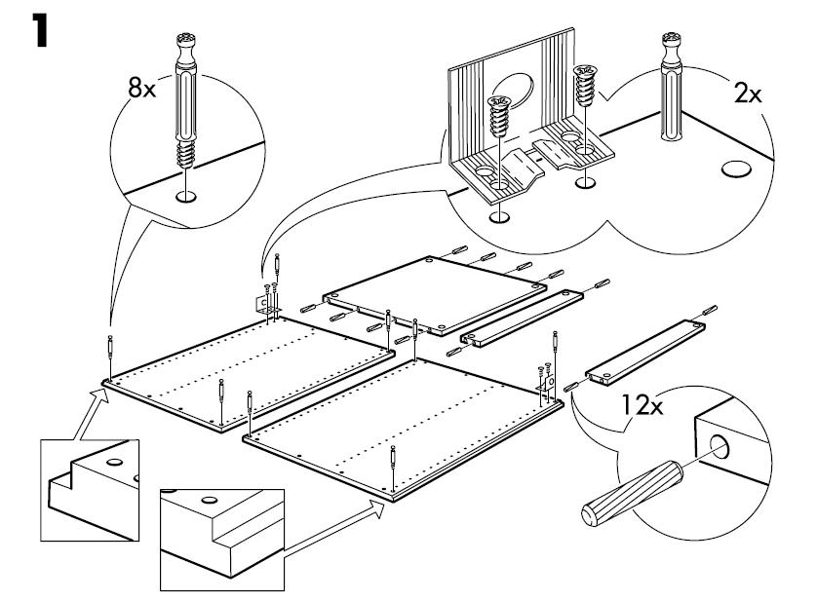
Processor Management
If you were assembling some IKEA furniture, and following the step-by-step guide of 20 steps.
Imagine you did step 1, then step 2, then step 3, suddenly the doorbell rang, and you are interrupted.

Slide 3
Processor Management
You would stop what you are doing and deal with whoever is at the door.
Then you would return to the assembly, check what step you were on, and then continue on from there (step 4).

Slide 4
Processor Management
This is how the computer runs multiple processes simultaneously … you do a few steps on one process, get interrupted, work on other processes, then return to the first process, remembering where you left off from, and continue on.
This swapping of processes is called a pre-emptive scheduling policy.

Slide 5
Processor Management
A “Process” is the basic unit of execution in the operating system
A “Process” is the name we give to a program when it is running in memory
So a “Program” is the complied executable
And a “Process” is the running executable with the execution state.

Slide 6
Processor Management
The same program being run by two different users in the operating system are two different processes
User 1
Process
1
Running
Executable 1
Execution
State 1
User 2
Process
2
Running
Executable 1
Execution
State 2

Slide 7
Processor Management
The Processor Manager is made up of two sub-managers:
Job Scheduler
Process Scheduler

Slide 8
Processor Management
Process
5
Process
4
Process
3
Process
2
Process
1
Job Scheduler
Process Scheduler

Slide 9
Job Scheduler
We describe a collection of processes as a “job”.
When the operating systems is presented with a queue of jobs or processes to run, the Job Scheduler has the task of deciding which order to run the are jobs in.
The Job Scheduler wants to ensure that the all components of the operating system are busy, and there is no component that is idle.

Slide 10
Job Scheduler
Let’s think about this program:
PROGRAM PrintValue:
BEGIN
Input A;
Input B;
C = A + B;
D = A – B;
Print “The sum of inputs is: “, C;
Print “The Difference of inputs is: “, D;
END.

Slide 11
Job Scheduler
Let’s think about this program:
PROGRAM PrintValue:
BEGIN
Input A;
Input B;
C = A + B;
D = A – B;
Print “The sum of inputs is: “, C;
Print “The Difference of inputs is: “, D;
END.
I/O

Slide 12
Job Scheduler
Reading from keyboard
Let’s think about this program:
PROGRAM PrintValue:
BEGIN
Input A;
Input B;
C = A + B;
D = A – B;
Print “The sum of inputs is: “, C;
Print “The Difference of inputs is: “, D;
END.
I/O

Slide 13
Job Scheduler
Let’s think about this program:
PROGRAM PrintValue:
BEGIN
Input A;
Input B;
C = A + B;
D = A – B;
Print “The sum of inputs is: “, C;
Print “The Difference of inputs is: “, D;
END.
I/O
I/O

Slide 14
Job Scheduler
Let’s think about this program:
PROGRAM PrintValue:
BEGIN
Input A;
Input B;
C = A + B;
D = A – B;
Print “The sum of inputs is: “, C;
Print “The Difference of inputs is: “, D;
END.
I/O
I/O
Writing
To
screen

Slide 15
Job Scheduler
Let’s think about this program:
PROGRAM PrintValue:
BEGIN
Input A;
Input B;
C = A + B;
D = A – B;
Print “The sum of inputs is: “, C;
Print “The Difference of inputs is: “, D;
END.
I/O
CPU
I/O

Slide 16
Job Scheduler
Let’s think about this program:
PROGRAM PrintValue:
BEGIN
Input A;
Input B;
C = A + B;
D = A – B;
Print “The sum of inputs is: “, C;
Print “The Difference of inputs is: “, D;
END.
I/O
Doing computation
CPU
I/O

Slide 17
Job Scheduler
Some programs do a lot of I/O, e.g. Graphics programs:
I/O
CPU
I/O

Slide 18
Job Scheduler
Others do a lot of computation, but little I/O, e.g. maths programs:
I/O
CPU
I/O

Slide 19
Job Scheduler
If the job scheduler gets jobs like this:

Slide 20
Job Scheduler
If the job scheduler gets jobs like this:
I/O Heavy
CPU Heavy

Slide 21
Job Scheduler
So the job scheduler will take these jobs:
I/O Heavy
CPU Heavy

Slide 22
Job Scheduler
And swap them around, and pass them onto the Process Scheduler
CPU Heavy
CPU Heavy
CPU Heavy
I/O Heavy
I/O Heavy

Slide 23
Job Scheduler
So in this case the Job Scheduler wants to balance the jobs coming in, so that the components of the operating system are all kept busy.
If we don’t change the order of job, the CPU will be very busy, but the I/O component will be idle, and then vice versa.
This is not an optimal use of resources, so we swap them around.

Slide 24
Job Scheduler
We'll call jobs that are CPU-bound Batch Jobs, and we’ll call jobs that have a lot of I/O operations Interactive Jobs.

Slide 25
Job Scheduler
This is the first level of swapping of processes that will occur, and more will be done by the Process Scheduler. The Job Scheduler is looking at jobs (or groups of processes), and looking at the whole process from a high-level.
For obvious reasons, the Job Scheduler is also called the High-Level Scheduler.

Slide 26
Job Scheduler
Every process has a field that records their current status, called the Process Status.
When the process is first passed to the Job Scheduler from the operating system, its status is always set as HOLD.
When the Job Scheduler passes the process onto the Process Scheduler, its status is always changed to READY.

Slide 27
Processor Management
Process
5
Process
4
Process
3
Process
2
Process
1
Job Scheduler
HOLD
Process Scheduler
READY

Slide 28
Processor Management
Other statuses that a process can have are:
Job Scheduler
HOLD
FINISHED
Process Scheduler
RUNNING
READY
WAITING

Slide 29
Process Scheduler
HOLD
FINISHED
READY
RUNNING
WAITING

Slide 30
Process Scheduler
HOLD
FINISHED
Admitted
Scheduler
Dispatch
Exit
READY
RUNNING
Interrupt
I/O or
Event completion
I/O or
Event wait
WAITING

Slide 31

Process Scheduler
Think about traffic lights:

Slide 32
Process Scheduler
This is the sequence:

Slide 33
Process Scheduler
As mentioned previously the process is first passed to the Job Scheduler from the operating system, its status is always set as HOLD. When the Job Scheduler passes the process onto the Process Scheduler, its status is always changed to READY.

Slide 34
Process Scheduler
When the CPU is available, the Process Scheduler will look at all of the upcoming processes and will select one of them (based on a predefined algorithm) and assuming there is memory free, the process will start running and its status is changed to RUNNING by the Process Scheduler.

Slide 35
Process Scheduler
After a predefined time, the process will be interrupted, and another process will take over the CPU, and the interrupted process will have its status changed to READY by the Process Scheduler. We will remember that this swapping of processes is called a pre-emptive scheduling policy.
When is CPU is available for this process again the process status be changed to RUNNING by the Process Scheduler.

Slide 36
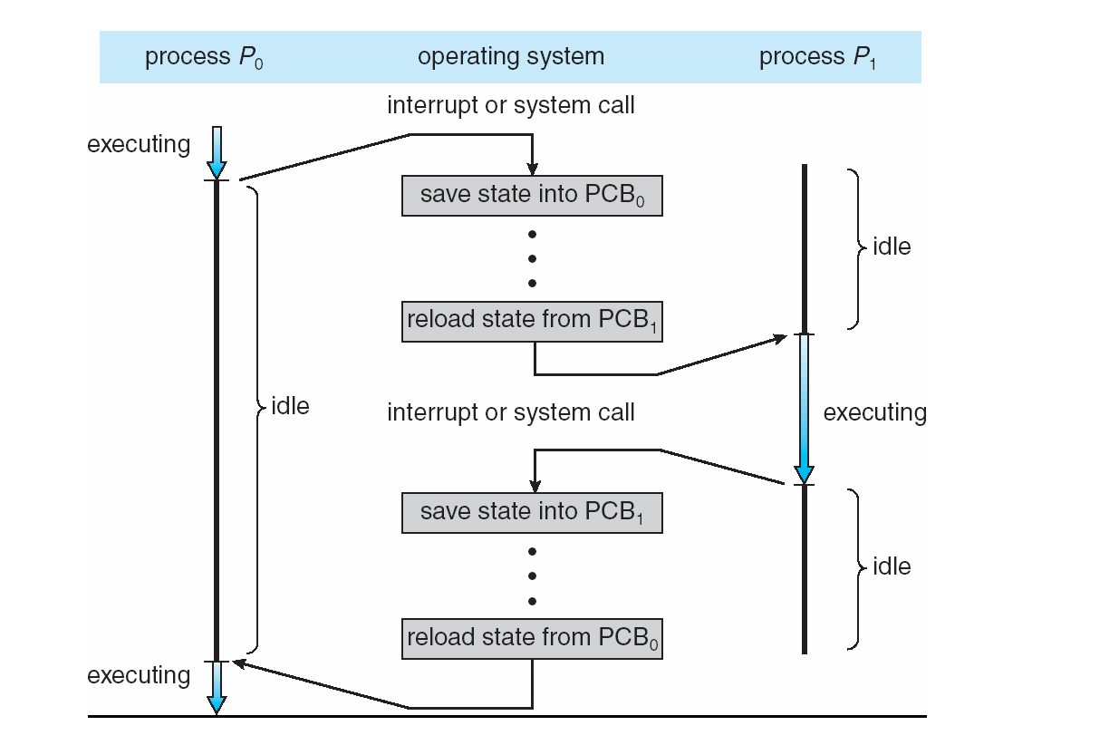
Process Scheduler

Slide 37
Process Scheduler
If the process has to wait for some I/O from the user or some other event, it is put in a status of WAITING by the Process Scheduler.
When the I/O device lets the Process Scheduler know that the I/O is completed, the process status will be changed to READY by the Process Scheduler.

Slide 38
Process Scheduler
Finally the process status will be changed to FINISHED either when the process has successful completed, or if an error occurs and the process has to terminate prematurely. The status change is usually handled by the Process Scheduler informing the Job Scheduler of the process completion, and the Job Scheduler of changing the status.

Slide 39
Processor Management
JOB SCHEDULER
HOLD
FINISHED
PROCESS SCHEDULER
READY
RUNNING
WAITING

Slide 40
Process Control Block (PCB)
The Process status is only one of a collection of descriptors that are associated with a process.
Each process has a data structure called a Process Control Block (PCB) associated with it, rather like a passport.

Slide 41

Process Control Block (PCB)
Operating System
Process Control Block (PCB)

Slide 42
Process Control Block (PCB)
Process ID
Process Status
Process State
Program Counter
Register Contents
Main Memory
Resources
Process Priority
Accounting

Slide 43
Process Control Block (PCB)
PROCESS IDENTIFIER
Each process is uniquely identified by both the user’s identification, and a pointer connecting it to its descriptor.

Slide 44
Process Control Block (PCB)
PROCESS STATUS
The current status of the process, it is either:
READY
HOLD
RUNNING
FINISHED
WAITING

Slide 45
Process Control Block (PCB)
PROCESS STATE
Program counter
Record the current value of the program counter
07
08

Slide 46
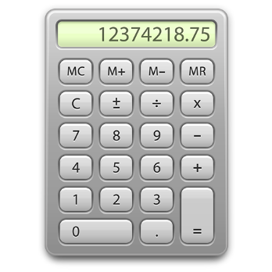
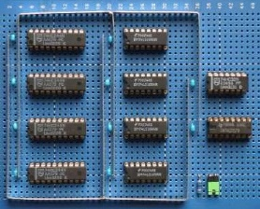
Process Control Block (PCB)
PROCESS STATE
Register Contents
Record the values of the data registers

Slide 47
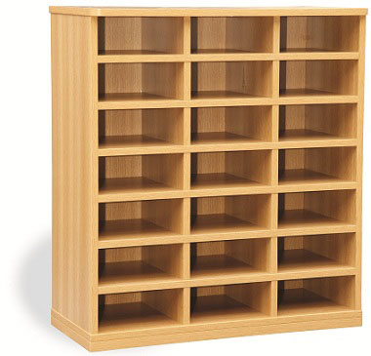
Process Control Block (PCB)
PROCESS STATE
Main Memory
Record all important information from memory, including most importantly the process location.
0
1
2
3
4
5
7
8
6
10
11
9
13
14
12
16
17
15
19
20
18

Slide 48
Process Control Block (PCB)
PROCESS STATE
Resources
Record the resources that have been allocated to this job, including files, disk drives, and printers.
ID | TYPE | DETAILS
1 | FILE | TXT file starting at memory address 0x456
2 | FILE | DAT file starting at memory address 0x087
3 | DISK | Disk Drive 4
4 | FILE | TXT file starting at memory address 0x673
5 | PRINTER | Printer at IP address 172.242.34.65

Slide 49
Process Control Block (PCB)
PROCESS STATE
Process Priority
The process is assigned a priority, and if the operating system using priorities to schedule processes.

Slide 50
Process Control Block (PCB)
PROCESS STATE
Process Priority
The process is assigned a priority, and if the operating system using priorities to schedule processes.
12
54
66
23
13
32

Slide 51
Process Control Block (PCB)
PROCESS STATE
Process Priority
The process is assigned a priority, and if the operating system using priorities to schedule processes.
12
54
66
23
13
32
1
1
5
2
1
1

Slide 52
Process Control Block (PCB)
ACCOUNTING
This section records some of the performance statistics associated with this process, including:
CPU time used so far
Time process has been in the system
Time taken in memory (Main and secondary)
Space taken in memory (Main and secondary)
System programs used, compliers, editors, etc.
Number and type of I/O operations
Time spent waiting for I/O operations completion
Number of Input records read and Output records written

Slide 53
Process Control Block (PCB)
Process ID
Process Status
Process State
Program Counter
Register Contents
Main Memory
Resources
Process Priority
Accounting

Slide 54
Process Control Block (PCB)
Process ID
457
Process Status
“WAITING”
Process State
Program Counter
Register Contents
Main Memory
Resources
Process Priority
Process State
245
R1:23, R2:63, R3:71
Process Address: 345
File1, File5, Disk4
5
Accounting
CPU: 3, Total Time:34…..

Slide 55
Process Scheduling Policies

Slide 56
Process Scheduling Policies
What are good policies to schedule processes?

Slide 57
Process Scheduling Policies
MAXIMUM THROUGHPUT
Get as many jobs done as quickly as possible.
There are several ways to achieve this, e.g. run only short jobs, run jobs without interruptions.

Slide 58
Process Scheduling Policies
MINIMIZE RESPONSE TIME
Ensure that interactive requests are dealt with as quickly as possible.
This could be achieved by scheduling just with a lot of I/O jobs first, and leave the computational jobs for later.

Slide 59
Process Scheduling Policies
MINIMIZE TURNAROUND TIME
Ensure that jobs are completed as quickly as possible.
This could be achieved by scheduling just with a lot of computation jobs first, and leave the I/O jobs for later, so there is no user delays.

Slide 60
Process Scheduling Policies
MINIMIZE WAITING TIME
Move jobs out of the READY status as soon as possible.
This could be achieved by reduce the number of users allowed on the system, so that the CPU would be available whenever a job enters the READY status.

Slide 61
Process Scheduling Policies
MINIMIZE WAITING TIME
Move jobs out of the READY status as soon as possible.
This could be achieved by reduce the number of users allowed on the system, so that the CPU would be available whenever a job enters the READY status.

Slide 62
Process Scheduling Policies
MAXIMISE CPU EFFICIENCY
Keep the CPU busy 100% of the time.
This could be achieved by scheduling just with a lot of computation jobs, and never run the I/O jobs.

Slide 63
Process Scheduling Policies
ENSURE FAIRNESS FOR ALL JOBS
Give everyone an equal amount of CPU time and I/O time.
This could be achieved by giving all jobs equal priority, regardless of it’s characteristics.

Slide 64
Process Scheduling Algorithms

Slide 65
Process Scheduling Algorithms
Here are six commonly used process scheduling algorithms

Slide 66
Process Scheduling Algorithms
First Come, First Served (FCFS)
A very simple algorithm that uses a FIFO structure.
Implemented as a non-pre-emptive scheduling algorithm.
Works well for Batch Processes, where users don’t expect any interaction.

Slide 67
Process Scheduling Algorithms
Shortest Job Next (SJN)
Also called Shortest Job First (SJF).
A very simple algorithm that schedules processes based on CPU cycle time.
Implemented as a non-pre-emptive scheduling algorithm.
Works well for Batch Processes, where it is easy to estimate CPU time.

Slide 68
Process Scheduling Algorithms
Priority Scheduling
An algorithm that schedules processes based on priority.
Implemented as a non-pre-emptive scheduling algorithm.
One of the most common algorithms used in systems that are mainly Batch Processes.
If two jobs come in of equal priority are READY, if works on a FIRST COME, FIRST SERVED basis.

Slide 69
Process Scheduling Algorithms
Shortest Remaining Time (SRT)
A pre-emptive scheduling version of the Shortest Job Next (SJN) algorithm.
An algorithm that schedules processes based on the one which is nearest to completion.
It can only be implemented on systems that are only Batch Processes, since you have to know the CPU time required to complete each job.

Slide 70
Process Scheduling Algorithms
Round Robin
A pre-emptive scheduling algorithm that is used extensively in interactive systems
All active processes are given a pre-determined slice of time (“time quantum”).
Choosing the time quantum is the key decision, for interactive systems the quantum must be small, whereas for batch systems it can be longer.

Slide 71
Process Scheduling Algorithms
Multi-Level Queues
This isn’t really a separate scheduling algorithm, it can be used with others.
Jobs are grouped together based on common characteristics.
For example, CPU-bound jobs based in one queue, and the I/O-bound jobs in another queue, and the process scheduler can select jobs from each queue based on balancing the load.

