Slide 1
Process Scheduling
Damian Gordon

Slide 2
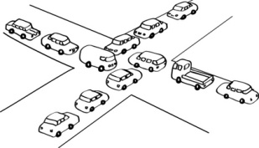
Deadlock

Slide 3
Deadlock
Deadlock can be said to occur when a process is allocated some non-sharable resources (such as files, printers or scanners), but is forced to wait for other non-sharable resources.

Slide 4
Deadlock
PROGRAM ProcA:
BEGIN
Do Stuff;
Open (File1);
Do more stuff;
Open (File2);
Do stuff;
END.

Slide 5
Deadlock
PROGRAM ProcA:
BEGIN
Do Stuff;
Open (File1);
Do more stuff;
Open (File2);
Do stuff;
END.

Slide 6
Deadlock
PROGRAM ProcA:
BEGIN
Do Stuff;
Open (File1);
Do more stuff;
Open (File2);
Do stuff;
END.

Slide 7
Deadlock
PROGRAM ProcA:
BEGIN
Do Stuff;
Open (File1);
Do more stuff;
Open (File2);
Do stuff;
END.
Is it free?

Slide 8
Deadlock
PROGRAM ProcA:
BEGIN
Do Stuff;
Open (File1);
Do more stuff;
Open (File2);
Do stuff;
END.
Is it free?
YES

Slide 9
Deadlock
PROGRAM ProcA:
BEGIN
Do Stuff;
Open (File1);
Do more stuff;
Open (File2);
Do stuff;
END.
Is it free?
Continue

Slide 10
Deadlock
PROGRAM ProcA:
BEGIN
Do Stuff;
Open (File1);
Do more stuff;
Open (File2);
Do stuff;
END.

Slide 11
Deadlock
PROGRAM ProcA:
BEGIN
Do Stuff;
Open (File1);
Do more stuff;
Open (File2);
Do stuff;
END.
Is it free?

Slide 12
Deadlock
PROGRAM ProcA:
BEGIN
Do Stuff;
Open (File1);
Do more stuff;
Open (File2);
Do stuff;
END.
Is it free?
NO

Slide 13
Deadlock
PROGRAM ProcA:
BEGIN
Do Stuff;
Open (File1);
Do more stuff;
Open (File2);
Do stuff;
END.
Is it free?
WAIT

Slide 14
Deadlock
PROGRAM ProcA:
BEGIN
Do Stuff;
Open (File1);
Do more stuff;
Open (File2);
Do stuff;
END.
Is it free?
WAIT

Slide 15
Deadlock
PROGRAM ProcA:
BEGIN
Do Stuff;
Open (File1);
Do more stuff;
Open (File2);
Do stuff;
END.

Slide 16
Deadlock
PROGRAM ProcA:
BEGIN
Do Stuff;
Open (File1);
Do more stuff;
Open (File2);
Do stuff;
END.
PROGRAM ProcB:
BEGIN
Do Stuff;
Open (File2);
Do more stuff;
Open (File1);
Do stuff;
END.

Slide 17
Deadlock
PROGRAM ProcA:
BEGIN
Do Stuff;
Open (File1);
Do more stuff;
Open (File2);
Do stuff;
END.
PROGRAM ProcB:
BEGIN
Do Stuff;
Open (File2);
Do more stuff;
Open (File1);
Do stuff;
END.

Slide 18

Deadlock
PROGRAM ProcA:
BEGIN
Do Stuff;
Open (File1);
Do more stuff;
Open (File2);
Do stuff;
END.
PROGRAM ProcB:
BEGIN
Do Stuff;
Open (File2);
Do more stuff;
Open (File1);
Do stuff;
END.

Slide 19
Deadlock
PROGRAM ProcA:
BEGIN
Do Stuff;
Open (File1);
Do more stuff;
Open (File2);
Do stuff;
END.
PROGRAM ProcB:
BEGIN
Do Stuff;
Open (File2);
Do more stuff;
Open (File1);
Do stuff;
END.

Slide 20
Deadlock
PROGRAM ProcA:
BEGIN
Do Stuff;
Open (File1);
Do more stuff;
Open (File2);
Do stuff;
END.
PROGRAM ProcB:
BEGIN
Do Stuff;
Open (File2);
Do more stuff;
Open (File1);
Do stuff;
END.

Slide 21
Deadlock
PROGRAM ProcA:
BEGIN
Do Stuff;
Open (File1);
Do more stuff;
Open (File2);
Do stuff;
END.
PROGRAM ProcB:
BEGIN
Do Stuff;
Open (File2);
Do more stuff;
Open (File1);
Do stuff;
END.

Slide 22
Deadlock
Process A

Slide 23
Deadlock
File 1
Process A
File 2

Slide 24
Deadlock
File 1
Process A
File 2

Slide 25

Deadlock
File 1
Process A
File 2

Slide 26
Deadlock
File 1
Process A
File 2

Slide 27
Deadlock
File 1
Process A
File 2

Slide 28
Deadlock
Process B

Slide 29
Deadlock
File 1
Process B
File 2

Slide 30
Deadlock
File 1
Process B
File 2

Slide 31
Deadlock
File 1
Process B
File 2

Slide 32
Deadlock
File 1
Process B
File 2

Slide 33
Deadlock
File 1
Process B
File 2

Slide 34
Deadlock
File 1
Process A
Process B
File 2

Slide 35
Seven Types of Deadlock
Deadlock on file requests
Deadlock in databases
Deadlock in dedicated device allocation
Deadlock in multiple device allocation
Deadlock in spooling
Deadlock in a network
Deadlock in disk sharing

Slide 36
Deadlock on File Requests
We just saw it:

Slide 37
Deadlock on File Requests
We just saw it:
File 1
Process A
Process B
File 2

Slide 38
Deadlock on File Requests
Only occurs because a process is allowed to lock a resource for the duration of its execution.

Slide 39
Deadlock in Databases
Similar
Record 1
Transaction
A
Transaction
B
Record 2

Slide 40
Deadlock in Databases
Begin transaction TA:
read balance1 [ 100 ]
balance1 = balance1 - 100
if balance < 0
print “insufficient funds”
abort T1
end
write balance1 [ 0 ]
read balance2 [ 100 ]

Slide 41
Deadlock in Databases
Begin transaction TA:
read balance1 [ 100 ]
balance1 = balance1 - 100
if balance < 0
print “insufficient funds”
abort T1
end
write balance1 [ 0 ]
read balance2 [ 100 ]
Begin transaction TB:
read balance2 [ 100 ]
balance2 = balance2 - 100
if balance < 0
print “insufficient funds”
abort T2
end
write balance2 [ 0 ]
read balance1 [ 100 ]

Slide 42
Deadlock in Databases
Begin transaction TA:
read balance1 [ 100 ]
balance1 = balance1 - 100
if balance < 0
print “insufficient funds”
abort T1
end
write balance1 [ 0 ]
read balance2 [ 100 ]
Begin transaction TB:
read balance2 [ 100 ]
balance2 = balance2 - 100
if balance < 0
print “insufficient funds”
abort T2
end
write balance2 [ 0 ]
read balance1 [ 100 ]

Slide 43
Deadlock in Databases
Begin transaction TA:
read balance1 [ 100 ]
balance1 = balance1 - 100
if balance < 0
print “insufficient funds”
abort T1
end
write balance1 [ 0 ]
read balance2 [ 100 ]
Begin transaction TB:
read balance2 [ 100 ]
balance2 = balance2 - 100
if balance < 0
print “insufficient funds”
abort T2
end
write balance2 [ 0 ]
read balance1 [ 100 ]

Slide 44
Deadlock in Dedicated Device Allocation
For example DVD Read/Write drives

Slide 45
Deadlock in Dedicated Device Allocation
DVD-R
1
Process
A
Process
B
DVD-R
2

Slide 46
Deadlock in Multiple Device Allocation
More than over device, e.g. DVD-R, printer, scanner.

Slide 47
Deadlock in Multiple Device Allocation
DVD-R
1
Process
A
Process
B
Scanner 1

Slide 48
Deadlock in Multiple Device Allocation
DVD-R
1
Process
A
Process
B
Printer
1
Process
C
Scanner 1

Slide 49
Deadlock in Spooling
What is Spooling?

Slide 50
Deadlock in Spooling
What is Spooling?
SPOOL is an acronym for Simultaneous Peripheral Operations On-Line.

Slide 51
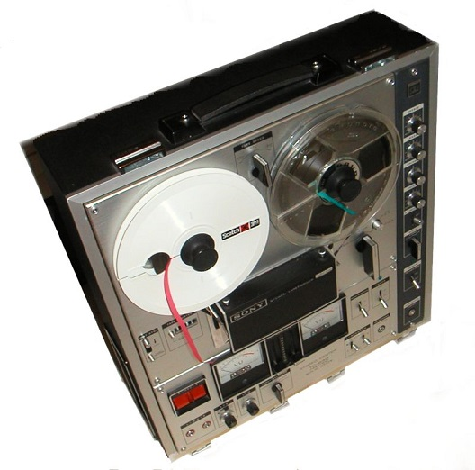
Deadlock in Spooling
What is Spooling?
SPOOL is an acronym for Simultaneous Peripheral Operations On-Line.

Slide 52
Deadlock in Spooling
What is Spooling?
SPOOL is an acronym for Simultaneous Peripheral Operations On-Line.
A simple example of a spooling application is print spooling, which places a print job a queue for extended or later processing.

Slide 53
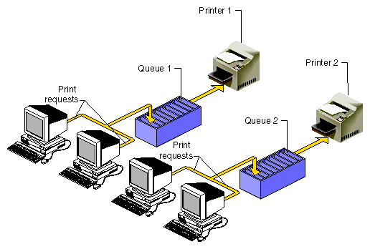
Deadlock in Spooling
What is Spooling?
Spool 1
Spool 2

Slide 54
Deadlock in Spooling
If all 108 of you guys had a 10-page assignment you had to hand up by 11am and you all printed your files at the same time at 10:55am, the spool might first accept page 1 from everyone, then page 2, and so on.,, but if it gets to page 9 and then the spooler is full, things get stuck. The printer might not want to print any jobs unless it has a full 10 pages from any one job, so we are deadlocked.

Slide 55
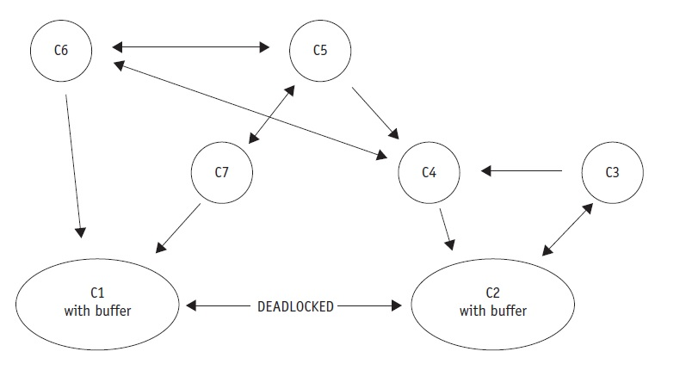
Deadlock in a Network

Slide 56
Deadlock in a Network
For example, a medium-sized word-processing centre has seven computers on a network, each on different nodes. C1 receives messages from nodes C2, C6, and C7 and sends messages to only one: C2. C2 receives messages from nodes C1, C3, and C4 and sends messages to only C1 and C3. The direction of the arrows in the diagram indicates the flow of messages.

Slide 57
Deadlock in a Network
Messages received by C1 from C6 and C7 and destined for C2 are buffered in an output queue. Messages received by C2 from C3 and C4 and destined for C1 are buffered in an output queue. As the traffic increases, the length of each output queue increases until all of the available buffer space is filled. At this point C1 can’t accept any more messages (from C2 or any other computer) because there’s no more buffer space available to store them.

Slide 58
Deadlock in a Network
For the same reason, C2 can’t accept any messages from C1 or any other computer, not even a request to send. The communication path between C1 and C2 becomes deadlocked; and because C1 can’t send messages to any other computer except C2 and can only receive messages from C6 and C7, those routes also become deadlocked. C1 can’t send word to C2 about the problem and so the deadlock can’t be resolved without outside intervention.

Slide 59
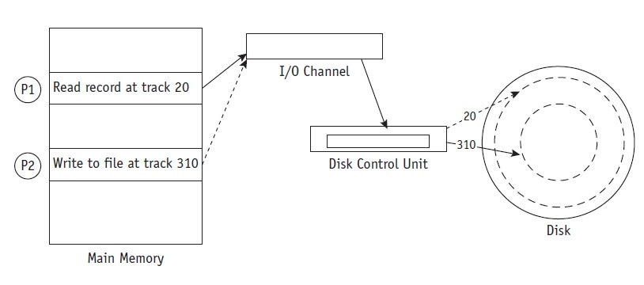
Deadlock in Disk Sharing

Slide 60
Deadlock in Disk Sharing
For example, at an insurance company the system performs many daily transactions. One day the following series of events ties up the system:

Slide 61
Deadlock in Disk Sharing
1. Customer Service (P1) wishes to show a payment so it issues a command to read the balance, which is stored on track 20 of a disk.

Slide 62
Deadlock in Disk Sharing
2. While the control unit is moving the arm to track 20, P1 is put on hold and the I/O channel is free to process the next I/O request.

Slide 63
Deadlock in Disk Sharing
3. While the arm is moving into position, Accounts Payable (P2) gains control of the I/O channel and issues a command to write someone else’s payment to a record stored on track 310. If the command is not “locked out,” P2 will be put on hold while the control unit moves the arm to track 310.

Slide 64
Deadlock in Disk Sharing
4. Because P2 is “on hold” while the arm is moving, the channel can be captured again by P1, which reconfirms its command to “read from track 20.”

Slide 65
Deadlock in Disk Sharing
5. Because the last command from P2 had forced the arm mechanism to track 310, the disk control unit begins to reposition the arm to track 20 to satisfy P1. The I/O channel would be released because P1 is once again put on hold, so it could be captured by P2, which issues a WRITE command only to discover that the arm mechanism needs to be repositioned.

Slide 66
Deadlock in Disk Sharing
This is LIVELOCK.

Slide 67
Modelling Deadlock

Slide 68
File 1
File 2
File 3
Process A
Process B
Process c

Slide 69

File 1
File 2
File 3
Process A
Process B
Process c

Slide 70
File 1
File 2
File 3
Process A
Process B
Process c

Slide 71
Starvation: The Dining Philosopher’s Problem

Slide 72
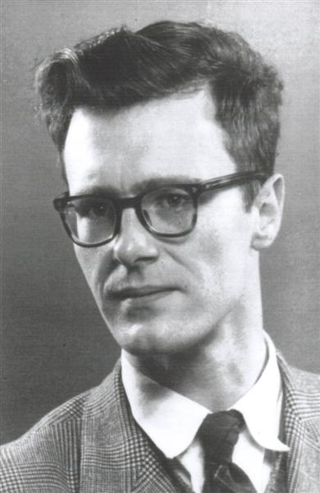
Edsger W. Dijkstra
Born May 11, 1930
Died August 6, 2002
Born in Rotterdam, Netherlands
A Dutch computer scientist, who received the 1972 Turing Award for fundamental contributions to developing programming languages.

Slide 73
