Slide 1

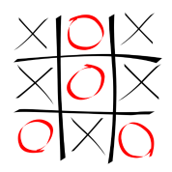
TEAMWORK PROJECT
TIC TAC TOE
CONSOLE-BASED GAME
CREATED BY
TEAM “HOTH”

Slide 2
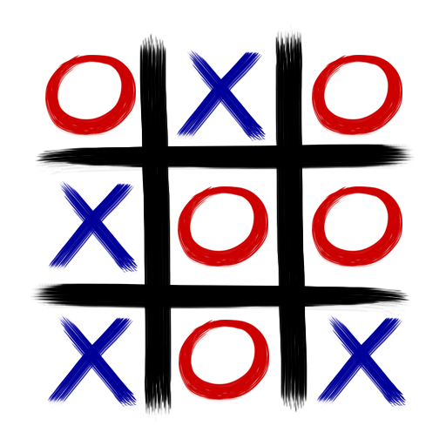
- Classic Tic Tac Toe Game - a Console- based Game - You can play: Player-Player Player – Computer Computer –Computer - Rate Score of MultiGaming
TIC TAC TOE
GAME

Slide 3



- Classes - Abstract Class (public abstract void) - Methods - Loops (if…else, do… while, for) - Writing and Running in Eclipse and NetBeans
- Java Code - a Console – based Application - Object – Oriented Programming

Slide 4


Teamwork Project
TEAM "HOTH“ MEMBERS:
Daniel Todorov
Nikola Chakarov
Nikolay Chochev
Slavi Koen
Valentin Karov
Tihomira Rakipova

