Slide 1
.NET5 와 F# 5 그리고 해외 .NET 커뮤니티
@ Thursday .NET Live Hayden

Slide 2
Table of Contents
Introduction
.Net 5 and F#
How to Stay Current with F#
F# Related Resources
Upcoming Event
What’s Next?
One More Thing

Slide 3
Introduction

Slide 4
What Brought Me Here
My Story
Early: Computer -> VB -> Dark Age
Mid: College -> Scheme -> Not My Way!
Present: Computer -> PL Geek
.NET5 and F#5
Brief Coverage
History
Learning Resources

Slide 5
.Net 5 and F#

Slide 6
.NET 5
Major Changes
Single .NET: .NET Core + Xamarin
Unified Libraries, toolset, SDK, and runtime
Native Applications for Multiple Platforms
Web Applications for Multiple Platforms
Cloud Native Applications (single file < 50 MB microservices )
For More Info: https://devblogs.microsoft.com/dotnet/announcing-net-5-0-preview-1/

Slide 7
F# 5
Summary: For Better Interactive and Analytical Programming
Major Changes
Package references for F# scripts
Enhanced slicing
The nameof function
Opening static classes
Applicative computation expressions

Slide 8
F# 5
For More Info: https://devblogs.microsoft.com/dotnet/announcing-f-5-preview-1/
F# 5.0 (preview) notebook: https://gist.github.com/cartermp/6b91c3561c6a5efca4288dca37c15edc
F# 5 and .NET 5 (Philip Carter): https://www.slideshare.net/PhillipCarter6/fsharp-5southkoreameetup2020/

Slide 9
Reasons that You Care about F#
Welcoming and Vibrant Community
F# Software Foundation: (https://fsharp.org/)
F# Slack: Become a member of FSF (http://foundation.fsharp.org/join)
Nice Frameworks
Fable: F# to Javascript Transpiler (http://fable.io/)
Find Out More in Guides section at F# Software Foundation (https://fsharp.org/)
Very Nice Interactive Programming
Built-in interpreter support via dotnet fsi
Jupyter Support via dotnet-try

Slide 10
Brief History of F#
Year 1997
In reponse to Java, Microsoft initiated internal projects that became .NET
FP Researchers gathered at Microsoft Research, Cambridge UK
Big Names: Andy Gordon, Luca Cardelli, Simon Peyton Jones, Nick Benton, Cedric Fournet, Sir Tony Hoare, Don Syme
Initiation of
1998: .NET Generics
2002: F#

Slide 11
Brief History of F#
F# was one of the responses to OOP of the mid-1990s
by the advocates of strongly-typed FP
Three Eras
F# 1.0 (2004-2007): Development of Core Features
F# 2.0 (2007-2010): Productization of F# by Microsoft
F# 3.0-4.5 (2010-present): Open-source, Cross-platform language
For More Information, read The Early History of F# (https://fsharp.org/history/hopl-final/hopl-fsharp.pdf)
Notes:
Andy Gordon (a high-profile young researcher in programming language theory)
Luca Cardelli (author of one of the first ML implementations and prolific researcher)
Simon Peyton Jones (a leading Haskell contributor)
Nick Benton (a theorist and initiator of MLj, discussed later)
Cedric Fournet (a core member of the OCaml team)
Sir Tony Hoare (world famous computer scientist)
Don Syme (the author of this paper; undergraduate student of early ML contributor Malcolm Newey in Australia; PhD student of Mike Gordon; with a background in functional programming, formal verification and Java)
F# 은 90년대 중반에 대두된 OOP 패러다임의 대항마로 소개됨.

Slide 12
How to Get Started with F# (NOW!)
Go to Resources
Microsoft Learn: https://dotnet.microsoft.com/languages/fsharp
Microsoft Docs: https://docs.microsoft.com/dotnet/fsharp/
Download and Install from .NET Core (https://dotnet.microsoft.com/download)
Open notepad or any editor you like
Type the following printfn "Hello World!
Save it as script.fsx
Run dotnet fsi script.fsx

Slide 13
How to Stay Current with F#

Slide 14
Listen to the Community Leaders
They are Very Loud on Social Media
Check out Hackernews and Reddit for responses from community at large

Slide 15
Don Syme
The Person Who Designed F#
Twitter: https://twitter.com/dsymetweets

Slide 16
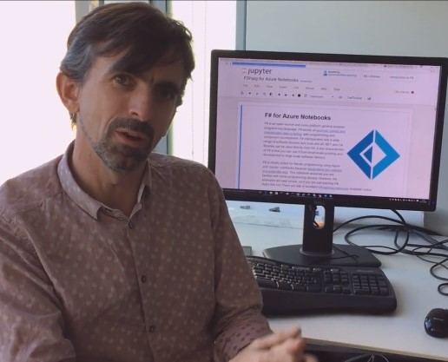
Don Syme

Slide 17
Scott Wlaschin
Have you heard https://fsharpforfunandprofit.com ?
Author of Domain Modeling Made Functional
Go Check Out All of His Presentations and Podcasts
Twitter: https://twitter.com/ScottWlaschin

Slide 18
Scott Wlaschin
Quotes
Learn as many languages as possible, especially if you are young
There are no technical problems, it's all human problem
It's about paradigm, not about a language

Slide 19
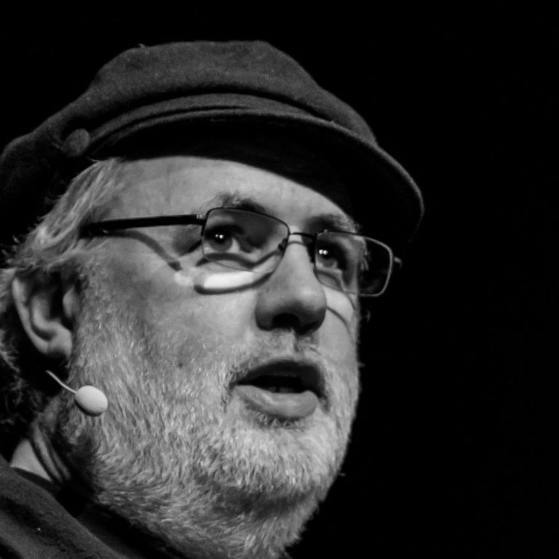
Scott Wlaschin

Slide 20
Krzysztof Cieślak
The author and creator of the Ionide Project (https://ionide.io/)
발음: 크리시토프 치에실랙
Twitter: https://twitter.com/k_cieslak
Twitch: https://www.twitch.tv/k_cieslak/videos

Slide 21
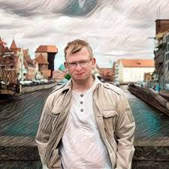
Krzysztof Cieślak
Notes:
Ionide is an organization which builds high quality, cross platform developer tools for F#. Our flagship project is Ionide-VSCode, which makes VSCode as a fully-fledged F# IDE.
Recently marked, 5 years anniversary.

Slide 22
Other Big Players
Dave Thomas
Twitter: https://twitter.com/7sharp9_exhumed
YouTube: https://www.youtube.com/user/Dethomas75/
Twitch: https://www.twitch.tv/7sharp9_dev/videos
Gareth Hubball
Twitter: https://twitter.com/GarethHubball
Twitch: https://www.twitch.tv/garethhubball

Slide 23
Other Big Players
Roman Sachse
Twitter: https://twitter.com/R0MMSEN
YouTube: https://www.youtube.com/channel/UCOX5DkLyqctM-wkOAU_mUpA
Frank A. Krueger
Twitter: https://twitter.com/praeclarum
Personal: https://praeclarum.org/
Podcast: https://www.mergeconflict.fm/

Slide 24
Who Else?
Philip Carter
.NET PM @ Microsoft
Twitter: https://twitter.com/_cartermp
Blog: https://devblogs.microsoft.com/dotnet/author/phcartmicrosoft-com/
Mathias Brandewinder
Economist turned Developer speciailized in Data Science
Twitter: https://twitter.com/brandewinder

Slide 25
Who Else?
Isaac Abraham
F# MVP, Founder of CompositionalIT
Twitter: https://twitter.com/isaac_abraham
Personal: cockneycoder.wordpress.com

Slide 26
F# Related Resources

Slide 27
There are many great community driven resources
Videos
Meetup
Conferences
Podcasts

Slide 28
Videos
F# Online
Community for F#: https://www.youtube.com/channel/UCCQPh0mSMaVpRcKUeWPotSA/featured
The Live Coders (.NET at Large)

Slide 29
Conferences
NDC Conferences: https://twitter.com/NDC_Conferences, ndcconferences.com
F# Europe: https://twitter.com/fsharp_eu, https://fsharp.eu
Open Fhsarp: openfsharp.org
Lambda Conf (FP in General): https://twitter.com/lambda_conf

Slide 30
Meetups
CaptionFsharp: https://capitolfsharp.org
Southern Fried Fsharp: https://southernfriedfsharp.com
Austin F#: https://t.co/WlsmDEcF49?amp=1
Briston F#: https://t.co/jpXhyFFmLV?amp=1
F# Seattle: https://twitter.com/FSharpSeattle
And Many More…

Slide 31
Upcoming Event

Slide 32
The Live Coders Conference
Sign Up Page: https://www.subscribepage.com/lcc2020
Twitter: https://twitter.com/thelivecoders
Twitch: twitch.tv/team/livecoders
GitHub: https://github.com/livecoders/home

Slide 33
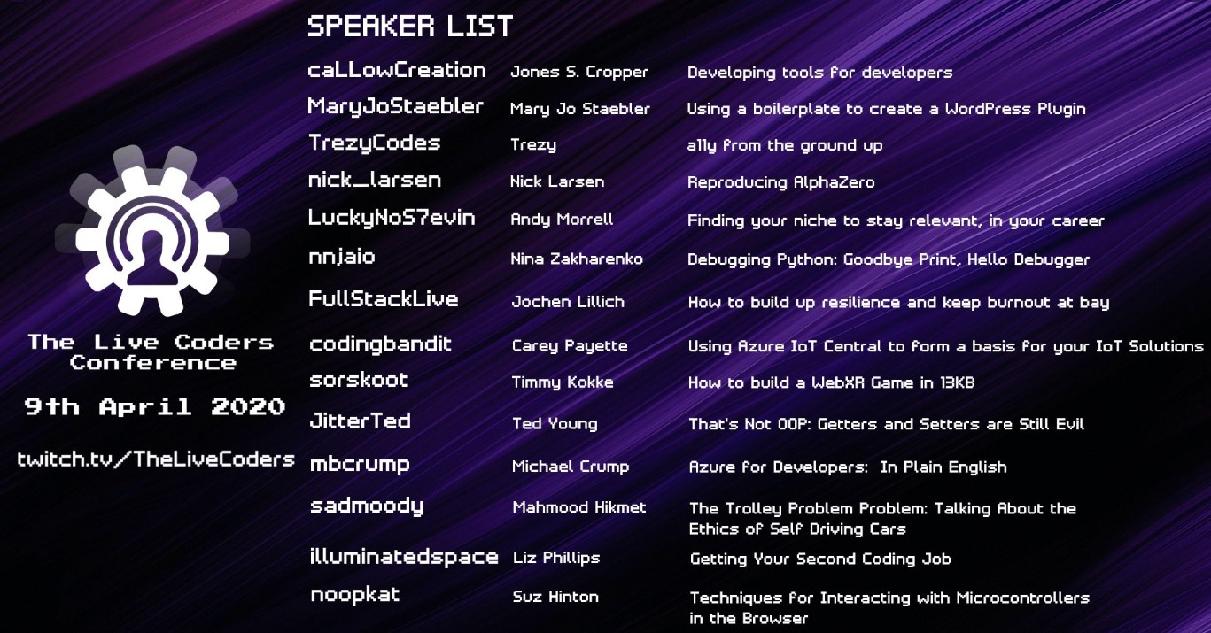
The Live Coders

Slide 34
What’s Next?

Slide 35
Personal Ambition
Twitch or YouTube Live F# Coding
In depth study on the History of F#
Serverless Computing
Artificial Intelligence and Machine Learning
Fullstack Web Apps
ML.NET & Q#

Slide 36
One More Thing

Slide 37
Special Thanks
F# Korea and .NET Dev KR
Microsoft MVP Jung Hyun Nam
Markdown, Pandoc, Office 365

