Slide 1

Personal Finances App

Slide 2
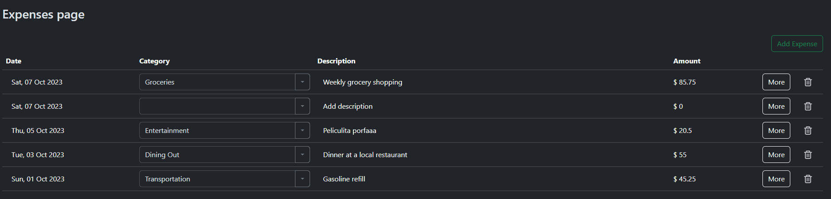
Expenses | Budget | Savings | Payments | Summary | Profile
< | October | 2023 | >
Total spent:
$2,000.00

Slide 3
Expenses | Budget | Savings | Payments | Summary | Profile
< | October | 2023 | >
Total spent:
$2,000.00
Category | Limit | Spent | Total
Groceries | $1,500.00 | $200.00 | $1,500.00
Transport | $1,000.00 | $400.00 | $1,000.00
Food | $1,300.00 | $100.00 | $1,300.00
Weekend | $500.00 | $0.00 | $500.00
Total | $500.00 | $0.00
Add Category
Total income:
$29,000.00

Slide 4
Expenses | Budget | Savings | Payments | Summary | Profile
< | October | 2023 | >
Total saved:
$2,000.00
Saving | Target | Spent | Total
For the future | $1,500.00 | $200.00 | $1,500.00
Unexpected | $1,000.00 | $400.00 | $1,000.00
For Christmas | $1,300.00 | $100.00 | $1,300.00
Total | $500.00 | $0.00
Add Saving

Slide 5
Expenses | Budget | Savings | Payments | Summary | Profile
< | October | 2023 | >
Total paid:
$2,000.00
Payment | Amount | Paid | Missing
Taxes | $1,500.00 | $200.00 | $1,500.00
IMSS | $1,000.00 | $400.00 | $1,000.00
Saving fund | $1,300.00 | $100.00 | $1,300.00
Rent | $500.00 | $0.00 | $500.00
Loans | $500.00 | $0.00 | $500.00
Total | $500.00 | $0.00
Add Payment

Slide 6
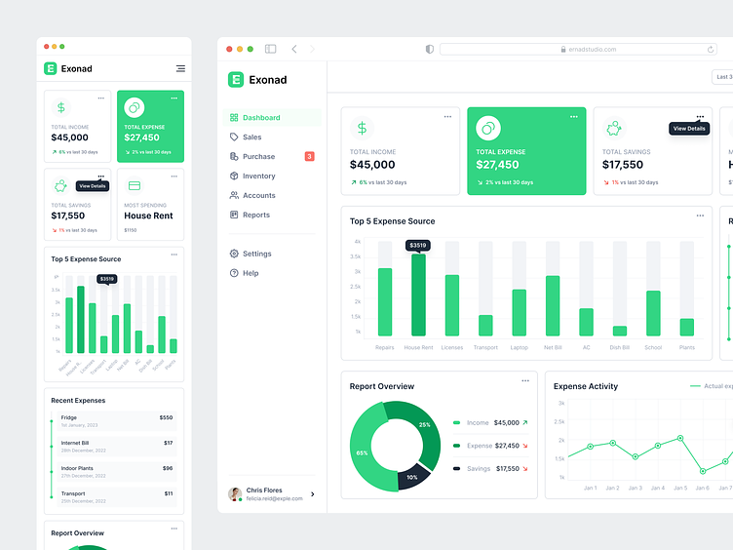
Expenses | Budget | Savings | Payments | Summary | Profile
< | October | 2023 | >
By month
TOTAL INCOME
TOTAL SPENT
TOTAL SAVED
TOTAL PAID
TOTAL LEFT
$29,000
$10,500
$5,500
$6,500
$1,500
Goal: $10,000 (3% over)
Goal: $5,000 (3% over)
Goal: $7,000 (3% under)
Same as last month
2% more than last month
3% less than last month
5% more than last month
2% more than last month
This text must hide when data is shown by range of dates
Inspired by:
https://dribbble.com/shots/20397691-Expense-Management-SaaS-Software-Design-Admin-Dashboard
Future implementations:
- Have a summary by week table
- Include graphs like the ones in the image
- Download CSV file of the information

Slide 7
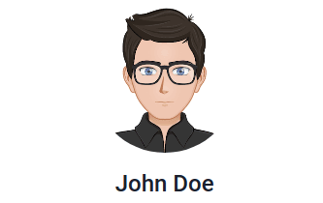
Expenses | Budget | Savings | Payments | Summary | Profile
Log out
Delete account and data

