Slide 1
Digital Portfolio
NAME : DANIEL.J
REGISTER NO AND NMID : asbru262422K1622/B84AD1AC90C9EC0A6C44A4FD3B652783
DEPARTMENT : B.sc COMPUTER SCIENCE
COLLEGE : SHRI NEHRU MAHA VIDYALAYA COLLAGE
ARTS AND SCIENCE
UNIVERSITY : BHARATHIYAR UNIVERSITY

Slide 2
PROJECT TITLE
Personalized Welcome Page

Slide 3
AGENDA
Problem Statement
Project Overview
End Users
Tools and Technologies
Portfolio design and Layout
Features and Functionality
Results and Screenshots
Conclusion
Github Link
3/21/2024 Annual Review

Slide 4
PROBLEM STATEMENT
Many beginner web developers struggle to understand how to:
Take input from users
Display dynamic results on a webpage
Use HTML, CSS, and JavaScript together
This project addresses these problems in a simple way.

Slide 5
PROJECT OVERVIEW
This project is a simple welcome page where:
Users enter their name in a text box
On submission, the page displays a personalized greeting
Example: 'Hi Daniel, welcome to my page!'
The focus is on interactivity and user experience.

Slide 6

WHO ARE THE END USERS?
Students learning web development basics
Teachers or trainers who need simple demos
Beginners experimenting with JavaScript DOM manipulation
The project is designed to be simple, interactive, and educational.

Slide 7
TOOLS AND TECHNIQUES
HTML: Structure of input box and button
CSS: Styling of the page and elements
JavaScript: Logic to display personalized message

Slide 8
PORTFOLIO DESIGN AND LAYOUT
Clean and professional design
Input field and button in the center
Personalized welcome message displayed dynamically
Responsive layout with modern CSS
Minimalist UI suitable for portfolio projects
‹#›

Slide 9
FEATURES AND FUNCTIONALITY
Simple input form
Personalized welcome message
Clean and professional UI with gradient background
Interactive response when user enters name
Beginner-friendly project

Slide 10
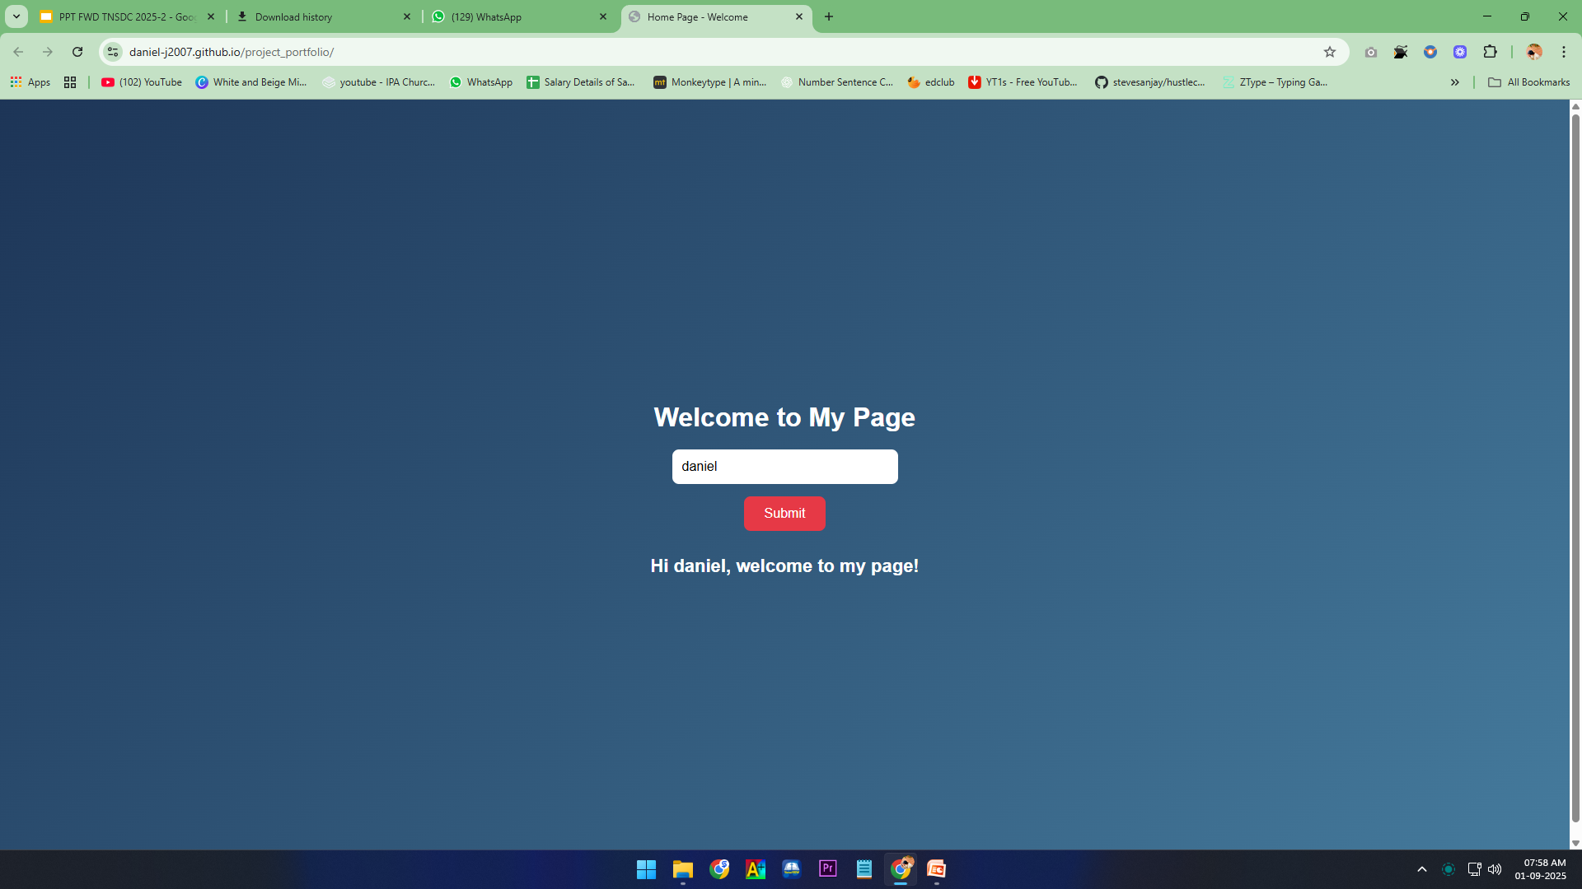
RESULTS AND SCREENSHOTS
Results:
Personalized message displayed after name submission
Smooth user interaction
Functional demonstration of HTML, CSS, and JavaScript
3/21/2024 Annual Review
‹#›

Slide 11
CONCLUSION
•This project is a beginner-friendly introduction to web development.
• It covers:
HTML forms
CSS styling
JavaScript DOM manipulation
‹#›

