Slide 1


Planning Techniques

Slide 2
Outline
Introduction
Classification of algorithms
Planning techniques
Conclusions

Slide 3
Introduction
Inputs and outputs of a planner
Domain
Planner
Problem
Validator
Sequential plan or Parallel plan

Slide 4
Outline
Introduction
Classification of algorithms
Planning techniques
Conclusions

Slide 5
Classification of algorithms
Criteria for classifying algorithms:
How the search is performed (state/plan, progression/regression)
Goals ordering: (no)lineal
How plans are built: generative (no library plans) or case-based
How plans are generated: by refining (gradually add actions and restrictions), retraction (removes previously added actions) and processing (mixing both
Dealing with uncertainty: contingent and probabilistics
Using specific knowledge: domain (in)dependent

Slide 6
State Space Search (SSS)
The easiest way to build a planner is to convert it in a search problem through the state space (SSS)
Each node in the tree/graph represents a state of the world
Each arc connects worlds that are achieved by executing an action
Once the planning problem is converted → we can apply any algorithm studied so far

Slide 7
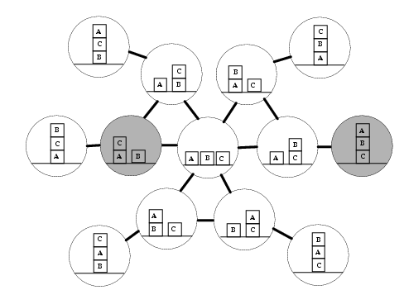
State Space Search (SSS)

Slide 8
State Space Search (SSS)
You can incrementally generate the set of reachable states from the initial state by a sequence of actions: progression
The states that are achieved in these sequences can be calculated
Checking if the goal has been achieved
Checking if the preconditions are satisfied
Instead of looking forward from the initial state, you can search backward from the goals: regression

Slide 9
State Space Search (SSS)
The algorithm is:
Robust? (the plan that returns, works)
Complete? (if there is a solution plan, can find it)
What algorithm is faster?
They have the same complexity, both will do approx. ”n" decisions before finding the solution
The number of decisions at each branch point suppose to be "b"
By experience, the branching factor (b) is smaller in one. What?
O(b^{n})
Regression

Slide 10
Plan Space Search (PSS)
In 1974, the planner NOAH (Sacerdoti) was built, the search was conducted through the space of plans (PSS) :
Each node in the tree/graph represents a partial plan
Each arc represents refining plan operations (add an action to the plan)
The initial node is a NULL plan and the final node represents the solution plan for the goal
While SSS has to return the solution path from the initial to the goal states, the goal state in PSS is the solution

Slide 11

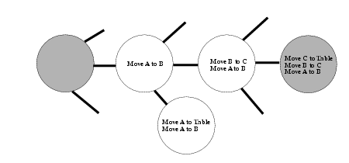
Plan Space Search (PSS)

Slide 12
Outline
Introduction
Classification of algorithms
Planning techniques
Total Order Planners (TO)
Partial Order Planners (POP)
Hierarchical Task Network (HTN)
Graph-based Planners (GP)
SAT-based planners
Heuristic Search Planners
Conclusions

Slide 13
Planning techniques
TO: the solution is a totally ordered sequence of actions (States / Plans)
PO: search at the space plans. Implements a "least Commitment approach": only the essential decisions orders are saved
HTN: network of tasks and constraints
Graph-based: The search structure is a planning graph
SAT: takes as input a problem, guess the length of the plan and generates propositional clauses
Heuristic Search Planners: transform planning problems in heuristic problems (length, cost)

Slide 14
Planning techniques
Total Order Planners (TO)
Partial Order Planners (POP)
Hierarchical Task Network (HTN)
Graph-based Planners (GP)
SAT-based planners
Heuristic Search Planners

Slide 15
TO Planners
The solution is an ordered sequence of actions
Distinguishing TO must be separated from the distinction of SSS and PSS based planners
SSS: each search state corresponds to a state in the world
PSS: each search state corresponds to a plan
Generally, TO is associated to SSS: Prodigy or VVPLAN, although there are PSS: INTERPLAN or WARPLAN

Slide 16
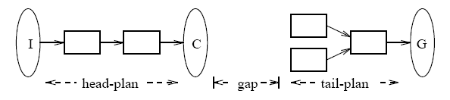
TO: Prodigy 4.0
Nonlinear, domain independent planner that includes learning (Carnegie Mellon)
An incomplete plan consists of:
The tail-plan is built using a backward chaining algorithm, which starts on the goals and adds operators one by one, to achieve the goal and the preconditions of the operators in the tail-plan that are not satisfied in the current state
The head-plan: applies operators in the tail-plan

Slide 17
TO: Prodigy 4.0
Goal
Quality
Operator
Bindings
Domain
Apply
Problem
QProdigy
Control R.

Slide 18
Planning techniques
Total Order Planners (TO)
Partial Order Planners (POP)
Hierarchical Task Network (HTN)
Graph-based Planners (GP)
SAT-based planners
Heuristic Search Planners

Slide 19
Partial Order Planners (POP)
Perform PSS
The planning algorithm implements the least commitment technique
Only essential planning decisions are saved because it is not necessary to commit
The causal link structure is responsible for storing them
3 fields: producer, consumer and the proposition
As can be actions that threaten it, we can apply:
Demotion: add the restriction before the step that threats it
Promotion: add the restriction after the step that threats it
Separation: add the restriction to the variable binding
Confrontation: add the negation to the conditional effects
Examples: UCPOP, Cassandra, ZENO, VHPOP

Slide 20

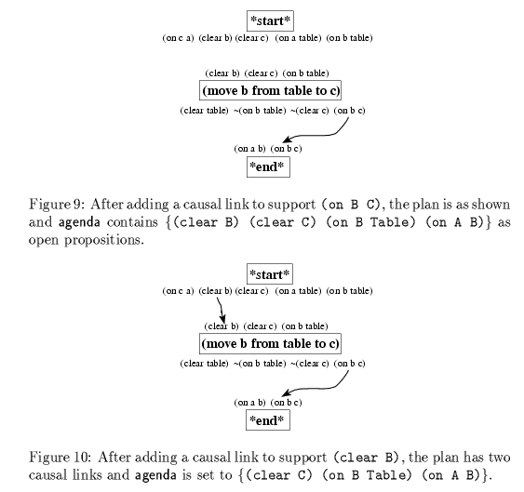
UCPOP

Slide 21
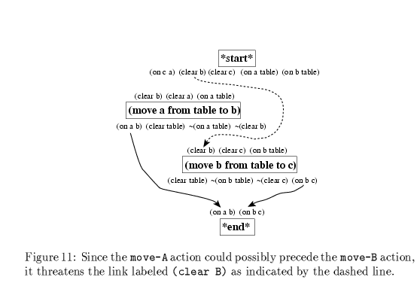
UCPOP

Slide 22
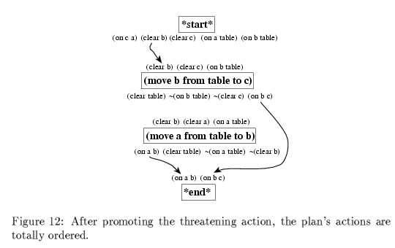
UCPOP

Slide 23
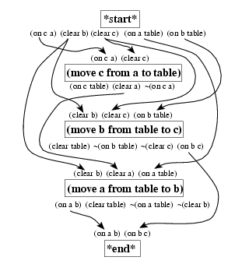
UCPOP

Slide 24
State reachability: planning tree
Action applicable to initial state
Initial world state
Resulting state after application of the action
s0
a11
a12
a1i
. . .
States reachable by one step
s11
s12
s1i
Search tree
a21
a2j
States reachable by two steps
s21
...
...
. . .
...
s2j
. . .
. . .
. . .
expand the tree until a goal state satisfying goal is reached
Unmanageable size ⇒ cannot be stored in memory

Slide 25
Planning techniques
Total Order Planners (TO)
Partial Order Planners (POP)
Hierarchical Task Network (HTN)
Graph-based Planners (GP)
SAT-based planners
Heuristic Search Planners

Slide 26
HTN
Problems and operators are arranged in a network or {} of task (called actions) that correspond to transition states
High-level tasks are reduced into low levels tasks
A method maps a task in a network of partially ordered tasks with few restrictions
The algorithm iteratively expands tasks and resolves conflicts until a plan consisting of primitives and free tasks conflict is found

Slide 27
HTN
Differences between HTN and STRIPS - style planners lies in what they do and how they plan for:
STRIPS: the objective is to find a {} of ordered actions from the IS to goals. It finds appropriate operators that have the desired effects and making their preconditions, the subgoals
HTN: it plans looking for task network that may include other things besides goals. Plan by decomposing tasks and conflict resolution. Methods should contain all possible ways to get tasks, which is much more tedious.

Slide 28
HTN
Examples:
NONLIN
O-PLAN
DEVISER
SIPE
NMRA
SHOP: plans the tasks in the order they are executed. Domain Independent
TALPlanner (Temporal Action Logic planner) domain dependent

Slide 29
Planning techniques
Total Order Planners (TO)
Partial Order Planners (POP)
Hierarchical Task Network (HTN)
Graph-based Planners (GP)
SAT-based planners
Heuristic Search Planners

Slide 30
Graph-based Planners
The search structure is based on a planning Graph→ Graphplan
The graph is directed and layered. contains:
2 types of nodes:
Proposition nodes: even levels (initial state→ 0)
Action nodes: odd levels
3 types of arcs: represent relationships between actions and propositions: added, deleted and nop

Slide 31
Graph-based Planners
Graphplan algorithm works in two alternating phases
expands (add layers) the planning graph until the last proposition layer satisfies the goal condition
tries to extract a valid plan (backtracking) from the planning graph
If unsuccessful continues with the former phase, the planning graph is expanded again

Slide 32
Graph-based Planners
It is necessary to develop a reachability analysis to reduce the set of actions that are not supported in each layer
Compatibility inferring mutual exclusion relations between incompatible actions is performed (mutex)
Have opposite effects
Incompatible preconditions
The effect of one action is the opposite of another
Between incompatible propositions: negated literals or all actions that can achieve them are mutex in the previous step

Slide 33
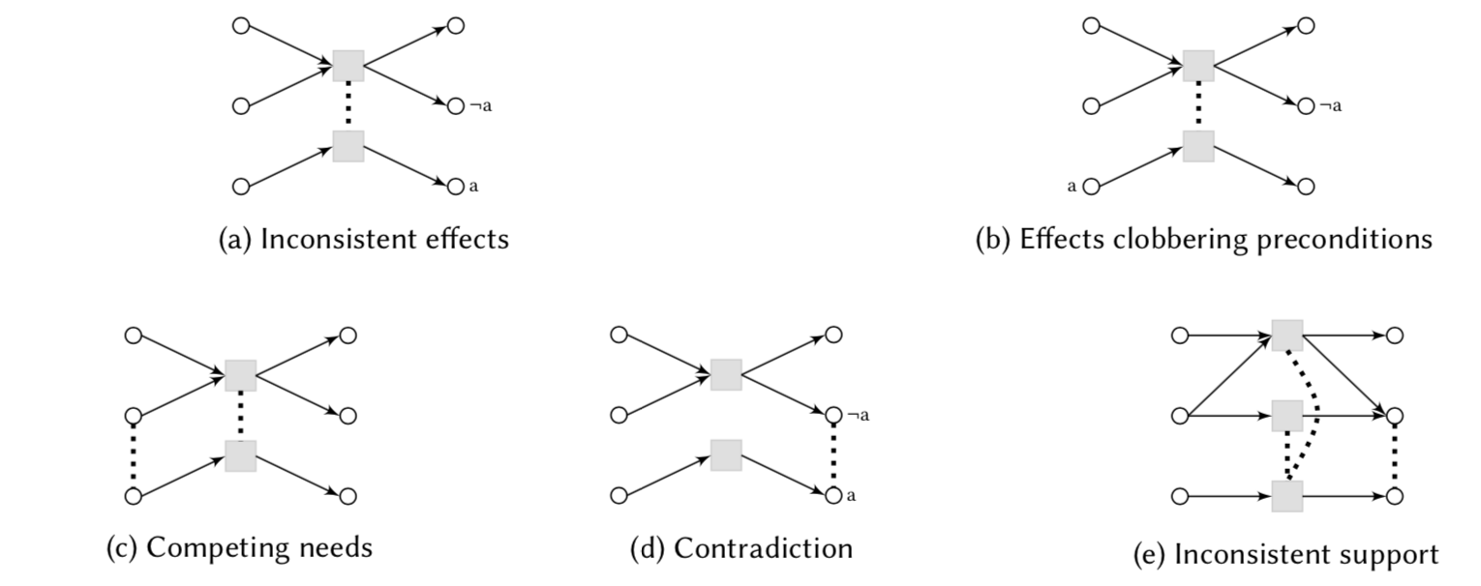
Graph-based Planners

Slide 34
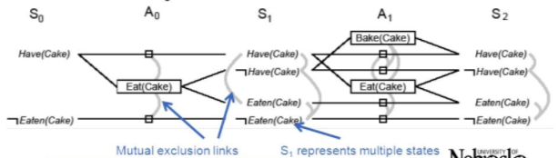
Graphplan
(:action eat
:parameters (?cake)
:precondition (and (have ?cake))
:effect (and (eaten ?cake) not (have ?cake)))
(:action bake
:parameters (?cake)
:precondition (not (have ?cake))
:effect (and (have ?cake))))

Slide 35
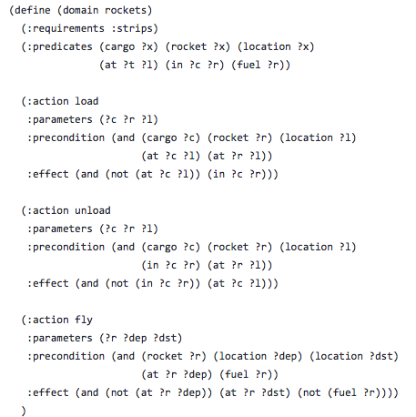
Graphplan

Slide 36
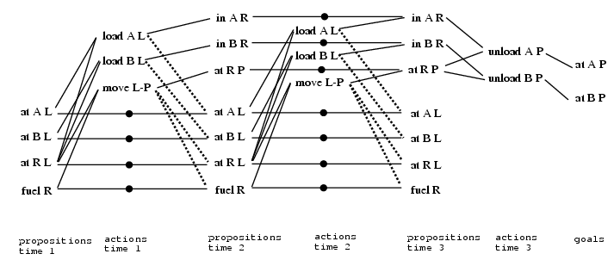
Graphplan
One rocket R, two pieces of cargo A & B, a start location L and one destination P. For simplicity the “rocket” param. does not appear. The delete effects are represented by dashed lines, nop with dots and add effects with solid lines

Slide 37
State reachability: planning graph
Preconditions of a given action
Initial proposition layer = set of atoms in the initial state
Action layer = a set of actions applicable to previous proposition layer
p01 p02 ... p0l
a11 a12 ... a1i
p11 p12 ... p1i
Proposition layer = set of all the positive effects of actions in the previous action layer
a21 a22 ... a2j
p21 p22 ... p1j
. . .
What actions produces a given proposition (atom)
this structure fits into memory
every proposition knows its origin in the previous action layer
every action knows its precondition in the previous proposition layer

Slide 38
Graph-based Planners
A big number of descendent
SGP: contingent planner
TGP: includes temporal reasoning
IPP: allows resource reasoning
TPSYS: combines GP & TGP
SAPA: uses a set of heuristics based on distances to control the search
STAN: extracts admissible heuristics from a domain analysis tool called TIM
LPG: combines GP & SAT
…
Output

Slide 39
Planning techniques
Total Order Planners (TO)
Partial Order Planners (POP)
Hierarchical Temporal Planners (HTN)
Graph-based Planners (GP)
SAT-based planners
Heuristic Search Planners

Slide 40
SAT
It is based on the evaluation of the satisfiability of a logical sequence (SAT-based)
The philosophy of the algorithm is:
The planning problem is translated to CNF
Guess the length which aims to achieve the goal
A set of propositional clauses is generated to check the satisfiability
Apply algorithms studied in the logic chapter (DPLL, WALSAT, LMTS-style)

Slide 41
SAT
Examples:
SATPLAN: builds a GP, translates manually the graph constraints to {} axioms, then uses a SAT and if no solution is found → length increases
BLACKBOX: combines GP and SATPLAN
LPSAT: uses a backtrack random algorithm with a new formalism (LCNF) that combines propositional logic with a set of metric constraints
LPG
…

Slide 42
Planning techniques
Total Order Planners (TO)
Partial Order Planners (POP)
Hierarchical Temporal Planners (HTN)
Graph-based Planners (GP)
SAT-based planners
Heuristic Search Planners

Slide 43
Heuristic Search Planners (HSP)
Heuristic Search Planners (HSP) transform planning problems into heuristic search problems extracting heuristics functions, rather than enter them by hand
Problems
Number of explored nodes is very high
Heuristic calculation in each step
Heuristic : not consider the delete effects
HSP: calculates the cost of a set of atoms assuming that the subgoals are independent
FF: based on a relaxed GP

Slide 44
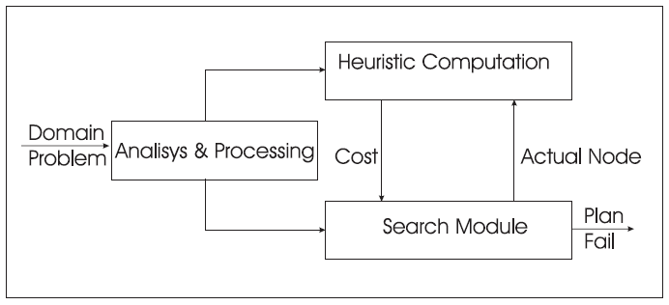
HSP
General architecture
Notes:
Now I will briefly describe the the summary of the dissertation,
This talk provides some ideas about the actual state of the art about the relationship between several Artificial Intelligence techniques and how they have been used to build a new type of Web systems
I will focus specially in those applications that have been specialized in the information management from electronic repositories like the Web
I briefly describe some of those Web content/based applications from several important research laboratories
finally some conclusions and the future trends of those AI techniques and their applications in Web environments will be described.

Slide 45
HSP
The Analysis & Processing module. Analyze and process all the information from the domain and the initial state (table or vector with all the possible operators instantiated)
The Heuristic Computation module. Computes the cost of applying a determined node in the search process
The Search module. Depends on the heuristic computation, uses a search algorithm or a combination of them
Notes:
Now I will briefly describe the the summary of the dissertation,
This talk provides some ideas about the actual state of the art about the relationship between several Artificial Intelligence techniques and how they have been used to build a new type of Web systems
I will focus specially in those applications that have been specialized in the information management from electronic repositories like the Web
I briefly describe some of those Web content/based applications from several important research laboratories
finally some conclusions and the future trends of those AI techniques and their applications in Web environments will be described.

Slide 46

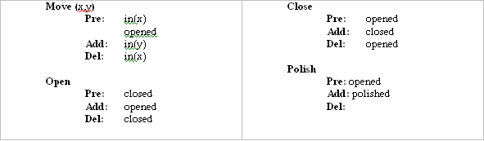
FF: h
Notes:
Now I will briefly describe the the summary of the dissertation,
This talk provides some ideas about the actual state of the art about the relationship between several Artificial Intelligence techniques and how they have been used to build a new type of Web systems
I will focus specially in those applications that have been specialized in the information management from electronic repositories like the Web
I briefly describe some of those Web content/based applications from several important research laboratories
finally some conclusions and the future trends of those AI techniques and their applications in Web environments will be described.

Slide 47
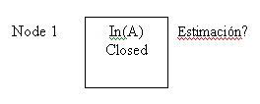
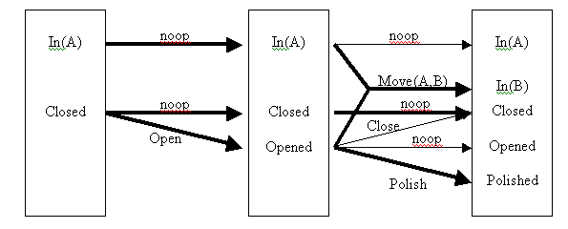
FF: h
3
Notes:
Now I will briefly describe the the summary of the dissertation,
This talk provides some ideas about the actual state of the art about the relationship between several Artificial Intelligence techniques and how they have been used to build a new type of Web systems
I will focus specially in those applications that have been specialized in the information management from electronic repositories like the Web
I briefly describe some of those Web content/based applications from several important research laboratories
finally some conclusions and the future trends of those AI techniques and their applications in Web environments will be described.

Slide 48
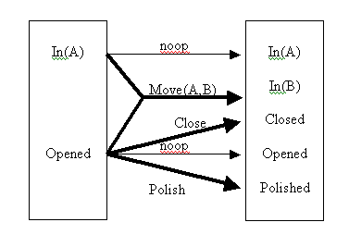
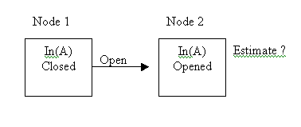
FF: h
3
3
3 3
Notes:
Now I will briefly describe the the summary of the dissertation,
This talk provides some ideas about the actual state of the art about the relationship between several Artificial Intelligence techniques and how they have been used to build a new type of Web systems
I will focus specially in those applications that have been specialized in the information management from electronic repositories like the Web
I briefly describe some of those Web content/based applications from several important research laboratories
finally some conclusions and the future trends of those AI techniques and their applications in Web environments will be described.

Slide 49
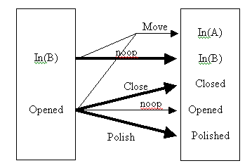
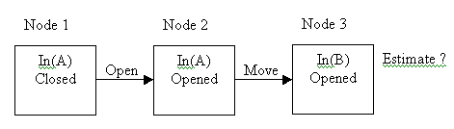
FF: h
3
3
2
3 3
Polish
Notes:
Now I will briefly describe the the summary of the dissertation,
This talk provides some ideas about the actual state of the art about the relationship between several Artificial Intelligence techniques and how they have been used to build a new type of Web systems
I will focus specially in those applications that have been specialized in the information management from electronic repositories like the Web
I briefly describe some of those Web content/based applications from several important research laboratories
finally some conclusions and the future trends of those AI techniques and their applications in Web environments will be described.

Slide 50
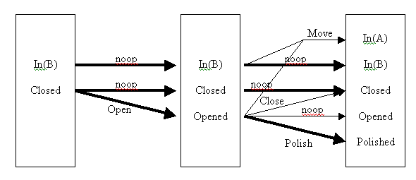
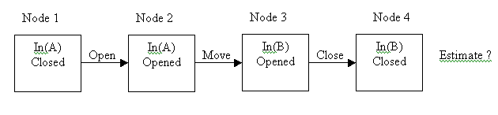
FF: h
3
3
2
2
Polish
Polish
3 3 2
It does not improve the previous result, try Polish
Notes:
Now I will briefly describe the the summary of the dissertation,
This talk provides some ideas about the actual state of the art about the relationship between several Artificial Intelligence techniques and how they have been used to build a new type of Web systems
I will focus specially in those applications that have been specialized in the information management from electronic repositories like the Web
I briefly describe some of those Web content/based applications from several important research laboratories
finally some conclusions and the future trends of those AI techniques and their applications in Web environments will be described.

Slide 51
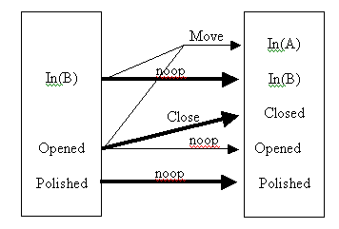
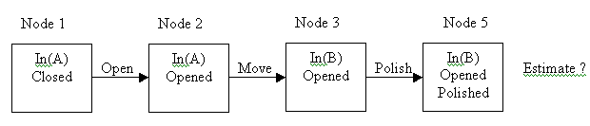
FF: h
3
3
1
2
2
3 3 2
3 3 2
Notes:
Now I will briefly describe the the summary of the dissertation,
This talk provides some ideas about the actual state of the art about the relationship between several Artificial Intelligence techniques and how they have been used to build a new type of Web systems
I will focus specially in those applications that have been specialized in the information management from electronic repositories like the Web
I briefly describe some of those Web content/based applications from several important research laboratories
finally some conclusions and the future trends of those AI techniques and their applications in Web environments will be described.

Slide 52

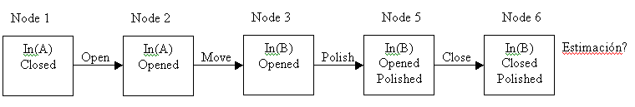
FF: h
3
0
3
1
3 3 2
2
3 3 2
3 3 2 1
Notes:
Now I will briefly describe the the summary of the dissertation,
This talk provides some ideas about the actual state of the art about the relationship between several Artificial Intelligence techniques and how they have been used to build a new type of Web systems
I will focus specially in those applications that have been specialized in the information management from electronic repositories like the Web
I briefly describe some of those Web content/based applications from several important research laboratories
finally some conclusions and the future trends of those AI techniques and their applications in Web environments will be described.

Slide 53
Outline
Introduction
Classification of algorithms
Planning techniques
Conclusions

Slide 54
Conclusions
Planning is an interesting area because it combines logic and search
We have studied the main planners and the search algorithms that use
There are actually no better strategies than others
Competition between approaches and the intersection and combination of techniques has resulted in gains in efficiencies in syst. planning

