Slide 1
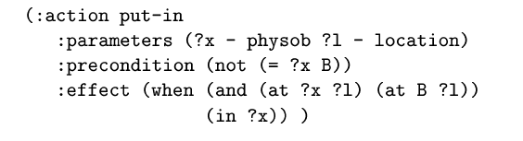
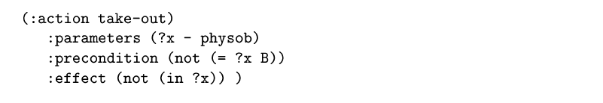
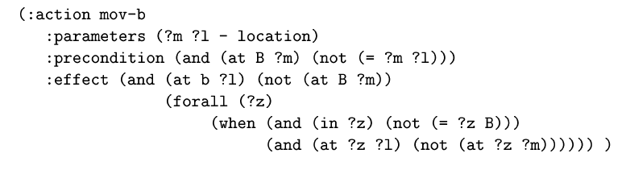
PDDL
Domain definition. Operators.
(in ?x B)
Mov-B
B
(in ?z B)
(in ?x B)

Slide 2
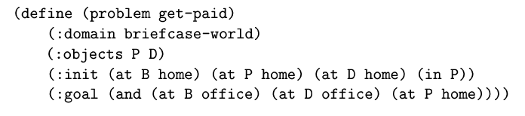
PDDL
Problem definition
- physob home office - location )
(in P B))

Slide 3
PDDL: example
Model in PDDL the blocks world domain
There are 4 operators:
Stack
Unstack
Pick-up
Put-down

Slide 4
PDDL: example
UNSTACK(x; y)
preconditions: encima(x; y),libre(x),brazo-libre
add: sujeto(x),libre(y)
del: encima(x; y),brazo-libre,libre(x)
STACK(x; y)
preconditions: sujeto(x),libre(y)
add: encima(x; y),libre(x),brazo-libre
del: sujeto(x),libre(y)
PUT-DOWN(x)
preconditions: sujeto(x)
add: en-mesa(x),libre(x),brazo-libre
del: sujeto(x)
PICK-UP(x)
preconditions: en-mesa(x),libre(x),brazo-libre
add: sujeto(x)
del: en-mesa(x),brazo-libre,libre(x)

Slide 5
Some Planners available
Planners (available in Blackboard)
FF
http://members.deri.at/~joergh/ff.html
Blackbox: http://www.cs.rochester.edu/u/kautz/satplan/blackbox/blackbox-download.html
LPG
http://zeus.ing.unibs.it/lpg/
SGPlan http://wah.cse.cuhk.edu.hk/wah/programs/SGPlan/sgplan4.html

Slide 6
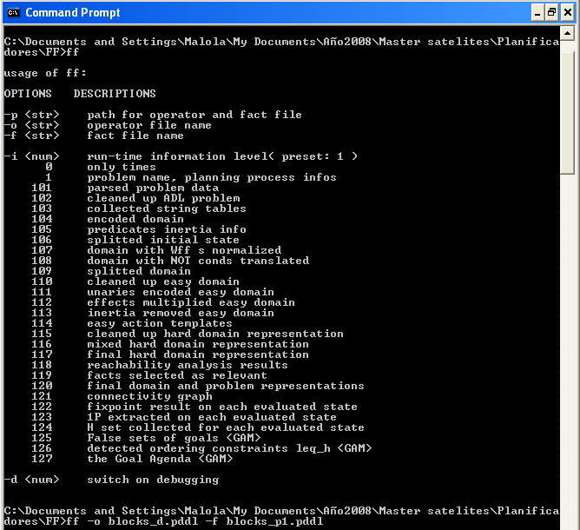
Execute FF (Windows)

Slide 7
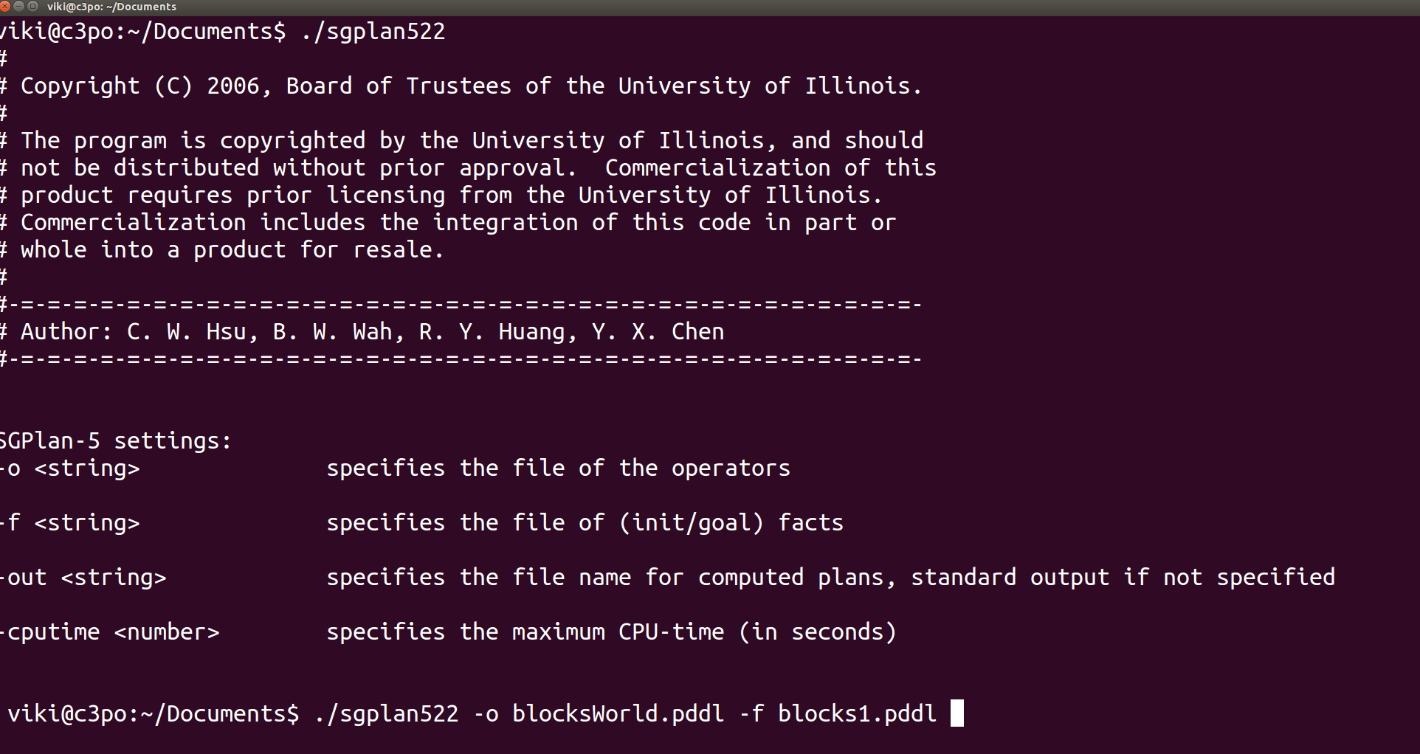
Execute SGPlan (Linux)

