Slide 1
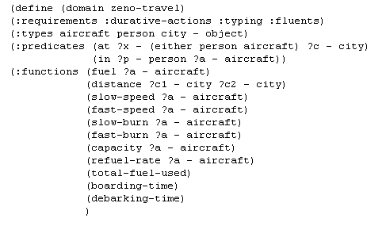
PDDL2.X
Domain definition. Functions (numbers)

Slide 2
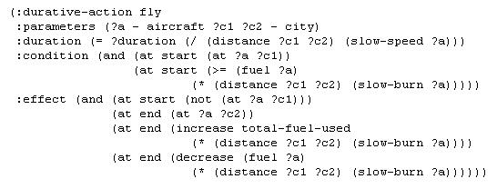
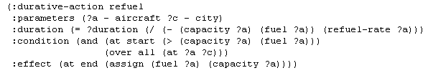
PDDL2.X
Domain definition. Operators with time

Slide 3
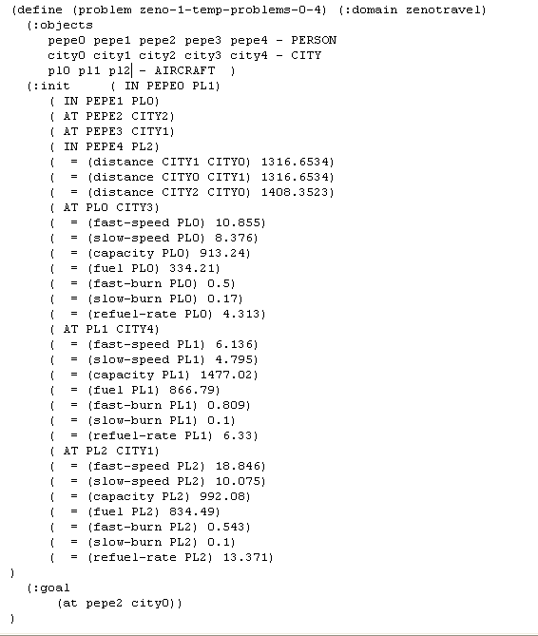
PDDL2.X
Problem definition

