Slide 1


Planning Representation

Slide 2
Overview
Introduction
Planning
STRIPS
PDDL
Conclusions

Slide 3
Introduction
Planning: selects a sequence of activities that meet one or more goals and a set of constraints imposed by the domain
Scheduling: Resource allocation and start times of activities, obeying the temporal restrictions on the activities and the capacity limitations of shared resources. It is an optimization task where limited resources are available throughout the time between activities that can be run in serial or in parallel according to different objectives

Slide 4
Overview
Introduction
Planning
STRIPS
PDDL
Conclusions

Slide 5
Planning
Representations based on predicates and objects
Each domain has a specific first-order language containing predicates and functions to describe the domain
In planning, we define a set of operators that are a parametrized representation of the available transitions domain
In scheduling, no specific languages

Slide 6
Planning
Given a planning domain D, a classical planning problem
Inputs
Initial State
Goal(s)
Domain
State space
All states reachable by applying a sequence of actions to the initial state
Actions are operators with its parameters instantiated by constants of the initial state
Output
A sequence of actions that transform the initial state to a state that satisfies the goals

Slide 7
State Representation
Planners decompose the world in terms of logical conditions and represent a state as a sequence of connected positive literals
Propositions: Fast ∧ AirbusA380
FOL: At(Plane1,Madrid) ∧ At(Plane2,Paris)
Not allowed: At(Padre(Ana),Madrid)
It is assumed that all conditions that are not mentioned in a state are FALSE (closed world assumption)

Slide 8
Initial State
It can be any logical description:
It is efficient to determine the true value of each atomic formula
Implies that it is possible:
Determine in the initial state, the true value of the FOL
Represent the initial state as a set of propositions
∀ x, x = c₁ ∨ x = c₂ ∨ ... ∨ x = c_{n}

Slide 9
Goals
To represent a goal
A set of literals (ground literals)
A goal is satisfied if all literals are satisfied
Other possibilities:
A more complex condition in a state with a formula specified in FOL
The difficulty lies in creating efficient methods to find plans that satisfy these more complex goals

Slide 10
Operators
Operators specify the possible transactions in a domain
For each problem, we must use both the initial state and the specification of operators to determine possible transactions for the particular problem
To be problem independent, operators use parameters

Slide 11
Operators
Instantiated operator = action
Specified in terms of::
preconditions: conditions that must be met before execution
All the variables in precond. should appear in the parameter list of the action
Effects: conditions that we achieve when the action is executed
What is not mentioned, remains unchanged
Example:
Fly(plane(p,desde,hasta))
precond: En(p,desde) ∧ plane(p) ∧ aeropuerto(desde) ∧
aeropuerto(hasta)
effect: En(p,hasta) ∧ ¬En(p,desde)

Slide 12
Operators
We say that an action is applicable in any state that satisfies its preconditions, otherwise the action has no effect
The application consists of replacing the variables
In general, given a FOL (with free variable) it is possible to determine the set of instances of these variables (constant) that satisfy the formula in the initial state
En(IB101,Madrid) ∧ plane(IB101) ∧ plane(KLM101) ∧
aeropuerto(Madrid) ∧ aeropuerto(Paris) ∧ En(KLM101,Paris)

Slide 13
Overview
Introduction
Planning
STRIPS
PDDL
Conclusions

Slide 14
STRIPS
STRIPS is in the simplest and oldest representation of operators in AI
The initial state is represented by a DB of positive facts
STRIPS can be seen as a simple way to specify updates to the DB
Little expressiveness for real domains so that other languages have emerged: ADL, Prodigy language (PDL), UCPOP language , SIPE-2 language ,…, PDDL (standar)
Notes:
Citation for Strips

Slide 15
STRIPS
(def-strips-operator (pickup ?x) (pre (handempty) (clear ?x) (ontable ?x)) (add (holding ?x)) (del (handempty) (clear ?x) (ontable ?x)))

Slide 16
STRIPS
Operator name & parameters
(def-strips-operator (pickup ?x)
(pre (handempty) (clear ?x) (ontable ?x)) (add (holding ?x)) (del (handempty) (clear ?x) (ontable ?x)))

Slide 17
STRIPS
(def-strips-operator (pickup ?x) (pre (handempty) (clear ?x) (ontable ?x))
(add (holding ?x)) (del (handempty) (clear ?x) (ontable ?x)))
List of predicates that must be true in the current state for aplying the action

Slide 18
STRIPS
(def-strips-operator (pickup ?x) (pre (handempty) (clear ?x) (ontable ?x)) (add (holding ?x))
(del (handempty) (clear ?x) (ontable ?x)))
List of predicates that must be true in the next state

Slide 19
STRIPS
(def-strips-operator (pickup ?x) (pre (handempty) (clear ?x) (ontable ?x)) (add (holding ?x)) (del (handempty) (clear ?x) (ontable ?x)))
List of predicates that must be false in the next state

Slide 20
STRIPS
Given the initial state
All instantiations of the ?x parameter that satisfy the precondition (and (handempty) (clear ?x) (ontable ?x)) produced a different action (transition) that can be applied to the initial state
Actions whose preconditions are not met are illegal transitions

Slide 21
STRIPS
Actions are deterministics:
Given a particular instantiation of the parameters, the action specifies a finite collection of ground atomic formula that must be true and another collection of formulas to be false in the next state
¡Nothing else changes more! (This often has algorithmic consequences)

Slide 22
STRIPS
handempty clear(A) ontable(A) holding(A) clear(B) ontable(B) clear(C) ontable(C)
handempty clear(A) ontable(A) clear(B) ontable(B) clear(C) ontable(C)
pickup(A)
pickup(B)
handempty clear(A) ontable(A) clear(B) ontable(B) holding(B) clear(C) ontable(C)
A
B
C
Initial State

Slide 23
STRIPS
From the properties of the initial state and the set of operators is possible to determine:
The finite set of actions that can be applied to the initial state
In each successor state generated by these actions, you can evaluate all logical formulas, and determine the set of available actions

Slide 24
Overview
Introduction
Planning
STRIPS
PDDL
Conclusions

Slide 25
PDDL
PDDL means Planning Domain Definition Language
Emerges as an attempt to unify previous formalisms and to compare the efficiency of planners
AIPS-98 Planning Competition Committee
Intended to represent the physics of a domain: what predicates there are, what actions are possible, the structure of such actions and their effects
New versions have currently emerged, actually in the 3.1

Slide 26
PDDL2.1 Variants (Wikipedia)
PDDL+: provides a more flexible model of continuous changes through the use of autonomous processes and events
MAPL (Multi-Agent Planning Language, pronounced "maple”)
Non-propositional state-variables (which may be n-ary: true, false, unknown, or anything else)
Temporal model given with modal operators (before, after, etc.).
Actions whose duration will be determined in runtime and explicit plan synchronization which is realized through speech act based communication among agents

Slide 27
PDDL2.1 Variants (Wikipedia)
OPT (Ontology with Polymorphic Types):
An attempt to create a general-purpose notation for creating ontologies, defined as formalized conceptual frameworks for planning domains
PPDDL (Probabilistic PDDL):
Probabilistic effects (discrete, general probability distributions over possible effects of an action)
Reward fluents (for incrementing or decrementing the total reward of a plan in the effects of the actions)
Goal rewards (for rewarding a state-trajectory, which incorporates at least one goal-state)
Goal-achieved fluents (which were true, if the state-trajectory incorporated at least one goal-state)

Slide 28
Variants (Wikipedia)
RDDL (Relational Dynamic influence Diagram Language): the 7th IPC in 2011
Based on PPDDL1.0 and PDDL3.0, is a completely different language both syntactically and semantically
Introduces partial observability (allows efficient description of MDPs and POMDPs by representing everything with variables
NDDL (New Domain Definition Language) is NASA's planning language based on HSTS (NRMA)
Use variable representation (timelines/activities) rather than a propositional/first-order logic, and
No concept of states or actions, only of intervals (activities) and constraints between activities

Slide 29
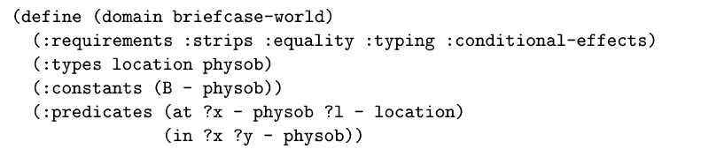
PDDL
Domain definition

Slide 30
PDDL versions
We will study:
PDDL
PDDL 2.X

Slide 31
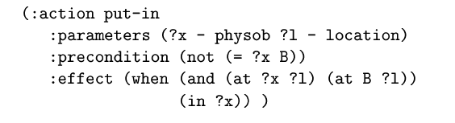
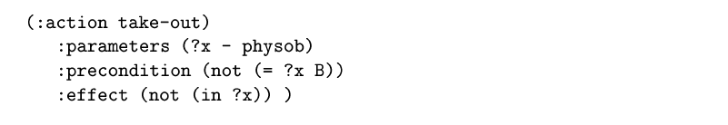
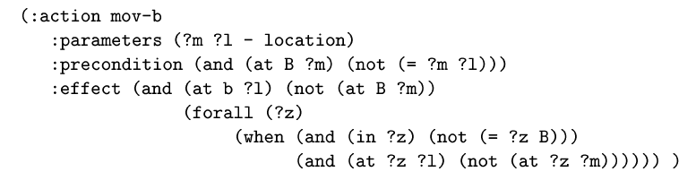
PDDL
Domain definition. Operators.
(in ?x B)
Mov-B
B
(in ?z B)
(in ?x B)

Slide 32
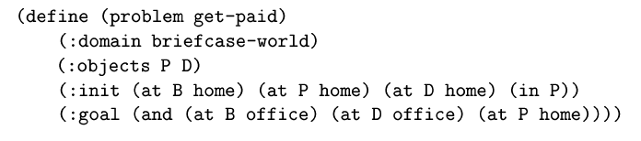
PDDL
Problem definition
- physob home office - location )
(in P B))

Slide 33
PDDL: example
Model in PDDL the blocks world domain
There are 4 operators:
Stack
Unstack
Pick-up
Put-down

Slide 34
PDDL: example
UNSTACK(x; y)
preconditions: encima(x; y),libre(x),brazo-libre
add: sujeto(x),libre(y)
del: encima(x; y),brazo-libre,libre(x)
STACK(x; y)
preconditions: sujeto(x),libre(y)
add: encima(x; y),libre(x),brazo-libre
del: sujeto(x),libre(y)
PUT-DOWN(x)
preconditions: sujeto(x)
add: en-mesa(x),libre(x),brazo-libre
del: sujeto(x)
PICK-UP(x)
preconditions: en-mesa(x),libre(x),brazo-libre
add: sujeto(x)
del: en-mesa(x),brazo-libre,libre(x)

Slide 35
Some Planners availables
Planners
HPP/PIPSS: developed by UAH students
FF
http://members.deri.at/~joergh/ff.html
Blackbox:
http://www.cs.rochester.edu/u/kautz/satplan/blackbox/blackbox-download.html
LPG
http://zeus.ing.unibs.it/lpg/
SGPlan (linux)
http://wah.cse.cuhk.edu.hk/wah/programs/SGPlan/sgplan4.html

Slide 36
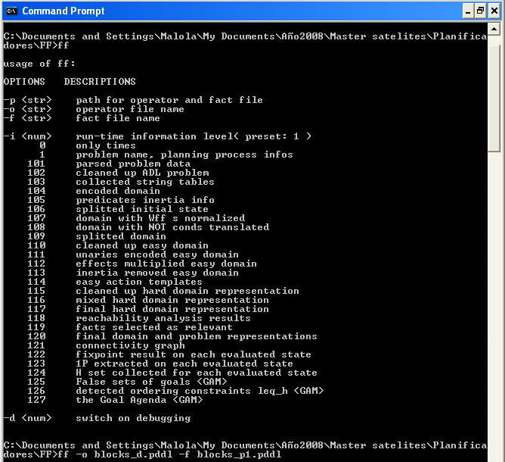
Execute FF

Slide 37
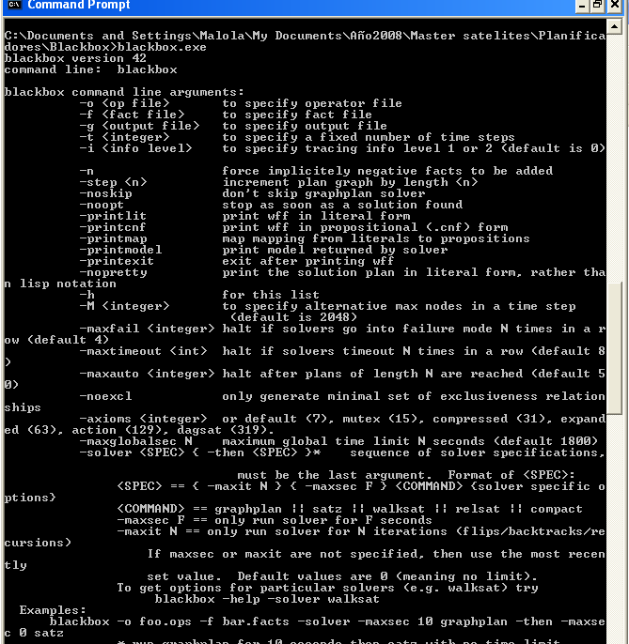
Execute BlackBox

Slide 38
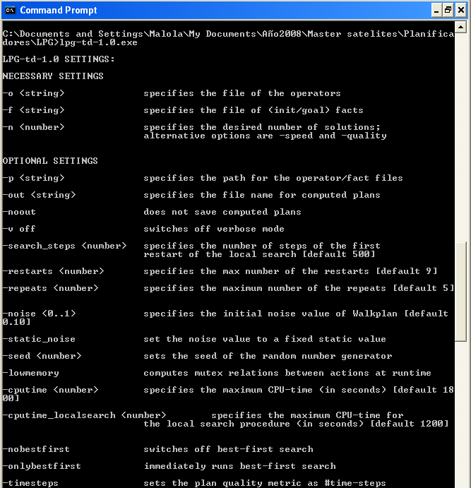
Execute LPG

Slide 39
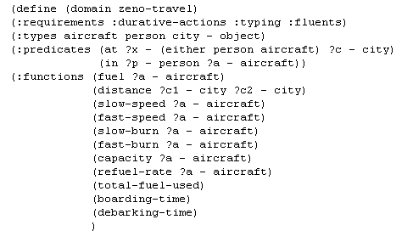
PDDL2.X
Domain definition. Functions (numbers)

Slide 40
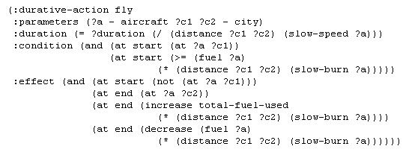
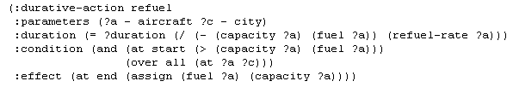
PDDL2.X
Domain definition. Operators with time

Slide 41
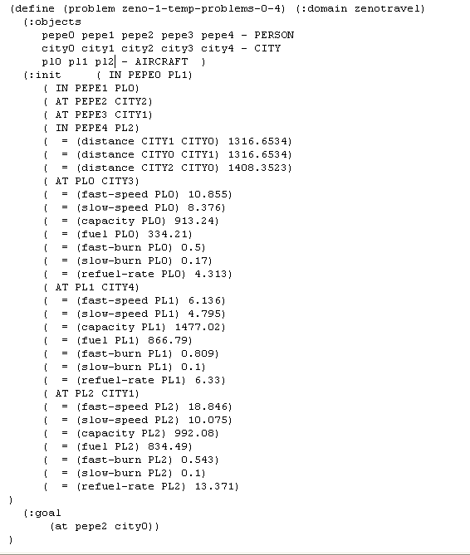
PDDL2.X
Problem definition

Slide 42
Overview
Introduction
Planning
STRIPS
PDDL
Conclusions

Slide 43
Conclusions
Represent knowledge → FOL
Languages: STRIPS, ADL… PDDL (standar)
Inputs & outputs of a planner
Domain
Planner
Problem
Validator
Sequential or Parallel Plan

