Slide 1

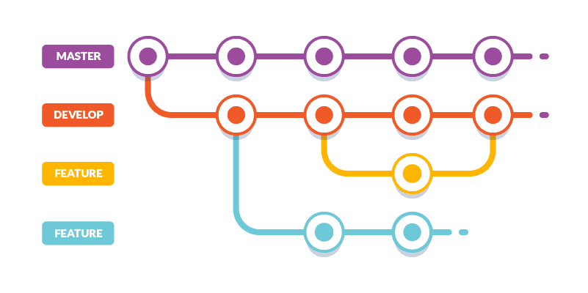
Git Flow and Best Practices
Introduction
Juan José Sánchez Sánchez
Oktober 2021

Slide 2
Index
What is Git?
What is Git Flow?
  The main branches
  Supporting branches
    Feature branches
    Bugfix branches
  Commit messages
Best practices
Q&A

Slide 3
Index
What is Git?
What is Git Flow?
  The main branches
  Supporting branches
    Feature branches
    Bugfix branches
  Commit messages
Best practices
Q&A

Slide 4
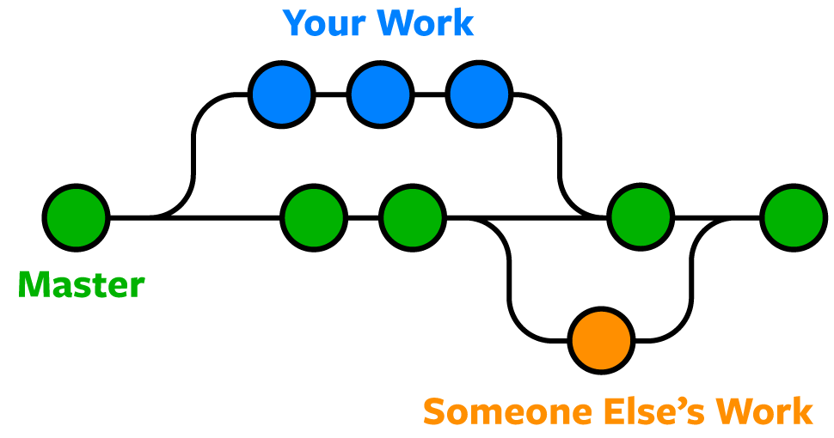
What is Git?
Git is a fast, scalable, distributed revision control system with an unusually rich command set that provides both high-level operations and full access to internals.
Git tracks the changes you make to files, so you have a record of what has been done, and you can revert to specific versions should you ever need to.
Git also makes collaboration easier, allowing changes by multiple people to all be merged into one source.
Git is the most commonly used version control system.

Slide 5
What is Git? - .gitignore
The .gitignore file is a simple text file that specifies intentionally untracked files and directories that Git should ignore when managing your project. These files could include build artifacts, system-generated files, logs, or any other files that shouldn't be committed to the repository.

Slide 6
Most common Git commands >> man git
git init - Create an empty Git repository or reinitalize one. git clone - Clones an repository into the working directory. git add - Add file contents to the index. git checkout - Switch branches or restore working tree files. git branch (-b | -d | -D) - List, create, or delete branches. git pull - Incorporates changes from a remote repository into the current branch. | git push - Update remote refs along with associated objects. git fetch - Fetch all the branches from the repository git status - Show the working tree status git merge - Join two or more development histories together. git commit -m “” - Create a new commit with the contents of the index. git log - Show commit logs.

Slide 7
Most common Git commands >> man git
git clean - Cleans the working tree. git revert - Revert some existing commits. git stash - Stash the changes in a dirty working directory away. git cherry-pick - Apply changes introduced by some existing commits. git diff - Show changes between commits. git rebase - Reapply commits on top of another base tip. | git reset - Reset current HEAD to the specified state. git <command> --help - Documentation of every command that’s searched for. git config - Get and set repository or global options.

Slide 8
Index
What is Git?
What is Git Flow?
  The main branches
  Supporting branches
    Feature branches
    Bugfix branches
  Commit messages
Best practices
Q&A

Slide 9
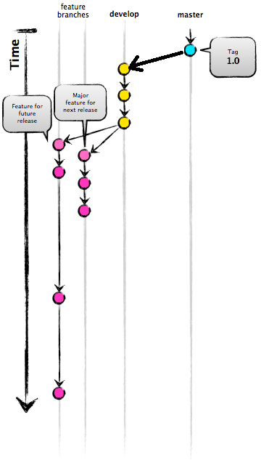
What is Git Flow?
Is a branching model for software development using Git.
Git flow is not a official standard from Git, it is more like an idea of how a successful branching model could look like. It provides some pre-defined rules that teams can consider to use or not.
Essentially it is a set of procedures that every team member has to follow in order to come to a managed software development process.

Slide 10
Index
What is Git?
What is Git Flow?
  The main branches
  Supporting branches
    Feature branches
    Bugfix branches
  Commit messages
Best practices
Q&A

Slide 11
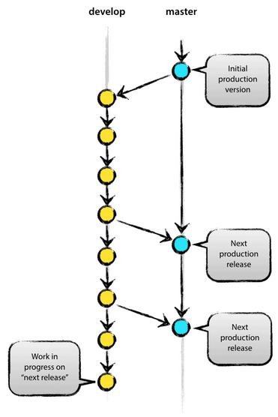
What is Git Flow?
The main branches: master & develop
origin/master is the main branch where the source code of HEAD always reflects a production-ready state.
origin/develop is the main branch where the source code of HEAD always reflects a state with the latest delivered development changes for the next release.
When the source code in the develop branch reaches a stable point and is ready to be released, all of the changes should be merged back into master somehow and then tagged with a release number.
Therefore, each time when changes are merged back into master, this is a new production release by definition.
Notes:
2º Some would call this the “integration branch”.
4º We tend to be very strict at this, so that theoretically, we could use a Git hook script to automatically build and roll-out our software to our production servers everytime there was a commit on master.

Slide 12
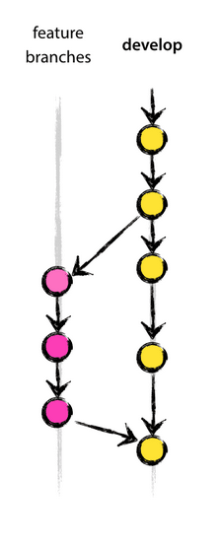
What is Git Flow?
Supporting branches: feature & bugfix
Specific user stories single tickets/tasks branches starting from dev branch
feature/branch_name are used to develop new features for the upcoming or a distant future release and can be used also for branches that improve/refactor existing code.
bugfix/branch_name are the ones used for correcting bugs.
feature/feature-name/sub_branch_name, could be a possibility that one feature ticket it's to big for one feature/feature-name branch, then it could be splited into multiple ones and later on be merged all together in the parent feature/feature-name and later on the parent be merged into dev/ and so on.
Notes:
Next to the main branches master and develop, our development model uses a variety of supporting branches to aid parallel development between team members, ease tracking of features, prepare for production releases and to assist in quickly fixing live production problems.
Each of these branches have a specific purpose and are bound to strict rules as to which branches may be their originating branch and which branches must be their merge targets.

Slide 13
What is Git Flow?
Supporting branches: feature & bugfix names
We should always keep the same flow and naming convention:
  feature/[ticket-number]-[short-ticket-description]
  bugfix/[ticket-number]-[short-ticket-description]
Feature/Bugfix branches should only contain FILE CHANGES regarding the ticket description!
Branches and PR should not contain changes on files that are not related to the ticket as it makes harder to keep track of the changes when reviewing the PR.
(Even if there are bugfix corrections on the feature, for those cases create specific tickets and add the changes there when possible!!).

Slide 14
What is Git Flow?
Commit messages
Commits should have the following format:
  git commit -m “(prefix) #[ticket-number] - Commit message”
Example on Current branch, feature/1-add-cockpit-panel-ui
  git commit -m “(feat) #1 – Implement cockpit panel UI interface”
  git commit -m “(feat) #1 – Enhace UI interface design”
  git commit -m “(feat) #1 – Refactor and clean up, correct review comments …”
  …
Afterwards the feature/bugfix branch commits will be squashed and merged into develop on one single commit with a meaningful ticket description message (provided from the developer who did solve the ticket, please).

Slide 15
Index
What is Git?
What is Git Flow?
  Decentralized but centralized
  The main branches
  Supporting branches
    Feature branches
    Bugfix branches
  Commit messages
Best practices
Q&A

Slide 16
Best Practices
Always pull to get the last state of the dev branch and before assigning PR pull/merge the last state of dev.
  When branches have diverged you can always use rebase.
Make clean, single-purpose commits, writing meaningful commit messages and push often.
Prevent massives PR, when that's the case split the feature ticket into childs and create a PR for every child to the parent. When tested and reviewed then merge it up.
Prevent yourself of adding more things to the PR than requested on the ticket description. Create new feature or bugfix tickets if that is the case.

Slide 17
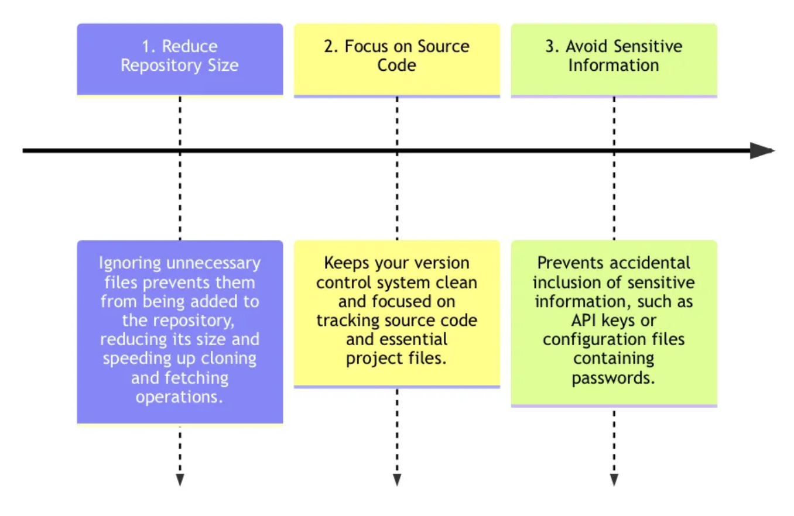
Best Practices - .gitignore
The .gitignore file is a simple text file that specifies intentionally untracked files and directories that Git should ignore when managing your project. These files could include build artifacts, system-generated files, logs, or any other files that shouldn't be committed to the repository.

Slide 18
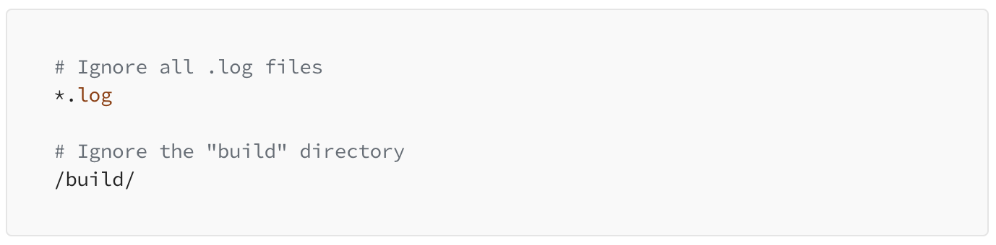
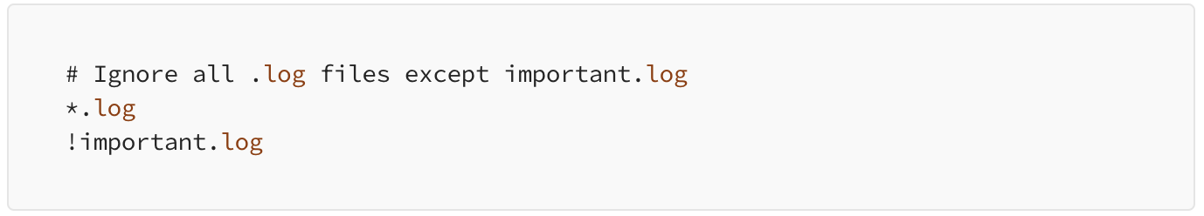
Best Practices - .gitignore
The syntax of a `.gitignore` file is simple. Each line specifies a pattern for files or directories to ignore. Wildcards, such as `*` and `**`, can be used for pattern matching.
You can negate patterns to include files that match a pattern but are ignored by other rules. For example:

Slide 19
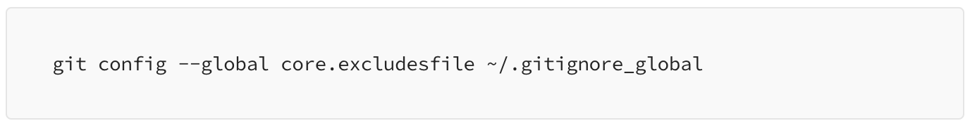
Best Practices - global .gitignore
You can create a global `.gitignore` file that applies to all your Git repositories. To set up a global `.gitignore` file, use the following commands:

Slide 20
Index
What is Git?
What is Git Flow?
  Decentralized but centralized
  The main branches
  Supporting branches
    Feature branches
    Bugfix branches
  Commit messages
Best practices
Q&A

Slide 21

Q&A

