Slide 1

FINE-GRAINED RUBRIC SCORING FOR JUNIOR DEVELOPER PROJECT ANSWERS
SMART INTERVIEW
Input: free-text interview answer → Output: six ordinal rubric scores + weak/strong aspects
NLP / LLM Course Project
Presenters: Daniel Shatzov, Shai Gigi

Slide 2

Review & Refined Project Definition
A structured NLP task for interview-answer quality assessment
Junior interviews increasingly ask candidates to explain portfolio or course projects. The challenge is not only whether the answer is “good”, but which dimensions are strong or weak.
INPUT
OUTPUT
Free-text answer to a junior developer project-experience question
Six ordinal rubric scores
+ weak/strong aspect labels
Example: “I reproduced the bug locally, checked the logs, and added validation tests.”
technical depth | personal contribution | clarity | problem solving | impact | role relevance
Modeling angle: compare simple baselines, classical ML, off-the-shelf LLM prompting, and a supervised DistilBERT encoder trained on synthetic data.
Junior Interview Answer Scoring | official_v1
02

Slide 3
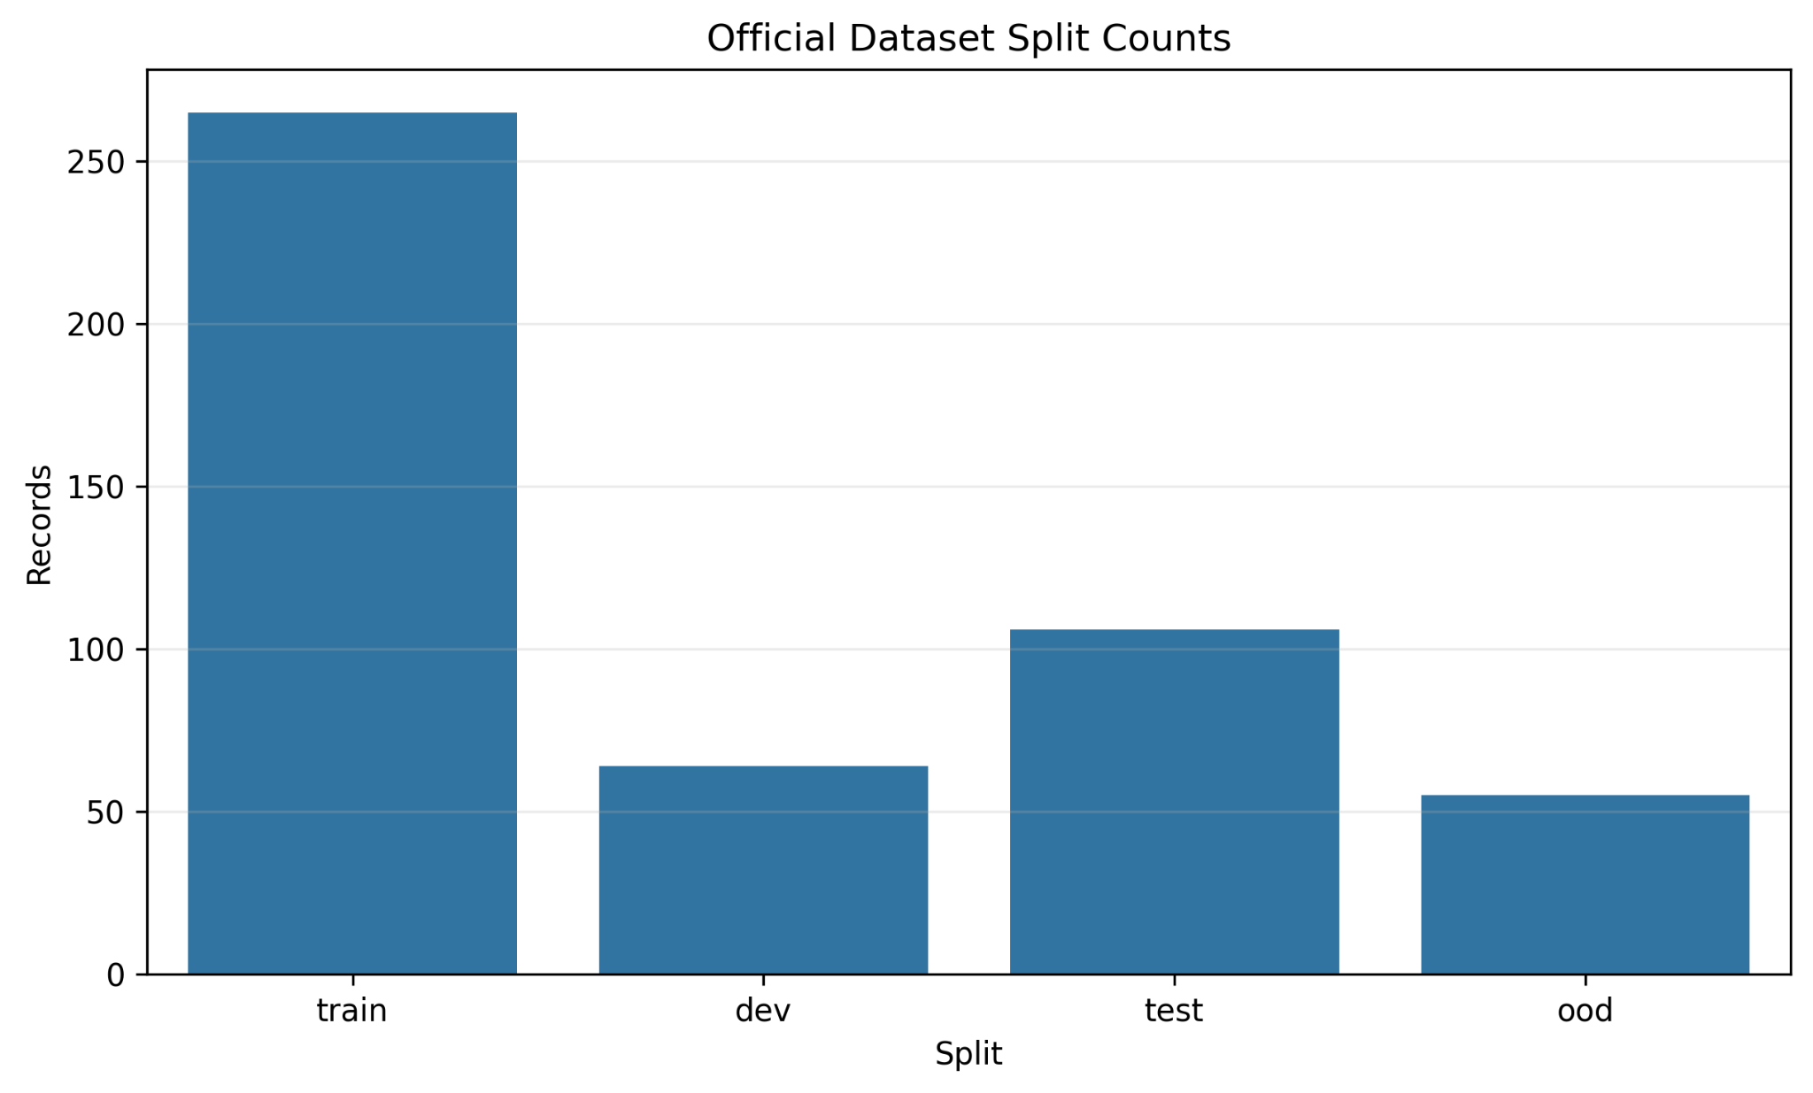
Data, Models, Metrics
official_v1: controlled synthetic data + project-team reviewed evaluation
DATA
• 558 accepted synthetic records
• 265 train examples
• 225 reviewed evaluation examples
• Dev/Test/OOD: 64 / 106 / 55
• 0 duplicate answers; 0 train-test leakage
MODELS
• Majority baseline
• TF-IDF logistic regression
• Zero-shot and few-shot LLM
• DistilBERT supervised encoder
METRICS
Exact accuracy • Low/Mid/High F1 • MAE • Weak F1 • OOD drop • Error analysis
Final evaluation uses project-team reviewed dev/test/OOD labels, not external expert annotations.
Junior Interview Answer Scoring | official_v1
03

Slide 4
Project Achievements and Novelty
The contribution is the task + data methodology + evaluation design
PROJECT ACHIEVEMENTS
• Defined a six-aspect ordinal scoring task for junior project-answer quality
• Built a controlled synthetic dataset with label-after-generation scoring
• Created project-team reviewed dev/test/OOD evaluation splits
• Compared majority, TF-IDF, zero-shot LLM, few-shot LLM, and a supervised encoder
• Added reproducible error analysis and final visualizations
✦
NOVELTY
Not a new neural architecture — a more precise NLP framing of interview answer quality, with controlled synthetic labels, validation, OOD evaluation, and error insight.
Junior Interview Answer Scoring | official_v1
04

Slide 5
Review Methodology
Label-after-generation: score what the answer actually says
CONTROLLED PROFILE → ANSWER → RUBRIC LABELER → VALIDATOR → REVIEWED SPLITS → MODELS → ERROR ANALYSIS
1 Profile
sampling
2 Generate
answer
3 Rubric
labeler
4 Independent
validator
5 Reviewed
dev/test/OOD
6 Model
comparison
7 Error
analysis
Quality control: rejected/profile-mismatch routing, evidence checks, score-delta checks, derived weak/strong validation, duplicate checks, and grouped leakage-safe splits.
Junior Interview Answer Scoring | official_v1
05

Slide 6
Example
A free-text interview answer becomes structured rubric feedback
CANDIDATE ANSWER
MODEL OUTPUT
“I worked on a small backend API for a course project. Some requests failed because payload validation was inconsistent, so I reproduced the bug locally, checked the logs, and added validation tests. After the fix, the demo requests passed reliably.”
4
technical_depth
4
personal_contribution
4
clarity
4
problem_solving
3
impact
5
role_relevance
weak_aspects: [ ]
strong_aspects: technical_depth, personal_contribution, clarity, problem_solving, role_relevance
Question: describe a project where you had to debug a difficult issue.
Scores are ordinal labels: exact adjacent boundaries can be subjective.
Junior Interview Answer Scoring | official_v1
06

Slide 7

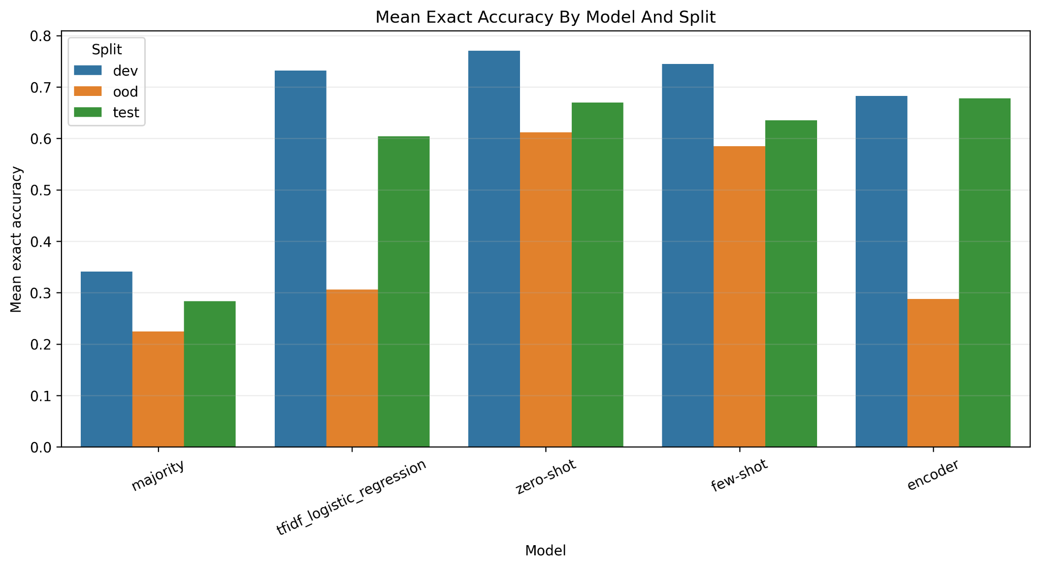
Results
Model comparison on reviewed dev/test/OOD splits
WHAT THE CHART SHOWS
0.6777
Encoder reviewed test exact accuracy
0.6121
Zero-shot LLM OOD exact accuracy
0.2879
Encoder OOD exact accuracy
Main interpretation: the encoder learns the regular test distribution, but zero-shot LLM is more robust under OOD shift.
Junior Interview Answer Scoring | official_v1
07

Slide 8
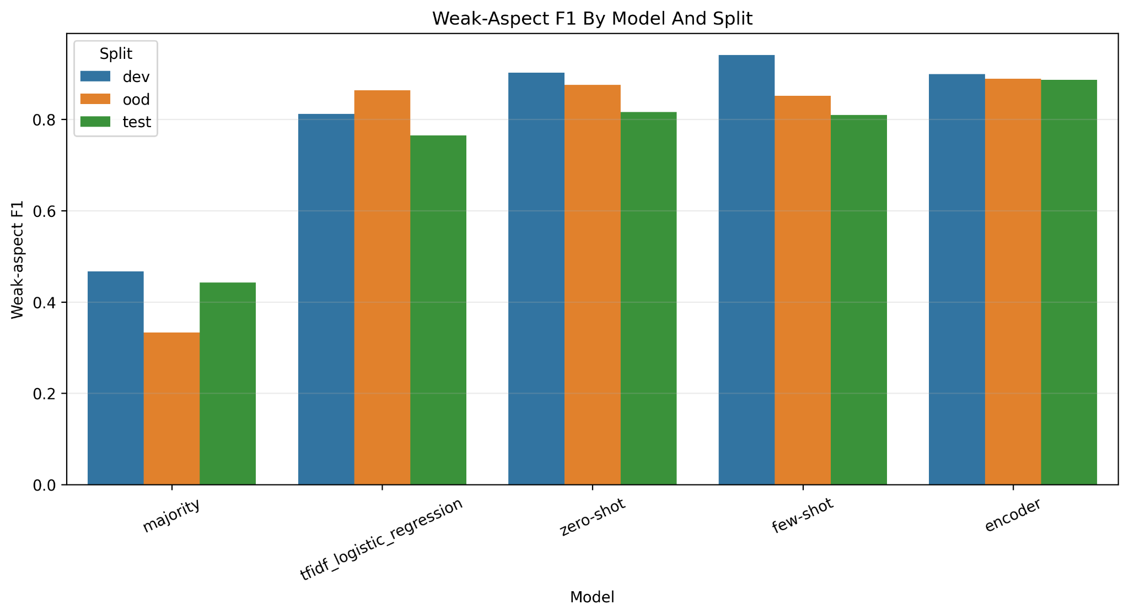
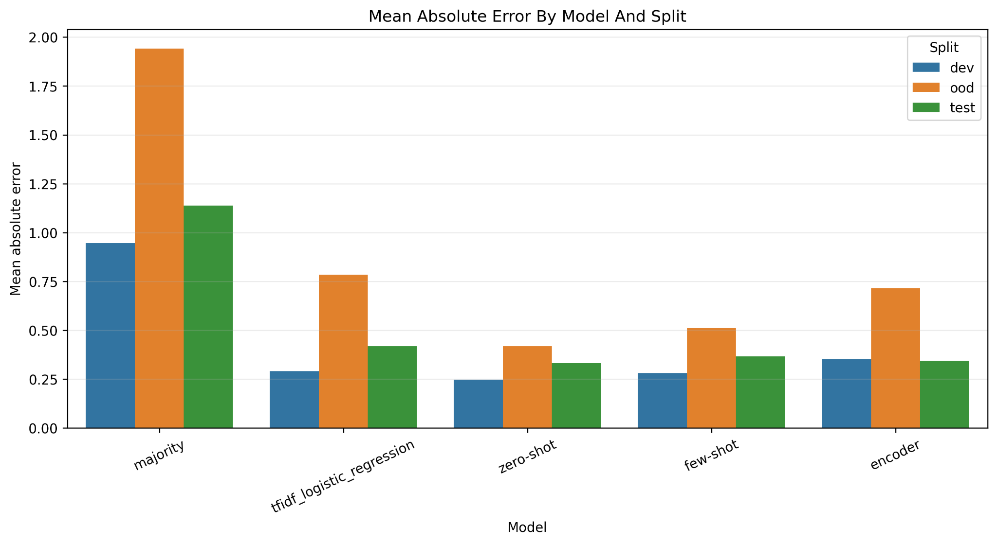
Beyond Exact Accuracy
Ordinal distance and weak-aspect detection tell a richer story
Weak-aspect F1 stays high for the encoder across dev/test/OOD (~0.89). MAE shows that many mistakes are near-boundary ordinal errors rather than severe jumps.
MAE: lower is better. Weak aspect = score <= 2.
Junior Interview Answer Scoring | official_v1
08

Slide 9
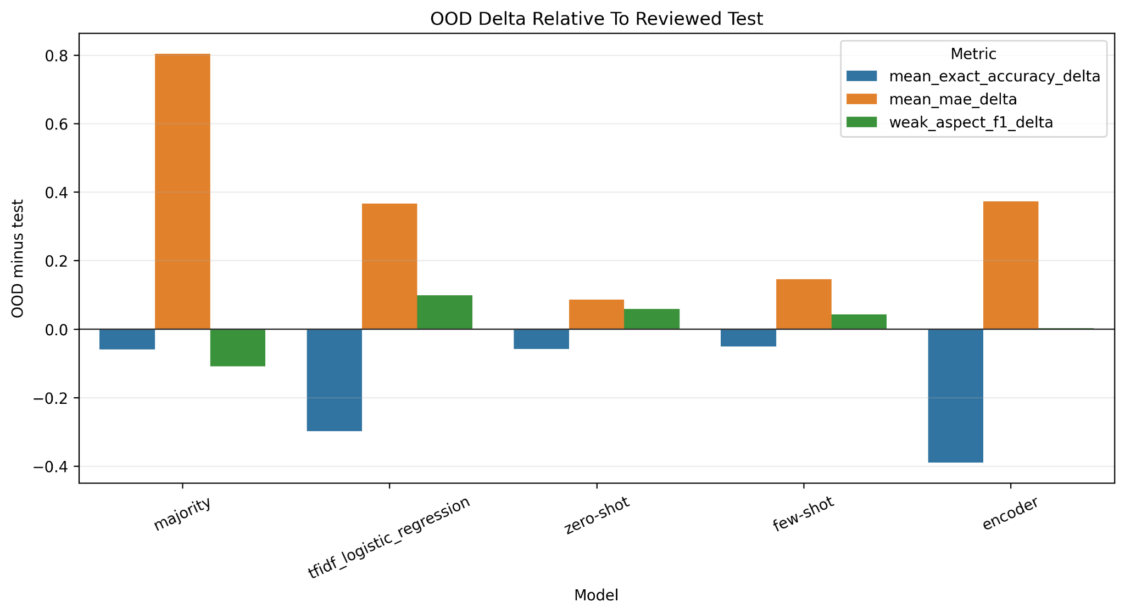
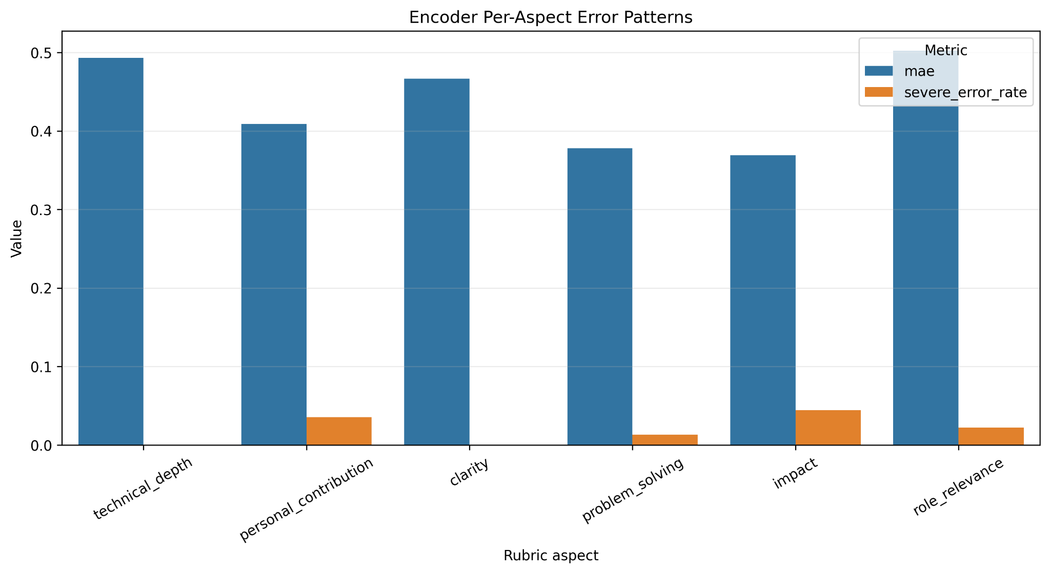
Error Analysis
OOD drop and aspect-level failures explain where the encoder breaks
• Largest OOD exact-accuracy delta: encoder (-0.3898)
• Hard aspects by MAE: role_relevance, technical_depth, clarity
• Bias patterns: role_relevance overpredicted; clarity and impact underpredicted
• Top errors are often one-score boundary mistakes across multiple aspects
Junior Interview Answer Scoring | official_v1
09

Slide 10
Conclusion
A complete NLP experiment: task, synthetic data, model comparison, OOD, and error analysis
WHAT WE ACHIEVED
WHAT WE LEARNED
• Defined a novel fine-grained interview-answer scoring task
• Generated and validated official_v1 synthetic data
• Compared five model families and documented results
• Added OOD and error analysis to explain model behavior
• Encoder is competitive on reviewed test data
• Zero-shot LLM generalizes better to OOD
• Weak-aspect detection is the most robust signal
• Exact 1-5 scoring remains subjective and difficult
Final takeaway
Controlled synthetic data can train useful baselines, but only model comparison + OOD evaluation + error analysis reveal whether the system truly generalizes.
Scope caveat: this is a course-level NLP evaluation project, not a production hiring decision system.
Junior Interview Answer Scoring | official_v1
10

