Slide 1
CAPSTONE PROJECT
LoopingCV
Evidence-based job search.
Applications you review and approve.
Public URL created | Account setup pending
Student name: ____________________
Register number / Department: ____________________
LoopingCV | Capstone prototype
01 / 12
Notes:
Introduce LoopingCV as an explainable job-search and application-review prototype. Replace the student and department placeholders. This is not a claim that the public service or every requested integration is already complete.

Slide 2
01 / PROBLEM AND OBJECTIVE
Reduce repetitive job-search work
Keep the user in control of facts, eligibility and every outgoing application.
PROBLEM
OBJECTIVE
Current difficulties
LoopingCV approach
Searching many job sites manually
Re-entering résumé information
Writing generic application messages
Tracking responses across different tools
Upload once and review evidence
Save India / remote search loops
Rank actual public listings
Approve exact messages and track status
Design principle: uncertainty becomes a review task.
LoopingCV | Capstone prototype
02 / 12
Notes:
The problem is repetitive discovery, repeated résumé uploads and scattered tracking. The objective is a private workspace that centralizes the workflow while requiring explicit human verification. It does not guarantee that a candidate qualifies or receives interviews.

Slide 3
02 / WORKFLOW
From résumé to reviewed application
Discovery can run on a schedule; sending requires a user's explicit approval.
01
02
03
Upload résumé
Review profile
Create a loop
Read PDF, DOCX or TXT
Confirm facts and preferences
Choose sources, region and limits
04
05
06
Discover and rank
Verify and approve
Track applications
Actual listings; explainable scores
Employer contact, eligibility and PDF
Dispatch state and confirmed updates
ATS applications currently open the official employer page for manual completion.
LoopingCV | Capstone prototype
03 / 12
Notes:
Explain the six stages. Extraction reads literal evidence and preferences are entered by the user. Listings come from actual public feeds. A match score is only a similarity signal. Gmail transport is implemented but needs configuration; automated ATS form submission is not implemented.

Slide 4
03 / ARCHITECTURE
A private workspace with external integrations
Python + Streamlit + SQLAlchemy + PostgreSQL + per-user Google OAuth.
USER
PYTHON
STORAGE
Streamlit interface
Workflow engine
Private PostgreSQL
Google sign-in
Résumé and loop screens
Review and tracking
Literal extraction and scoring
Verification and exact approval
Quota / duplicate checks
Tenant-separated records
Original résumé and drafts
Encrypted Gmail connection
Public feeds: Himalayas / Remotive / Greenhouse / Lever
External scheduler: discovery only | Gmail API: individually approved emails
LoopingCV | Capstone prototype
04 / 12
Notes:
The UI uses Google OIDC for private sign-in. The workflow layer runs extraction, scoring, review and approval checks. PostgreSQL isolates records by a stable identity. Public feeds are read-only. Gmail uses a user's own encrypted refresh token and only sends after a database reservation. The scheduler discovers jobs and never sends applications.

Slide 5
04 / MATCHING METHOD
Explainable keyword matching
A transparent scoring baseline. No trained language model or LLM API is required.
50%
32%
18%
Skill overlap
Keyword overlap
Title overlap
Compare recognized skills in the
résumé and job text.
Compare normalized job and
résumé words.
Compare the role title against
résumé terms.
Output: matched skills, missing skills, shared keywords and a similarity score.
Eligibility, work authorization and mandatory requirements still need human verification.
LoopingCV | Capstone prototype
05 / 12
Notes:
Explain the actual implementation: recognized skill overlap contributes 50%, scaled keyword overlap 32% and title overlap 18%. If a job has no recognized skills, keyword overlap substitutes for that component. Scores are clamped to 0–100. These are heuristic similarity scores, not calibrated probabilities. Accuracy has not been measured on a labeled dataset.

Slide 6
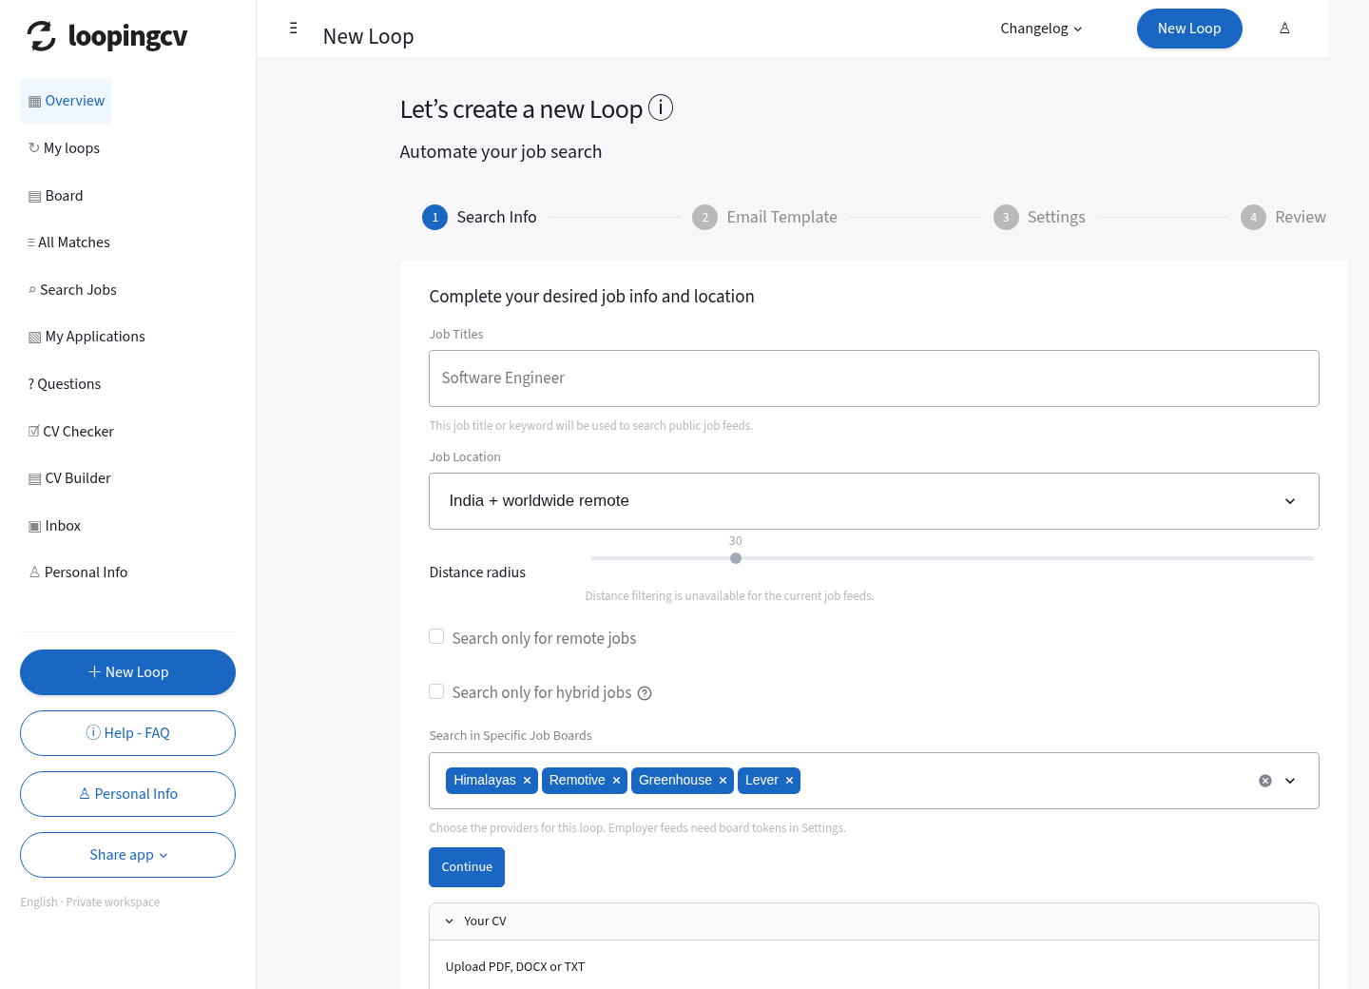
05 / APPLICATION INTERFACE
LoopingCV dashboard
The actual local interface: a four-step search-loop wizard and private navigation.
One place to work
CV Checker
New Loop
Search Jobs / All Matches
My Applications
Board and CSV export
Share app
Screenshot: local preview
LoopingCV | Capstone prototype
06 / 12
Notes:
This screenshot is an actual browser render of the current local interface. It is not a deployed public website or evidence of a completed job application. Show the New Loop wizard, CV Checker, All Matches, My Applications and Board. Share app becomes useful after a valid public deployment is configured.

Slide 7
06 / RELIABILITY
Safeguards around each outgoing email
Approval is checked against the recipient, subject, message and original PDF.
Exact approval
Private accounts
Daily attempt limits
A message/PDF fingerprint must
match the saved draft.
Records and Gmail credentials are
scoped to each user.
Database locks protect per-user
quota reservations.
Duplicate protection
Uncertain delivery
Credential protection
An already-attempted application
cannot be resent.
Timeouts require reconciliation in
Gmail Sent.
Verified database TLS and
encrypted OAuth tokens.
LoopingCV | Capstone prototype
07 / 12
Notes:
Discuss why approved sending needs PostgreSQL concurrency protection. Approval fingerprints prevent changing an already-approved message. Per-user locking enforces quotas. Sent or uncertain applications cannot be automatically retried. Remote database TLS is verified and Gmail tokens are encrypted. These safeguards are covered by tests but real delivery still needs a deployed acceptance test.

Slide 8
07 / VALIDATION
32 automated checks passed
Validated on 11 October 2026, including a real temporary PostgreSQL database.
Confirmed fixes
32
DOCX table contents are included.
Accented “résumé” no longer invents an R skill.
Missing or conflicting locations remain uncertain.
Degree dates are not treated as work experience.
Null optional job text does not crash matching.
passed
0 failed
0 skipped
Tests verify software behavior; they are not a model-accuracy score.
LoopingCV | Capstone prototype
08 / 12
Notes:
The full suite passed with 32 checks and no skips, including concurrent approvals and encrypted, user-bound, one-use OAuth persistence. Provider sends in the suite are mocked: these tests do not establish real delivery. Browser checks exercised desktop/mobile navigation. Live read-only Greenhouse discovery also returned actual India listings. Model accuracy was not measured.

Slide 9
08 / HONEST FEATURE STATUS
Implemented behavior and remaining work
The capstone scope separates working code from configuration and future integrations.
Résumé / loops / discovery / matching
Implemented
Exact draft approval / tracking / CSV
Implemented
Per-user Gmail sending
Built; OAuth setup + live delivery test pending
Scheduled discovery
Built; Actions secret + default-branch setup
Public URL / WhatsApp app sharing
URL created; private configuration pending
Automatic ATS forms / inbox replies
Not implemented; manual confirmation today
OCR / trained semantic model
Not implemented
No submission or employer response is claimed without a confirmed action.
LoopingCV | Capstone prototype
09 / 12
Notes:
Be candid about status. Résumé extraction, loops, discovery, matching, review and tracking are implemented. Gmail transport and scheduling need external configuration. ATS submission and inbox synchronization are not implemented. Interviews and rejections are manually confirmed. The public deployment needs the user's Streamlit, database and Google accounts.

Slide 10
09 / PUBLIC DEPLOYMENT
Finish configuring the public app
Streamlit Community Cloud hosts the app; Google and PostgreSQL enable private use.
STEP 1
STEP 2
STEP 3
App URL created
Configure secrets
Validate and share
Repository: automated-ai-
Branch:
codex/approval-gated-streamlit
File: streamlit_app.py
Python: 3.12
Managed PostgreSQL
Google Web OAuth + Gmail API
Cookie and encryption keys
Actual app callback URLs
Two private test accounts
Reviewed résumé and draft
User-approved test email
Share app → WhatsApp
Public app: https://5dasesqq5hdkocoz5dupwp.streamlit.app/
The app currently shows setup. Add private secrets before inviting demo users.
LoopingCV | Capstone prototype
10 / 12
Notes:
The setup screen means the app code is running but auth/database secrets are missing. Use the actual Streamlit app URL for both Google callbacks. Enter private credentials in Streamlit Secrets. Add demo friends to Google test users while OAuth is in testing. Validate separate accounts and approved Gmail delivery before presenting the integration as live.

Slide 11
10 / CAPSTONE DEMONSTRATION
A short, reproducible demonstration
Demonstrate the actual state; use clearly labeled demo data when presenting.
1
Upload a readable résumé and review the extracted evidence.
2
Create an India / remote loop with a reviewed template and limits.
3
Discover real vacancies and inspect matched / missing skills.
4
Verify mandatory criteria and the employer-published contact.
5
Review the exact draft and original PDF before any approval.
6
Inspect Board, export CSV and share the configured public link.
Local demo: no real email sends. Hosted integration demo: explicit approval + Gmail Sent check.
LoopingCV | Capstone prototype
11 / 12
Notes:
Walk through these six actions. In local mode, sending is disabled and the presentation should show the saved draft and attachment review. Once hosted sign-in, PostgreSQL and per-user Gmail are configured, the owner can approve an intentional real test email and verify Gmail Sent. Do not send applications using fictional demo credentials or a fictional résumé.

Slide 12
11 / NEXT STEPS
A reliable baseline for further development
Complete external configuration first, then evaluate each new integration.
FUTURE WORK
FUTURE WORK
FUTURE WORK
Evaluate matching
Add ATS adapters
Extend tracking
Build a labeled résumé/job dataset.
Measure ranking quality and errors.
Compare a semantic model with
the keyword baseline.
Choose a supported provider API.
Obtain authorized integration
access.
Keep review, consent and truthful
status.
Add consented inbox read access.
Classify real replies conservatively.
Improve monitoring and worker
scale.
Today: explainable discovery, private review and approval safeguards.
Questions
LoopingCV | Capstone prototype
12 / 12
Notes:
Conclude with measurable next steps rather than promising perfection. Publish and validate the authenticated app; evaluate ranking on a labeled dataset; add only authorized ATS provider adapters; implement inbox tracking with the required additional OAuth scopes and consent. The current version is a tested prototype with documented limits.

