Slide 1
Game Data Analysis of League of Legend
Supervisor: Prof. John C.S. Lui
Team Members: 1155066601 Feng Chen
1155066051 Wu Di
1155066626 Zhao Che

Slide 2
Overview
Introduction
Data Crawling
Champion Matrix and Recommendation
Champion Ability Ranking
Champion Clustering and Match Prediction

Slide 3
Outline
Introduction
Data Crawling
Champion Matrix and Recommendation
Champion Ability Ranking
Champion Clustering and Match Prediction

Slide 4
Objectives
MOBA (multiplayer online battle arena): a quite new but popular game genre
LoL (League of Legends): one of the most popular MOBA in the world: over 27 million daily players
Data analysis on games
Insights on game design: game balance, champion positioning
Insights for gamers: how to pick champion, how to find champion suitable for a player

Slide 5
Introduction to League of Legends
Goal: destroy the opposing team's building (base)
Two opposing team: 5 v.s. 5, summoner (player) – champion (game character)
Champion official position: Fighter, Marksman, Mage, Tank, Assassin, Support
Damage and scores of kill, assist, death
Earn money and level up by killing champion, building…
Each match is discrete, kind of like ball games

Slide 6
Outline
Introduction
Data Crawling
Champion Matrix and Recommendation
Champion Ability Ranking
Champion Clustering and Match Prediction

Slide 7
API and Target Data
Riot REST API: free, URL query, return JSON data
Cassiopeia: open source python wrapper of Riot API, return Python object data
Target Matches: North American district, Pre-Season 2016 in different levels
Seven database tables to remodel the crawled data

Slide 8
Crawling Strategy
(1) Randomly choose 3 summoners (players) with tier “Silver”, “Challenger” and “Diamond” separately, add them to an empty seed list;
(2) For each summoner in the seed list, use a processor to crawl all his historical matches into the datasets ;
(3) For each crawled much, obtain ten summoners’ ID. If the summoner is not crawled, add his ID to the seed list;
(4) Stop the corresponding processor when we obtain about 100,000 matches from the Silver seed, 60,000 from the Challenger seeds and 60,000 from the diamond seed;
(5) Repeat step (2);
(6) If all processors stopped, merge three crawled datasets into one.

Slide 9
Crawled Data
SQLite Database size: 2.1 GB
Table Records:
Summoner: 487,484
Match: 222,652
Team: 445,304
TeamBan: 1,330,757
Participant: 2,226,520
ParticipantTimeLine: 8,906,080
FrameKillEvent: 21,692,852

Slide 10
Outline
Introduction
Data Crawling
Champion Matrix and Recommendation
Champion Ability Ranking
Champion Clustering and Match Prediction

Slide 11
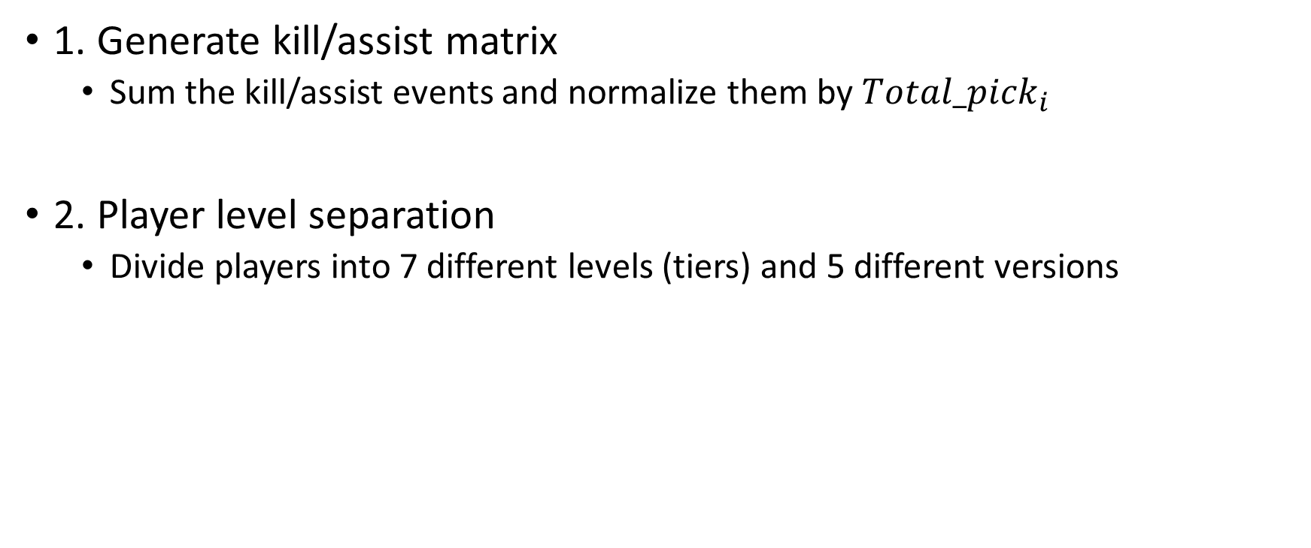
Preprocessing
1. Generate kill/assist matrix
Sum the kill/assist events and normalize them by ${Total_pick}_{i}$
2. Player level separation
Divide players into 7 different levels (tiers) and 5 different versions
Notes:
Data preprocessing is an important step in the data mining process. Analyzing data that has not been carefully screened for such problems can produce misleading results.
In our project, the dataset is crawled from League of Legends North America Server. Nearly all the data is assembled nicely. There is seldom missing values in the SQL file we generated. So what we have to do is to extract the information we need or generate new form of features we may use in later analysis.

Slide 12
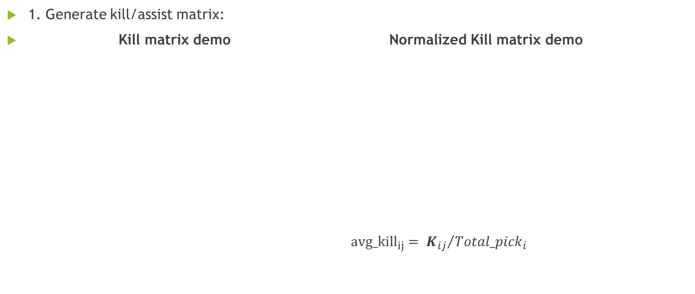
Preprocessing
1. Generate kill/assist matrix:
Kill matrix demo Normalized Kill matrix demo
${avg_kill}_{ij}= {K_{ij}}/{{Total_pick}_{i}}$
 | Aatrox | Ahri | Akali | Alistar | Amumu
Aatrox | 0 | 232 | 141 | 198 | 195
Ahri | 314 | 0 | 761 | 1601 | 1032
Akali | 151 | 942 | 0 | 352 | 316
Alistar | 82 | 445 | 143 | 0 | 201
Amumu | 177 | 754 | 274 | 601 | 0
 | Aatrox | Ahri | Akali | Alistar | Amumu
Aatrox | 0 | 0.0478 | 0.0290 | 0.0408 | 0.0402
Ahri | 0.0117 | 0 | 0.0285 | 0.0599 | 0.0386
Akali | 0.0249 | 0.1551 | 0 | 0.0579 | 0.0520
Alistar | 0.0034 | 0.0189 | 0.0061 | 0 | 0.0086
Amumu | 0.0125 | 0.0534 | 0.0194 | 0.0425 | 0
Notes:
The left table is a demo of the kill matrix. Kij here means champion I kills champion j for kij times. For example, 232 here means champion Aatrox kills champion Ahri(阿狸) 232 times in 220 thousand matches we got.
However, there is a problem in the kill matrix. That is, if the champion always been picked by the players, intuitively the sum of the kill events would be higher than those less popular champions. In that case, we decided to do a normalization.
The right table is a demo of the normalized kill matrix. We use the ‘total pick’ to normalize the kill events, in order to reduce the influence of popularity.

Slide 13
Preprocessing
2. Player level separation:
Tiers : | Challenger | Master | Diamond | Platinum | Gold | Silver | Bronze
Versions : | 5.21 | 5.22 | 5.23 | 5.24 | 6.1
Notes:
As this game has millions of players, there is distinction of the ability of each player. The LOL game officially use 7 different levels to distinguish different level players. The 7 different levels (tiers) are ‘Challenger’, ‘Master’, ‘Diamond’, ‘Platinum’, ‘Gold’, ‘Silver’ and ‘Bronze’.
In that case, we decided to separate the matches into 7 different level according to the average tier of 10 players in a same match.
During the period of time we get the data, there are totally 5 updates of the game, which means there are 5 different version.
We decided to divide all matches we got into 35 parts according to the version and average tier. We finished the coding of this part but the program will run for about 15 days.
As it its time consuming, we give up this part of work. However, we think that the future work of this part should be using distributed computing to reduce the running time.

Slide 14
Introduction of Champion Recommendation
Time | Number of Champions
01/01/2016 | 128
05/01/2016 | 140
1. Recommend according to popularity and win rate
2. Recommend according to kill/assist matrices
Notes:
There are 128 champions in the game since we crawled the data. However, after about half a year, it now contains 140 champions. Different champions have their different abilities. Sometimes it is even hard for players to know which champion might fit their tastes well. If the game system can sent players some advices according to some specific ‘rules’, it might be much more comfortable for those players who do not have enough time to study the characteristics of different champions. So we decided to establish champion recommendation according to different rules.

Slide 15
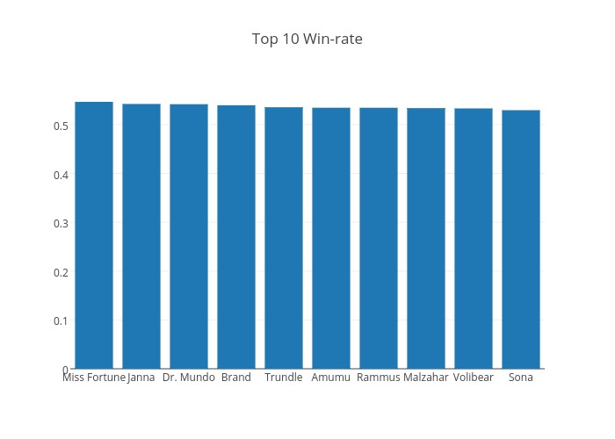
Introduction of Champion Recommendation
1. Recommend according to popularity and win rate:
Champion | win_rate
Miss Fortune | 0.546508
Janna | 0.542181
Dr. Mundo | 0.541674
Brand | 0.539527
Trundle | 0.535452
Amumu | 0.534467
Rammus | 0.534403
Malzahar | 0.533652
Volibear | 0.533047
Sona | 0.529421
Notes:
This part of the recommendation is established according to the popularity and win rate of champions. We count the total ‘pick’ among the matches we have and sort them in order. With these ordered list, we can recommend ‘top-10 popular’ champions to players. Then we calculate the win rate of each champions and sort them in order. With this win rate list, we can recommend the champion who has a high win rate to players. Intuitively it can raise the win rate of players.

Slide 16
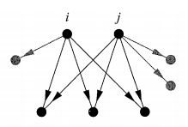
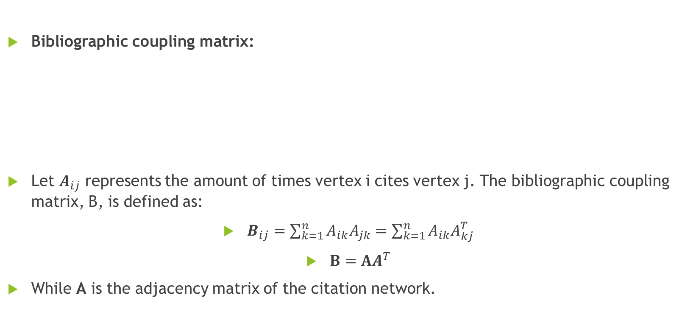
Introduction of Champion Recommendation
Bibliographic coupling matrix:
Let $A_{ij}$ represents the amount of times vertex i cites vertex j. The bibliographic coupling matrix, B, is defined as:
$B_{ij}=\sum_{k=1}^{n}{A_{ik}A_{jk}}=\sum_{k=1}^{n}{A_{ik}A_{kj}^{T}}$
$B=AA^{T}$
While A is the adjacency matrix of the citation network.
Notes:
Before talking about the recommendation, let me briefly introduce the bibliographic coupling matrix.
We simply use the bibliographic coupling matrix to do some analysis with the kill/assist matrices. By using bibliographic coupling on kill matrix, we can find out those champions that always been killed by the same other champions. By using bibliographic coupling on assist matrix, we can find out those champions that always assist others together. In other words, they can be recognized as good partner of each other.

Slide 17
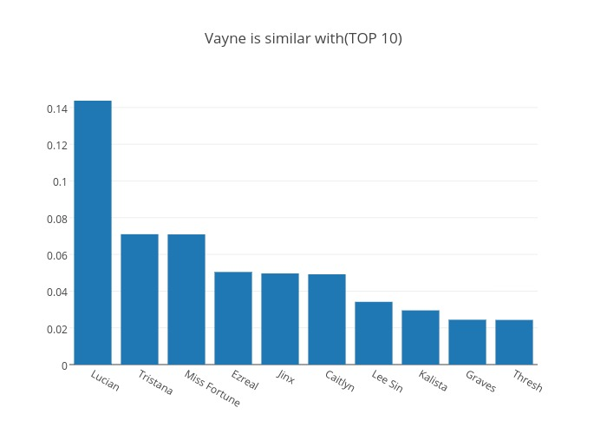
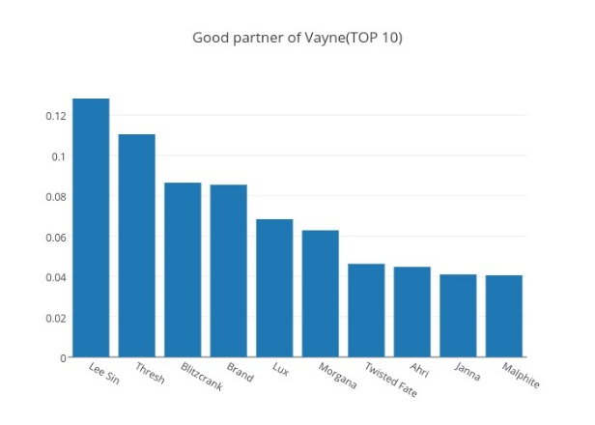
Introduction of Champion Recommendation
2. Recommend according to kill/assist matrices K / A:
Notes:
Here is the result of the bibliographic coupling kill/assist matrix.
The left figure is the result of champion ‘Vayne’ by using bibliographic coupling on kill matrix. It indicates that ‘Vayne’ and these ten champions always kill the same group of champions. The right figure is the result of champion ‘Vayne’ by using bibliographic coupling on assist matrix. It indicates that ‘Vayne’ always assists its teammates together with these ten champions.

Slide 18
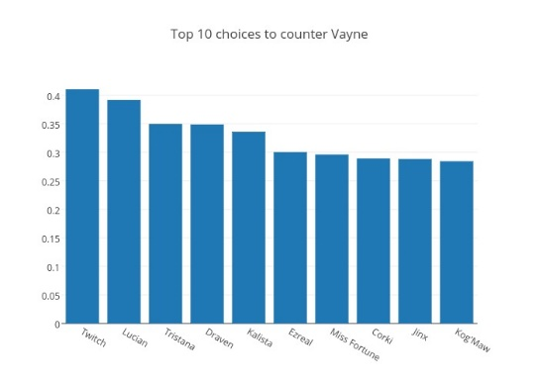
Introduction of Champion Recommendation
2. Recommend according to kill/assist matrices:
Notes:
We also do a simple ‘counter’ recommendation according to the kill matrix. The figure here shows the result of champion ‘Vayne’.
This figure indicates that ‘Vayne’ is always been killed by ‘Twitch’, ‘Lucian’ and ‘Tristana’. It indicates that while facing champion Vayne, these champions tends to perform better.

Slide 19
Single Feature Win Rate Prediction
0-1 classification problem.
Totally 31 features of each match.
220 thousand match – 80% for training, 20% for testing.
Train models and select the best model and the best predict result.

Slide 20
Single Feature Win Rate Prediction
Feature type | Error Rate | Predict Rate
gold_earned | 0.0267 | 0.9733
turret_kills | 0.0427 | 0.9573
champion_level | 0.0538 | 0.9462
kills | 0.0668 | 0.9332
deaths | 0.0673 | 0.9327
kda | 0.0721 | 0.9279
damage_dealt | 0.1028 | 0.8972
gold_spent | 0.1043 | 0.8957
assists | 0.1095 | 0.8905
largest_killing_spree | 0.124 | 0.876
killing_sprees | 0.131 | 0.869
damage_dealt_to_champions | 0.131 | 0.869
largest_multi_kill | 0.1916 | 0.8084
physical_damage_dealt | 0.2307 | 0.7693
cs | 0.248 | 0.752
Feature type | Error Rate | Predict Rate
physical_damage_dealt_to_champions | 0.2543 | 0.7457
damage_taken | 0.2582 | 0.7418
magic_damage_dealt_to_champions | 0.3229 | 0.6771
magic_damage_taken | 0.3334 | 0.6666
healing_done | 0.3339 | 0.6661
largest_critical_strike | 0.361 | 0.639
true_damage_dealt | 0.3649 | 0.6351
magic_damage_dealt | 0.3694 | 0.6306
wards_placed | 0.3837 | 0.6163
crowd_control_dealt | 0.3961 | 0.6039
true_damage_dealt_to_champions | 0.4156 | 0.5844
true_damage_taken | 0.4156 | 0.5844
physical_damage_taken | 0.4221 | 0.5779
vision_wards_bought | 0.4391 | 0.5609
units_healed | 0.4567 | 0.5433
ward_kills | 0.4758 | 0.5242
Notes:
We have got totally 31 features of each match. This part of work is to use single feature to predict the match result, which aims to find out the feature that influence match result the most.
We can find out that the top-9 features in left Table all have very high accuracy. Intuitively, these features should have high accuracy while doing the single feature win rate prediction. For example, the team who earns more gold in a single game tends to win the game.
However, this part of work is just a warm up for later multi-feature win rate prediction which done by my teammate Feng Chen.

Slide 21
Outline
Introduction
Data Crawling
Champion Matrix and Recommendation
Champion Ability Ranking
Champion Clustering and Match Prediction

Slide 22
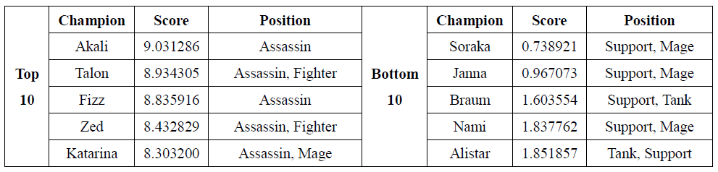
Champion Ranking with Average Score
Killing Ability Ranking
Tops all have Assassin labels, while bottoms all have Support Labels.
Underperformed: Vi(55, F, A), Xin Zhao(60, F, A), Teemo(64, Mar, A)
Outperformed: Quinn(10, Mar, F), Corki(19, Mar)

Slide 23
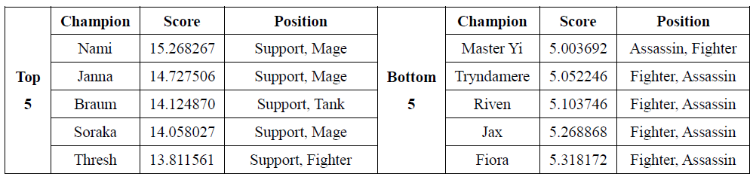
Champion Ranking with Average Score
Assisting Ability Ranking
Tops all have Support labels, bottoms all have Assassin and Fighter Labels.
Underperformed: Kayle(75, F, S), Anivia(49, Ma, S)
Outperformed: Nautilus, (13, T, F), Rammus(18, T, F)

Slide 24
Graph Model of Champion Relationship
Champion Kill Matrix K:
non-negative: K_{ij} = k ≥ 0
champion i kills j for k times in all matches
asymmetric: K_{ij} ≠ K_{ji}
diagonal entries are all 0: K_{ii} = 0
any champion can only be picked once in a match
K’: K normalized by picks(i)
K’’: K normalized by enemy_incidence(i,j)
Champion Assist Matrix A: A, A’ and A’’(normed by partner_incidence), with similar properties

Slide 25
Graph Model of Champion Relationship
Relationship between each pair of champions
Transitive assumption: if champion i kills j many times, j itself has high killing ability, then i also has high killing ability
Eigenvector Centrality: K’x = wx
find the eigenvector x corresponding to the largest eigenvalue w;
x_{i} is the score of champion i’s killing ability
HITS: hub score of i in K’ measures its killing ability

Slide 26
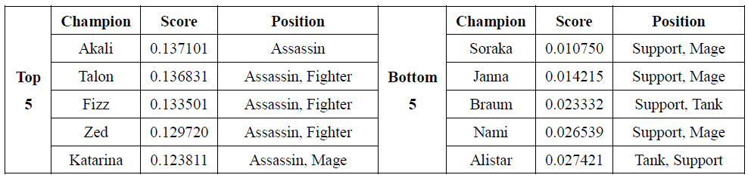
Champion Ranking with Graph Model
Killing Ranking with Eigenvector Centrality of K’
No significant difference.

Slide 27
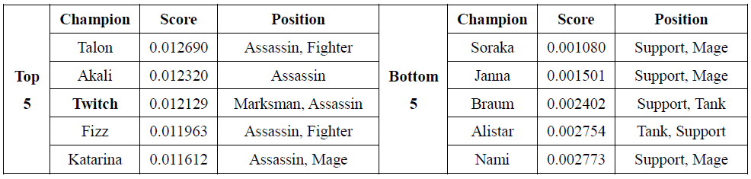
Champion Ranking with Graph Model
Killing Ranking with Hub Centrality of K’
No significant difference: average score method is good enough

Slide 28
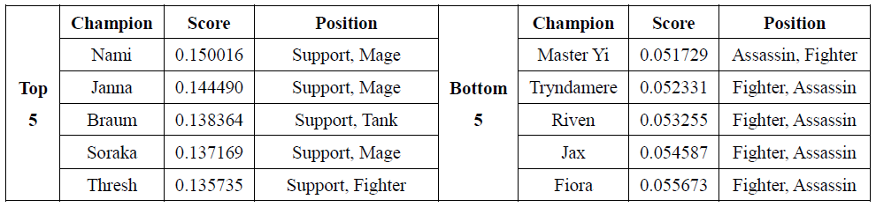
Champion Ranking with Graph Model
Assisting Ranking with Eigenvector Centrality of A’
No significant difference.

Slide 29
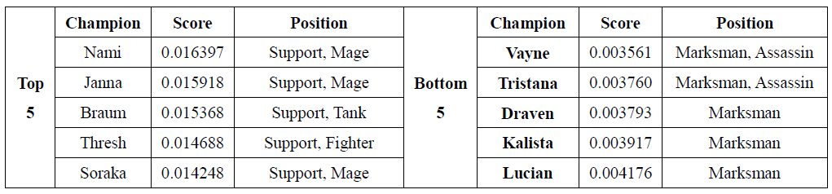
Champion Ranking with Graph Model
Assisting Ranking with Hub Centrality of A’
Bottoms are quite different: Marksman instead of Fighter and Assassin.

Slide 30
Champion Ranking with Graph Model
However, K’ and A’ gives us only biased result, because we ignore how the victim / assisted champion is picked in normalization
Using K’’ and A’’ is more reasonable, but Killing Ranking using eigenvector centrality with K’’ cannot get a stable solution in our experiments, and HITS cannot even converge
So we try another method: PageRank
x_{i} = α Σ_{j}(K’’)^{T}_{ij}x_{j} / k^{out}_{j} + β
We use transpose of K’’ because i kills j means i has higher killing ability than j; α=0.85, β=0.15; similar for A’’

Slide 31
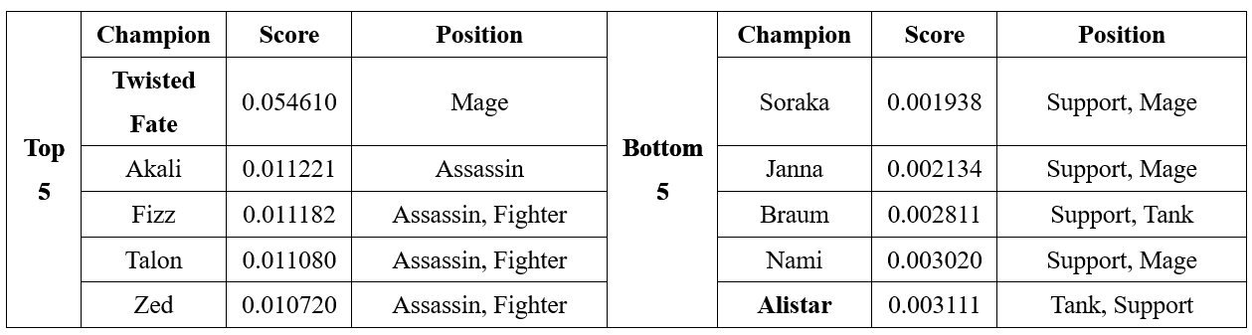
Champion Ranking with Graph Model
Killing Ranking with PageRank Centrality of K’’
Twisted Fate is outstanding.

Slide 32
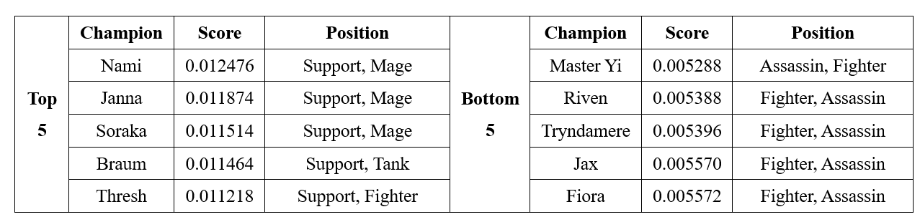
Champion Ranking with Graph Model
Assisting Ranking with PageRank Centrality of A’’
No significant difference.

Slide 33
Champion Ability Ranking
Some possible future Works in this part:
Deep analysis on exceptional results like non-convergence HITS
Combine the result from match data with static champion setting like health, skills, and growth curve (by level)
Comparison with the champion clustering results
Champion Popularity Ranking

Slide 34
Outline
Introduction
Data Crawling
Champion Matrix and Recommendation
Champion Ability Ranking
Champion Clustering and Match Prediction

Slide 35
Champion Clustering
Features
Match champion | Champions that involve in this match
Kills | Number of enemy champions killed
Deaths | Number of time champions die
Assists | Number of times assisting teammates to kill enemy champions
Gold earned | How much gold earned by champions
Magic damage | Magic damage dealt to enemy champions
Physical damage | Physical damage dealt to enemy champions
True damage | True damage dealt to enemy champions
Damage taken | Damage taken from enemy champions
Crowd control dealt | Sum of time of dealing control to enemy champions
Ward placed | Number of wards that have been placed
Ward kills | Number of wards that have been killed

Slide 36
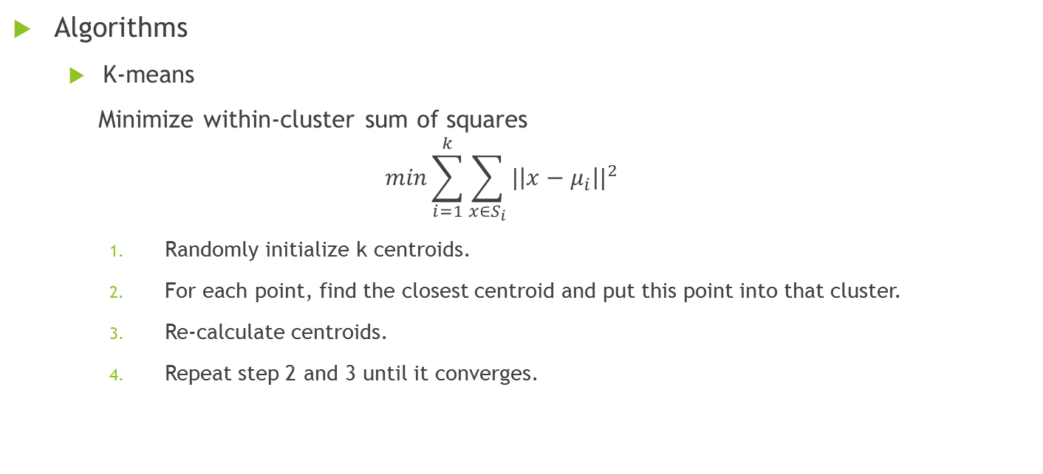
Champion Clustering
Algorithms
K-means
Minimize within-cluster sum of squares
$$min\sum_{i=1}^{k}{\sum_{x∈S_{i}}{{|\left|x−μ_{i}\right||}^{2}}}$$
Randomly initialize k centroids.
For each point, find the closest centroid and put this point into that cluster.
Re-calculate centroids.
Repeat step 2 and 3 until it converges.

Slide 37
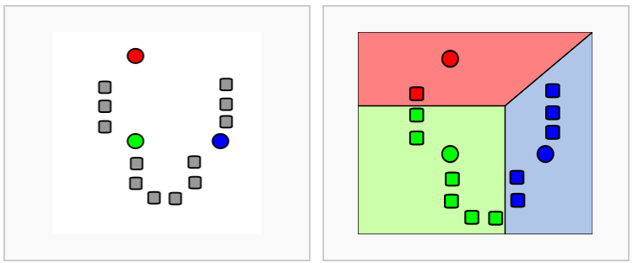
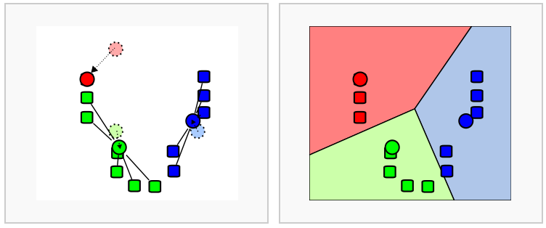
Champion Clustering
Algorithms
K-means

Slide 38
Champion Clustering
Algorithms
Agglomerative
Pair nearest points/clusters and finally obtain n clusters.
Initialize with m points.
For each point, find and be merged with the nearest cluster as a cluster.
For each cluster, find and be merged with the nearest cluster as a new cluster.
Repeat step 3 until there are exactly n clusters.

Slide 39
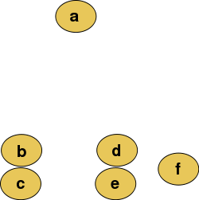
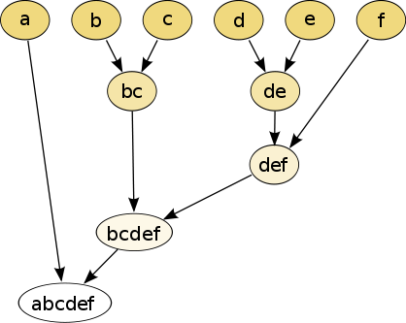
Champion Clustering
Algorithms
Agglomerative

Slide 40
Champion Clustering
Evaluation
Distortion: sum of distances between points and their centroid.
$Distortion=\frac{\sum{Euclidean(v, centroid)}}{n}$
Distance between clusters
$Distance= \frac{\sum{Euclidean({centroid}_{i}, {centroid}_{j})}}{2m}$

Slide 41

Champion Clustering
Evaluation
Distortion and distance between clusters are both important. Low distortion and high distance between clusters are what we desire.
$$D= \frac{distance}{distortion}$$

Slide 42
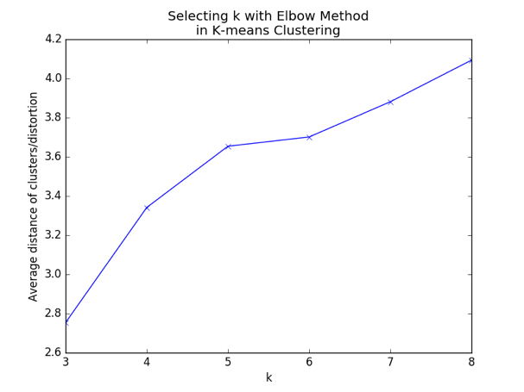
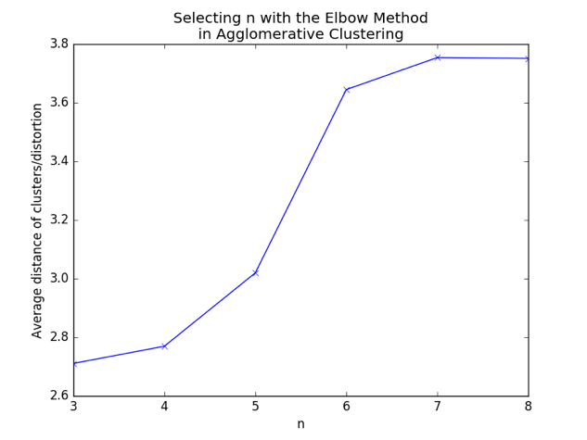
Champion Clustering
Selecting k
Elbow method: find k where D decreases the most and slows down the trend afterwards.

Slide 43
Champion Clustering
Result
Index | Kills | Deaths | Assists | Gold | Magic damage | Physical damage | True damage | Damage taken | Control | Ward
1 | 4 | 5 | 8 | 11291 | 13340 | 2436 | 890 | 30760 | 685 | 11
2 | 5 | 5 | 6 | 11742 | 3515 | 11856 | 1366 | 29593 | 685 | 10
3 | 6 | 5 | 6 | 12328 | 2545 | 16919 | 846 | 20438 | 332 | 9
4 | 5 | 5 | 7 | 11801 | 19353 | 1624 | 716 | 18880 | 560 | 11
5 | 4 | 5 | 9 | 10684 | 9367 | 3626 | 682 | 24158 | 530 | 15
6 | 2 | 4 | 13 | 9864 | 8806 | 1765 | 216 | 16455 | 266 | 19

Slide 44
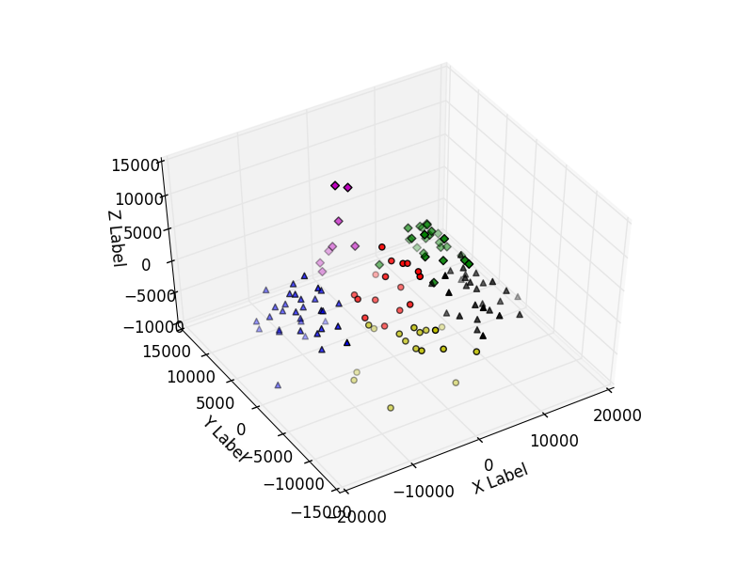
Champion Clustering
Result illustration

Slide 45

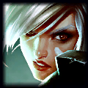
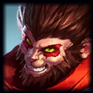
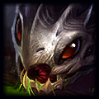
Champion Clustering
Interesting results
Fighters perform just like marksman.
Marksman is alike support character.
There are many more.

Slide 46
Win Prediction
Based on character composition
Feature is a vector representing two teams’ character composition.
Label is win/lose of team 1.
Cluster | 1 | 2 | 3 | 4 | 5 | 6
Count | 2 | 1 | 1 | 0 | 1 | 0
+
Cluster | 1 | 2 | 3 | 4 | 5 | 6
Count | 0 | 0 | 2 | 1 | 1 | 1

Slide 47
Win Prediction
Based on character composition
Result is not satisfying. That means it’s impossible to predict result before match happens with such features.
To improve: include players’ data.
 | Precision | Recall | F1-score
Lose | 49% | 50% | 50%
Win | 52% | 49% | 50%
Average | 51% | 49% | 50%

Slide 48
Win Prediction
2. Based on match statistics
Single feature’s result
Feature | Prediction precision
Gold difference | 97%
Turret kills | 95%
Levels | 94%
Kills | 93%
Deaths | 93%
Assists | 89%
Dragon kills | 78%
Physical damage | 74%
Damage taken | 74%
Baron kills | 80%
Magic damage | 67%
Heal | 66%
Wards placed | 61%
Crowd control dealt | 60%
True damage | 58%
Ward kills | 52%

Slide 49
Win Prediction
2. Based on match statistics
Included features
Damage | Physical damage, magic damage, true damage, damage taken
Buffs | Dragon kills, Baron kills
Wards | Number of wards placed, killed
Other | Heal, crowd control dealt

Slide 50
Win Prediction
2. Based on match statistics
This result’s precision is higher than any of the included single features.
Future work: use in-match statistics to predict trends, recommend strategies.
 | Precision | Recall | F1-score
Lose | 89% | 90% | 90%
Win | 90% | 89% | 89%
Average | 90% | 90% | 89%

Slide 51
Thank you.

