Slide 1
Project Timetracker
Group 19:
COMP 4900
Client: Mike Mulder
Notes:
#1-9

Slide 2
Group roles
Dorothy Truong: Product Owner
Syrra Cagalawan: Product Manager
Alan Gunadio: Architecture & Design
Daniel Lim: QA Tester

Slide 3
Our Client

Slide 4

Our Client
Mike Mulder
BCIT CIT instructor
Teaches Python and Project Management

Slide 5
The Project

Slide 6
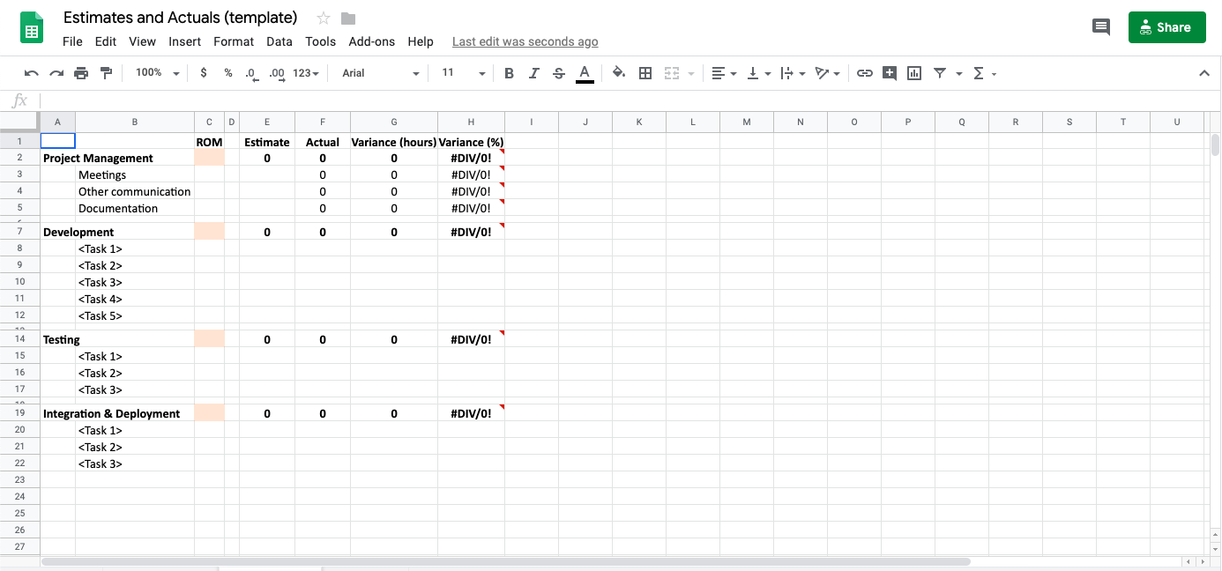
Currently in 3900...
What students use to track their time now

Slide 7





Why Project Timetracker?
Problem:
Manual spreadsheets
Kept in individual laptops
Possibility of files being deleted
Others can’t access it as easily
Solution:
Permanent
Central location/standardized across users
Scalable
Notes:
Feedback:
Why do we need it? Currently, Donna keeps manual spreadsheets, keep it in her laptop, could be deleted, others can’t get to it
Need a permanent solution for instructors to keep track/monitor students and teams, personalized, central location, scalable
Have bullet points on the problem/solutions
Who’s going to have access to it (students & instructors)

Slide 8
The Solution & Architecture

Slide 9

Project Timetracker: the site
Automates certain project management aspects of software development
Designed for 200-300 BCIT students enrolled in COMP 3900
Uses:
Allows users to record their time worked on the project
Allows the project manager to know how well the project is being run and to report to management.
Notes:
A system to automate certain project management aspects of software development for 200-300 students. This allows users to record their time worked on the project and allows the project manager to know how well the project is being run and to report to management.
Feedback:
Write who this design is for: cloud-based system for instructors running COMP 3900/4900, example Donna Turner
Write why this is needed: instructors have 200-300 students to manage

Slide 10
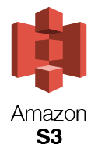
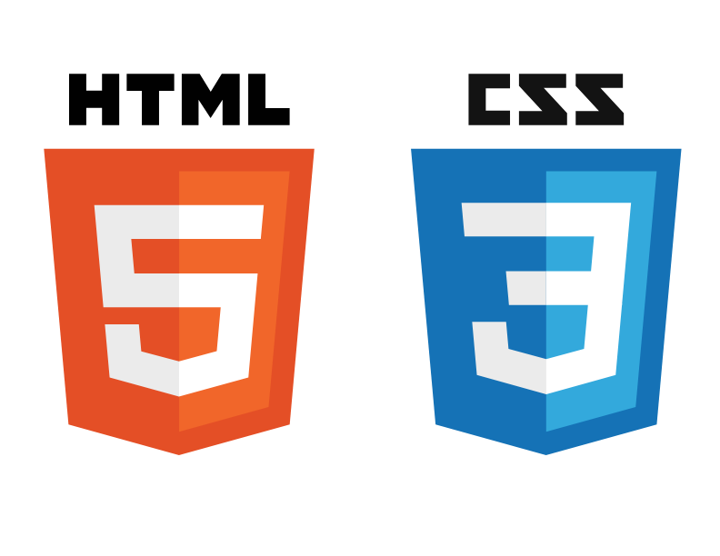


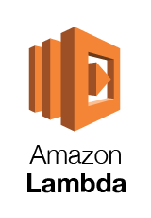



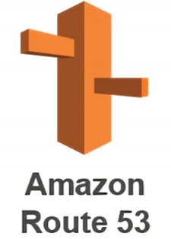
Architecture
Notes:
We have a two tier architecture for our application
- The front end consists of html, css and bootstrapping
- for the back end we used amazon lightsail which has aws relational database services included in it:
- amazon lightsail is similar to amazon ec2 except that its much simpler to use
- the has virtually no learning curve and has a simplified console
- lightsail has preconfigured plans that you can select depending on your needs
- so you can use it to create things like servers, load balancers and databases
- for our application, we used something called a LAMP stack
- lamp stands for linux, apache, mysql, and php
- we also used amazons s3 bucket and lambda function for our upload page
- and we used amazons route 53 to route users to our website
- route 53 is a domain name system
- and to connect the front end with the backend, we used php

Slide 11



Technologies

Slide 12
Demo

Slide 13
The Pages
Login
Admin home page
Project Manager home page
Upload projects and users
Manage employees
Manage Projects
Work Breakdown Structure (WBS)
Edit projects
Timesheet
Weekly report

Slide 14

Notes:
Our application will have 3 different types of users, each with a different home page
- the users will be administrator, project manager, and a regular employee
- alan will be logging in and demoing as a administrator and regualr employee
- and daniel will be showing you the project managers side of things

Slide 15
Conclusions

Slide 16

Estimates & Actuals
Project Management
ROM: 100 hours
Estimated hours: 27 hours
Actual hours: 54.5 hours
Variance: 49.5%
Notes:
ROM: Rough Order of Magnitude

Slide 17
Estimates & Actuals
Development
ROM: 320 hours
Estimated hours: 359 hours
Actual hours: 408.5 hours
Variance: 87.8%
Notes:
ROM: Rough Order of Magnitude

Slide 18

Recommendations/Next steps
Cron job
Purchase own domain
CSS/Bootstrap
“Forgot password” feature
Rearrange tasks/categories in WBS page feature
Email forwarding to recently uploaded employees

Slide 19
What is not needed
Load balancer
Autoscale

Slide 20

Thank you for listening!

