Slide 1
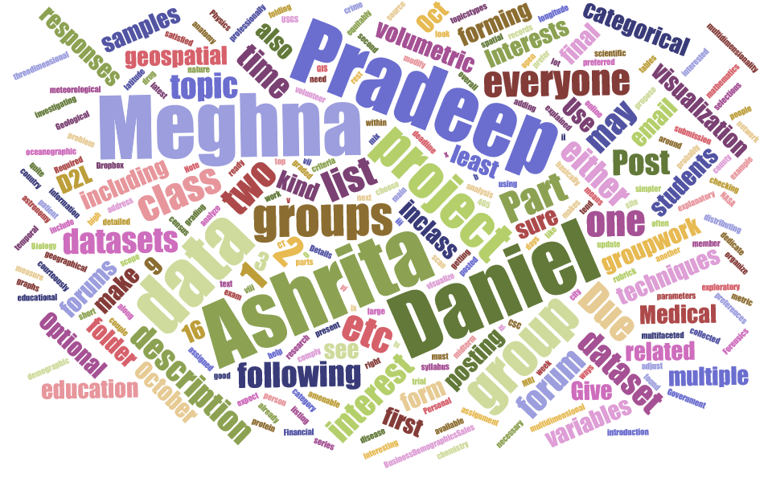
Course: CSC-465
Professor: Dr. Eli T. Brown
Team: PMAD
Project: Visualizing Divvy Dataset
Scope: 2016 Dataset of Q1 &Q2
Topics Experimented:
Word Cloud
2-D Visualizations
Hierarchy Plot
Geospatial VIZ – Choropleth
Heat Map
Neural Network Map

Slide 2
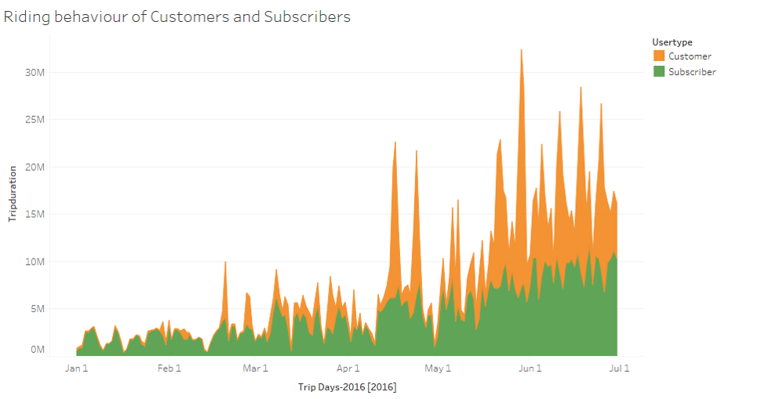
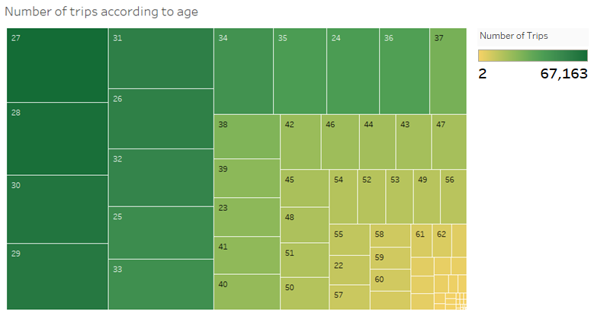
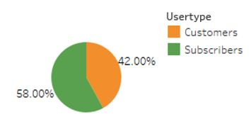

Slide 3
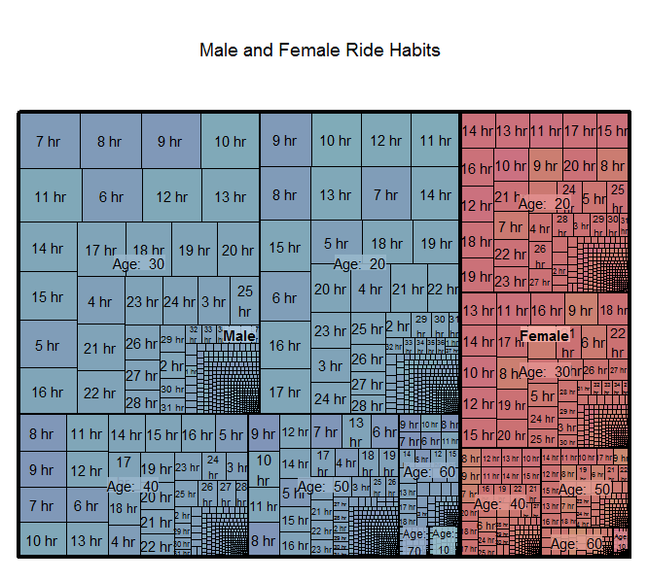
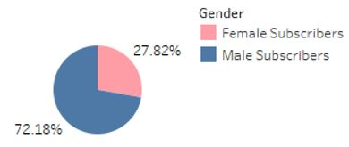

Slide 4
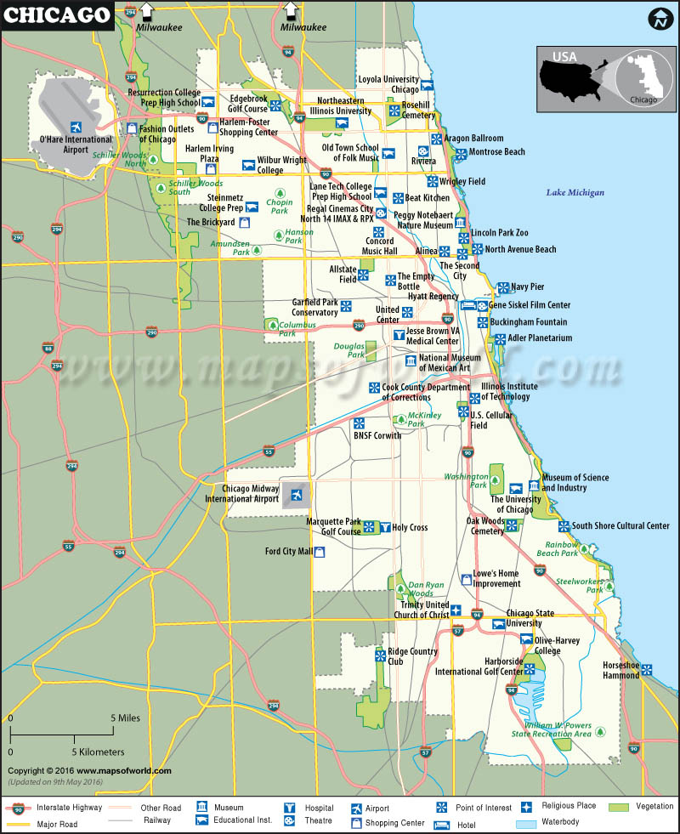
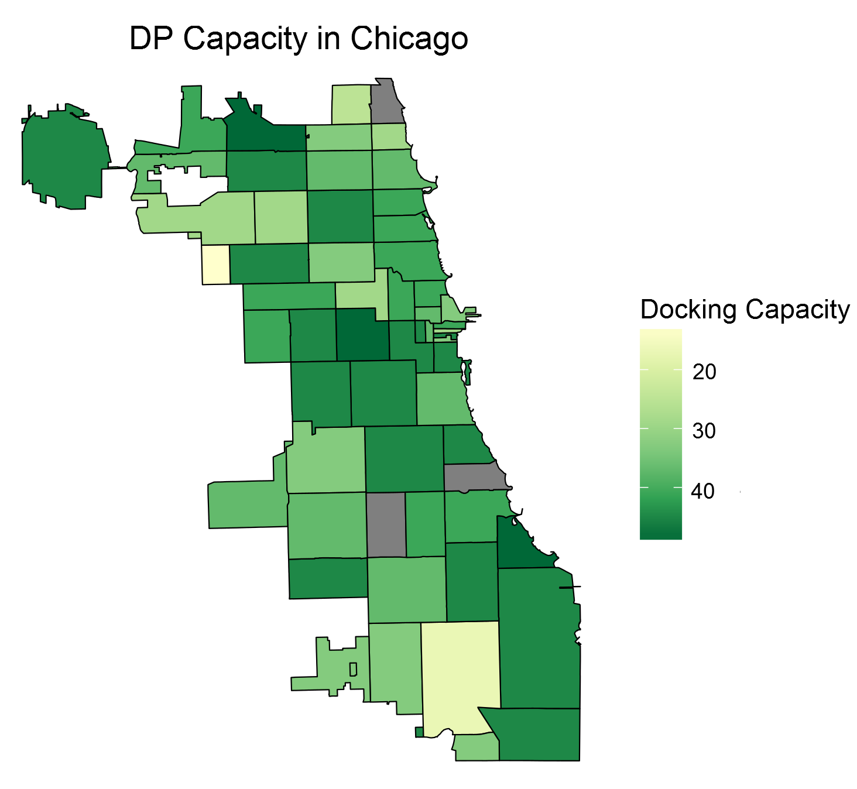
http://via.library.depaul.edu/mom/20/

Slide 5
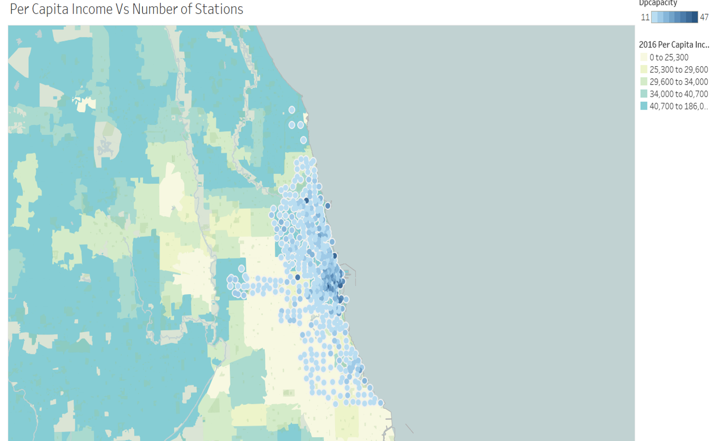

Slide 6
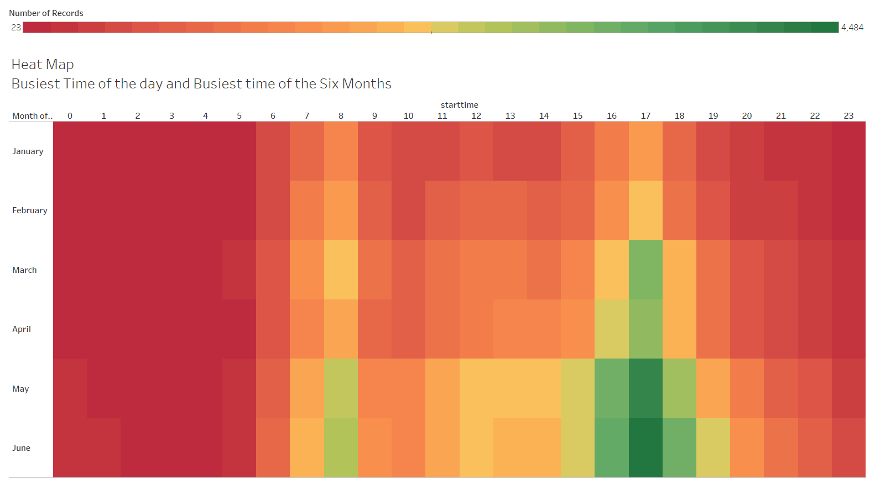

Slide 7
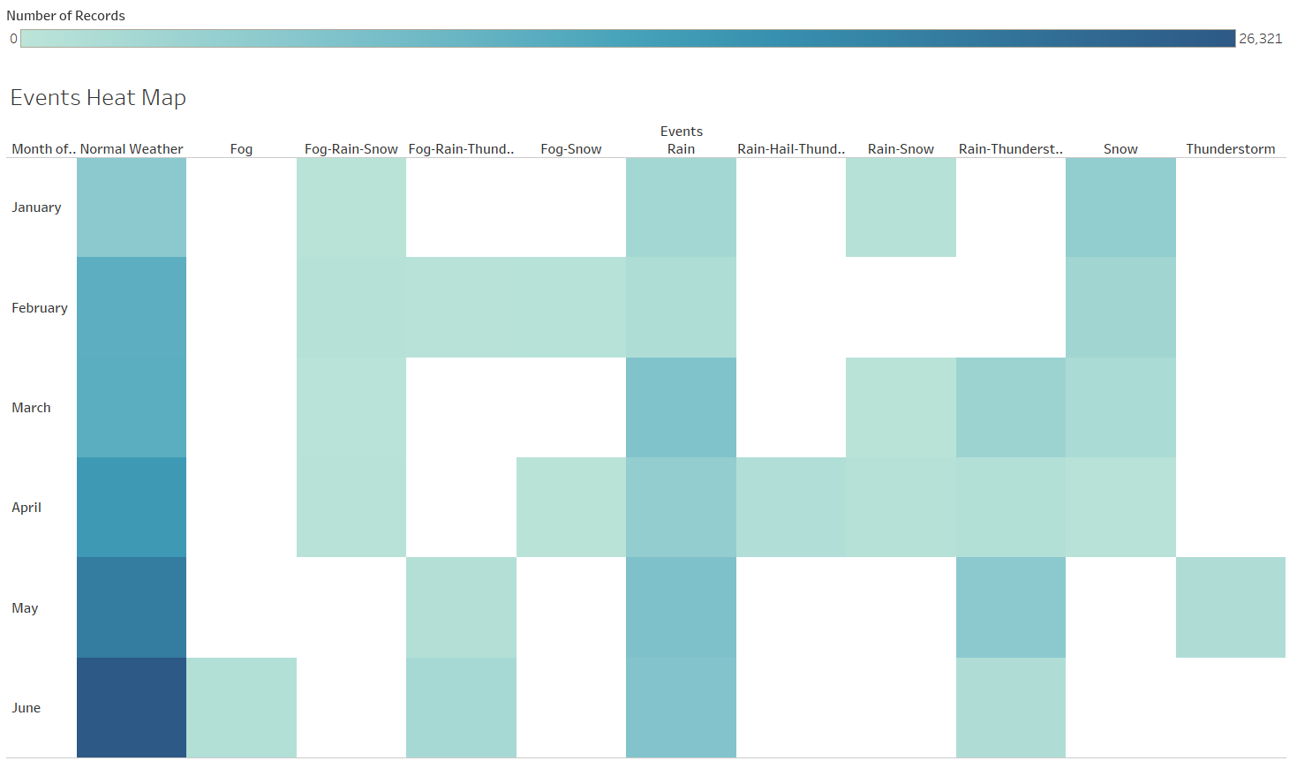

Slide 8
