Slide 1







Smart Contracts and Solidity Basics
Language Overview, Writing Solidity Code
Svetlin Nakov
Senior Technical Trainer
SoftUni
http://softuni.org/

Slide 2



Table of Contents
What is Solidity?
Ethereum Virtual Machine (EVM)
Solidity Dev Environment & IDEs
Compile, Publish, and Test Contracts
Smart Contract Basics
Solidity Language Basics
Contracts, functions, data types, arrays, maps, structs

Slide 3

Ethereum Virtual Machine and Solidity
Architectural Concepts

Slide 4

What is Solidity?
Solidity is a contract-oriented, high-level programming language
Syntax similar to JavaScript and C#
Runs in the Ethereum Virtual Machine (EVM)
Statically typed language (like C# and Java)
Complex user-defined types (structs)
Contracts and inheritance (like in OOP)
Libraries (like in any other dev platform)
Official documentation: https://solidity.readthedocs.io

Slide 5
Solidity Code Compilation
Bytecode (EVM instructions)
Solidity Code
Solc compiler
ABI definition
Ethereum Virtual Machine (EVM) is the environment where the contracts are executed
Code execution costs money (called gas)
Application Binary Interface (ABI) – describes the contract’s interface
Public methods + input arguments + return values + contract events

Slide 6
Solidity Code Compilation (2)
deploy
Bytecode (EVM instructions)
Ethereum Blockchain
invoke
ABI definition
Accessing the contract
To publish the contract, the bytecode is uploaded to the blockchain
To access it, you need the ABI definition to know what inputs and outputs the contract operates with
Demo in Remix

Slide 7
Transaction Validation in EVM
EVM uses validators to ensure transactions are OK
Validators take a transaction and apply it executing the associated code, make sure that:
The transaction is valid (e.g. encoding, sender signature, constraints, etc.)
The sender has enough funds to pay for the execution
The EVM did not throw any exceptions during the execution

Slide 8
Ethereum Gas Measurement
Contracts aren’t free, execution costs gas
Gas is the internal unit for keeping track of execution cost
Gas measures the consumed computational resources
Each CPU instruction in EVM costs gas: 1 gas = 1 computational step
Each persistent storage write also costs gas
E.g. writing 32 bytes in the contract memory costs 80 000 gas
Gas price can be negotiated (cannot be 0 to avoid spam):
1 gas ~= 20 Gwei (dynamic)

Slide 9
Gas Payments
Gas is measured and paid for at each contract execution
Every transaction to a contract or contract creation
Reading data from a contract (reading its state) is free!
Code execution / data storage is paid
The gas price is set by the caller (you)
The lower the price, the more time it will take for a miner to include the tx in a block
Best gas price calculator: https://ethgasstation.info

Slide 10
Gas Limit
Gas limit == maximum allowed gas usage in a transaction
Sum of all gas spending for all operations and storage
Do not reach the limit!
Current contract execution will be terminated
Any changes to the contract’s state will be reverted

Slide 11
Operations and Gas
Operations that cost gas:
Anything that changes the blockchain state:
Writing to contract’s memory
Execution of contract logic
Uploading data to blockchain (contract publishing)
Free operations:
Anything not requiring changes, like:
Reading blockchain data (contracts, their state, …)
Examples: get contract metadata, check account balance, etc.

Slide 12
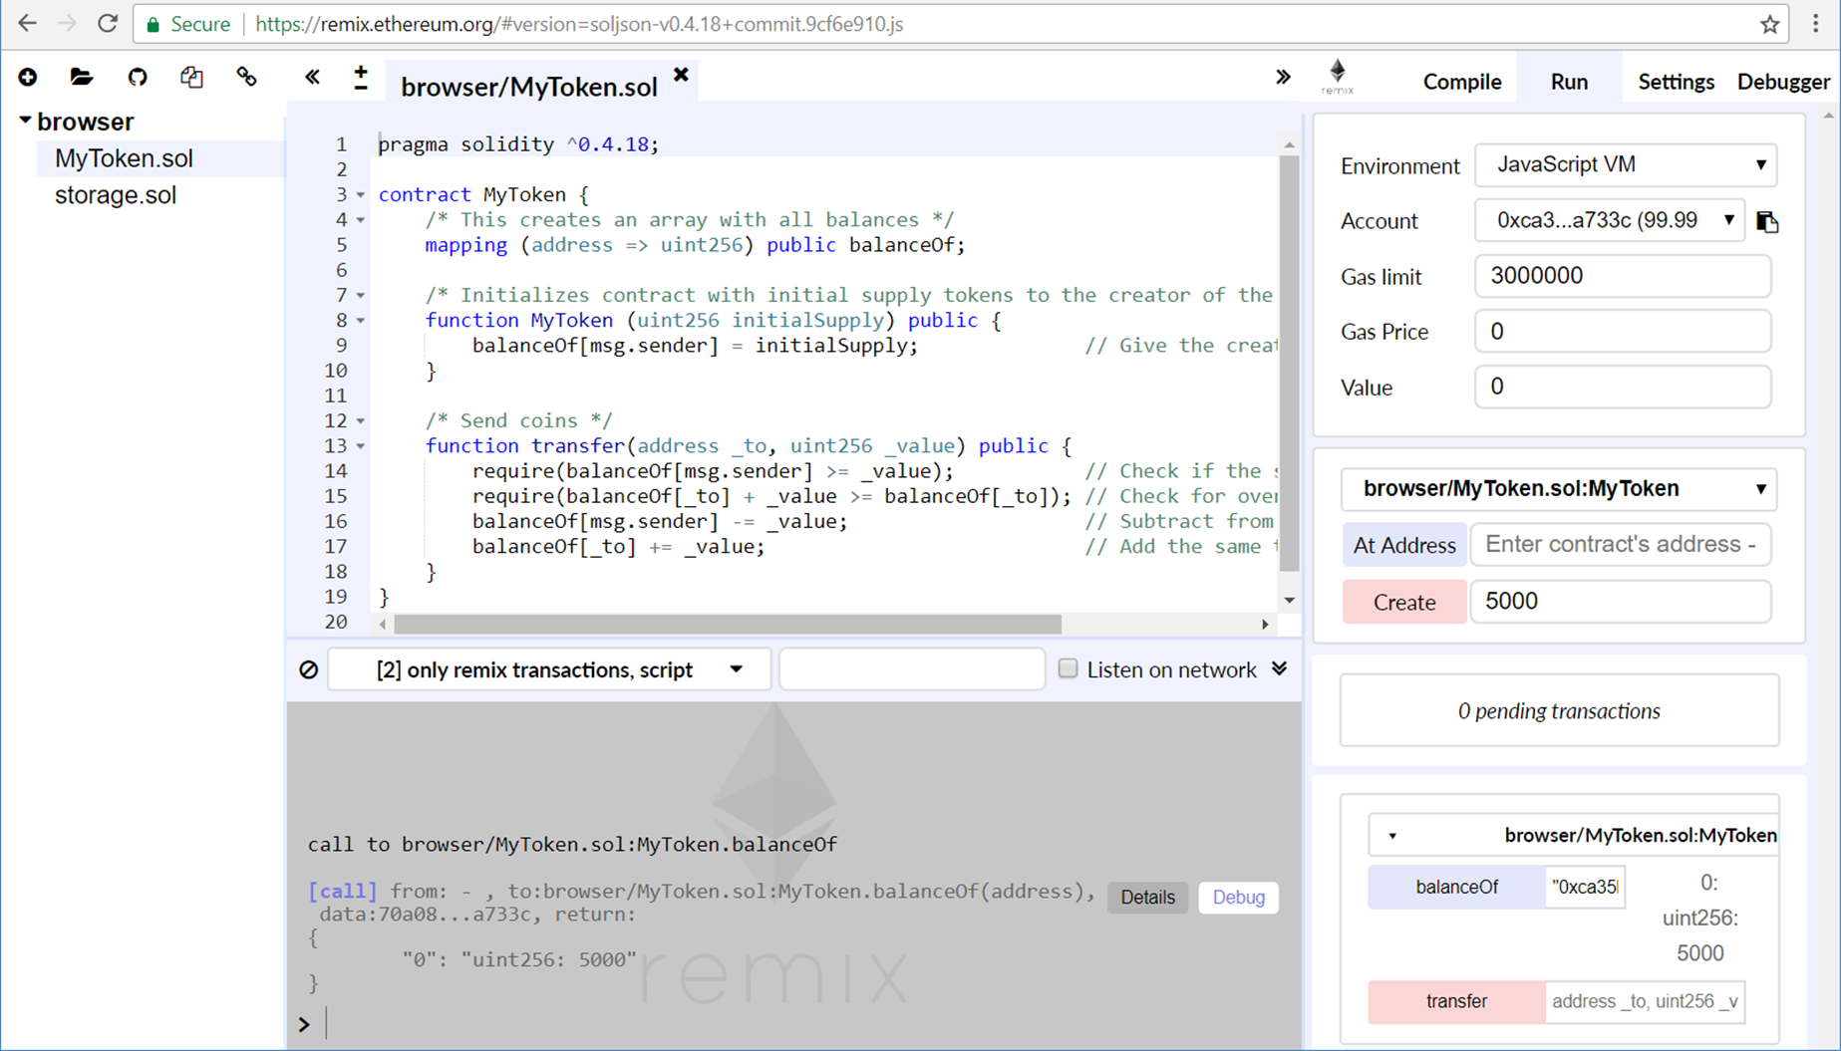
Solidity in Practice
Write and Run Solidity Code in Remix IDE

Slide 13

Installing Solidity Dev Environment
Remix
In-browser Solidity IDE
https://remix.ethereum.org
Solidity compiler
https://www.npmjs.com/package/solc
Ethereum ganache-cli(former testrpc) + Truffle Framework
https://github.com/ethereumjs/testrpc
http://truffleframework.com

Slide 14
Playing with Ethereum Remix

Slide 15

Contracts Programming Basics
Contracts in Solidity are
Like classes and interfaces in the OOP languages
Contracts may hold
Data + functions
Just like classes in OOP
Contract execution is paid with gas consumption
contract SomeContract {
uint someData;
function someFunc(uint p) {
// function body …
}
…
}

Slide 16
Functions in Solidity
Functions are the executable units of code within a contract
Once defined, can be invoked later (with some arguments):
pragma solidity ^0.4.24;
contract SimpleAuction {
function bid(uint bidPrice) public {
// function body …
}
}
bid(15000);

Slide 17
Example: Simple Storage Contract
pragma solidity ^0.4.24;
contract SimpleStorage {
uint private storedData;
function set(uint x) public {
storedData = x;
}
function get() view public returns (uint) {
return storedData;
}
}
Persistent data stored in the blockchain
Public member function: anyone can invoke it
View function: does not change the contract's state

Slide 18
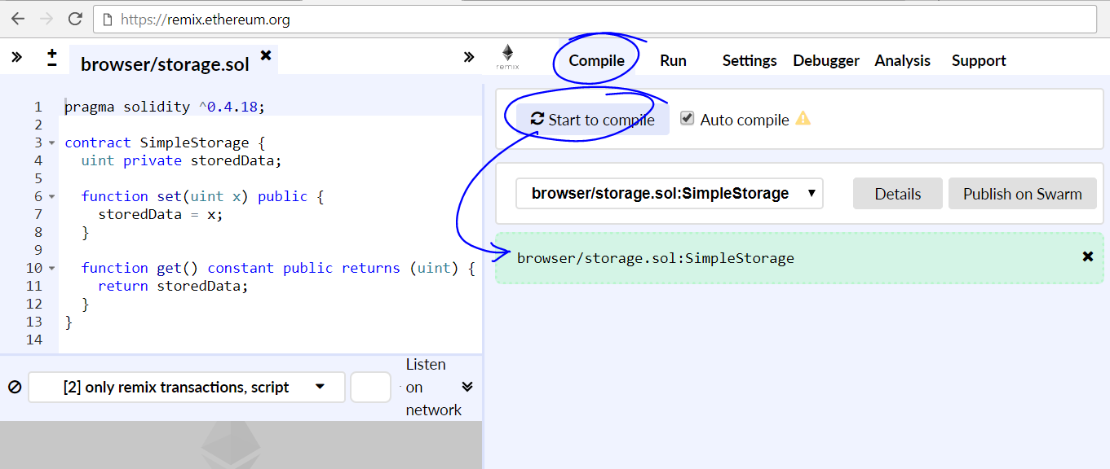
Compiling the Contract in Remix

Slide 19
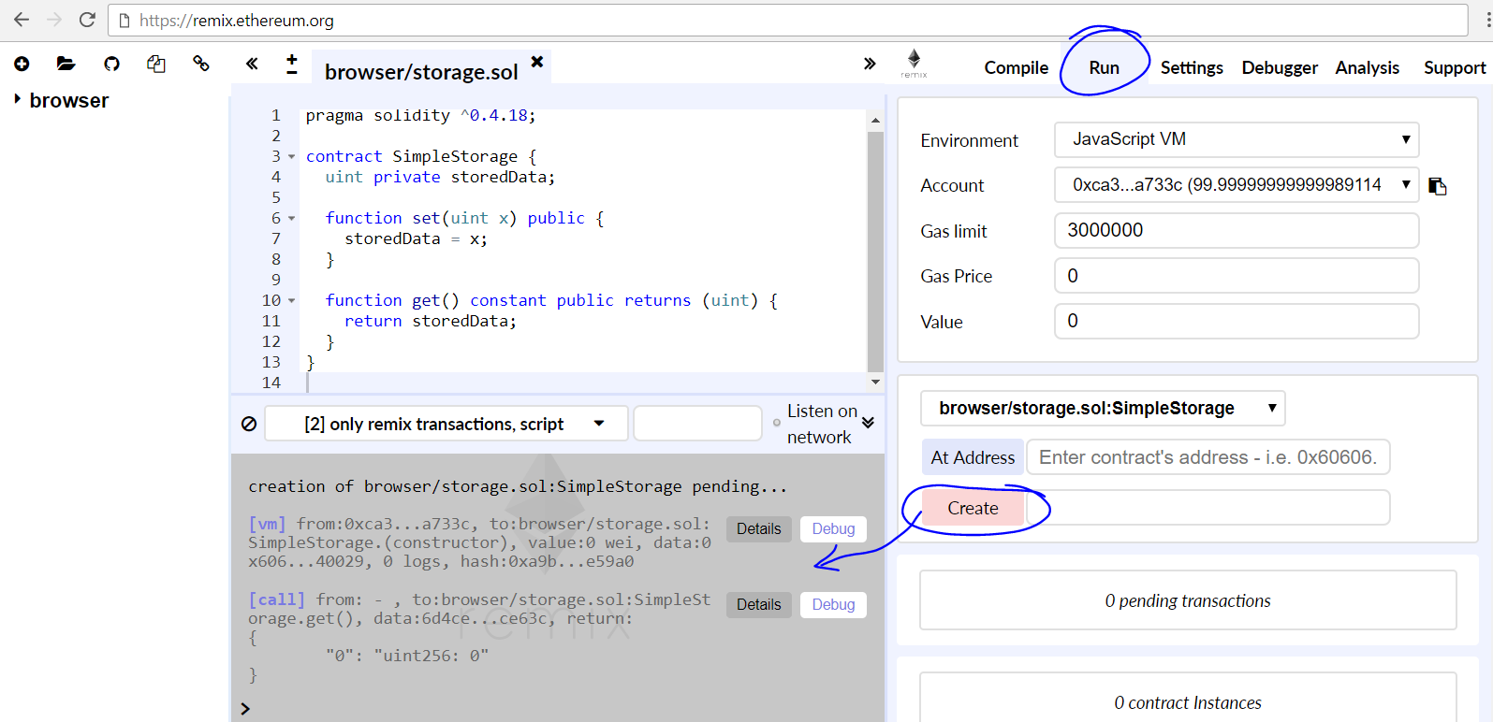
Deploying the Contract in a Testing EVM

Slide 20
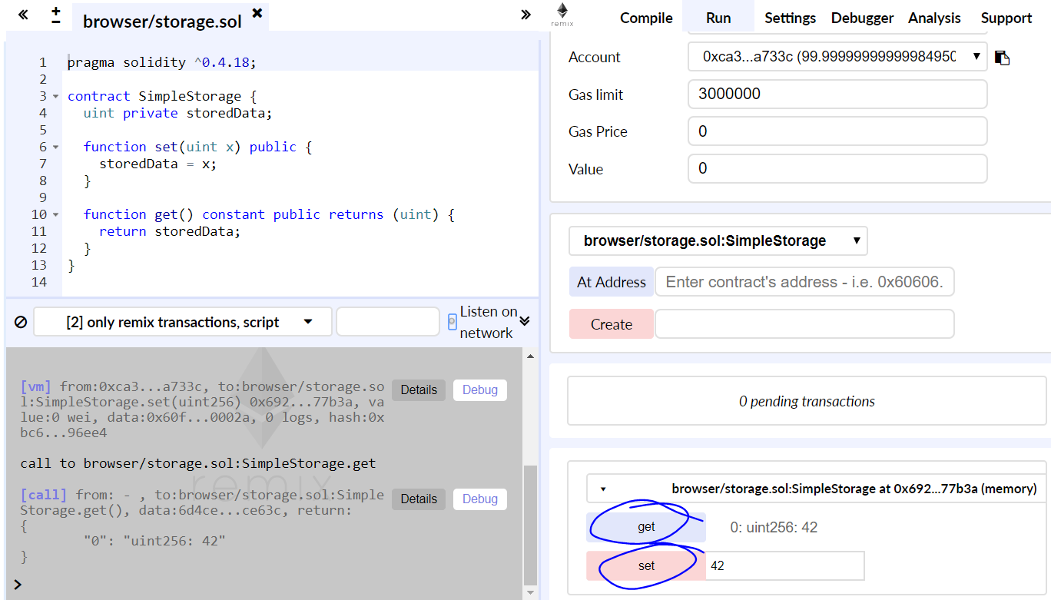
Invoking Functions on the Deployed Contract

Slide 21

Debugging in Remix

Slide 22
Debugging in Remix
The debugger allows one to see detailed information about the transaction’s execution
You can start a debug session by providing either a transaction hash or a block number and transaction index
The transaction panel displays basic information
The navigation part contains a slider and buttons
Low level panels
Instructions, Solidity Locals, Solidity State, Stack, Storage Changes,
Memory, Call Data, Call Stack, Return Value.

Slide 23
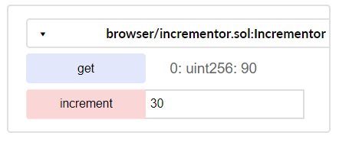
Problem: Incrementor Contract
Write a Solidity contract
Contract holds a certain value
value (uint)
Anyone can read the value
get() → uint
Anyone can increment the value
increment(uint delta)
increment
value

Slide 24
Solution: Incrementor Contract
pragma solidity ^0.4.24;
contract Incrementor {
uint private value;
function increment(uint delta) public {
value += delta;
}
function get() view public returns (uint) {
return value;
}
}
Persistent data stored in the blockchain
Change the persistent data field
Read the persistent data field

Slide 25
Function Visibility: Public and External
Public (default)
Part of the contract interface, can be called by anyone
For public state variables, an automatic getter function is generated
External
Functions designed to be called externally
From other contracts and by external transactions
An external function cannot be called internally
I.e. f() does not work, but this.f() works
Cheaper to execute compared to Public
uint256 public totalSupply;
function finalize() external { … }

Slide 26
Function Visibility: Internal and Private
uint256 internal totalSupply;
Internal
Accessed internally (i.e. from within the current contract or contracts deriving from it), without using “this”
Like "protected" in object-oriented languages
Private
Accessible in the contract only
Not accessible in the derived contracts
uint256 private totalSupply;

Slide 27
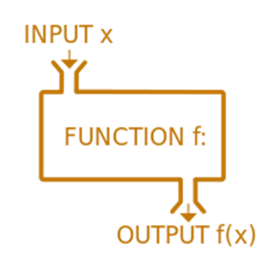
Functions in Solidity
Functions with no output
Functions returning values
function increment(uint delta) public {
value += delta;
}
Function visibility: external / public / internal / private
function get() view public returns (uint) {
return value;
}
Promise not to modify the state of blockchain
Specify explicitly the return type

Slide 28
Data Types in Solidity
Data types are similar to most programming languages:
int8 / uint8, … uint256 (uint) – integers of 8 … 256 bits
No floating-points numbers
bool – true / false value
string – UTF8-encoded text, e.g. "Hello, Solidity!" or "“
bytes/ bytes8, … bytes32 – Storing information as bytes
address – Ethereum address (EIP 55 encoded)
e.g. 0xdCad3a6d3569DF655070DEd06cb7A1b2Ccd1D3AF
enum – enumerated type

Slide 29
Data Types in Solidity
int8,int32 … int256/ uint8, … uint256 (uint)
Number literal expressions retain arbitrary precision until they are converted to a non-literal type
Expressions with variables don’t retain arbitrary precision!
Integer literal division evaluates to a rational number
uint public a = 0xA3F; // is 2623
uint public c = ( 2 / 5 + 1) * 10;
// (0.4 + 1) * 10 = 1.4*10 = 14

Slide 30
Data Types in Solidity
Strings
Arbitrary-length UTF-8 data
Support escape characters - \n, \xNN and \uNNNN
\xNN takes a Hex value and inserts the appropriate byte
\uNNNN takes Unicode and inserts the appropriate UTF-8 sequence
No index access. You need to cast it to bytes!
Strings in Solidity are expensive
string public a = "\x4b\x69\x6e\x67\x73\x6c\x61\x6e\x64"; // Kingsland
string public a = "\u004b\u0069\u006e\u0067\u0073\u006c\u0061\u006e\u0064"; // Kingsland

Slide 31
Data Types in Solidity
Bytes, bytes1, bytes2, … bytes32
Arbitrary-length raw byte date
Has default value of 0 when initialized
bytesX == new byte[X];
bytesX[n] will return the N-th byte
This is Read-only
Value is between 0 and 255
Better to use bytesX instead of String

Slide 32
Data Types in Solidity
Address
The address type is a 20 byte value that does not allow any arithmetic operations
Has members
balance - query the balance of an address
transfer - can be used for sending Ether other addresses
send - the lower level counterpart of the member transfer
call, callcode, delegatecall - discuss in the Advanced lectures

Slide 33
Data Types in Solidity
Enum
Enums are one way to create a user-defined type in Solidity
Value ranges checked at runtime
Failure causes an exception
Type Deduction
enum Answer {Yes, No, Maybe}
Answer decision = Answer.Yes;
uint14 x = 123;
var y = x; // y becomes uint14

Slide 34
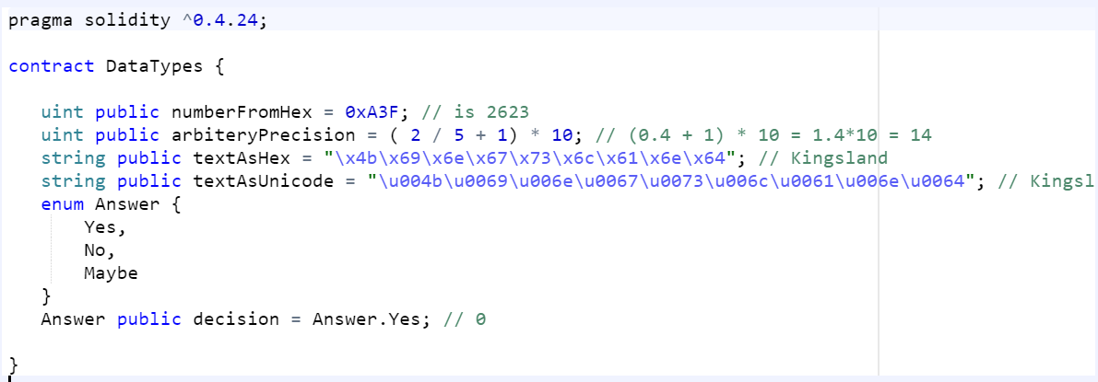
Data Types in Solidity
Live Demo

Slide 35
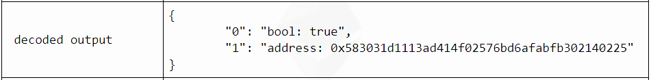
Problem: Last Invoker
Write a Solidity contract
Keep the address of its previous invoker
getLastInvoker() → returns (bool, address)
true / false – if a previous invoker exists or not
The address that has invoked the contract before you

Slide 36
Solution: Last Invoker
pragma solidity ^0.4.24;
contract LastInvoker {
address private lastInvoker;
function getLastInvoker() public
returns (bool, address) {
address result = lastInvoker;
lastInvoker = msg.sender;
return (result != 0x0, result);
}
}
Keep the last invoking address in the contract's persistent storage
The address of the contract's invoker is sent as msg.sender

Slide 37
Arrays
Types of Arrays in Solidity
Compile-time fixed size
Dynamic
Can hold arbitrary types
Arrays, Mappings or Structs
Multidimensional Arrays
Array Members
Length – returns the number of elements in the Array
Push – appends new elements to Dynamic Array
bool[2][] pairsOfFlags;
pairsOfFlags[index][0] = true;
pairsOfFlags[index][1] = false;

Slide 38
Arrays
// Array of fixed size
uint8[3] nums = [10, 20, 30];
nums[0] = 10;
0 1 2
10 | 20 | 30
// Dynamic array (variable size)
uint24[] score;
function addScore(uint24 s) public returns (uint) {
if (score[score.length-1] < s)
score.push(s);
return score.length;
}
0 1 2 …
50 | 62 | 73 | …

Slide 39

Problem: Array of Facts
Create a Solidity contract
Contract owner (creator) can
Add facts (string values)
Anyone can read the facts
count() – returns the count of facts
getFact(index) – returns specified fact by index [0…count-1]
Solidity cannot return all facts (array of strings)
Nobody can delete facts or destroy the contract

Slide 40
Solution: Array of Facts
Hold all the facts in array stored on the blockchain
contract Facts {
string[] private facts;
address private contractOwner = msg.sender;
function add(string newFact) public {
require(msg.sender == contractOwner);
facts.push(newFact);
}
function count() view public returns (uint) {
return facts.length;
}
function getFact(uint index) view public returns (string) {
return facts[index];
}
}
Check for ownership
Append an element into the array
Solidity functions cannot return string[] so we use a workaround

Slide 41
Maps
Key-value Pair – mapping(_keyType => _valueType)
_keyType – Any type except for a mapping, a dynamically sized array, a contract, an enum and a struct
_valueType – can actually be any type, including mappings.
The key is not stored, its keccak256 is used to look up the value
Impossible to retrieve the keys
Impossible to retrieve the values without the keys
Values are initialized with the default value of their type

Slide 42
Maps
mapping (string => address) private accounts;
accounts["Peter"] =
0xdCad3a6d3569DF655070DEd06cb7A1b2Ccd1D3AF;
struct Account {
string personName;
uint amount;
}
mapping (address => Account) accByAddr;
accByAddr[0xdCad3a6d3569DF655070DEd06cb7A1b2Ccd1D3AF] =
Account("Peter", 120);
Mappings can be used as fields in the contracts only. No instantiation is needed.

Slide 43
Structs
Structs are a composition of more primitive types
Doesn’t support Struct Methods
Doesn’t support Modifiers
No inheritance, polymorphism and encapsulation
Not possible to contain, a member of its own type
You can store Structs inside Mappings and Arrays
Direct access to the members of Struct

Slide 44
Structs
A simple structure holding two data fields
struct Account {
address addr;
uint amount;
}
Account acc = Account({
addr: 0xdCad3a6d3569DF655070DEd06cb7A1b2Ccd1D3AF,
amount: 50});
Account peterAcc = Account(
0xca35b7d915458ef540ade6068dfe2f44e8fa733c, 180);
acc.amount += 20;
Creating an object of given structure
Creating another object
Accessing a field from the structure

Slide 45


Problem: Registry of Certificates
A company issues certificates for completed trainings
Each certificate has its data and content calculated as hash
The registry of all valid certificate hashes stored on the blockchain
Owner can add certificate hashes: add(hash)
Anyone can verify а certificate by its hash: verify(hash)
hashing
add(…)
Hashes stored in the blockchain
0x6a7e9e1…
verify(…)
true / false

Slide 46
Solution: Registry of Certificates
contract Certificates {
mapping (string => bool) private certificateHashes;
address contractOwner = msg.sender;
function add(string hash) public {
require (msg.sender == contractOwner);
certificateHashes[hash] = true;
}
function verify(string hash) view public
returns (bool) {
return certificateHashes[hash];
}
}
Contract owner only
Store the certificate hash on the blockchain

Slide 47

Problem: Create a Simple Token
Create a simple token contract
The initial supply is specified at contract's creation
The entire initial supply is held by the contract's creator
Token owners can send tokens to other addresses
transfer
0x2C…e9
transfer
owner
0x6a51…7F
create
transfer
transfer
0x7…5b
contract (initial supply)
0x38ad…e3

Slide 48
Solution: Simple Token
contract SimpleToken {
mapping (address => uint256) public balanceOf;
function SimpleToken (uint256 initialSupply) public {
balanceOf[msg.sender] = initialSupply;
}
function transfer(address to, uint256 value) public {
if (balanceOf[msg.sender] >= value) &&
(balanceOf[to] + value >= balanceOf[to]) {
balanceOf[msg.sender] -= value; // Subtract the value from the sender
balanceOf[to] += value; // Add the same value to the recipient
}
}
}

Slide 49

Summary
Solidity is a high-level programming language
Designed to write smart contracts in the Ethereum VM
Remix is a powerful online Solidity IDE
Solidity programming: contracts, functions, data types, arrays, maps, structs
contract SomeContract {
uint someData;
function someFunc(uint p) {
…
}
}

Slide 50

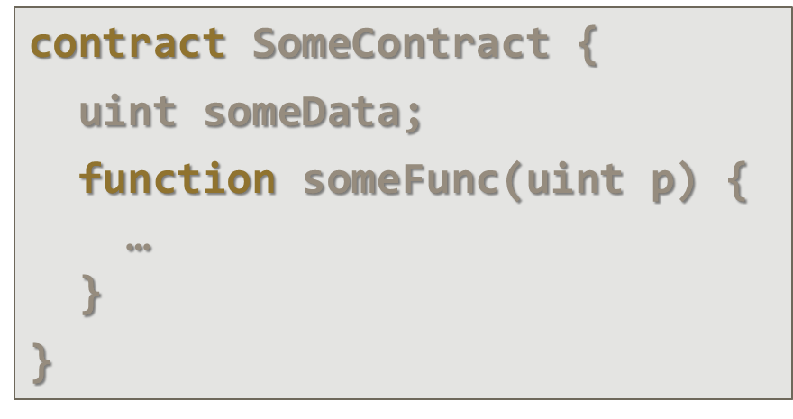


Smart Contracts and Solidity Basics

Slide 51
Resources
Remix – https://remix.ethereum.org
Solidity official documentation – https://solidity.readthedocs.io/en/develop/
Solidity tutorials – https://ethereumbuilders. gitbooks.io/guide/content/en/solidity_tutorials.html
Learn Solidity in Y Minutes – https://learnxinyminutes.com/docs/solidity/
Solidity Code Style Guide – http://solidity.readthedocs.io/en/ develop/style-guide.html

Slide 52
Resources (2)
https://ethereum.stackexchange.com
https://github.com/OpenZeppelin/zeppelin-solidity/commit/370e6a882aef6b9600949594d3a3e4854260d51e
https://medium.com/@jeff.ethereum/optimising-the-ethereum-virtual-machine-58457e61ca15
http://www.blockchainexpert.uk/blog/what-is-solidity
https://github.com/OpenZeppelin/zeppelin-solidity

