Slide 1
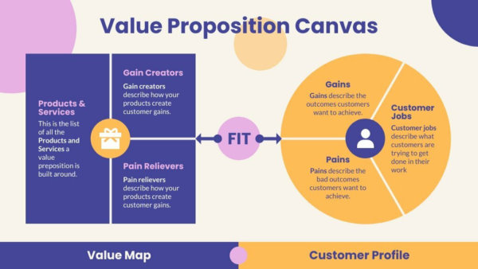
Value Proposition
Value Proposition, Definition, Product,
Service, Customer, USP

Slide 2
Table of Contents
What is Value Proposition?
What Problem Does Our Business Solve?
Product (and Types of Products), Service, Value
Customer
Types of Customers and Customer Value Drivers
Creating a Unique Selling Proposition (USP)
How to Identify a Value Proposition?
Value Proposition Canvas

Slide 3

What is Value Proposition?
Definition

Slide 4

What is Value Proposition?
Value proposition
A short statement that communicates why buyers should choose your product or service
The value a company promises to deliver to customers
What your business does better than anyone else

Slide 5

Value Proposition – Example
Example: Fruit and vegetables shop
Problem: Difficulty finding fresh and high-quality fruits and vegetables in local markets
Solution:
Discover our farm-fresh produce sourced directly from local growers
Ensuring the highest quality and freshness for your healthy lifestyle

Slide 6

What is a Product?
Definition, Types of Products
Notes:
6

Slide 7

What is a Product?
What is Product?
A product is the item offered for sale
Anything that can be offered to a market for use or consumption that might satisfy a want / need
Product:
can be an item or a service
can be physical or in virtual or hybrid form
every product is made at a cost and each is sold at a price

Slide 8
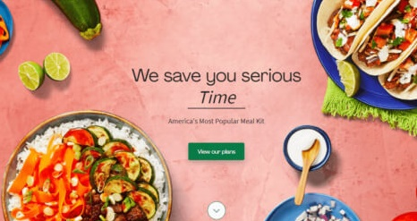
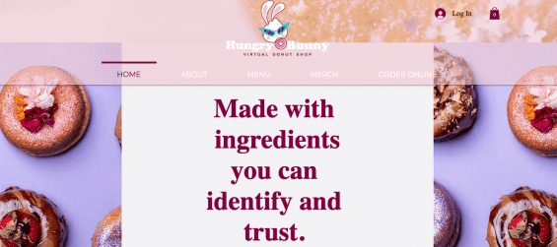
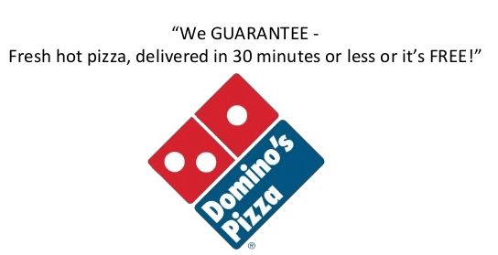
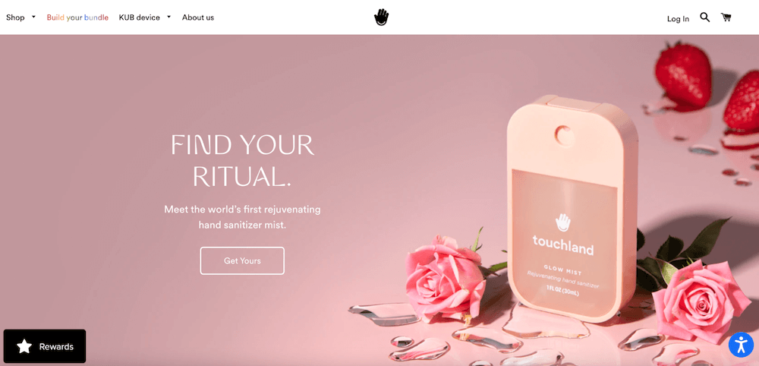
USP – Examples

Slide 9
Goods vs. Services
Goods
Objects or system made available for customers
Tangible
Manufactured, stored and transported
Ex: Food, furniture, electronic devices
It can be returned / replaced
Products can be identical
Service
Transactions where no physical goods are transferred
Intangible
Can’t be manufactured, stored and transported
Ex: cleaning, car repair, haircuts, medical checkups
Can’t be returned or replaced
Each delivery of service is never the same
vs.

Slide 10
What Did We Learn Today?
Value proposition == what the problem is and how your product / service solves it?
Value == how much benefit or usefulness you get?
Customer value drivers == price, quality, convenience, innovation, personalization, brand reputation, customer service, user experience, sustainability, and emotional appeal
Unique Selling Proposition (USP) == how you are different?
Value Proposition Canvas == a framework for designing a value proposition

Slide 11
Questions?

Slide 12

License
This course (slides, examples, code, demos, exercises, tutorials, homework, projects, documents, videos and other assets) is copyrighted content, created by SoftUni
Unauthorized copy, reproduction or use is illegal
© SoftUni – https://softuni.org
© Software University – https://softuni.bg
© Software Buditel – https://buditel.softuni.bg

