Slide 1
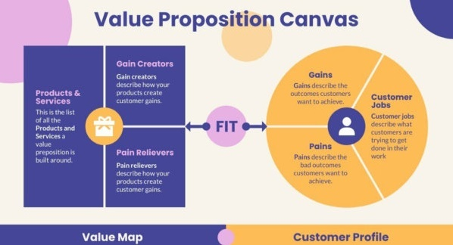
Value Proposition
Value Proposition, Definition, Product,
Service, Customer, USP, Value Proposition Canvas
Svetlin Nakov
SoftUni Buditel

Slide 2
Contents
Objects and JSON
JS Objects and Properties
JSON: Stringify and Parse
Associative Arrays
Mapping Keys to Values
Iterating over the Key-Value Pairs
The Map Class
The Set Class

Slide 3

What is Value Proposition?
Definition

Slide 4

What is Value Proposition?
Value proposition
A short statement that communicates why buyers should choose your product or service
The value a company promises to deliver to customers
What your business does better than anyone else

Slide 5

Value Proposition – Example
Example: Fruit and vegetables shop
Problem:
Difficulty finding fresh and high-quality fruits and vegetables in local markets
Solution:
Discover our farm-fresh produce sourced directly from local growers
Ensuring the highest quality and freshness for your healthy lifestyle

Slide 6

What is a Product?
Definition, Types of Products
Notes:
6

Slide 7

What is a Product?
What is a product?
A product is the item offered for sale
Anything that can be offered to a market for use or consumption that might satisfy a want / need
Product:
can be an item or a service
can be physical or in virtual or hybrid form
every product is made at a cost and each is sold at a price

Slide 8
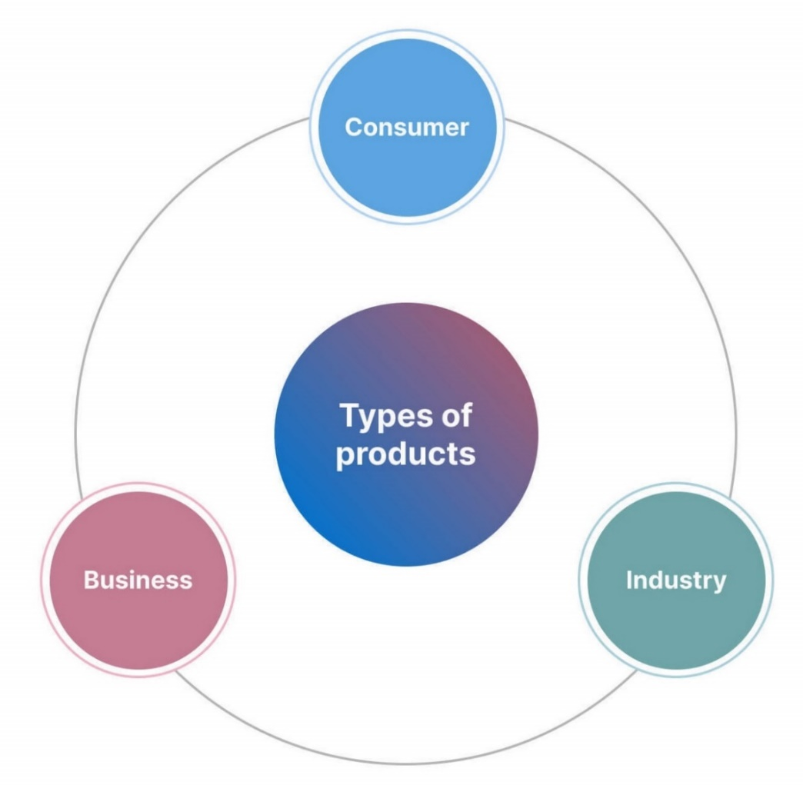
Types of Products
Consumer products (e.g. car):
Finished products offered to the final customer who consumes them
Industrial products (e.g. bricks):
These act as materials used in the production of other goods
Business products (e.g. Shkolo.bg):
Help other companies create their own products or operate their business

Slide 9

Objects in JS
Objects, Properties and JSON

Slide 10



Learn to Search in Internet
The course assignments require to search in Internet
This is an important part of the learning process
Some exercises intentionally have no hints
Learn to find solutions!
Software development includes everyday searching and learning
No excuses, just learn to study!
Developers learn new technologies, tools, languages every day!

Slide 11

Basic Slide
Short explanation of the slide topic
Keep slide content centered
let names = new Set();
names.add("Peter"); names.add(20);
names.add("Maria"); names.add(5);
console.log(names.has('Peter')); // true
names.add("Maria"); // Duplicates are skipped
names.delete(20); // Delete element if exists
for (let name of names) console.log(name);

Slide 12
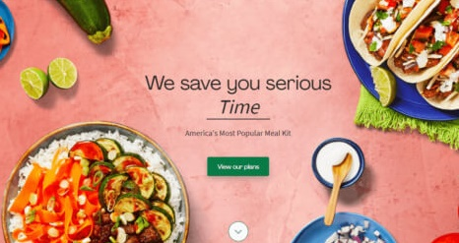
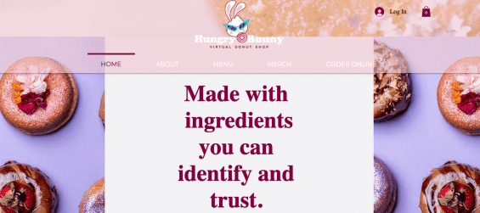
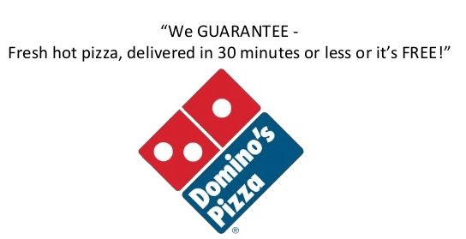
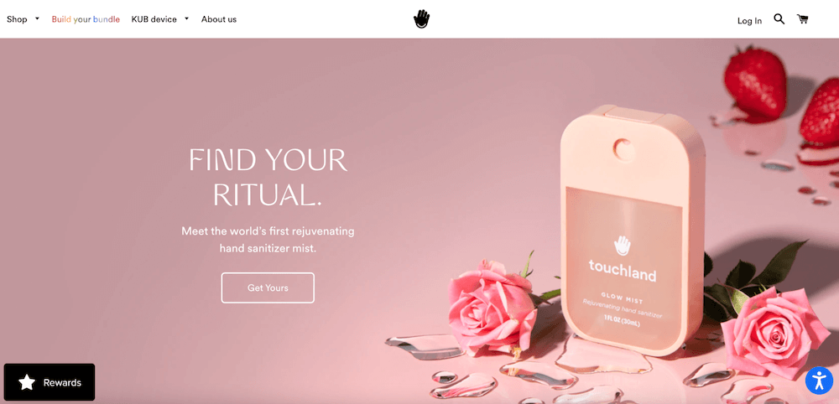
USP – Examples

Slide 13
Goods vs. Services
Goods
Objects or system made available for customers
Tangible
Manufactured, stored and transported
Ex: Food, furniture, electronic devices
It can be returned / replaced
Products can be identical
Service
Transactions where no physical goods are transferred
Intangible
Can’t be manufactured, stored and transported
Ex: cleaning, car repair, haircuts, medical checkups
Can’t be returned or replaced
Each delivery of service is never the same
vs.

Slide 14

Debugging
Simple Operations with the Debugger
Notes:
14

Slide 15
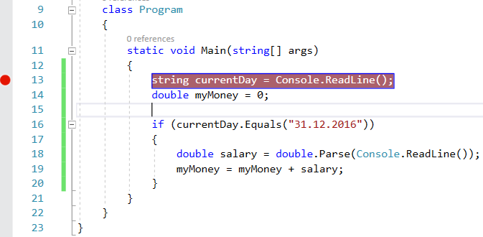
Debugging
Debugging == the process of step-by-step tracing the program execution
This helps finding errors (bugs)
Breakpoint
Notes:
15

Slide 16
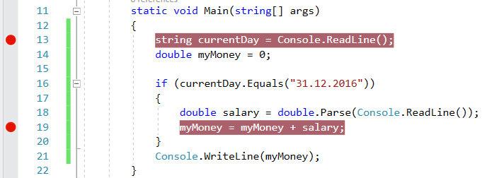
Debugging in Visual Studio
Press [F5] to run the program in debug mode
Proceed to the next execution step using [F10]
Press [F9] to create a breakpoint (stopper)
Run the program and it will stop when a breakpoint is hit
Notes:
16

Slide 17
The "switch-case" Statement
switch()
case:
…
default:
Checking Multiple Values at Once
Notes:
17

Slide 18
The "switch-case" Conditional Statement
switch-case works as a sequence of if-else-if-else-if…
switch (…)
{
case …:
// code
break;
case …:
// code
break;
default:
// code
break;
}
The switch starts by an input expression
Sequence of values for checking
Code to execute if no case is matched
Notes:
18

Slide 19
Problem: Day of Week
Create a program, which:
Reads an integer from the console
Prints at the console the day of week (in English, as text) according to the input number [1…7]
When the number is out of range, prints "Error"
Sample input and output:
1
Monday
4
Thursday
9
Error
Notes:
19

Slide 20
Solution: Day of Week
int day = int.Parse(Console.ReadLine());
switch (day)
{
case 1:
Console.WriteLine("Monday"); break;
case 2:
Console.WriteLine("Tuesday"); break;
// TODO: check the other days
case 7:
Console.WriteLine("Sunday"); break;
default:
Console.WriteLine("Error"); break;
}
Notes:
20

Slide 21

Exercises
Practical Problem Solving

Slide 22
What Did We Learn Today?
Value proposition == what the problem is and how your product / service solves it?
Value == how much benefit or usefulness you get?
Customer value drivers == price, quality, convenience, innovation, personalization, brand reputation, customer service, user experience, sustainability, and emotional appeal
Unique Selling Proposition (USP) == how you are different?
Value Proposition Canvas == a framework for designing a value proposition

Slide 23
Conclusion
Objects in hold key value pairs
Maps map keys to values, preserves key order
Sets hold unique collection of values
let p = { x: 5, y: 7 };
let obj = { name: "SoftUni", age: 3 };
obj.age++;
delete obj.name;
let set = new Set(); set.add(5);

Slide 24
Questions?

