Slide 1
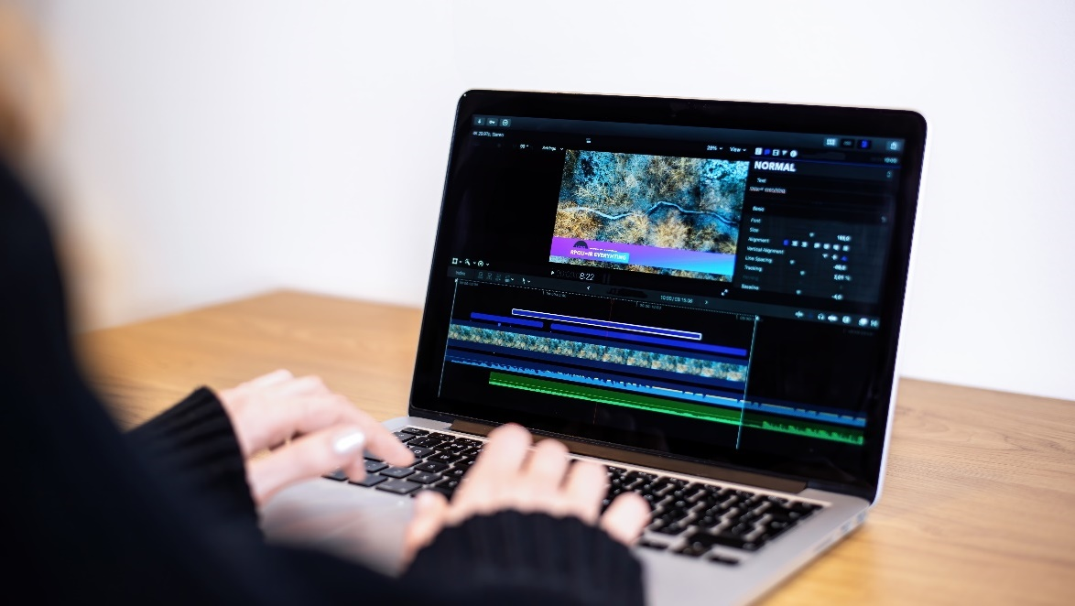
1. Filters and tools
Filters, tools, greyscale coloring
Alexander Ivanov
Co-Founder, CreateX
https://softuni.digital.bg

Slide 2

Intern and Team Lead Academy
Gain Real World Skills. Work on Real Projects. Learn Teamwork
Svetlin Dylgoimest Dalgofamiliest
Manager Innovations, New Projects and AI Technologies @ SoftUni
Co-founder of SoftUni Foundation
https://softuni.digital.bg

Slide 3
Table of Contents
Greyscale coloring
Types of coloring
Color schemes
Generating color schemes
Filters
Creating filters
Applying filters
Tools

Slide 4
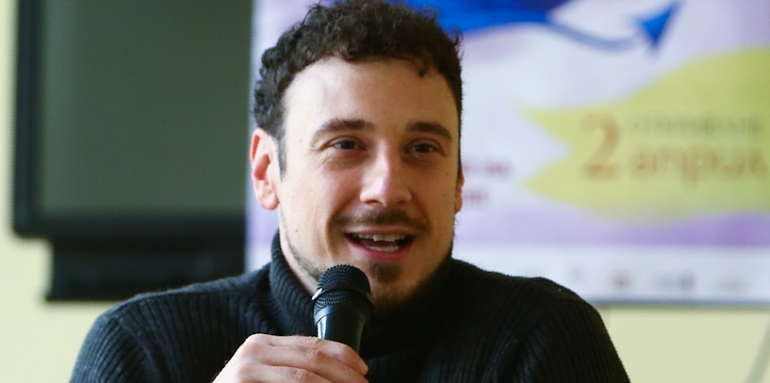
Alexander Ivanov
Founder @ CreateX

Slide 5
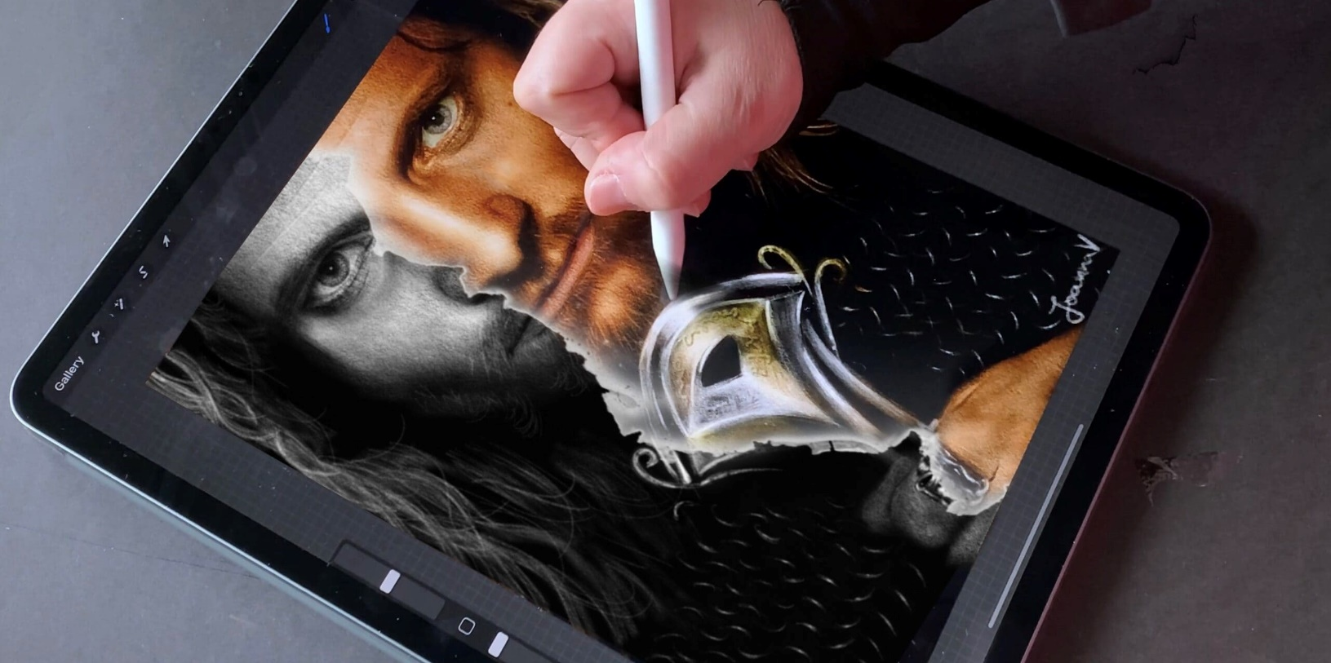
Greyscale coloring
Transition painting from greyscale to color

Slide 6
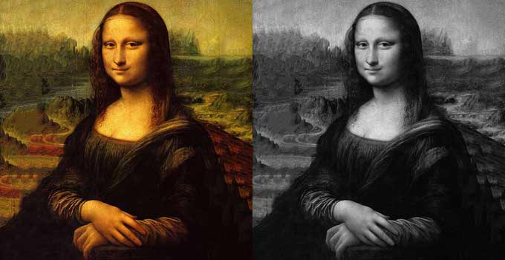
What is greyscale coloring?
Grayscale coloring is adding color to a design that already has the shading added
These designs can look like black-and-white pictures or can be designed specifically for coloring
Example: coloring an old black-and-white photograph
To color a greyscale image:
Just color right over the shades of gray, covering it fully
Let the gray guide you, matching the darkness or lightness of your colors to the levels of gray

Slide 7
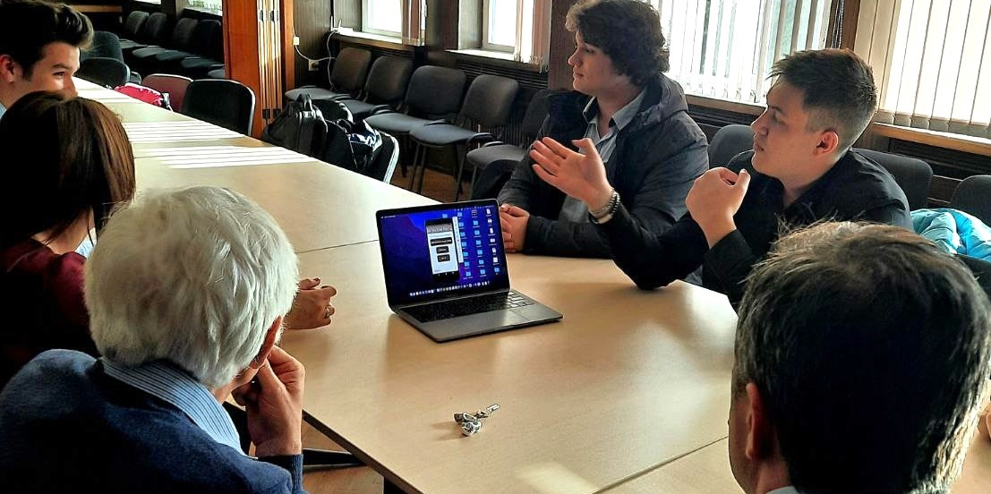
Finding a Product-Market Fit in the AI Industry Tech Startups

Slide 8
Goods vs. Services
Goods
Objects or system made available for customers
Tangible
Manufactured, stored and transported
Ex: Food, furniture, electronic devices
It can be returned or replaced
Products sold can be identical
Service
Transactions where no physical goods are transferred
Intangible
Can’t be manufactured, stored and transported
Ex: cleaning, car repair, haircuts, medical checkups
Can’t be returned or replaced
Each delivery of service is never the same
vs.

Slide 9

Product-Market Fit
What is product-market fit? How to reach it? Frameworks for achieving product-market fit

Slide 10
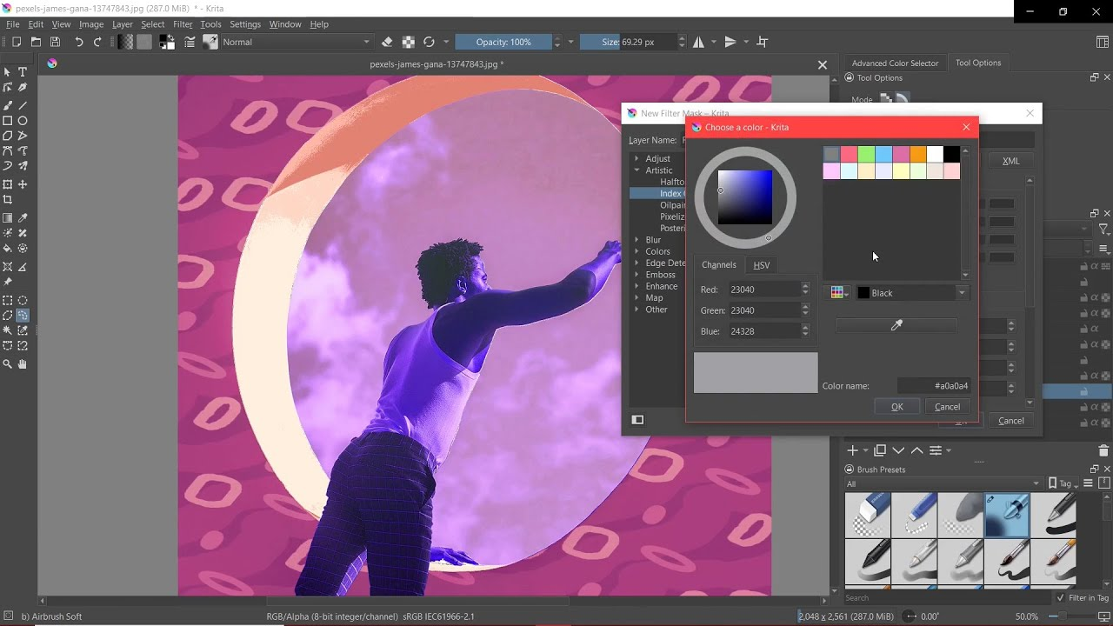
What do filters do?
Filters are unique to digital painting in terms of complexity and their part in the painting pipeline
Some artists only use filters to adjust their colors a little
Others, use Filter Layers and Filter Masks, use filters to dynamically update a part of an image
Thus, they keep the original underneath without changing it
This is part of a technique called ‘non-destructive’ editing

Slide 11
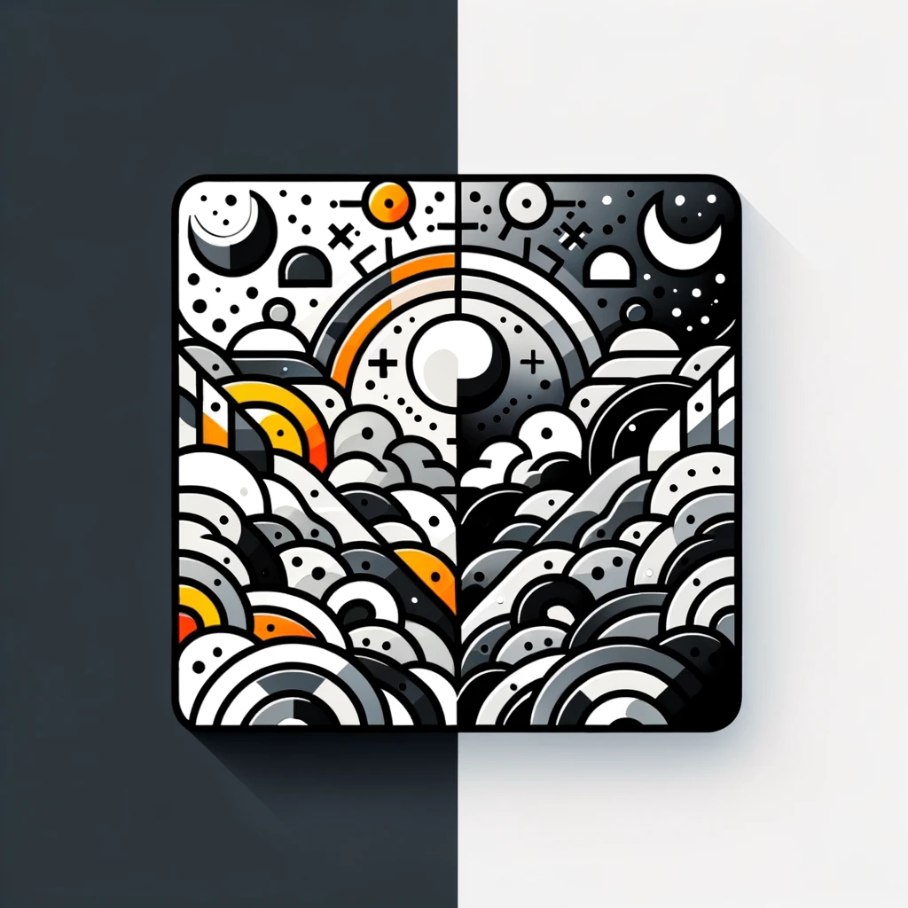
Greyscale coloring
Transition painting from greyscale to color

Slide 12

Creating Presentations
Good master template
High contrast
Light text on dark background
Dark text on light background
Big enough fonts
Rich images / illustrations
Use bullets
Not full sentences

Slide 13
Greyscale coloring
Transition painting from greyscale to color

Slide 14

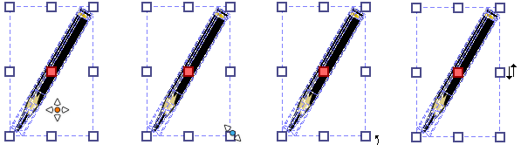


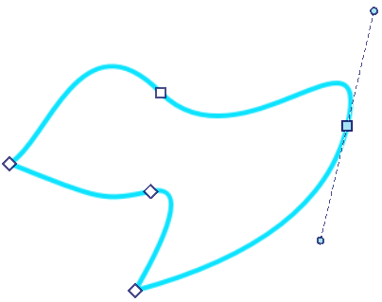

Shape and text tools
Shape selection tool – only works on vector layers, so trying to use it on a paint layer will give a notification
Shape edit tool – for editing vector shapes
Text tool – add text to your artwork

Slide 15
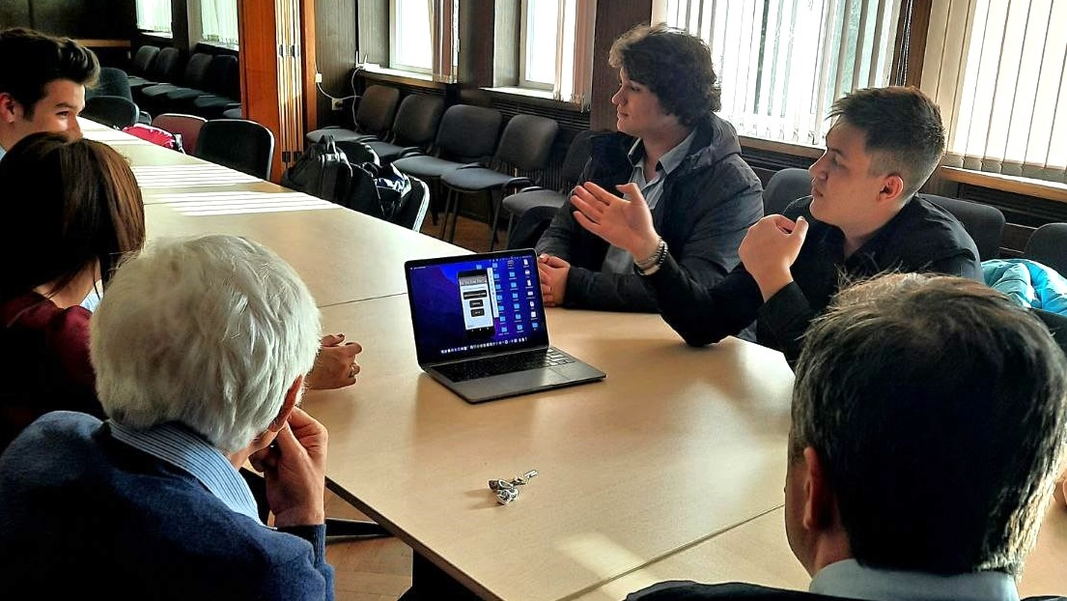
Pitching Your Product

Slide 16
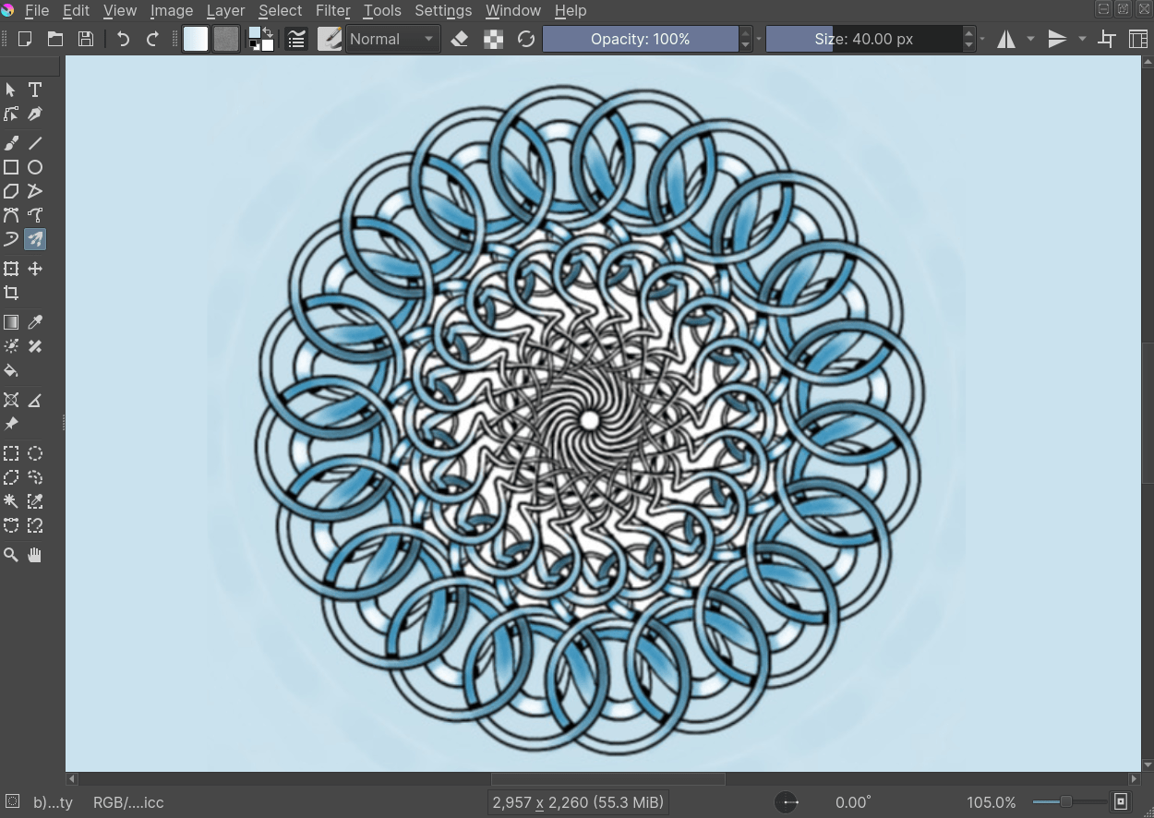
Tools
What does each Krita tool do?

Slide 17
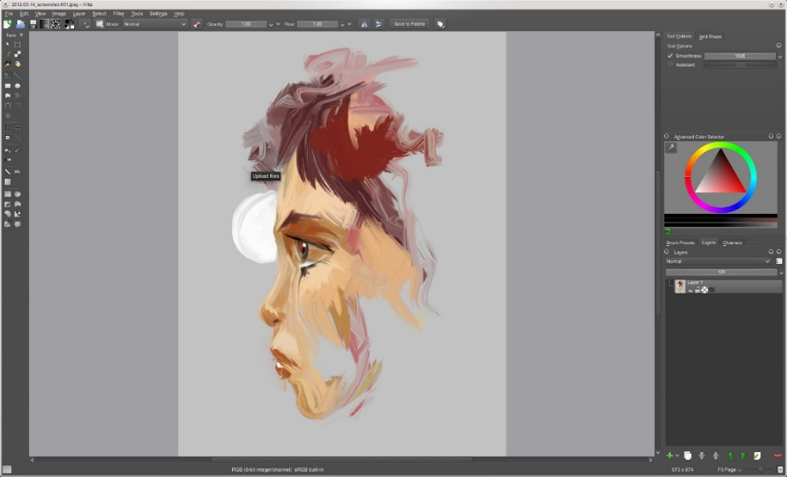
Why are digital art tools important?
With these tools, you can draw more quickly compared to traditional tools
Tracing refers to mimicking a photo or image
Tracing will help you learn how to draw illustrations
Such as tracing a complicated building or tracing a picture to copy the lines

Slide 18
Why are digital art tools important?
With these tools, you can draw more quickly compared to traditional tools
Tracing refers to mimicking a photo or image
Tracing will help you learn how to draw illustrations
Such as tracing a complicated building or tracing a picture to copy the lines

Slide 19
Jobs in the Software Industry in Bulgaria (Oct 2022)
5K open positions in the software industry in dev.bg
This excludes the broader ICT industry! Source: https://dev.bg
5.1K open IT job positions at jobs.bg
Source: https://www.jobs.bg/it
54K professionals have already software-related jobs in BG
Source: LinkedIn: People | software | Bulgaria
55K professionals in the BG software industry (108K in the ICT)
4600 software companies (2021) from 20+ countries
Source: BASSCOM Barometer; Eurostat Employed ICT Specialists

Slide 20
Software Developers in Bulgaria (2005-2021)
SoftUni starts in 2014
54K devs in Bulgaria in 2022
Source: BASSCOM Barometers (https://basscom.org/industry/all-barometers)

Slide 21
Software Jobs in Bulgaria / Mongolia
Software jobs in Bulgaria / Mongolia / US in numbers (Oct 2022):
Metric | Bulgaria | Mongolia | United States
Population | 6.8M | 3.4M | 335.4M
GDP | 84B USD | 15.1B USD | 24 880B USD
GDP per capita | 8293 USD | 4121 USD | 69 288 USD
Dev companies | 5 000 - 6 000 | ? 200 - 300 ? | 500 000 - 600 000
Dev jobs (open positions) | 5 500 | 500 | 1 365 500
Software devs count | 54 000 | 3 000 | 4 400 000
Devs as % of population | 0.795% | 0.088% | 1.312%
Growth potential
1.6x
15x

Slide 22
Software Industry Evolution
This is how the software industry evolved in Bulgaria
1990-2000
2000-2010
2010-2022
Focus on the local market
Outsourcing for US and Europe
US and Europe dominated market
Small companies (5-50 devs)
Work mostly for the local market
Outsourcing started
Mid-size companies (50-250 devs)
Work mostly for US / Europe
SAP and VMware opened dev centers
Big-size: 500-3000 devs
Mostly owned by US and EU business
Hundreds of EU / US dev centers in Bulgaria: HP, Experian, LIDL, Software AG

Slide 23
Summary
…
…
…
Greyscale to color: in this way, we quickly orientate ourselves about shadows and light
Also helps us when we have not chosen the palette or colors
Filters – they help us change whatever we want in our composition quickly and easily
Examples: color, blur, and others
Tools – with them, we perform a number of operations that greatly facilitate our work
Examples: basic, selection, brush, fill and color, and others

Slide 24
Questions?

Slide 25

License
This course (slides, examples, code, demos, exercises, tutorials, homework, projects, documents, videos and other assets) is copyrighted content, created by SoftUni
Unauthorized copy, reproduction or use is illegal
© SoftUni – https://softuni.org
© Software University – https://softuni.bg

Slide 26


Trainings @ SoftUni Digital
SoftUni Digital: high-quality education, profession and job for marketing experts
digital.softuni.bg
SoftUni Digital @ Facebook
facebook.com/SoftUniDigital
SoftUni @ Instagram
instagram.com/softunidigital

