Slide 1
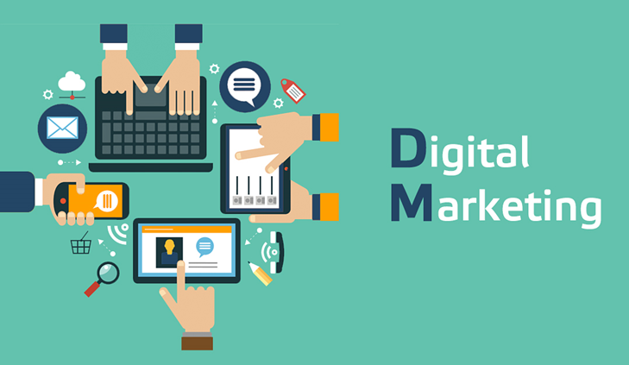
Introduction to Digital Marketing
Digital Marketing, Content Marketing, Performance Marketing, Search Engine Marketing
SoftUni Digital
Trainers Team
SoftUni Digital
https://digital.softuni.bg

Slide 2

Sli.do Code
#digital-intro

Slide 3
Table of Contents
Introduction
Marketing Concepts
Digital Marketing
Social Media Marketing
Performance Marketing
Search Engine Marketing
Digital Brands

Slide 4

Marketing Concepts
What is digital marketing?
Social media marketing
Performance marketing
Search engine marketing
Digital brands
The power of the brand

Slide 5

More Marketing Concepts
What is digital marketing?
Social media marketing
Performance marketing
Search engine marketing
Content marketing, email marketing, video marketing, PPC marketing, etc.
Digital brands
The power of the brand in the digital world

Slide 6



Learn to Search in Internet!
The course assignments require to search in Internet
This is an important part of the learning process
Some exercises intentionally have no hints
Learn to find solutions!
Digital marketing experts' job includes everyday searching and learning
No excuses, just learn to study!
Experts learn new technologies, tools and concepts every day!
Notes:
6

Slide 7

Marketing Trends
What is Coming in the Marketing Landscape?

Slide 8
Traditional vs. Digital Marketing
Traditional Marketing
Expensive
Non-flexible
Hard to scale
Performed from specific location
Digital Marketing
Cheaper
Flexible
Scalable
Performed from anywhere

Slide 9
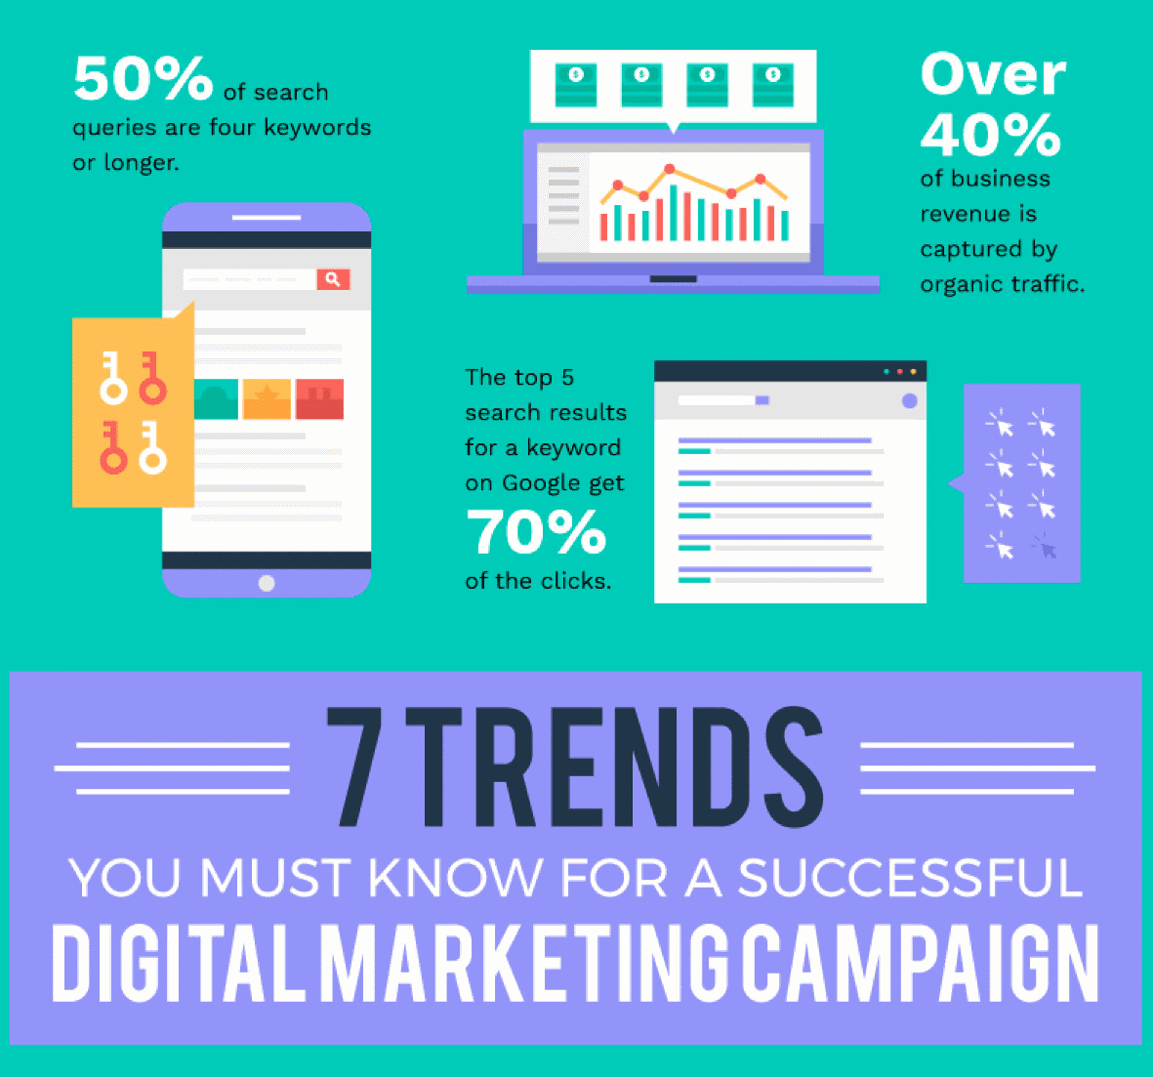
Marketing in 2019: Trends
Mobile first
Top 3 results in search engines
Organic traffic

Slide 10
Did You Know?
Marketing is not advertising
Marketing is not promotions
Marketing is all about communicating the right message to the right people using the right channel
Most powerful channels today are digital
Digital marketing == marketing over digital channels
Marketing is changing very fast

Slide 11
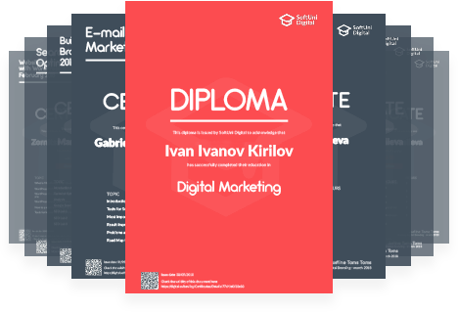
Diplomas and Certificates
Certificates are given for high achievements only
Average result over 5.00 out of 6.00
Not for attendance!
Diplomas are given for graduation
Based on credits earned from successfully passed courses

Slide 12
Sample Code
Source code example:
class Abstract {
constructor() {
if (new.target === Abstract) {
throw new TypeError("Cannot construct Abstract instances directly"); }
}
}

Slide 13


Summary
Marketing is about communicating the right message to the right people over the right channel
Digital marketing
Social media marketing
Performance marketing
Search engine marketing
Marketing trends: organic traffic and brand
Notes:
13

Slide 14
Questions?

Slide 15






Partners

Slide 16
License
This course (slides, examples, demos, exercises, homework, documents, videos and other assets) is copyrighted content
Unauthorized copy, reproduction or use is illegal
© SoftUni – https://softuni.org
© SoftUni Digital – https://digital.softuni.bg

Slide 17
About SoftUni Digital
SoftUni Digital: High-Quality Education, Profession and Job for Marketing Experts
digital.softuni.bg
SoftUni Digital @ Facebook
facebook.com/SoftUniDigital
SoftUni Digital Forums
softuni.bg/forum/categories/58/softuni-digital

