Slide 1

Introduction to Creative and Design
Design Principle, Graphic Design, Web Design, Motion Design, 3D Design, Multimedia
Trainers Team
SoftUni Creative
SoftUni Creative
https://creative.softuni.bg

Slide 2

Sli.do Code
#creative-intro

Slide 3
Table of Contents
Introduction
Design Concepts
Composition
Vector Graphics
Raster Graphics
Web Design, UI and UX
Video and Multimedia
3D Graphics

Slide 4

Design Fundamentals
Fundamental design concepts
Composition
Colors and color palettes
Grids and ratios
Fonts
Graphical Symbols
Graphical Software
Vector graphics, raster graphics, print design, …

Slide 5






Elements of Design
Line
Color
Shape
Texture
Space
Size
Value (lightness / darkness)

Slide 6



Learn to Search in Internet!
The course assignments require to search in Internet
This is an important part of the learning process
Some exercises intentionally have no hints
Learn to find solutions!
Digital marketing experts' job includes everyday searching and learning
No excuses, just learn to study!
Experts learn new technologies, tools and concepts every day!
Notes:
6

Slide 7

Design Trends
What is Coming in the Design Landscape?

Slide 8
Traditional vs. Digital Marketing
Traditional Marketing
Expensive
Non-flexible
Hard to scale
Performed from specific location
Digital Marketing
Cheaper
Flexible
Scalable
Performed from anywhere

Slide 9
Digital Marketing Concepts
What is digital marketing?
Social media marketing
Performance marketing
Search engine marketing
Content marketing, email marketing, video marketing, PPC marketing, etc.
Digital brands
The power of the brand in the digital world

Slide 10
Did You Know?
Marketing is not advertising
Marketing is not promotions
Marketing is all about communicating the right message to the right people using the right channel
Most powerful channels today are digital
Digital marketing == marketing over digital channels
Marketing is changing very fast

Slide 11
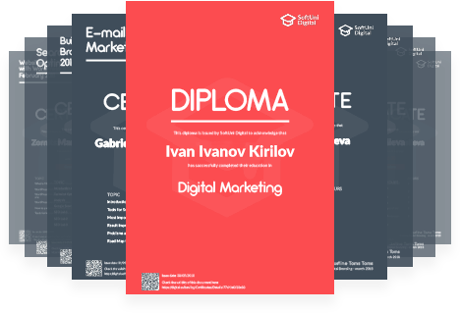
Diplomas and Certificates
Certificates are given for high achievements only
Average result over 5.00 out of 6.00
Not for attendance!
Diplomas are given for graduation
Based on credits earned from successfully passed courses

Slide 12


Summary
Marketing is about communicating the right message to the right people over the right channel
Digital marketing
Social media marketing
Performance marketing
Search engine marketing
Marketing trends: organic traffic and brand
Notes:
12

Slide 13
Questions?

Slide 14






Partners

Slide 15
License
This course (slides, examples, demos, exercises, homework, documents, videos and other assets) is copyrighted content
Unauthorized copy, reproduction or use is illegal
© SoftUni – https://softuni.org
© SoftUni Creative – https://creative.softuni.bg
Notes:
15

Slide 16
About SoftUni Creative
SoftUni Creative – High-Quality Education, Profession and Job for Designers
creative.softuni.bg
SoftUni Creative @ Facebook
facebook.com/SoftUniCreative
SoftUni Creative Forums
softuni.bg/forum/categories/116/softuni-creative

