Slide 1
Presentation Title
Presentation Subtitle
SoftUni
Training Team
Software University
http://softuni.bg

Slide 2
Contents
Objects and JSON
JS Objects and Properties
JSON: Stringify and Parse
Associative Arrays
Mapping Keys to Values
Iterating over the Key-Value Pairs
The Map Class
The Set Class

Slide 3

Objects in JS
Objects, Properties and JSON

Slide 4



Learn to Search in Internet
The course assignments require to search in Internet
This is an important part of the learning process
Some exercises intentionally have no hints
Learn to find solutions!
Software development includes everyday searching and learning
No excuses, just learn to study!
Developers learn new technologies, tools, languages every day!

Slide 5

Basic Slide
Short explanation of the slide topic
Keep slide content centered
let names = new Set();
names.add("Peter"); names.add(20);
names.add("Maria"); names.add(5);
console.log(names.has('Peter')); // true
names.add("Maria"); // Duplicates are skipped
names.delete(20); // Delete element if exists
for (let name of names) console.log(name);

Slide 6

Debugging
Simple Operations with the Debugger
Notes:
6

Slide 7
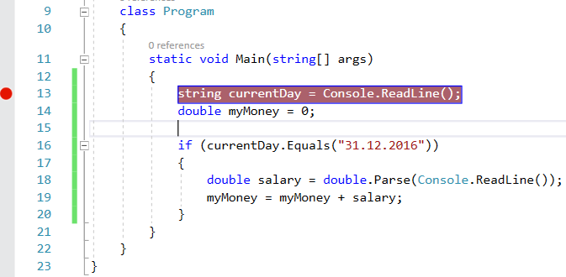
Debugging
Debugging == the process of step-by-step tracing the program execution
This helps finding errors (bugs)
Breakpoint
Notes:
7

Slide 8
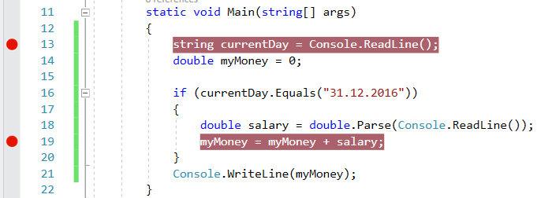
Debugging in Visual Studio
Press [F5] to run the program in debug mode
Proceed to the next execution step using [F10]
Press [F9] to create a breakpoint (stopper)
Run the program and it will stop when a breakpoint is hit
Notes:
8

Slide 9
The "switch-case" Statement
switch()
case:
…
default:
Checking Multiple Values at Once
Notes:
9

Slide 10
The "switch-case" Conditional Statement
switch-case works as a sequence of if-else-if-else-if…
switch (…)
{
case …: …:
// code
break;
case …:
// code
break;
default::
// code
break;
}
The switch starts by an input expression
Sequence of values for checking
Code to execute if no case is matched
Notes:
10

Slide 11
Problem: Day of Week
Create a program, which:
Reads an integer from the console
Prints at the console the day of week (in English, as text) according to the input number [1…7]
When the number is out of range, prints "Error"
Sample input and output:
1
Monday
4
Thursday
9
Error
Notes:
11

Slide 12
Solution: Day of Week
int day = int.Parse(Console.ReadLine());
switch (day)
{
case 1:
Console.WriteLine("Monday"); break;
case 2:
Console.WriteLine("Tuesday"); break;
// TODO: check the other days
case 7:
Console.WriteLine("Sunday"); break;
default:
Console.WriteLine("Error"); break;
}
Notes:
12

Slide 13
Multiple Cases in switch-case
The switch-case statement supports multiple cases for the same action:
switch (…)
{
case … :
case … :
casе … :
// code
break;
default:
// code break;
}
The code will execute, when at least one of the conditions is matched
Notes:
13

Slide 14

Exercises
Practical Problem Solving

Slide 15
What Did We Learn Today?
…
…
…
Objects in hold key value pairs
Maps map keys to values, preserves key order
Sets hold unique collection of values
let p = { x: 5, y: 7 };
let obj = { name: "SoftUni", age: 3 };
obj.age++;
delete obj.name;
let set = new Set(); set.add(5);

Slide 16
Questions?

Slide 17

License
This course (slides, examples, code, demos, exercises, tutorials, homework, projects, documents, videos and other assets) is copyrighted content, created by SoftUni
Unauthorized copy, reproduction or use is illegal
© SoftUni – https://softuni.org
© Software University – https://softuni.bg

