Slide 1
Model Builder 4.2
Traceable automation of shaft–hub key joints
for Abaqus 2022
DIN 6885-1 · DIN 6892 Methods A / B / C · FVA 600 III
01

Slide 2
THE PROBLEM
A good keyway model is not the hard part.
Repeating it is.
Every model was rebuilt by hand
the DIN table was read on paper and typed in case by case
The mesh depended on its author
with no explicit acceptance criterion and no record of attempts
The result could not be audited
with no way to know which version, standard and assumptions produced it
02

Slide 3
WHAT IT IS
One tool, from the table in the standard
to the signed report
14
Python modules
desktop, Abaqus kernel
and the shared core
26
DIN 6885-1 rows
transcribed with no extrapolation,
6 < d1 ≤ 500 mm
8
mesh templates
with hard quality gates
and element budgets
4
DIN 6892 methods
A, B, B-FVA and C, evaluated
in parallel
3
languages
Spanish, English and German
650 keys at parity
Everything on these slides comes from running the code: the screenshots are of the real application and the figures are computed by the packaged engine.
04

Slide 4
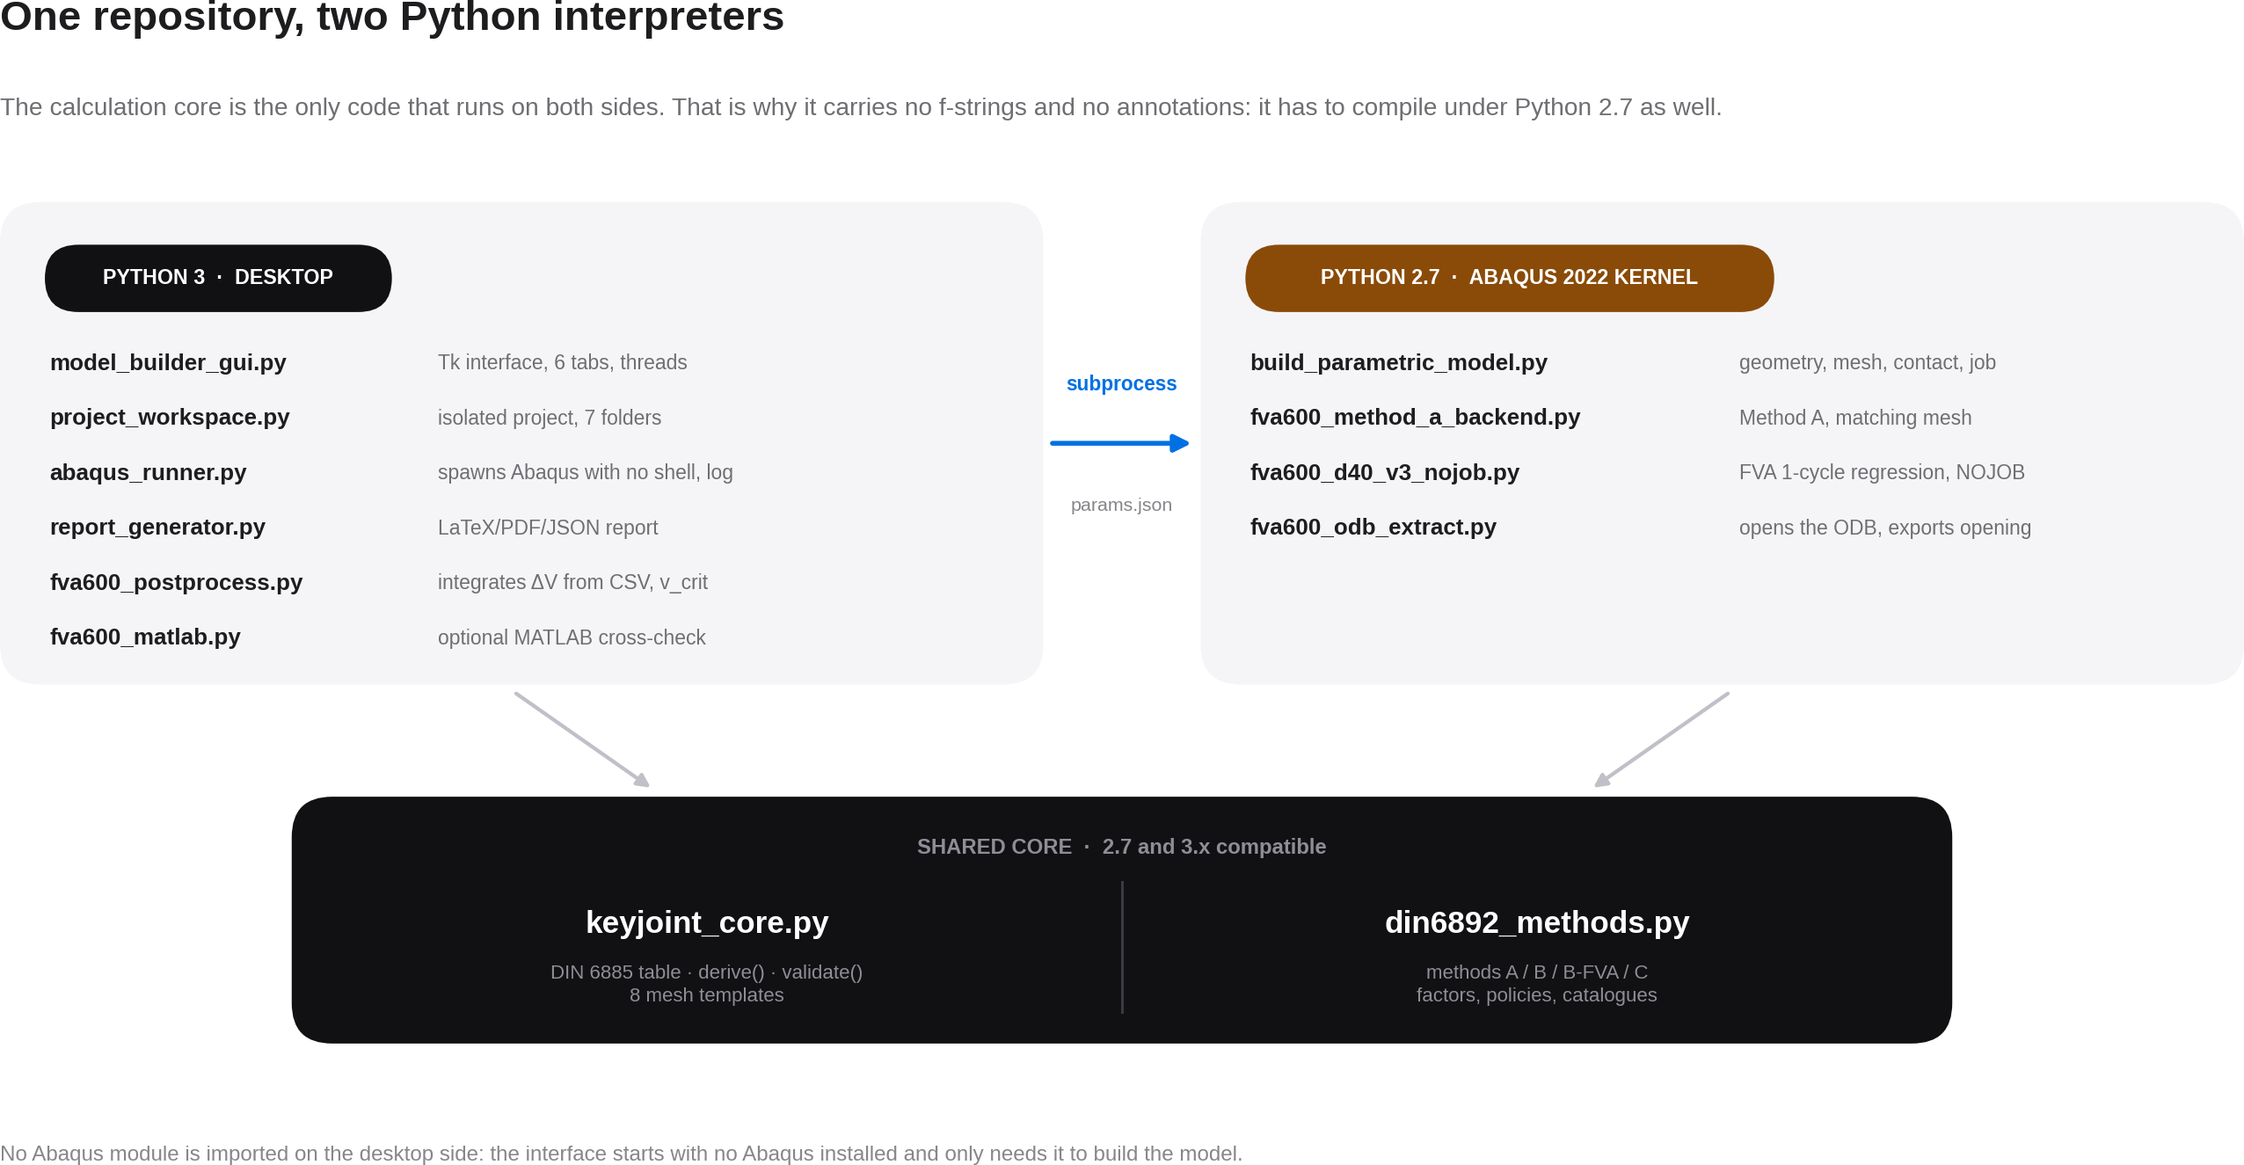
ARCHITECTURE
A change to the DIN table or to a DIN 6892 factor is written once and reaches both interpreters.
04

Slide 5
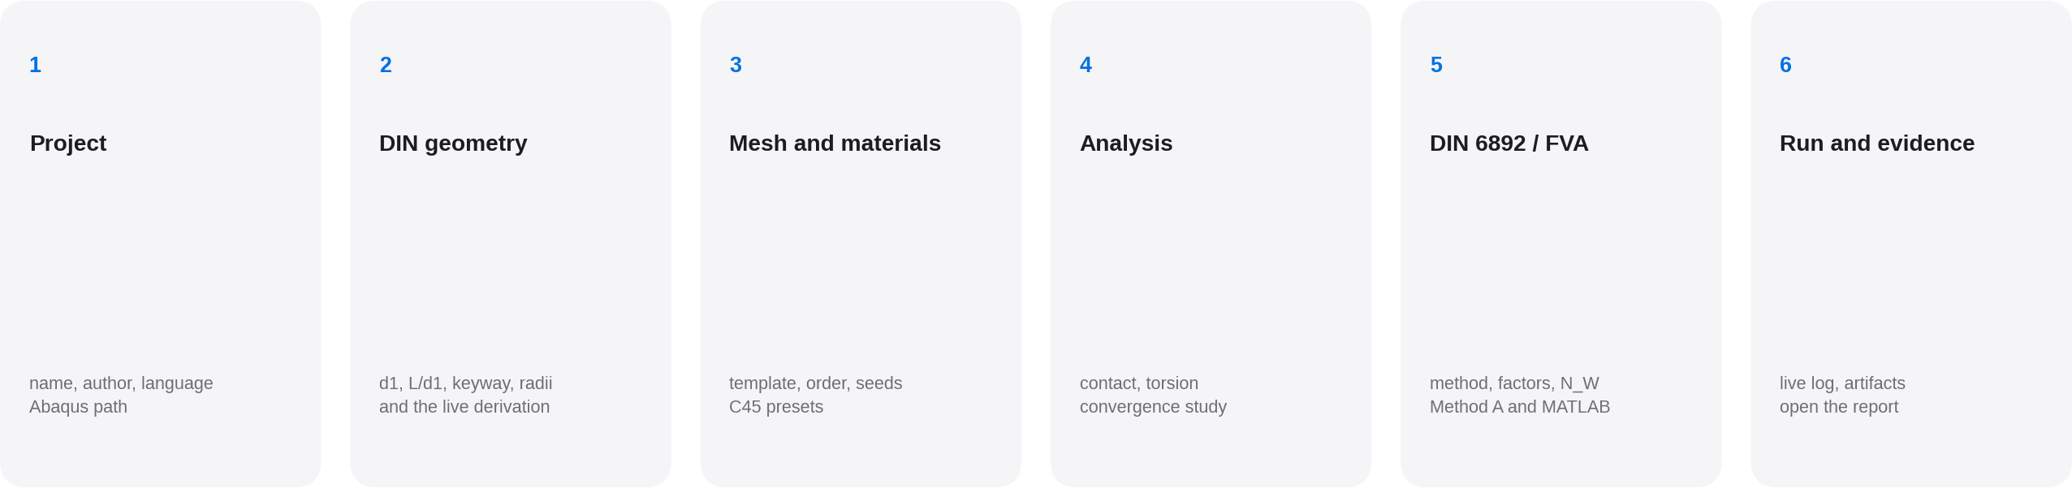
HOW IT IS USED
Six tabs in the order the decisions are actually made: the project first, then the normative geometry, and only at the end the run.
05

Slide 6
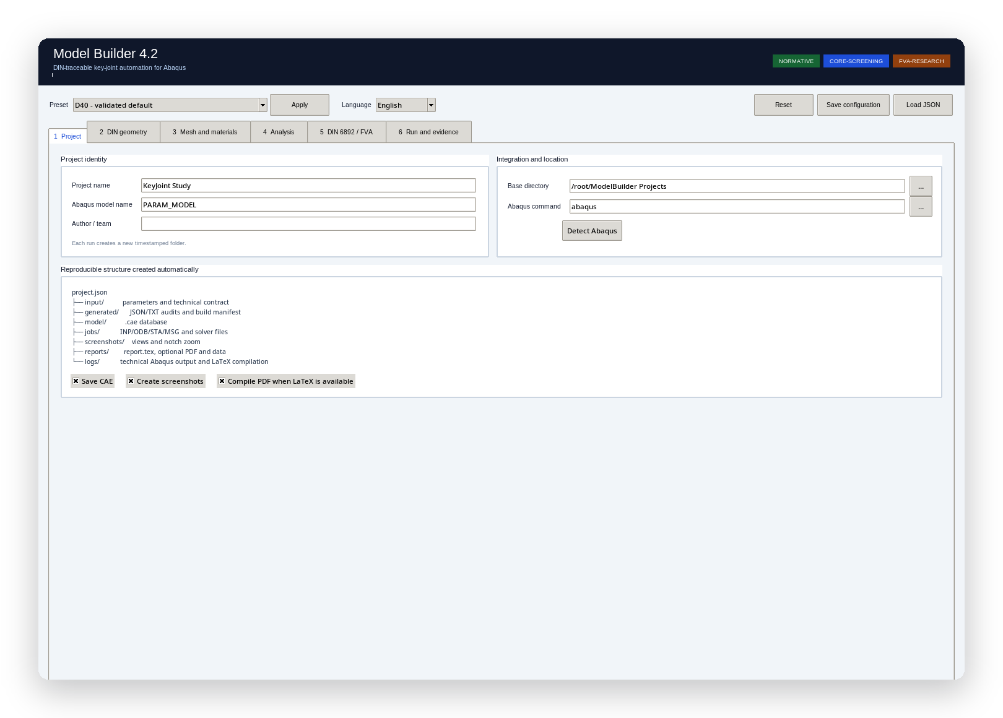
TAB 1
Project
Name, author and language are recorded in project.json: the report is issued in the project's language, not in the language of whoever opens it.
The Abaqus path is detected by looking for installed launchers, without executing any of them.
The default root folder is Documents/ModelBuilder Projects.
Real capture of the application, with the interface switched to English.
06

Slide 7
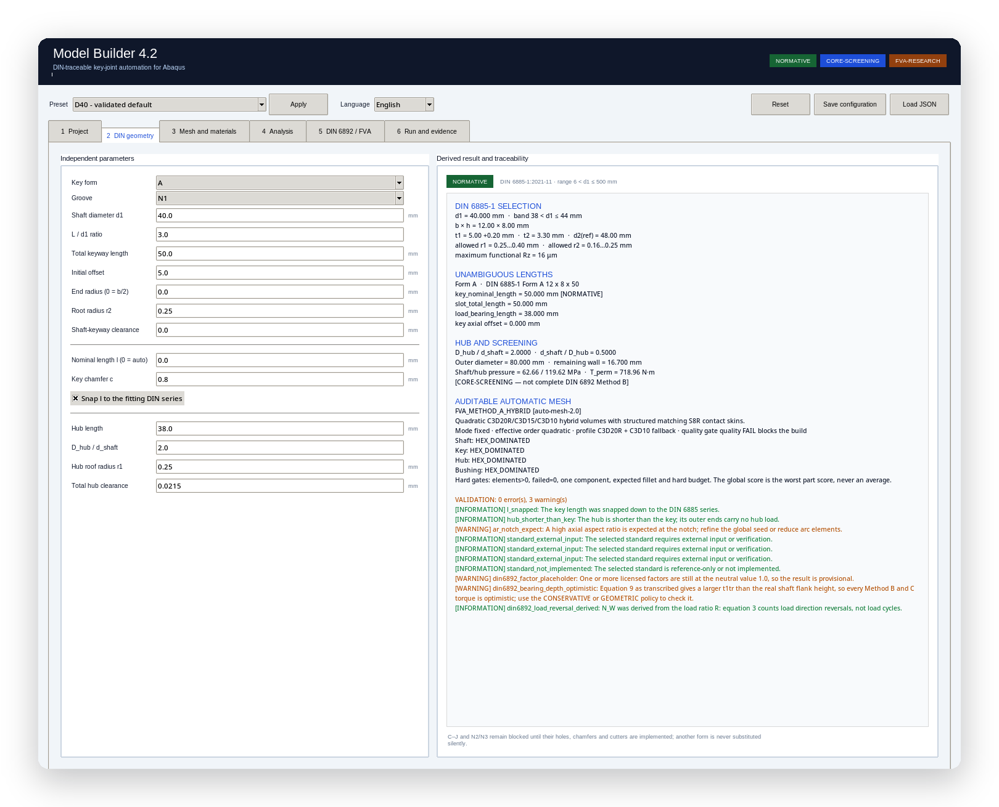
TAB 2
DIN geometry
On the left, the few independent parameters the user decides. On the right, everything the standard derives from them.
The right panel recomputes as you type: DIN row, lengths, hub, mesh plan and the complete validation list.
The green NORMATIVE badge means the geometry sits inside the envelope of the standard.
d1 = 40 mm · band 38 < d1 ≤ 44 · b × h = 12 × 8 · DIN 6885-1 Form A 12 × 8 × 50.
07

Slide 8
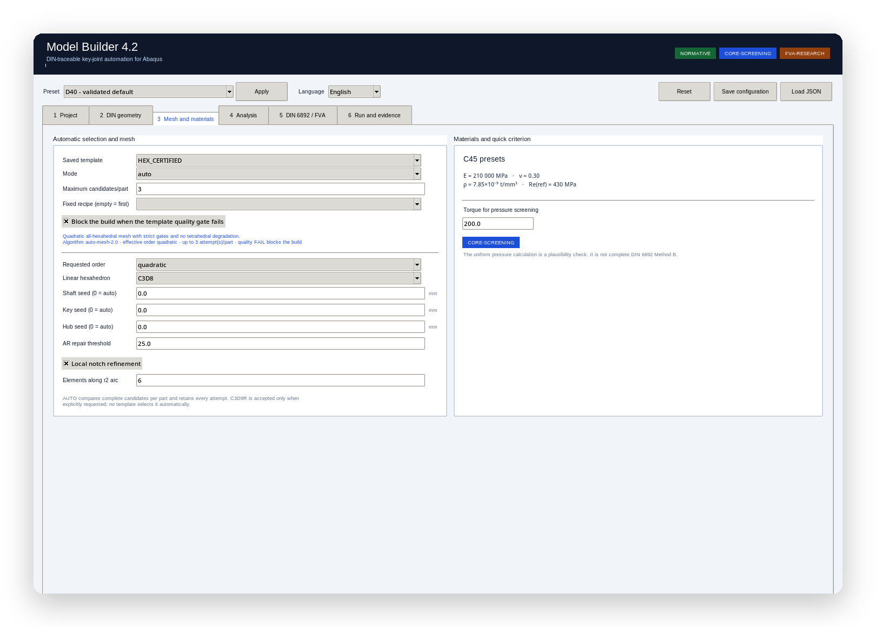
TAB 3
Mesh and materials
The template is chosen by name; AUTO mode compares complete candidates per part and keeps the winner.
A seed left at 0 means automatic, and the rule follows the refinement: with the notch band on it is D/16 on the shaft and d_a/40 on the hub. The key is always b/20.
The quick pressure check is badged CORE-SCREENING: it is plausibility, not DIN 6892 Method B.
Here the template is HEX_CERTIFIED, in auto mode with 3 attempts.
08

Slide 9
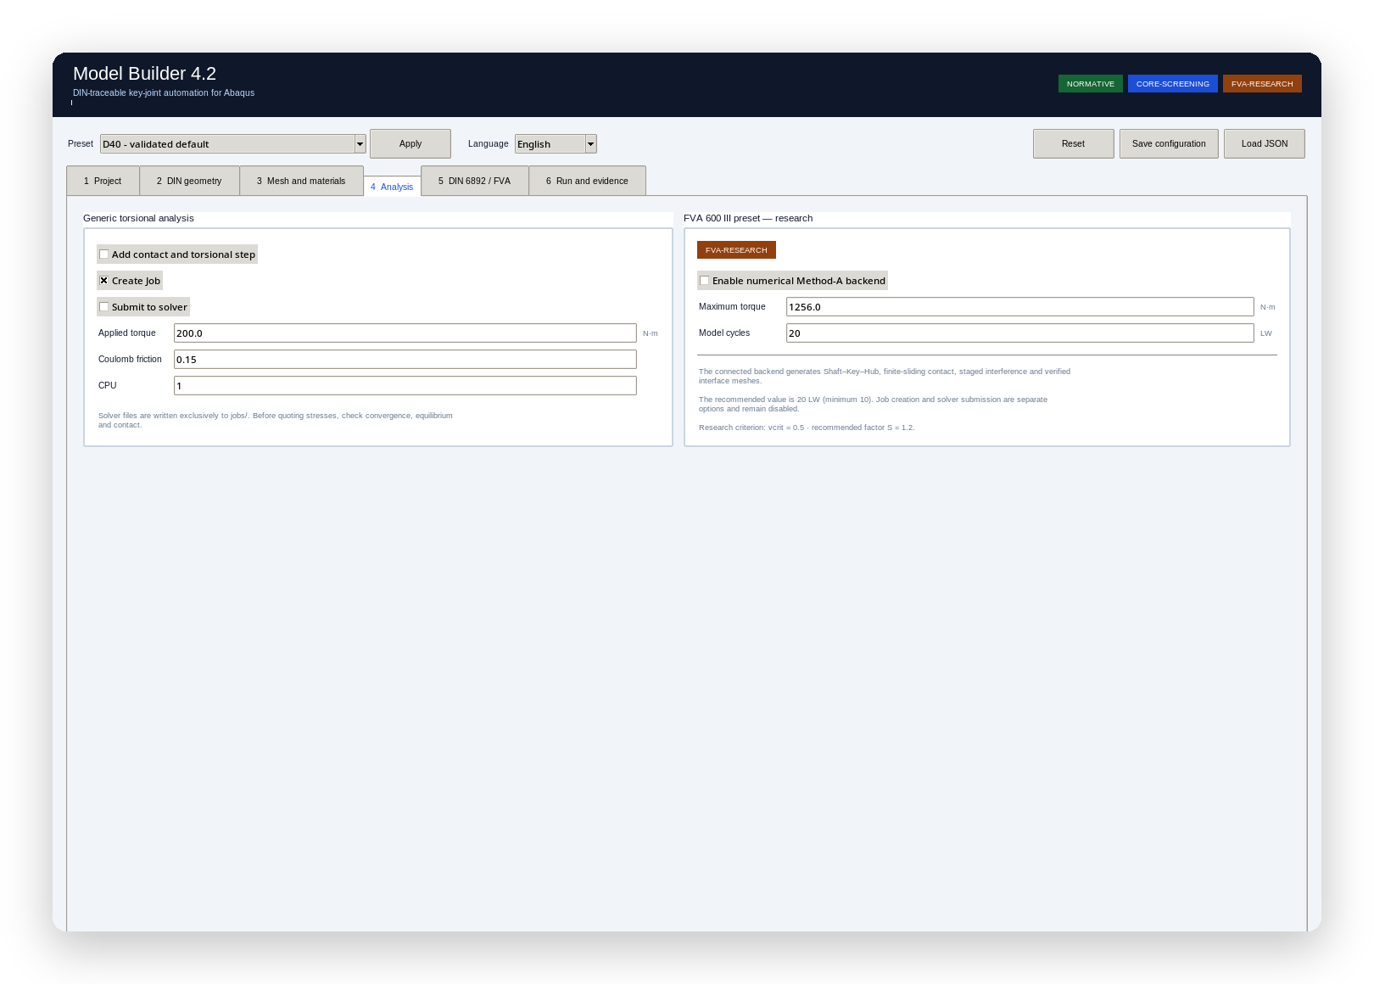
TAB 4
Analysis
The analysis is optional and off by default: building and auditing does not require solving.
When enabled it creates general contact, a static TORSION step and a moment on the reference point of the drive end.
The mesh convergence study runs separately and writes its own CSV.
Creating the job and submitting it to the solver are two separate checkboxes.
09

Slide 10
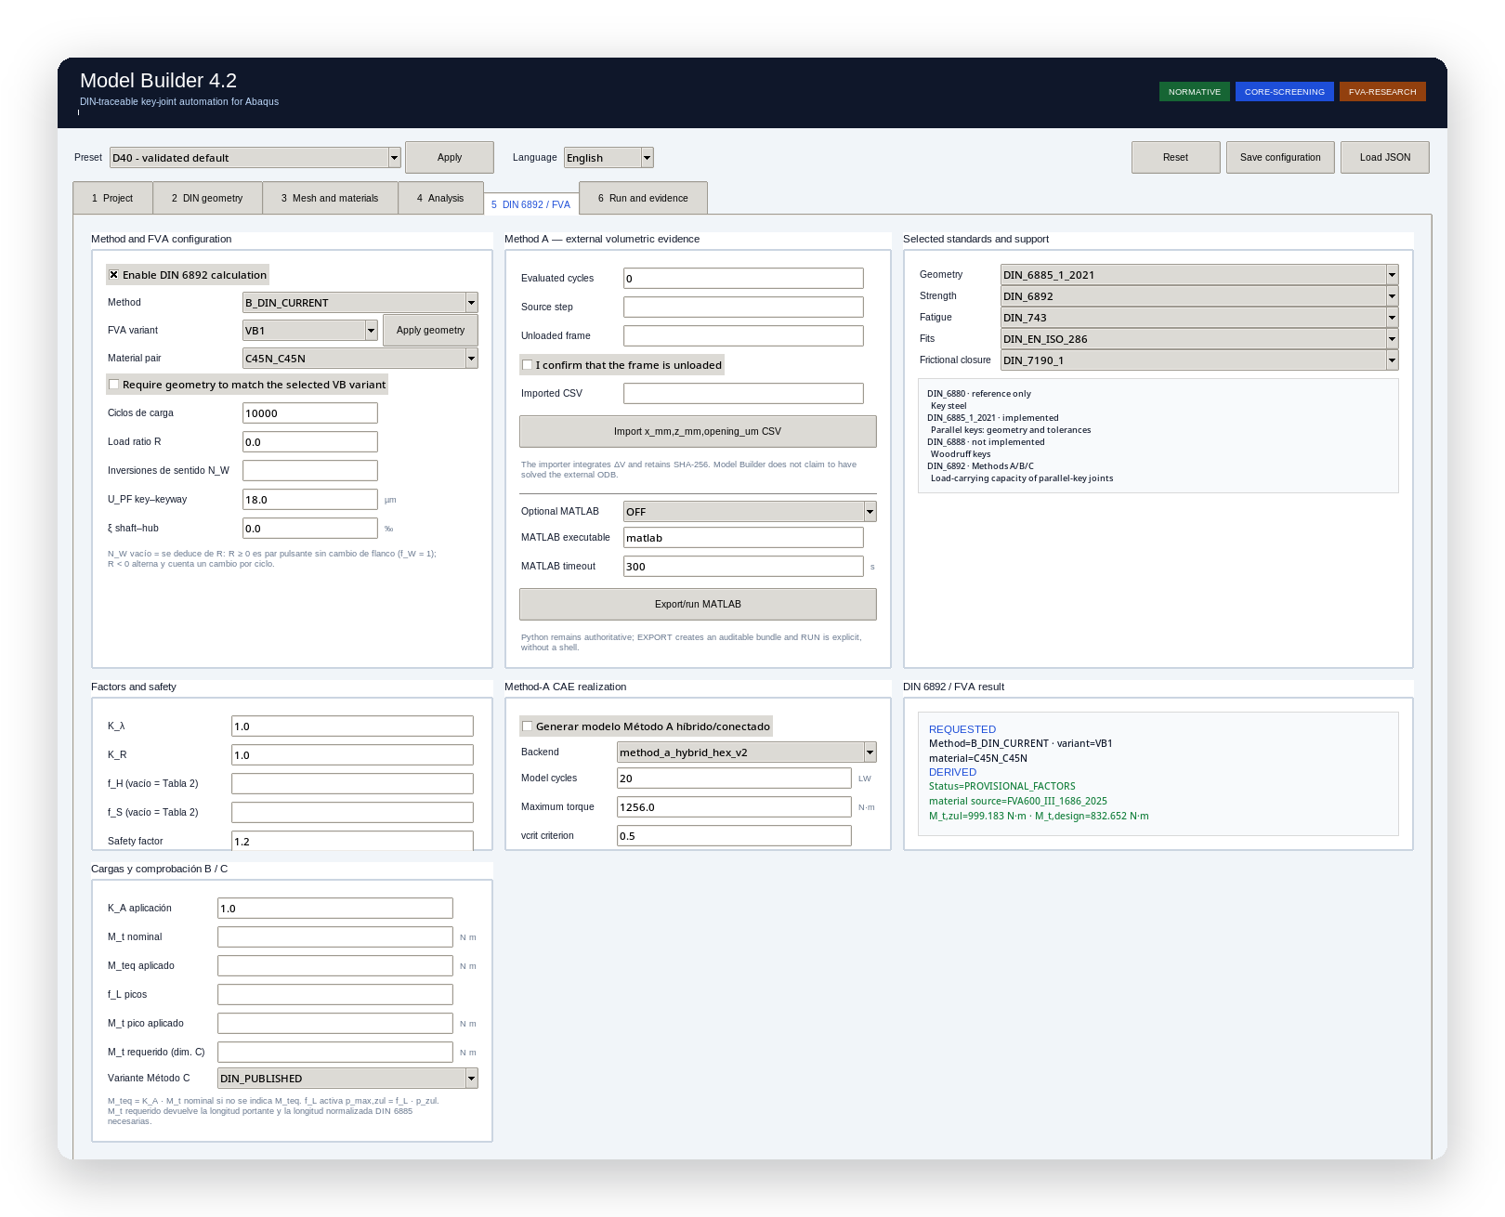
TAB 5
DIN 6892 / FVA
The method is chosen explicitly. Licensed factors that cannot be transcribed stay at 1.0 and the result is flagged PROVISIONAL_FACTORS.
N_W left blank means derive it from the load ratio R; a pulsating torque gives zero reversals and f_W = 1.
Method A is not computed here: a CSV from an already solved ODB is imported, with SHA-256 and coverage verified.
The selected standards are declared one by one, including the ones that are not implemented.
10

Slide 11
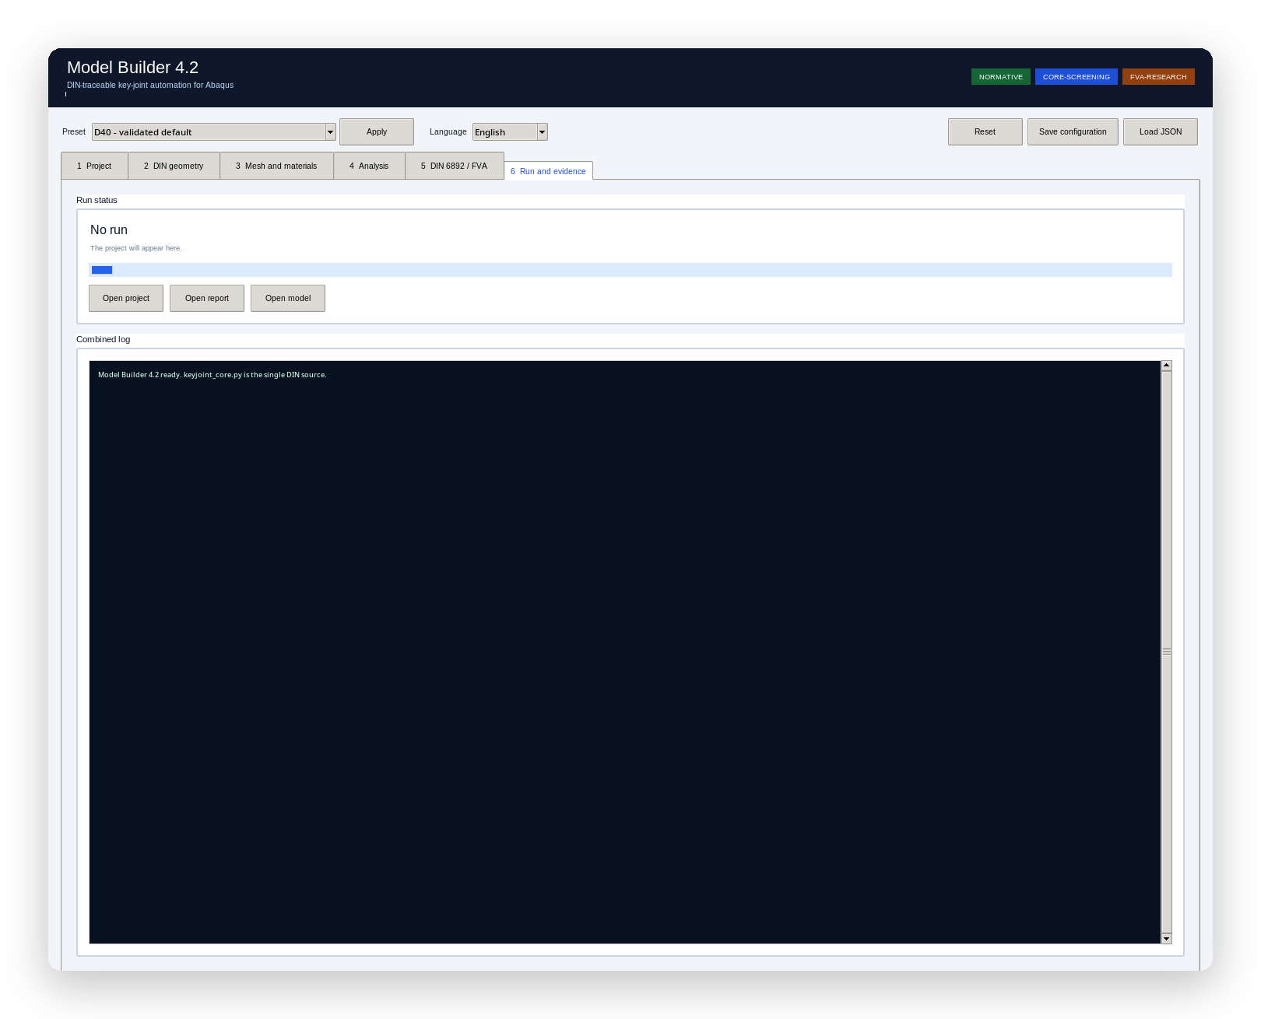
TAB 6
Run and evidence
The Abaqus log is streamed live to the window and to logs/abaqus.log, with the command and the working directory in the header.
When it finishes, the artifact list fills in with size and evidence badge; the buttons open the project, the report and the model.
Stop kills the solver process tree and marks the project CANCELLED.
No solver file lands next to the executable: the subprocess runs with cwd = jobs/.
11

Slide 12
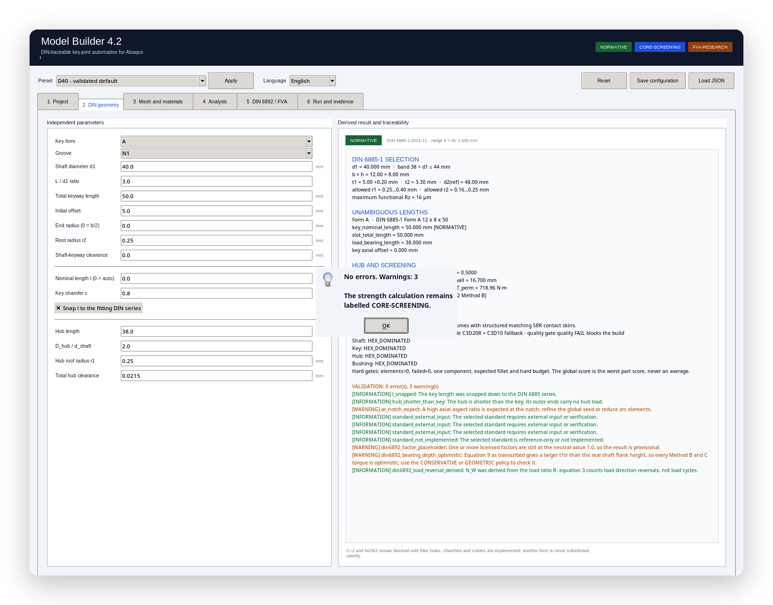
QUALITY CONTROL
Validation speaks in codes
Every issue has a stable code, a canonical English message and a translated presentation. The code is what gets cited in the report and in a review.
The dialog reports the outcome, it does not dress it up: no errors, the warning count, and the reminder that the strength calculation stays labelled CORE-SCREENING.
An error blocks the build before Abaqus is touched; a warning informs and is recorded in the audit.
By default: 0 errors and 3 warnings — a licensed factor still neutral, the optimistic equation 9, and a high axial aspect ratio expected at the notch.
12

Slide 13
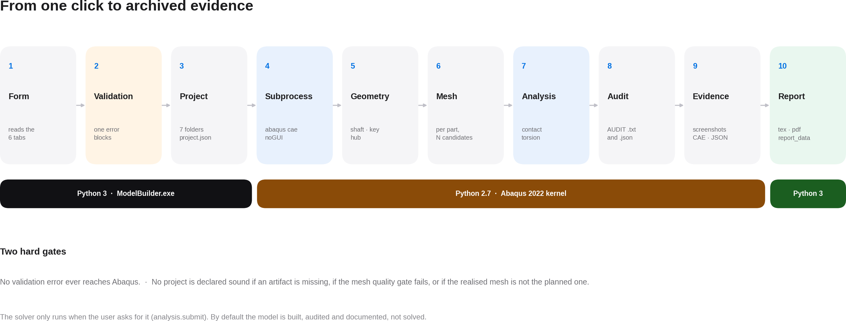
EXECUTION FLOW
13

Slide 14
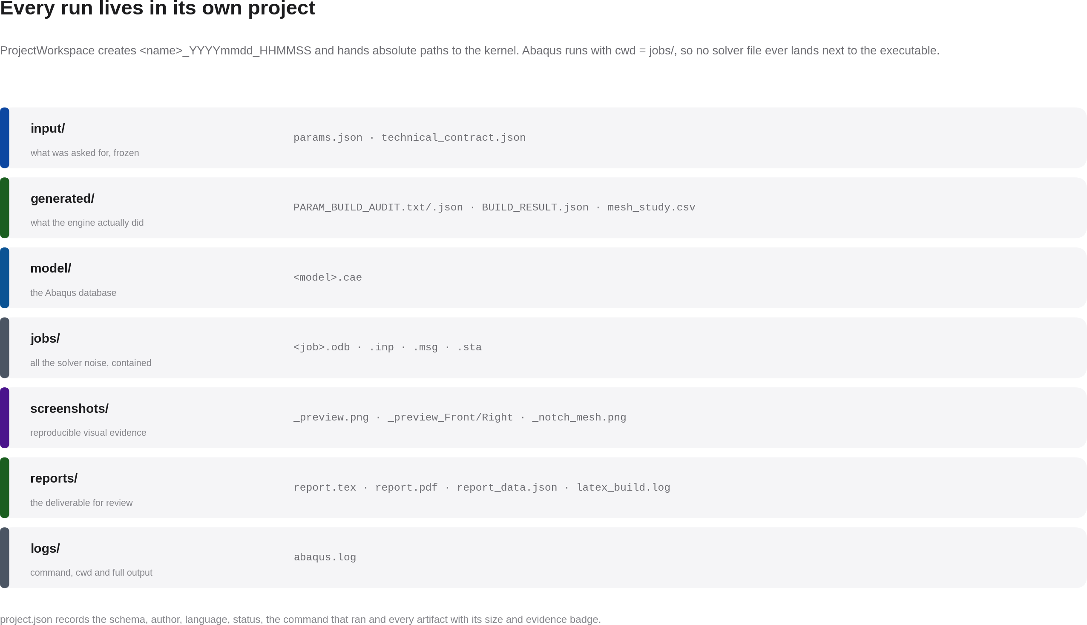
WHAT STAYS ON DISK
14

Slide 15
STARTING POINTS
Fifteen presets, none of which skips validation
A preset only sets parameters. It is then merged onto the defaults and re-derived and re-validated exactly as if it had been typed in by hand.
5 geometry and analysis
D25 small joint, D40 validated default, D50 next DIN band, D40 quadratic C3D20 and D40 with torsion analysis.
8 mesh policies
One per template: hex certified, FVA Method A hybrid, balanced, quality critical, fast preview, hex dominant, quadratic accuracy and robust fallback.
2 FVA research
D40 1-cycle pre-solve and a 20-cycle D40 Method A setup whose matching must be verified at build time. Both with the solver deliberately off.
A preset is not a shortcut
It goes through the same gates: if the result leaves the normative envelope, the error blocks it just the same.
Saved and reloaded
The configuration round-trips to JSON, so a case can be handed over as a file and reproduced exactly.
The bundled presets are guarded
The publisher checks the two FVA companions field by field: they cannot change silently between versions.
The mesh presets exist to make the policy explicit, not to hide it.
15

Slide 16
DESIGN SPACE
What can be built, and what is deliberately refused
Key forms
A, B and AB implemented. C through J are refused with their own message: they need hole and chamfer dimensions that are not implemented.
Cylindrical or tapered hub
Tapered adds a fourth solid, the bushing, and switches off the notch band refinement; the model declares it.
Diameter
Continuous over 6 < d1 <= 500 mm, resolved to one of the 26 rows. Outside that it raises instead of approximating.
Element order and type
Linear or quadratic (default), C3D8/C3D8I or C3D20/C3D20R. C3D8R is accepted only as an explicit legacy choice, and it raises a warning.
Automatic seeds
With notch refinement, which is the default: D/16 on the shaft and d_a/40 on the hub. Without it, D/32 and d_a/80. The rule actually used is written into the audit.
Compliance mode
Normative or user override. Leaving the envelope is allowed; what is not allowed is for it to go unnoticed.
16

Slide 17
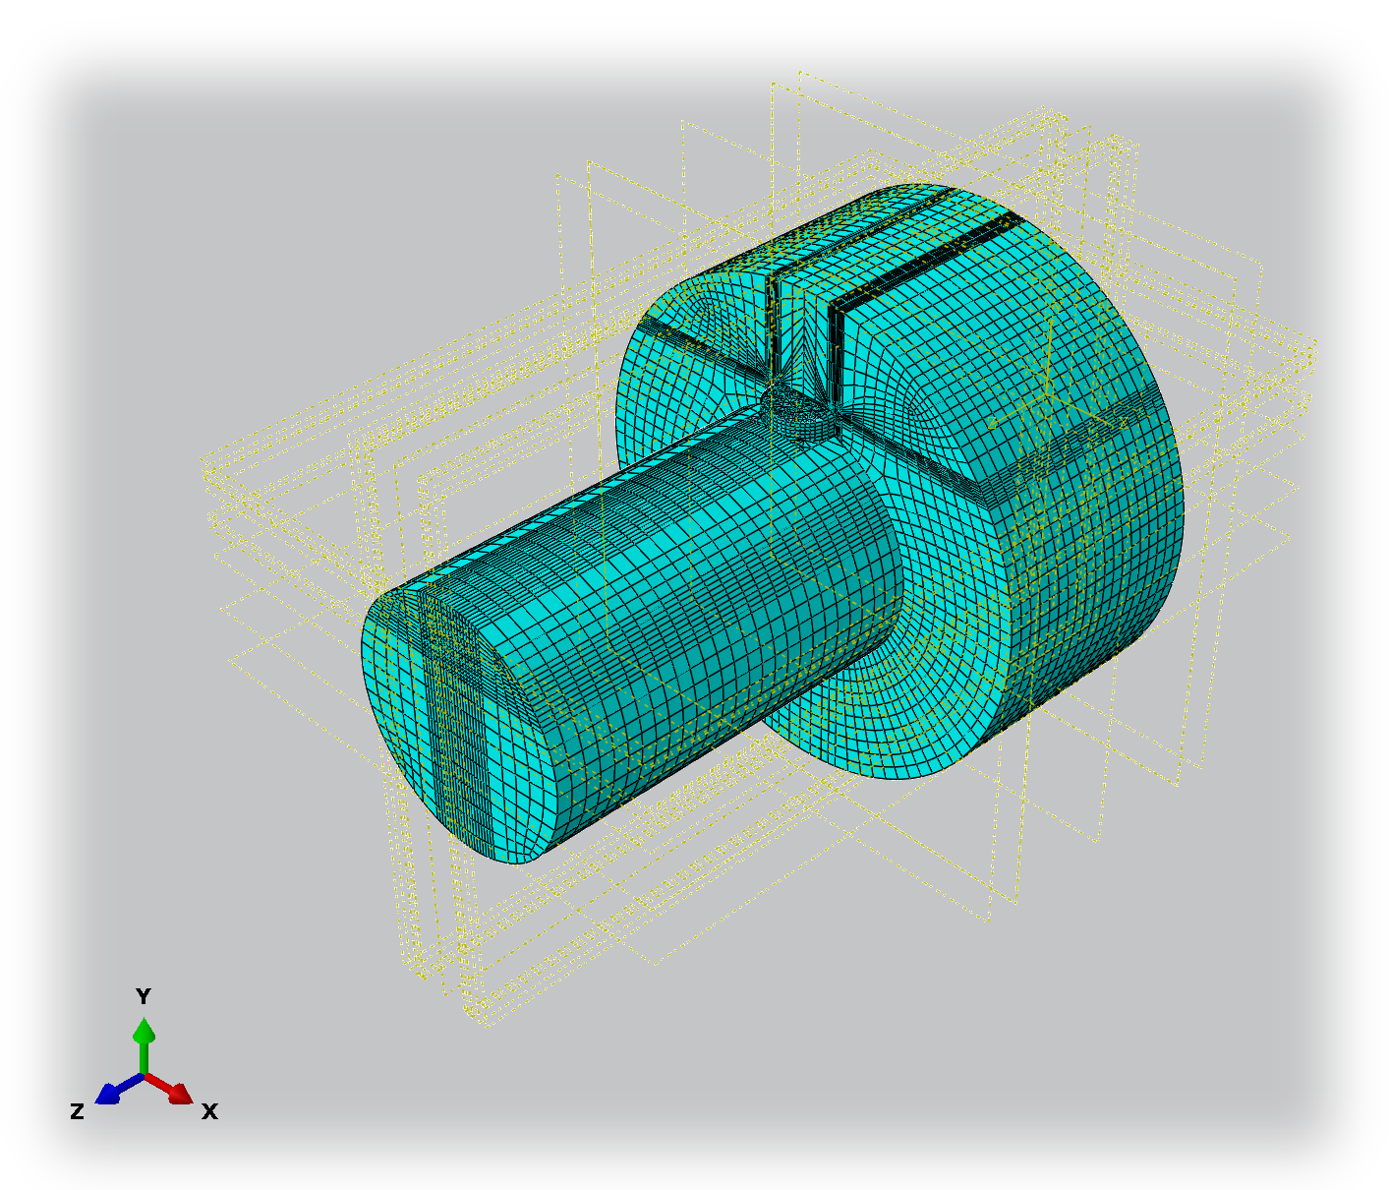
THE RESULT
Solids, not shells
Shaft, key and hub are built as independent solids and assembled with the tolerances of the standard.
This evidence shows a hexahedral mesh. Exact interface matching is not inferred from the image: the specialized Method A backend checks it by comparing node coordinates after meshing.
This is the image the engine itself saves to screenshots/ when it finishes.
17

Slide 18
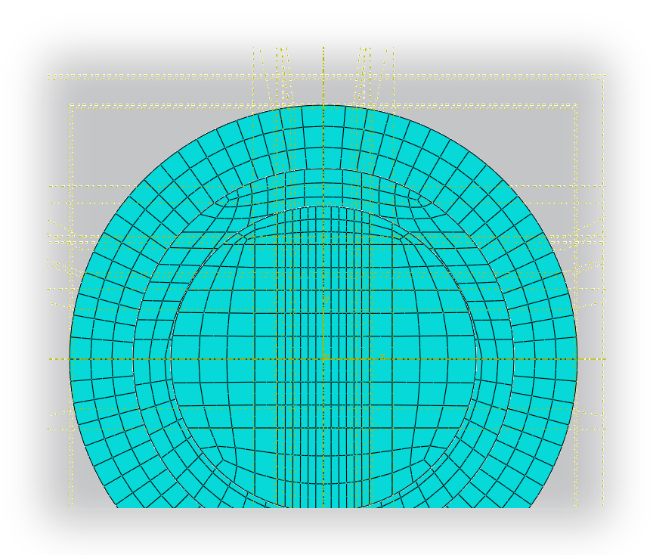
THE DETAIL THAT MATTERS
The keyway band
The section shows the band of finer elements around the keyway: not a uniformly denser mesh, but refinement where the gradient is.
The band width and the number of elements across the r2 fillet arc are parameters, and the audit checks that they were honoured.
The NOTCH_SHAFT element set is built around both keyway corners so the stress-concentration query cannot wander off to an unrelated hot spot.
18

Slide 19
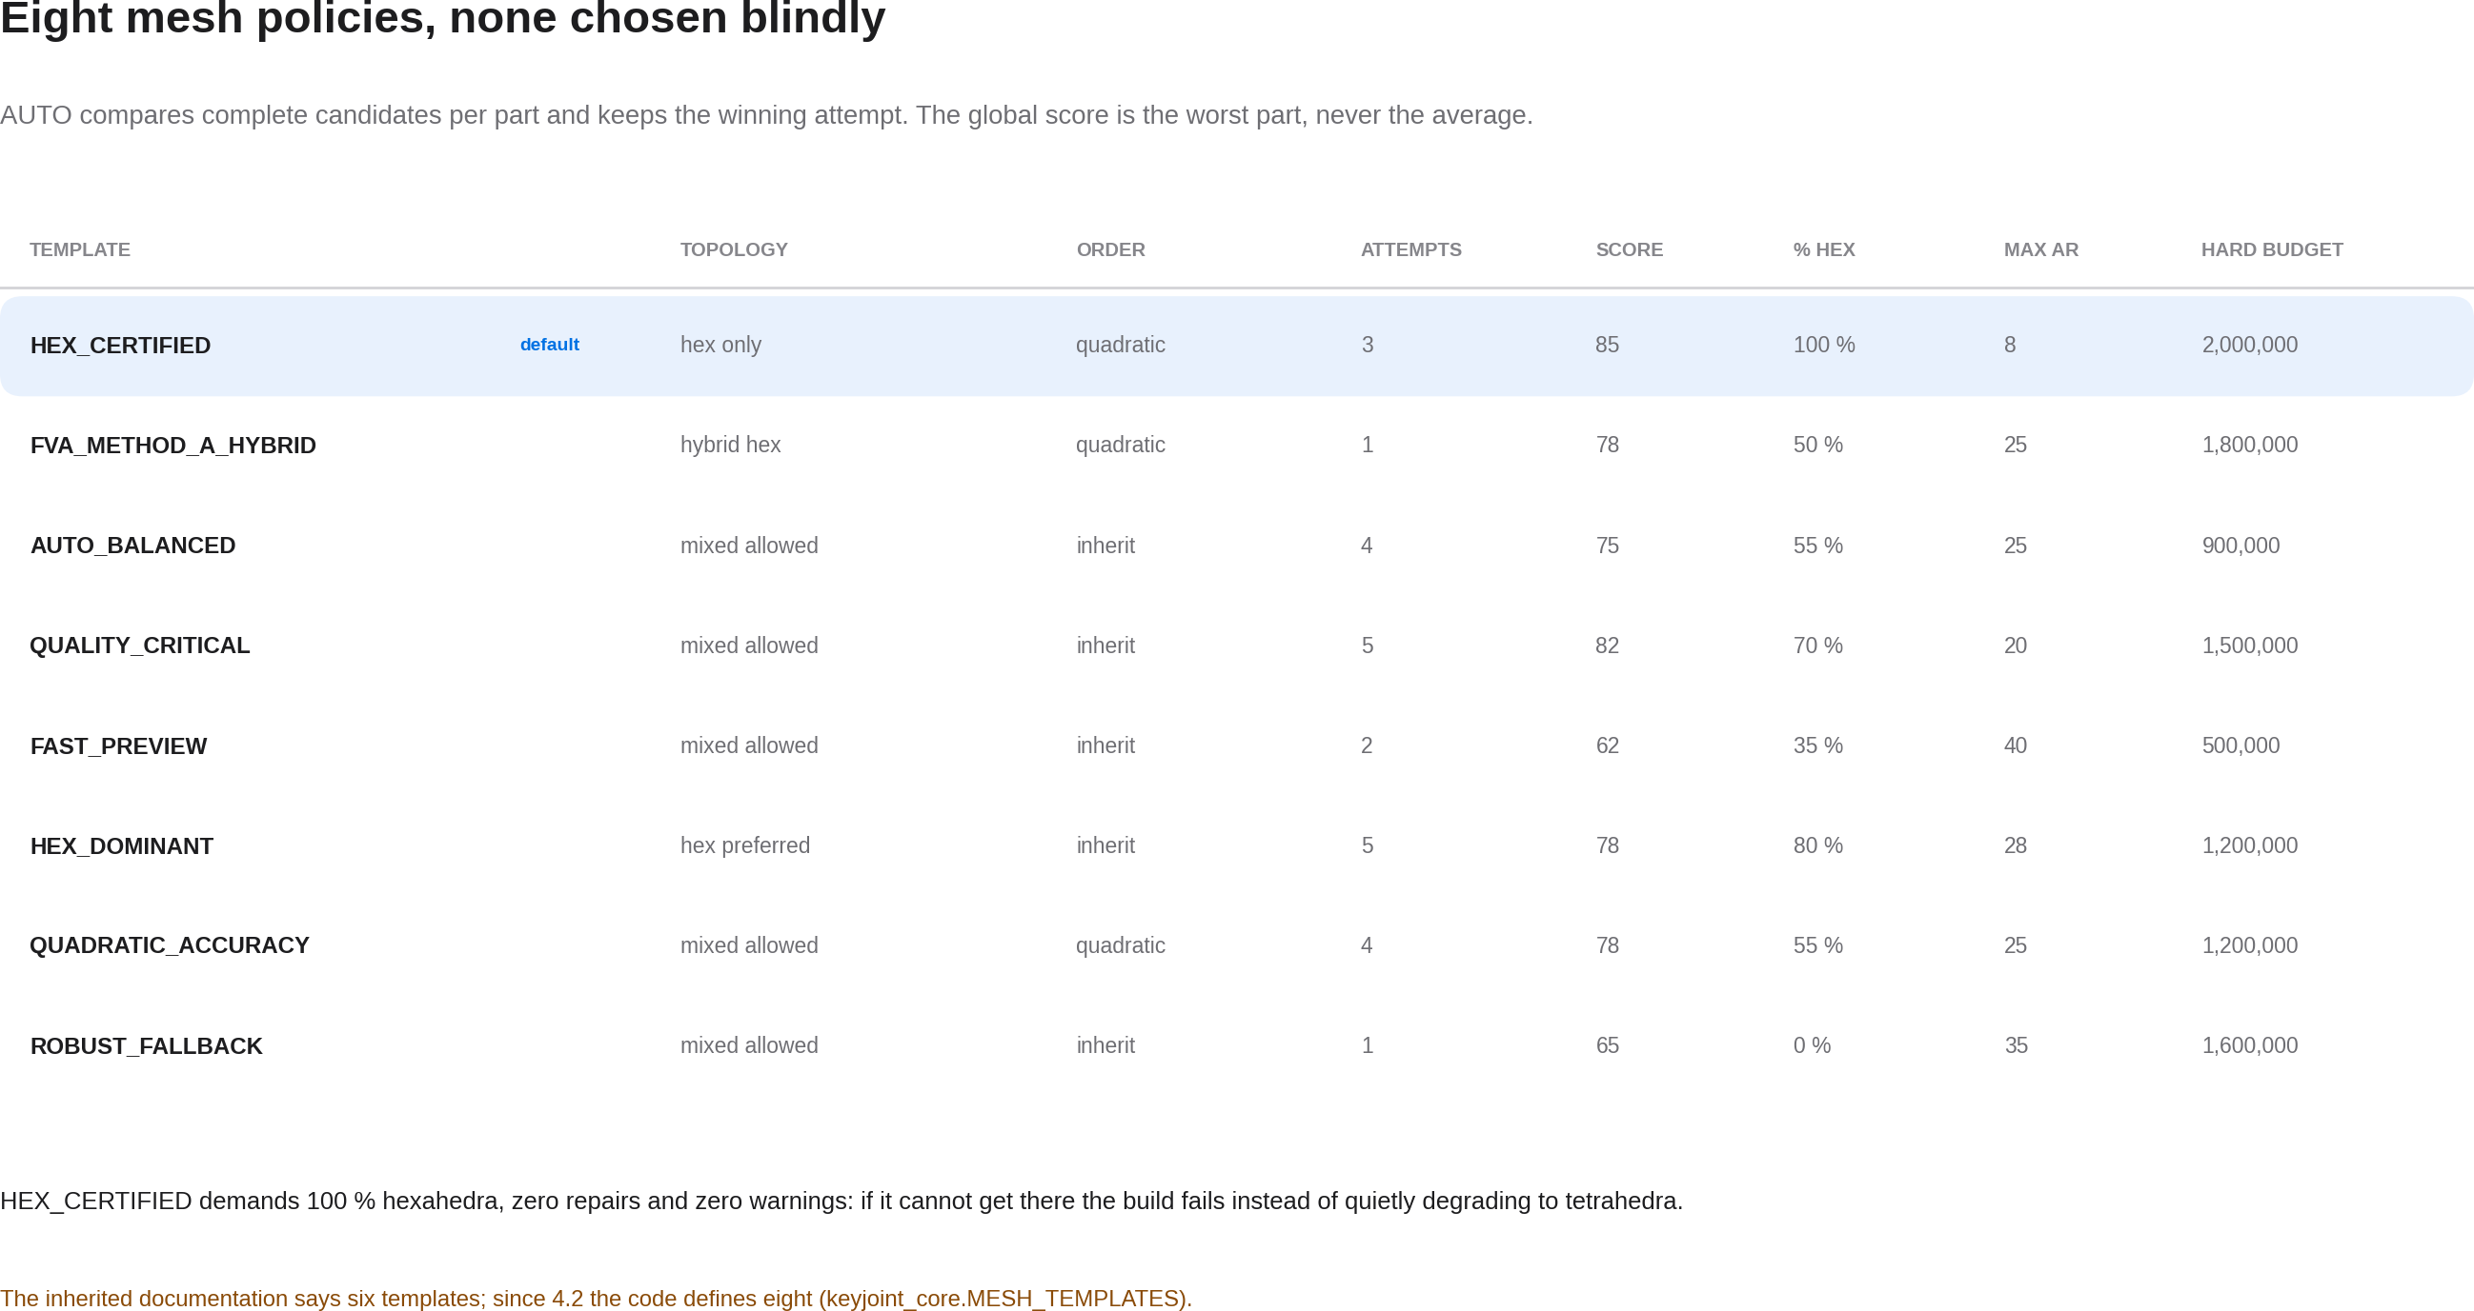
MESH POLICY
19

Slide 20
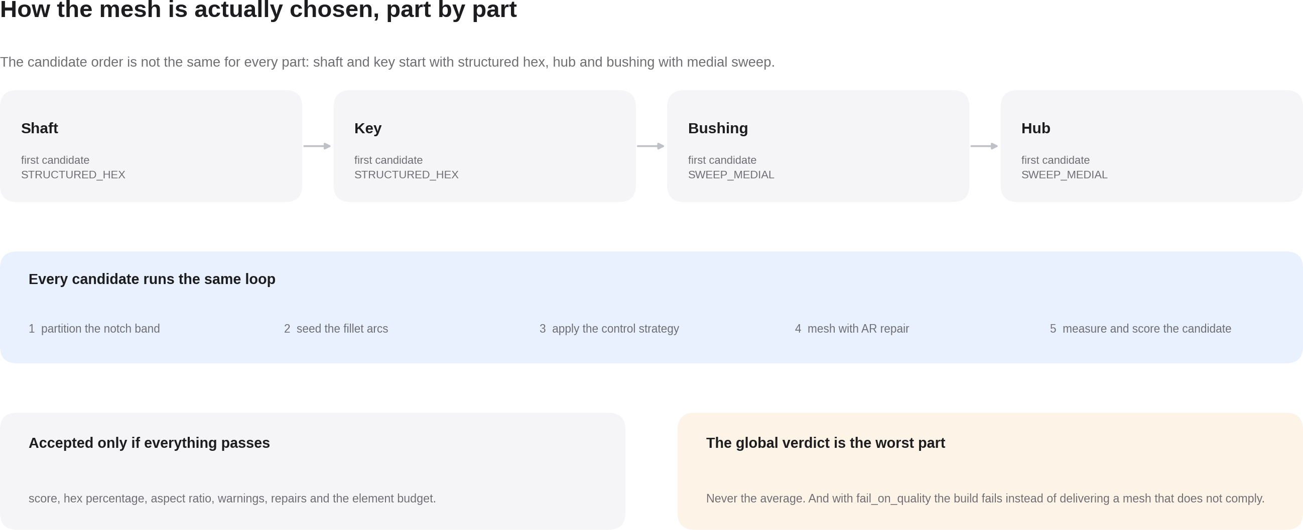
MESH SELECTION
20

Slide 21
ANALYSIS SETUP
If the analysis is requested, this is what gets built
Contact
General contact with isotropic penalty friction and hard normal behaviour with separation allowed.
Drive end
Surface at the shaft end, a reference point and a kinematic coupling over the whole surface.
Held region
The hub outer diameter or both hub faces, encastred. A user choice, not a hidden assumption.
Step
Static TORSION step, with optional geometric nonlinearity and stabilization, and increment control from the form.
Load
A moment about the shaft axis applied at the reference point; the guide point locks every degree of freedom except the rotation.
Output
Field S, U, E, RF, CSTRESS and CDISP at four intervals; history UR3 and RM3 at the reference point.
Creating the job and submitting it to the solver remain two separate decisions, and neither is the default.
21

Slide 22
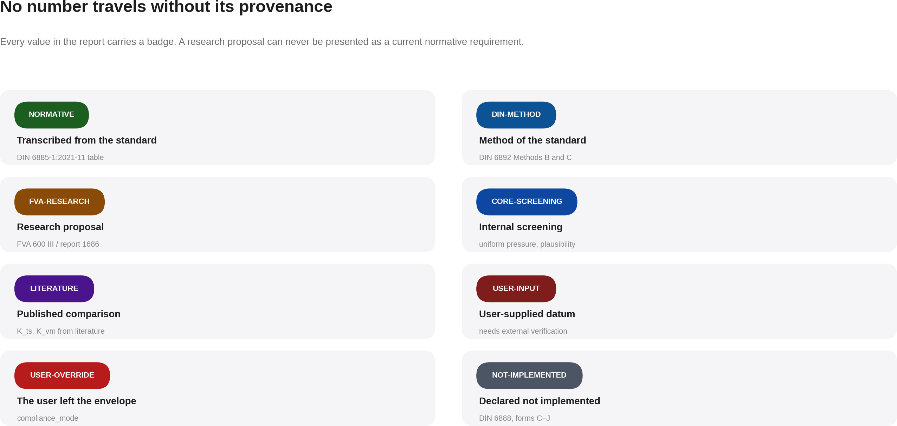
TRACEABILITY
22

Slide 23
THE NORMATIVE DATUM
The table is never interpolated: either a row or an error
din6885_row() returns the exact row with its NORMATIVE badge. Outside the range of the standard it raises, so nobody can claim DIN compliance from the nearest row.
26 cross-section rows
b × h, t1, t2, the t1 tolerance and the d2 increment for every diameter band
34 standard lengths
from 6 to 400 mm; the key is snapped down, never up
7 radius bands
mouth r1 and root r2 separately: they are not the same radius
3 forms implemented
A, B and AB. C through J are rejected with their own message, not silently
D40, the project's reference row
38 < d1 ≤ 44 mm b × h = 12 × 8 mm t1 = 5.00 +0.20 mm t2 = 3.30 mm d2(ref) = 48.00 mm r1 = 0.25…0.40 mm r2 = 0.16…0.25 mm
The key chamfer is not in the table: it is a user parameter (c = 0.8 mm by default) and the report says so.
23

Slide 24
THE AUDIT
The file that says what was actually built
Two formats
PARAM_BUILD_AUDIT.txt to read with your eyes and .json to process with a tool.
A verdict
OK or CHECK, and the same verdict is mirrored into the build result: there are not two versions of the truth.
Provenance
SHA-256 of the engine and core files that produced that model, not of whatever is on disk today.
Plan versus reality
The planned mesh and the realised one, part by part. If they disagree, the project is not declared sound.
Per part
Elements, quality score, hex share, aspect ratio, repairs and the attempt history.
The issue list
Every warning with its stable code, plus the evidence badges and the sets and surfaces created.
24

Slide 25
THE DELIVERABLE
The report is the product, not an extra
Ten sections
Project and provenance, scope, geometry, DIN 6892 and standards, validation, mesh and policy, checks, evidence, deliverables and limitations.
Three files and a log
report.tex to review, report.pdf to sign, report_data.json to process and latex_build.log to debug.
Trilingual
Emitted in the project's language, from the same 650-key catalogues the interface uses.
The badges survive
Every value reaches the PDF with its provenance badge as a coloured chip, not as a footnote.
Compilation
latexmk when available, two pdflatex passes otherwise, with no shell and a finite timeout.
With no LaTeX installed
It writes the .tex, says so with a translated message, and does not fail the build over something that is not the model's fault.
25

Slide 26
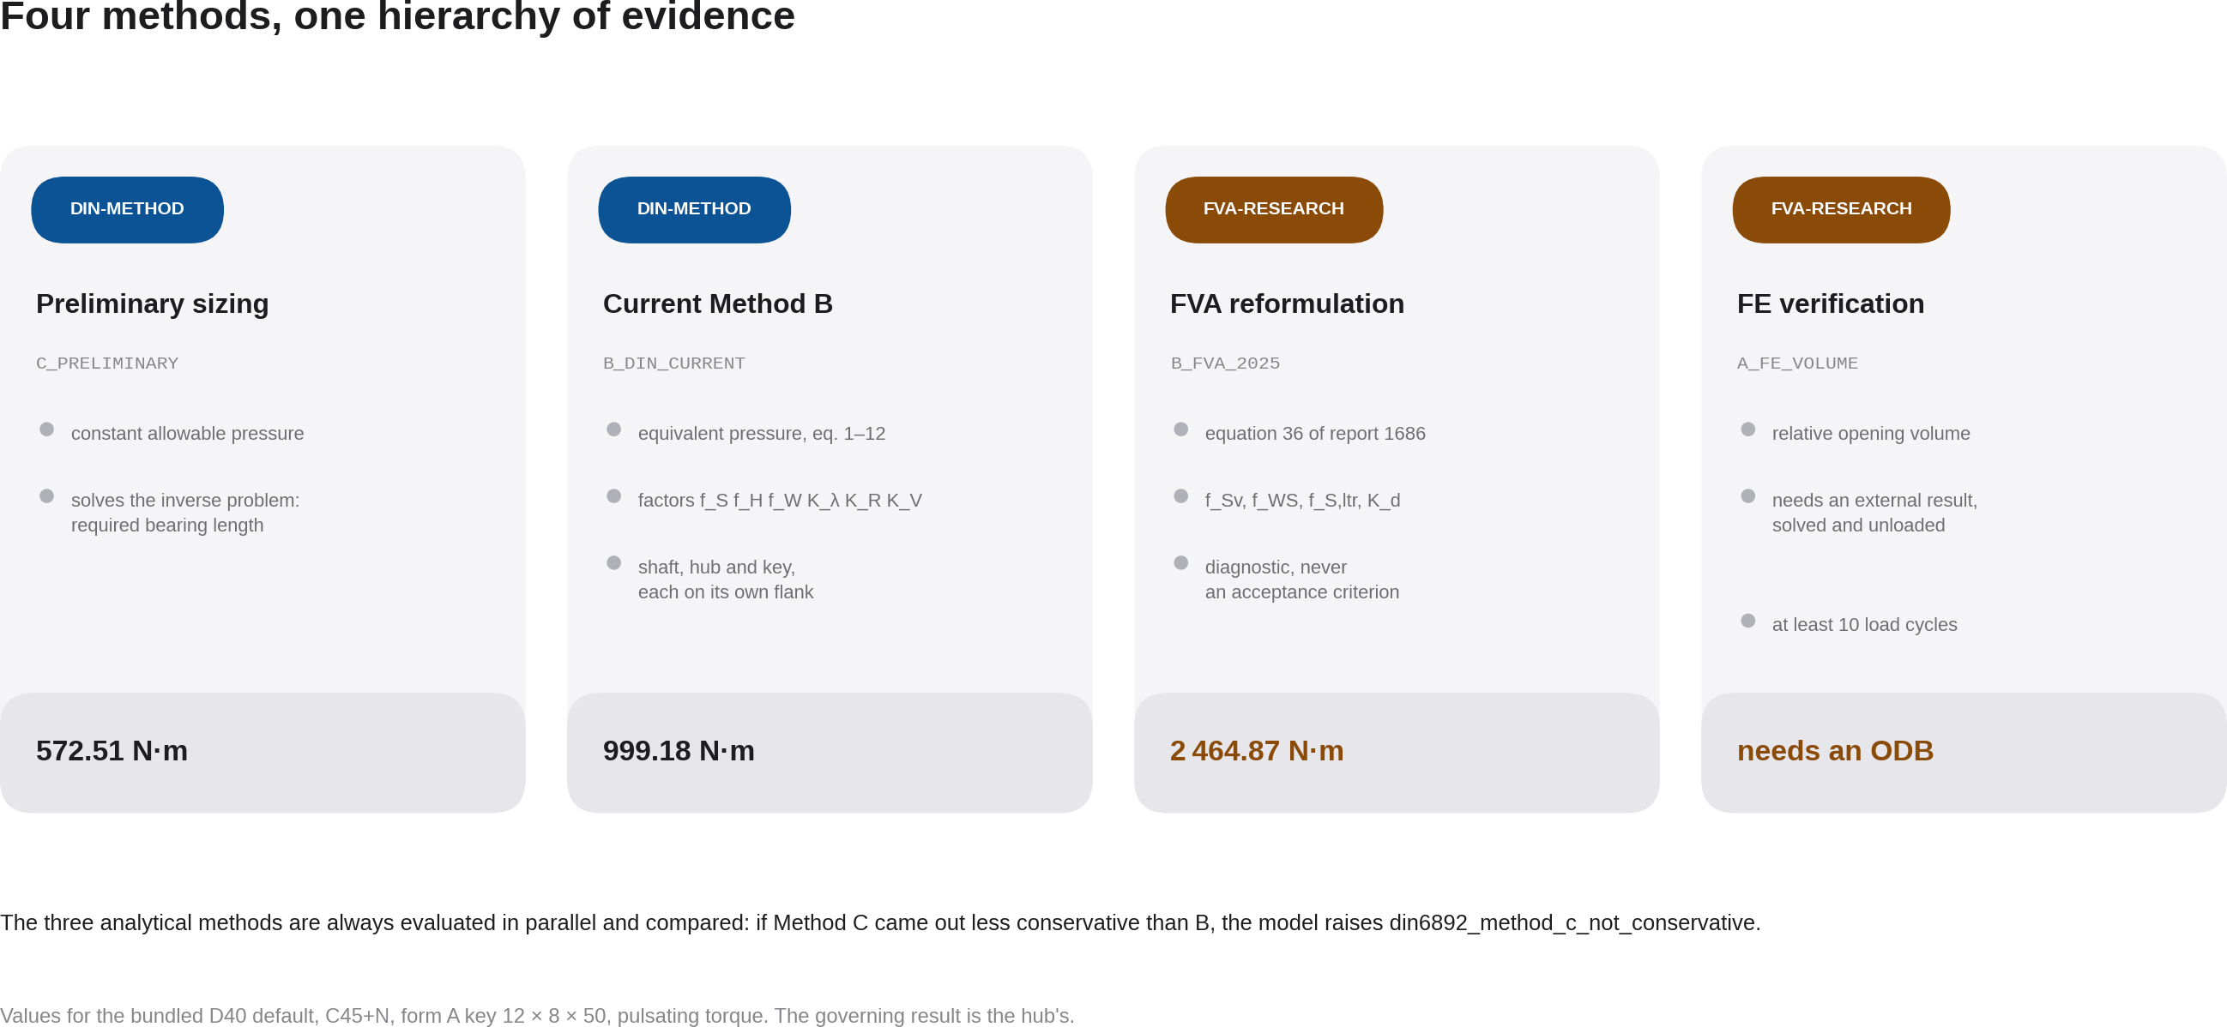
LOAD CAPACITY
26

Slide 27
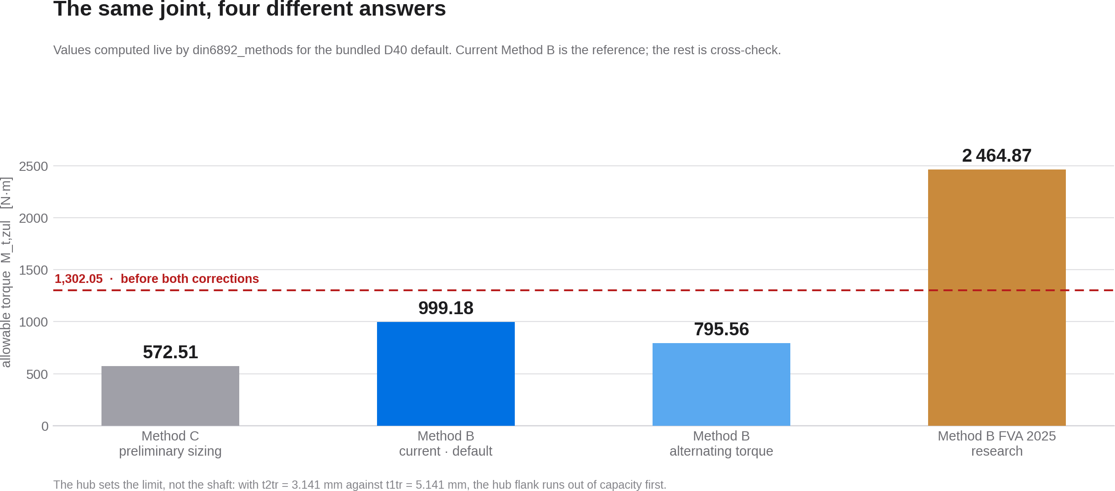
RESULTS
27

Slide 28
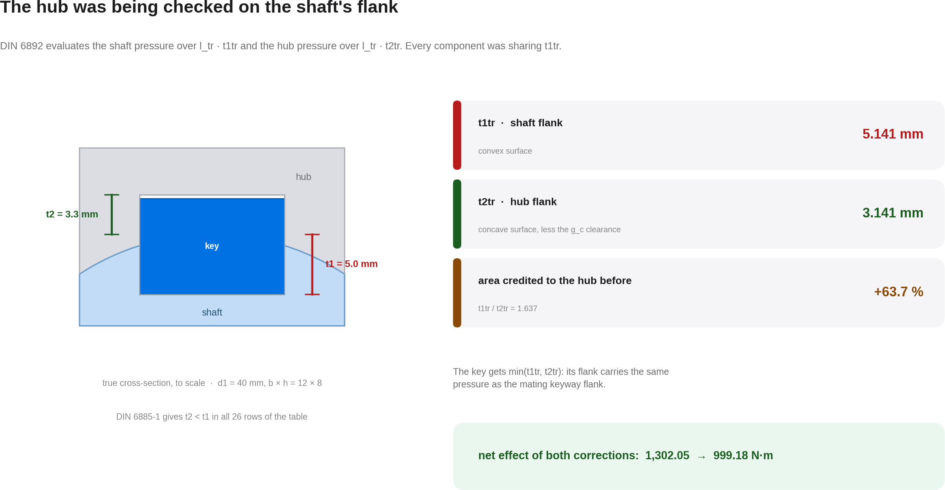
CORRECTION 1 OF 2
28

Slide 29
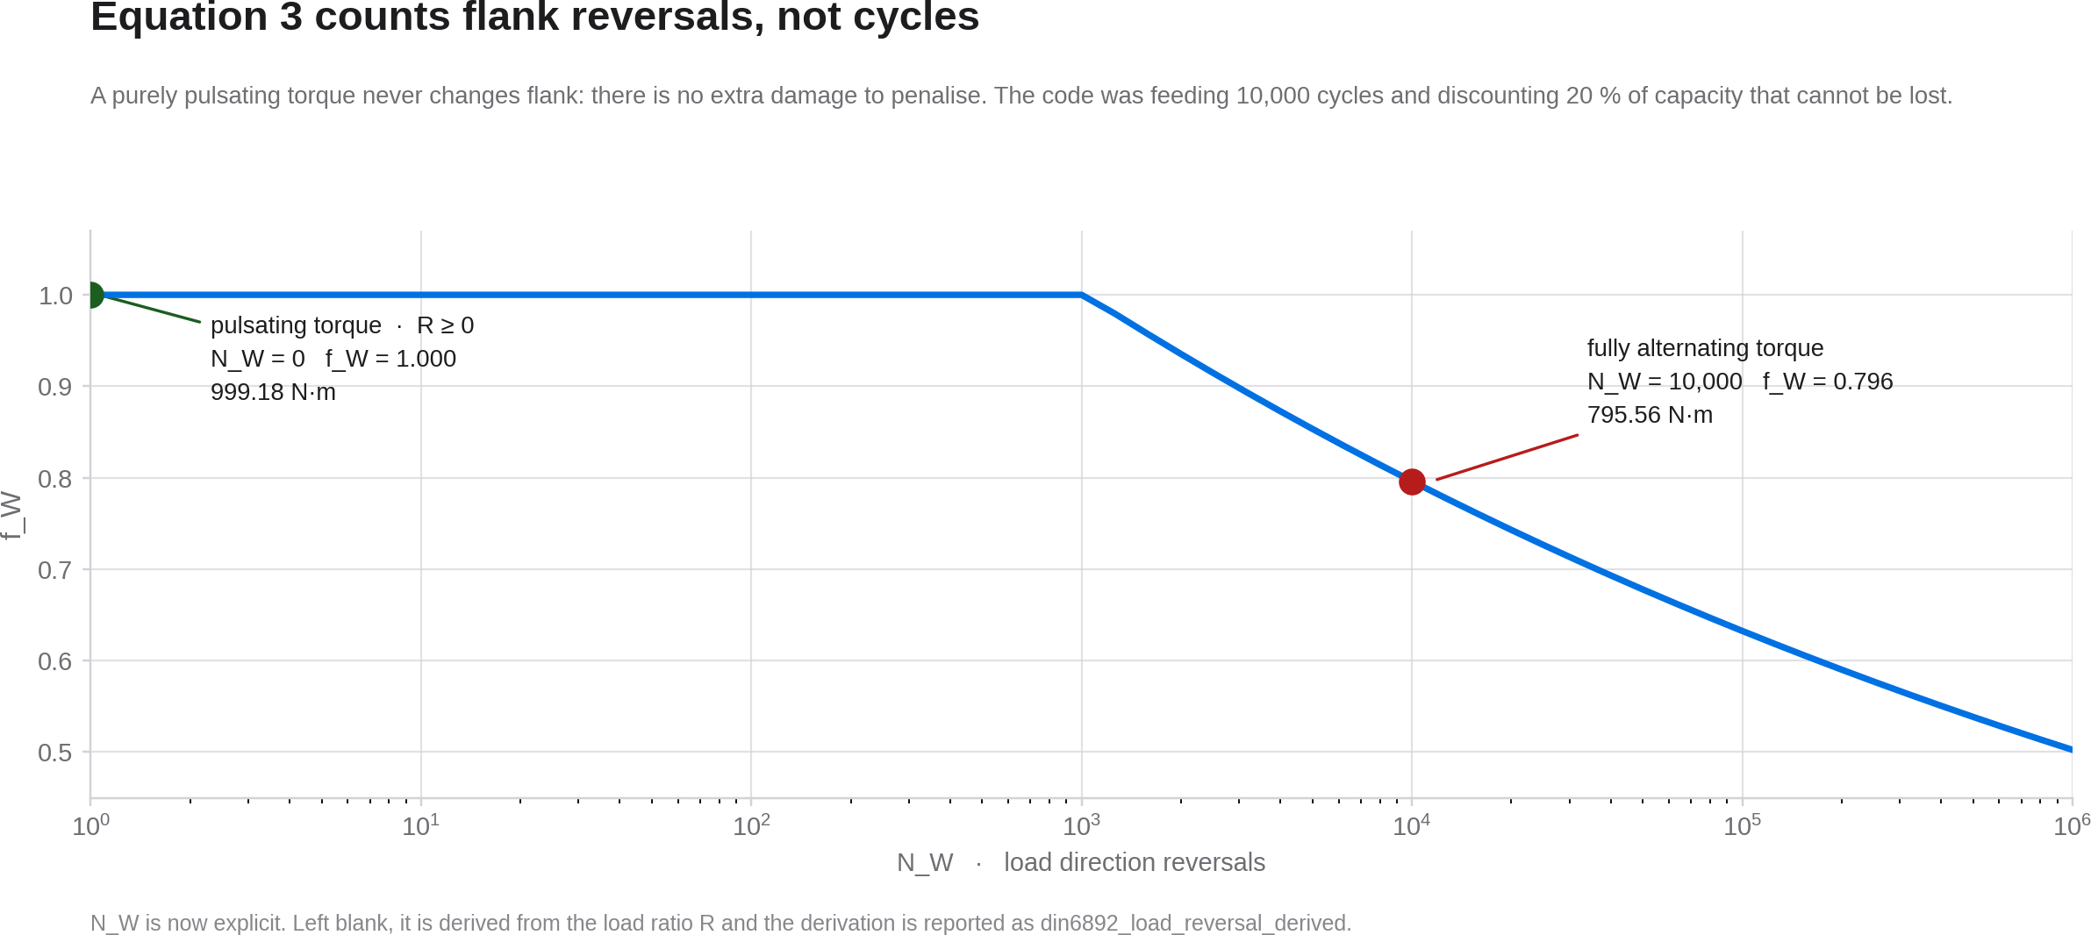
CORRECTION 2 OF 2
29

Slide 30
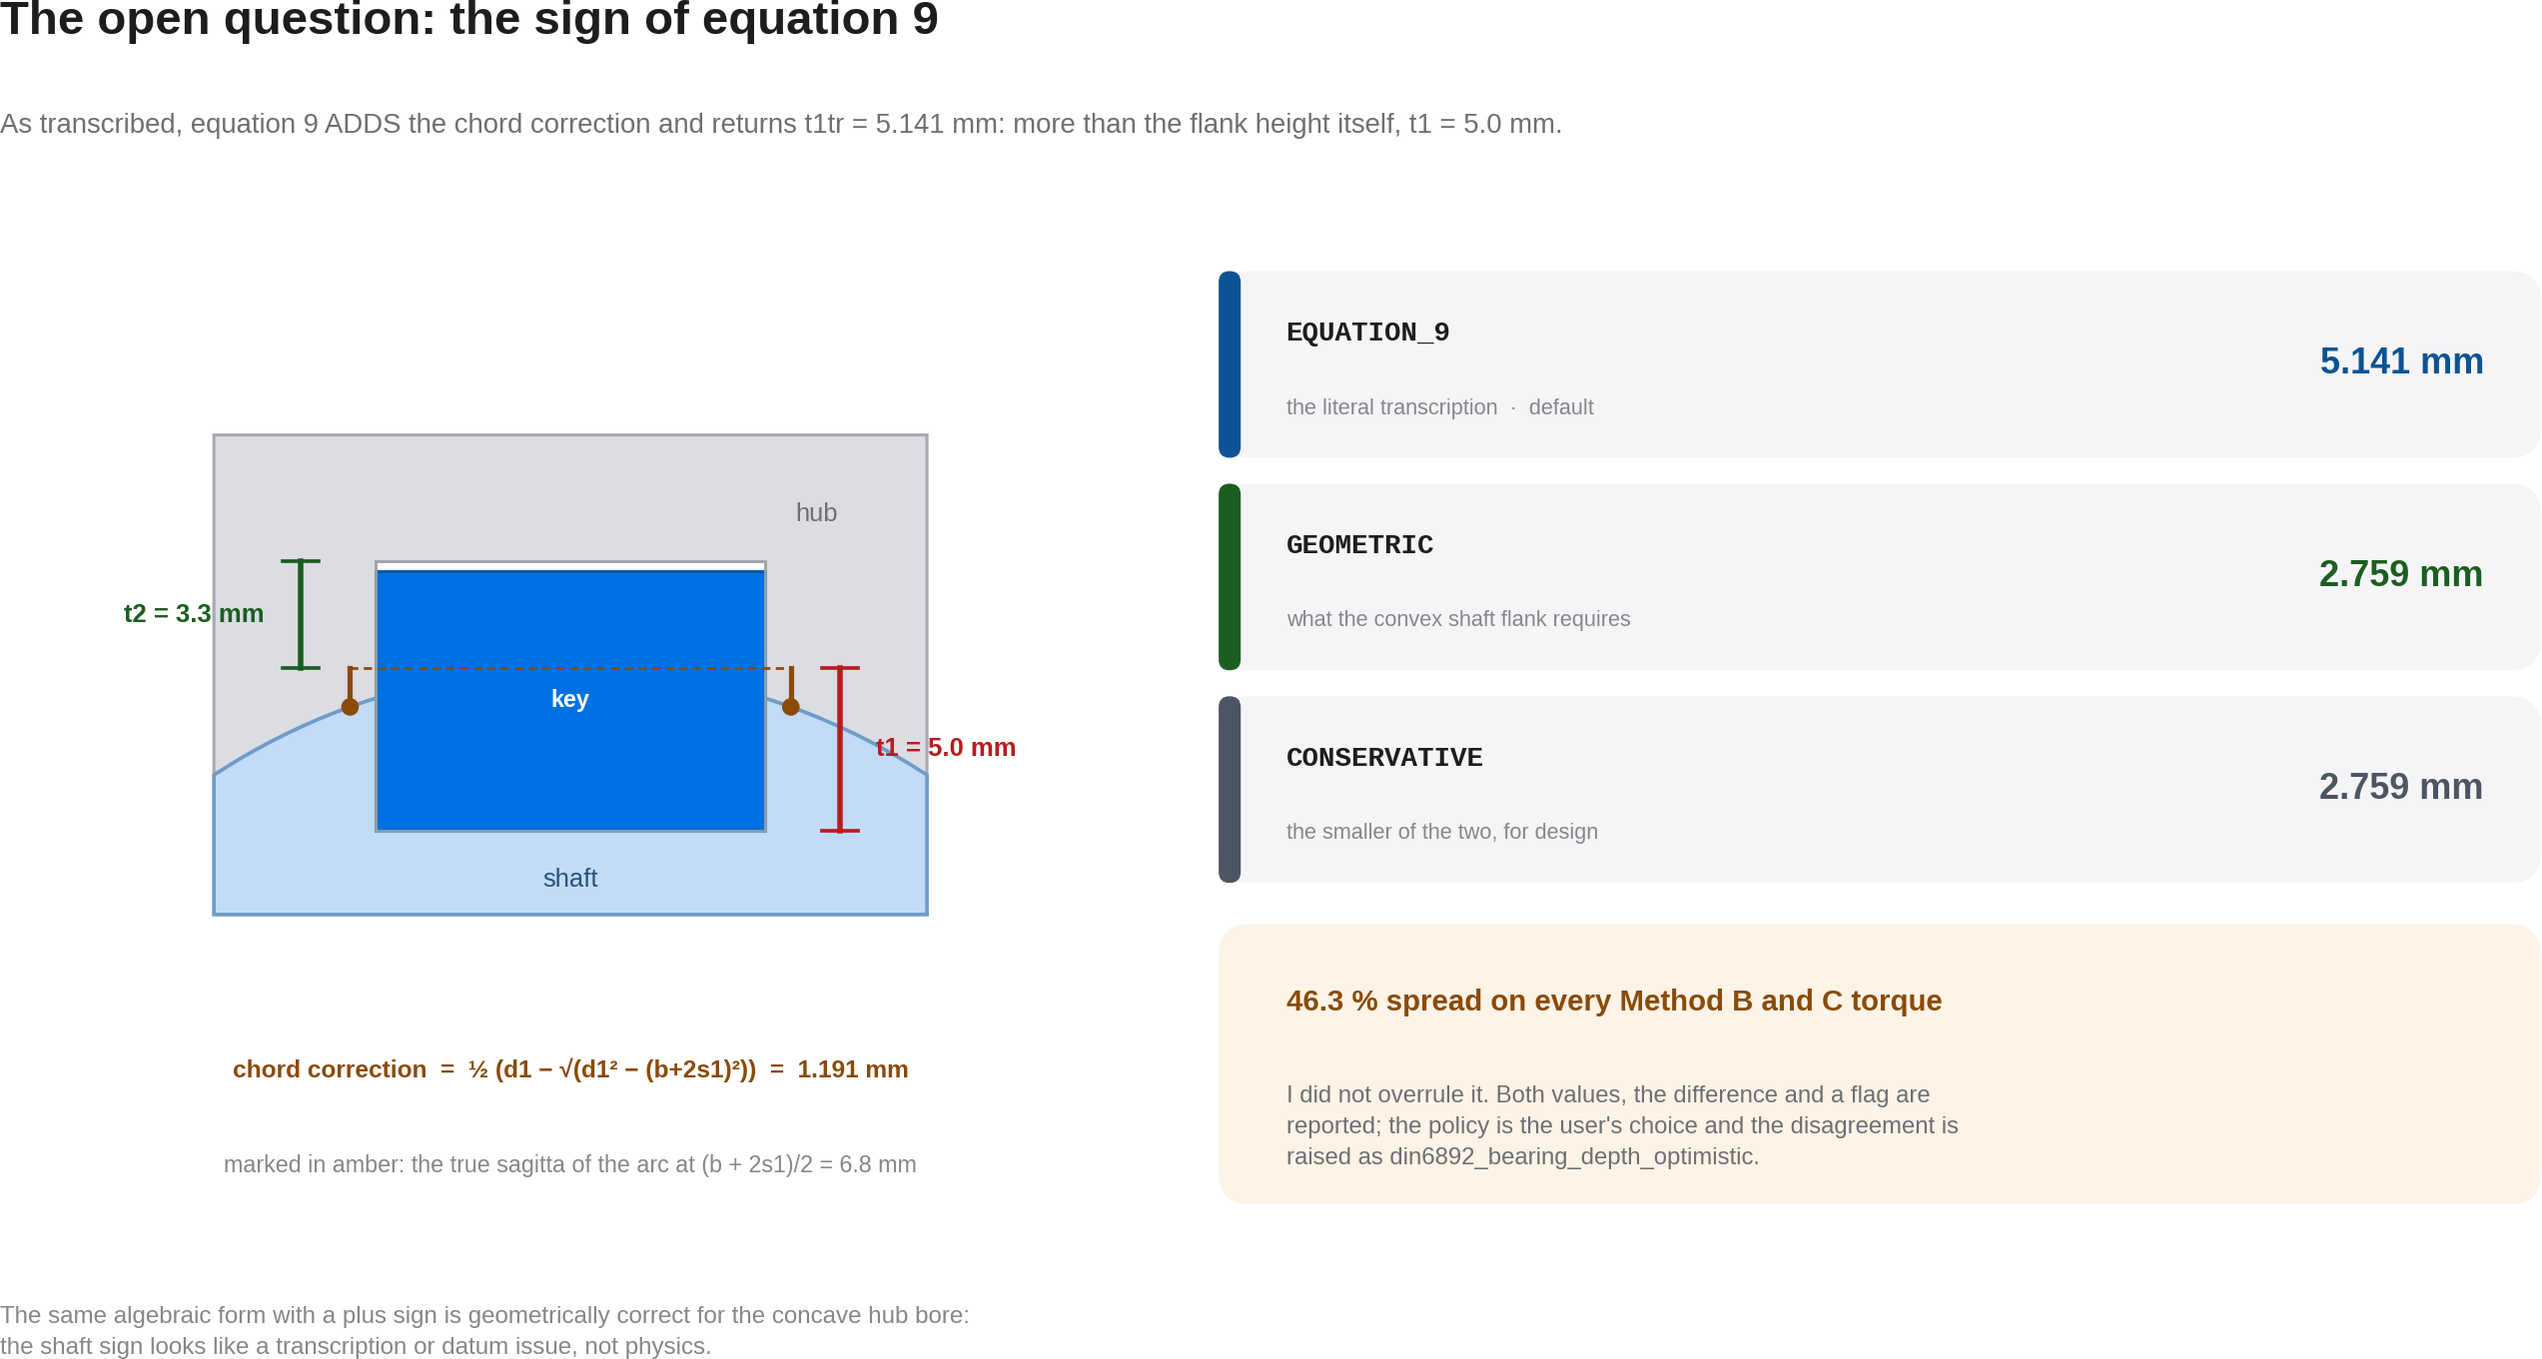
OPEN FINDING
30

Slide 31
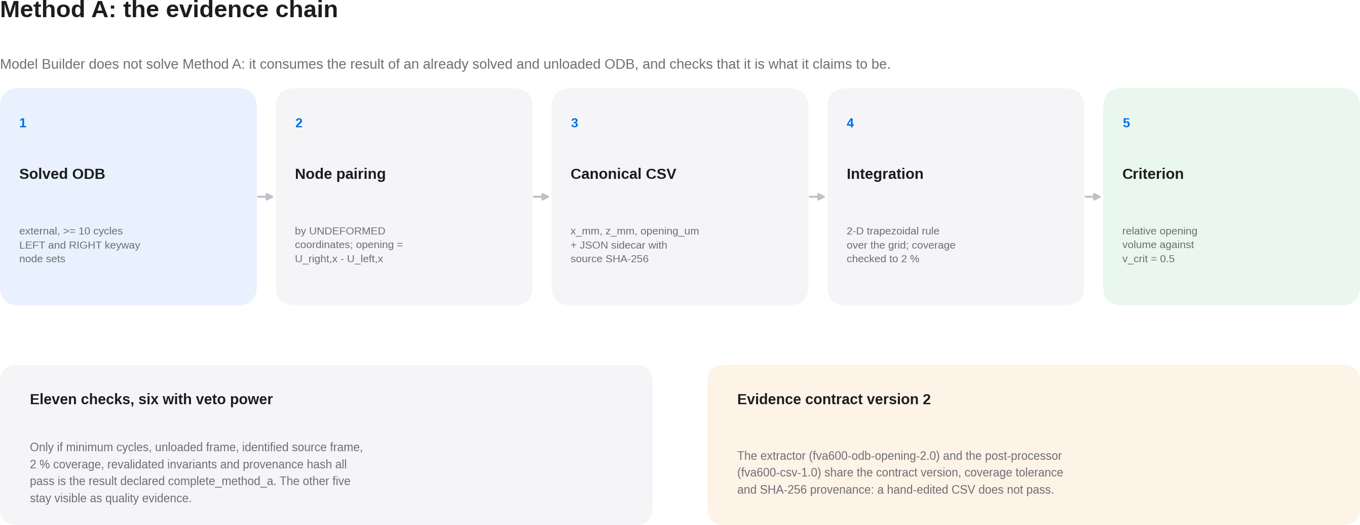
METHOD A
31

Slide 32
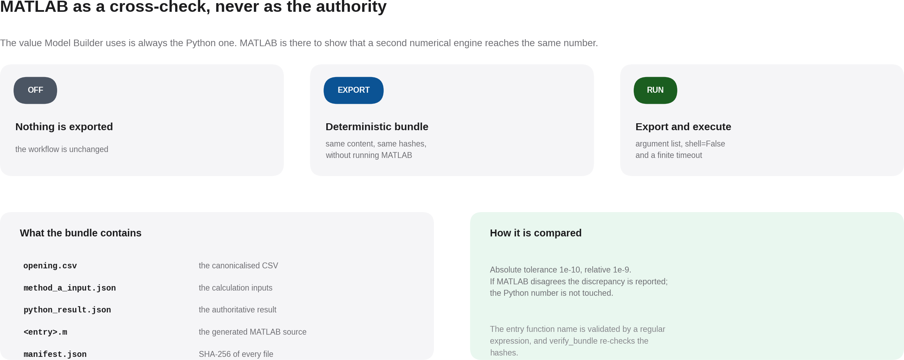
NUMERICAL CROSS-CHECK
32

Slide 33
FVA 600 III CATALOGUE
Eight discrete configurations, not a continuous domain
VB1 to VB8
Each variant fixes d_w, l_tr/d_w, Q_A, the interference, the load ratio R and the key form.
They are points, not a range
The catalogue is documented as discrete research configurations: interpolating between them is not supported.
VB1, the reference
d_w = 40 mm, l_tr/d_w = 0.95, Q_A = 0.5, R = 0 and a form A key. It is the variant of the bundled presets.
Material models
Chaboche-Lemaitre combined on the shaft, UML Ramberg-Osgood on the hub and elastic-ideal-plastic on the key.
Matching mesh
Five interfaces verified after meshing, with a 0.8 mm target size and a 1e-6 mm tolerance.
MATCHED is earned
Only declared after comparing real node coordinates on every load-carrying interface. Equal seeding is not proof.
33

Slide 34
VERIFICATION
What has been checked, and how
Packaged self-test
4.2 identity and schema 6, the 5→6 migration, DIN and FVA catalogues, golden calculations, eight mesh templates, reports in all three languages. Exits with code 0.
Compatibility with the kernel
the six modules that run inside Abaqus were audited with AST: no f-strings, no annotations, only os, sys, json, math, time and hashlib. Division imported from __future__.
Parity across the three catalogues
650 keys per language with no gaps; every validation code has its translated presentation.
Artifact contract
a project is declared sound only if the audit, BUILD_RESULT and all requested or required artifacts exist, and the realised mesh matches the planned one.
Guarded configurations
the defaults and the two packaged FVA companions validate under schema 6. The repository's 10-cycle setup is validated separately and is not packaged.
Figures locked in the test
999.18 N·m hub-governed, t2tr = 3.141 mm, f_W from equation 3 and the K_λ domain.
What the self-test does not do, and says so: it does not start Abaqus, does not solve, does not compile LaTeX and does not validate an FVA specimen.
34

Slide 35
ROBUSTNESS
Decisions that rule out whole classes of error
No shell
The launcher is built as an argument list; shell=True is never used and control characters are rejected.
Contained
The subprocess runs with cwd = jobs/ and artifact routes must be absolute: there is no fallback to the current directory.
Three NOJOB guards
No job objects, no solver files, plus an explicit configuration check.
Cancel means cancel
The whole solver process tree is killed and the project is marked CANCELLED, not finished.
Atomic writes
Every JSON is written to .tmp and renamed, so a crash cannot leave half a manifest.
Nothing licensed ships
DIN and FVA documents stay out of the package by whitelist, not by accident.
35

Slide 36
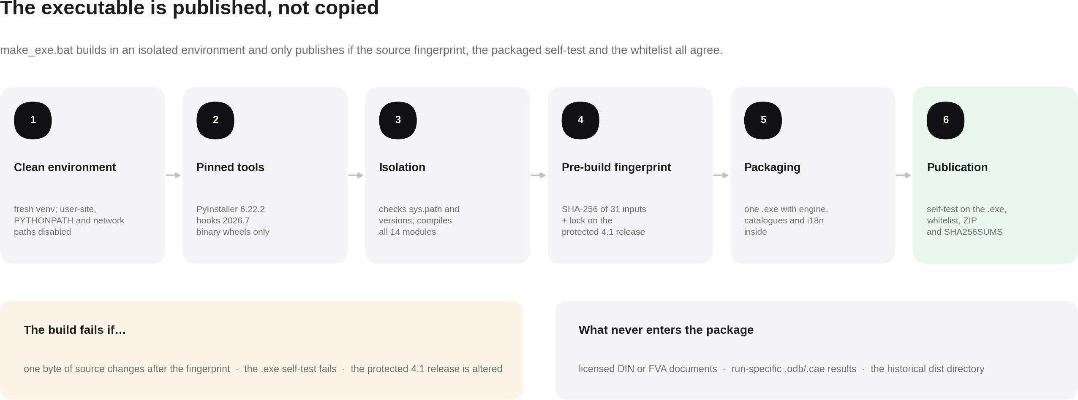
DISTRIBUTION
36

Slide 37
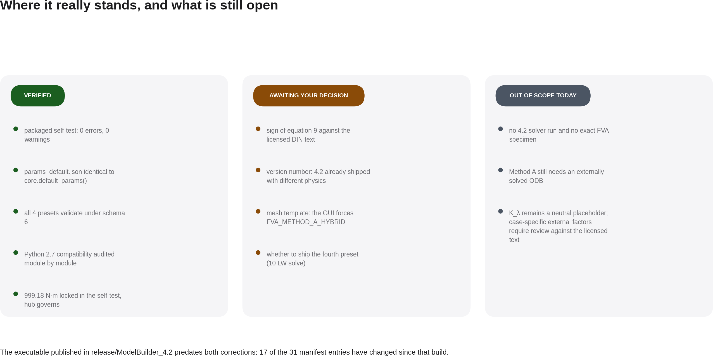
STATUS
37

Slide 38
NEXT STEPS
Three decisions and one build
01
Rebuild the executable
make_exe.bat, unchanged, from the full project tree. The published .exe predates both corrections: 17 of the 31 manifest entries have changed.
02
Settle the sign of equation 9
against the licensed DIN 6892 text. The sign changes the shaft depth and shaft component by 46.35%; in the bundled D40 default, the hub still governs at 999.18 N·m.
03
Number the version
two executables that both report 4.2 and return different torques are an identity collision. My recommendation is 4.3.
38

Slide 39
The value is not the model.
It is being able to show how it was made.
Model Builder 4.2 · parameter schema 6 · din6892-methods-1.0 · auto-mesh-2.0
Every calculation can be traced to code; historical screenshots and renders are identified as source evidence.
39

