Slide 1

Structure of mobility networks in DK during the pandemic

Slide 2
The data
Telco datasets
Travel times in DK between municipalities

Slide 3
Ideas
How does mobility change during the pandemic?
Which trips are most affected by lockdowns?
Did the Danes react differently during the two lockdowns?

Slide 4
Ideas for future analysis
Did the Danes move during the pandemic?

Slide 5
Challenges
No baseline data
Geographical distances is not strongly correlated with travel times in Denmark

Slide 6
Methodology

Slide 7
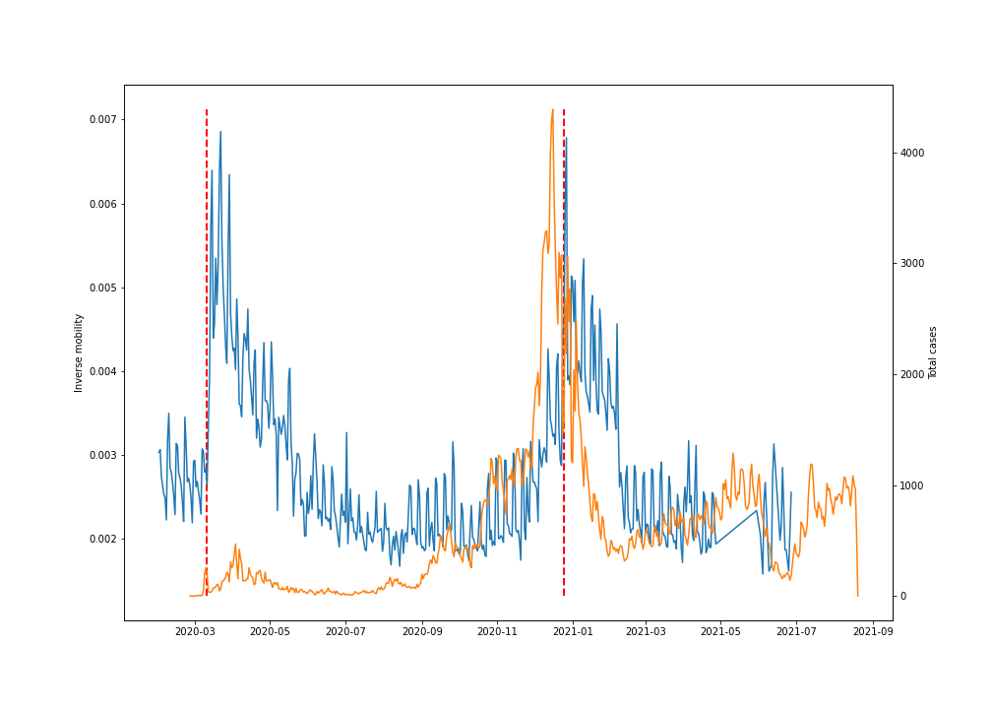
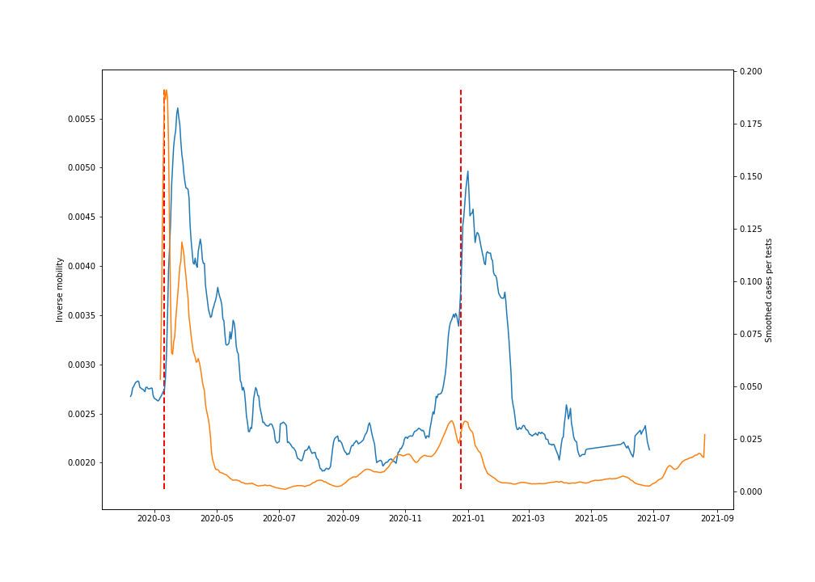
Results: Naive approach
1st lockdown: case/tests: -21%, inverse mobility: +67%
2nd lockdown: case/tests: -6%, inverse mobility: +33%

Slide 8
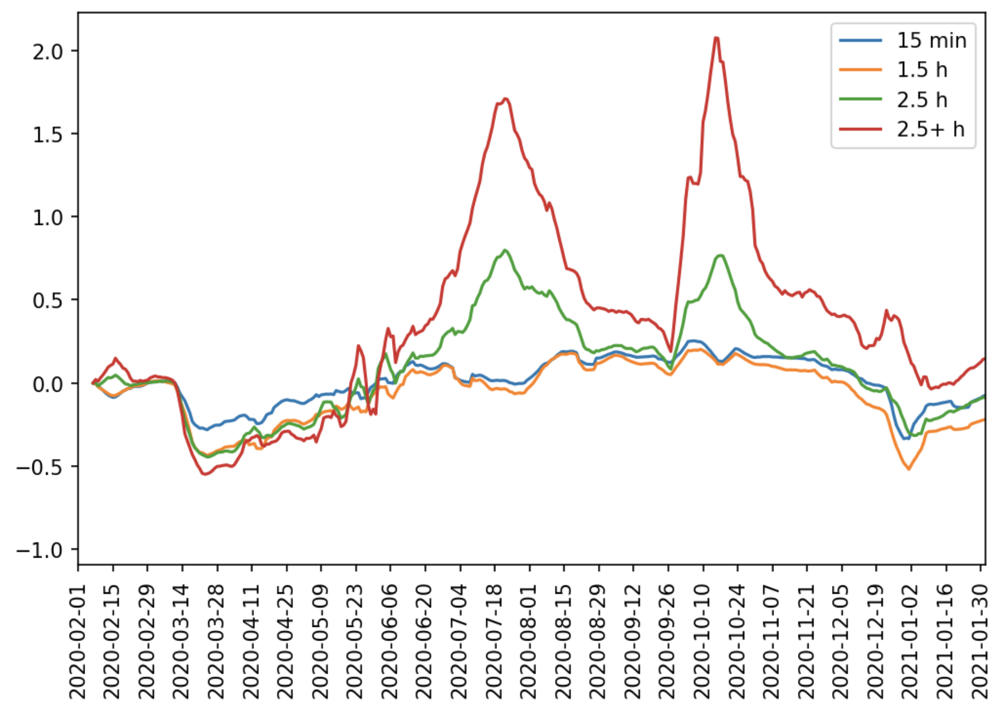
Results: Travel times

