Slide 1


AtliQ Motors India Market Analysis
AtliQ Motors, an American automotive giant specializing in electric vehicles (EVs), holds a 25% market share in the North American EV and hybrid vehicle segment. With plans for expansion, the company aims to enter the Indian market by launching its bestselling models. This presentation highlights the data analytics conducted for AtliQ Motors' Indian market expansion, focusing on key insights and strategic recommendations.
by Animesh daniel

Slide 2
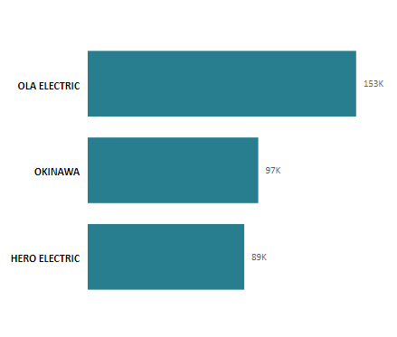
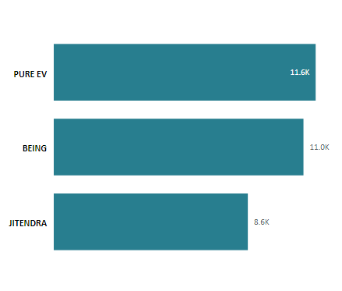
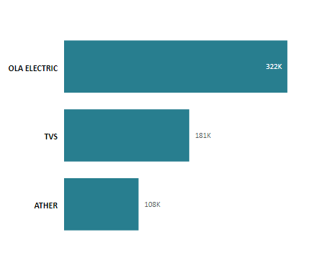
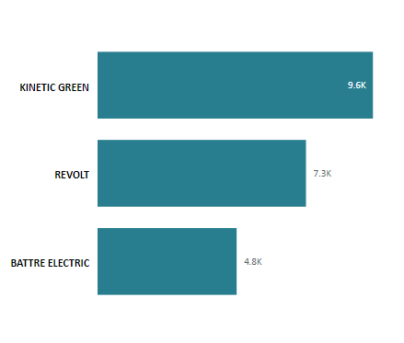
Market Landscape: EV Makers ( 2 Wheeler)
Top 3: 2023
Bottom 3: 2023
Top 3: 2024
Bottom 3: 2024
Ola Electric: 153,000 units sold
Ola Electric: 153,000 units sold
Ola Electric: 153,000 units sold
Ola Electric: 322,000 units sold
Okinawa: 97,000 units sold
Okinawa: 97,000 units sold
Okinawa: 97,000 units sold
TVS: 181,000 units sold
Hero Electric: 89,000 units sold
Hero Electric: 89,000 units sold
Hero Electric: 89,000 units sold
Ather: 108,000 units sold

Slide 3
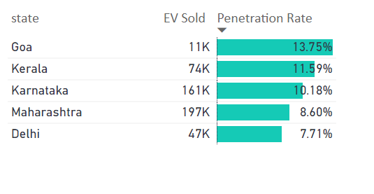
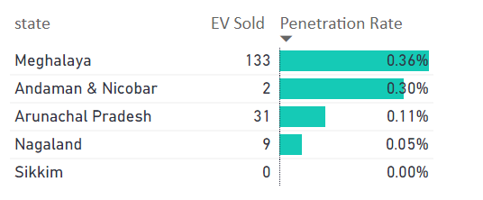
State-wise Penetration FY 23
Top 5 States
Bottom 5 States
Goa: 13.75%
Meghalaya: 0.36%
Kerala: 11.59%
Andaman & Nicobar: 0.30%
Karnataka: 10.18%
Nagaland: 0.05%
Maharashtra: 8.60%
Sikkim: 0.00%
Delhi: 7.71%
Arunachal Pradesh: 0.11%

Slide 4
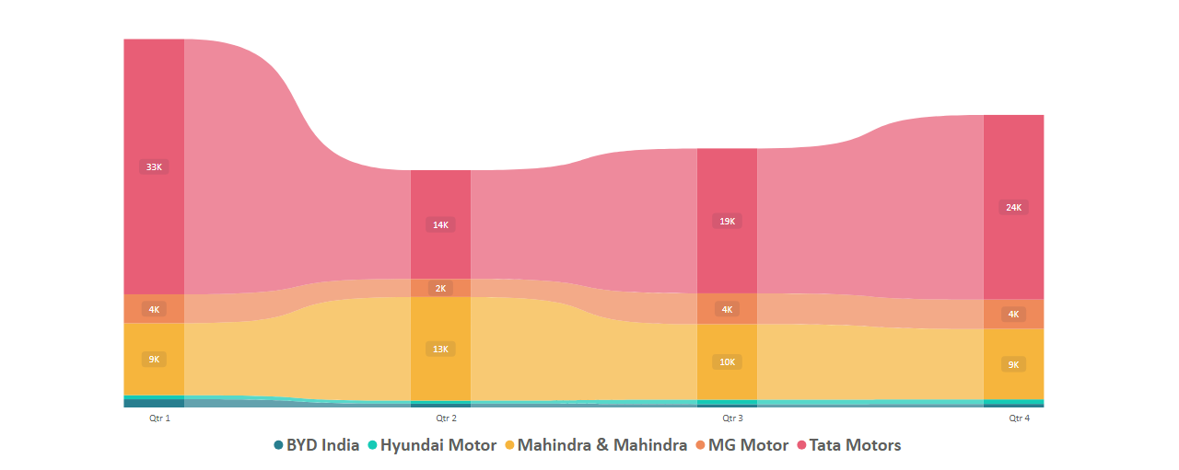
Top 5 EV Makers (4 wheeler) : Quarterly Sales Trends
1
Sales peak in Q4
2
Tata Motors
3
Mahindra & Mahindra
Sales are lowest in Q1.
Significant sales growth every quarter and maintains the lead consistently.
Ranks second but sales are gradually declining.
4
MG Motors
5
BYD India & Hyundai Motor
Sales increase from Q1 to Q2 but eventually decline.
Consistently record the lowest sales.

Slide 5
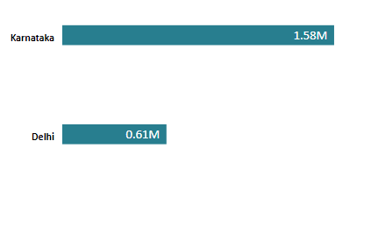
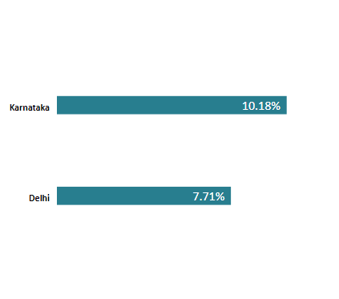
Delhi vs Karnataka: EV Sales Comparison
Karnataka leads the EV market in India with a 10.18% penetration rate and 1.58 million EV sales, showcasing strong adoption and significant contribution to overall market growth. The state's extensive charging infrastructure and progressive EV policies have positioned it as a frontrunner. In comparison, Delhi has a 7.71% penetration rate and 0.61 million EV sales, reflecting a growing urban preference for electric vehicles driven by increasing environmental awareness and government incentives. Both states highlight the critical role of infrastructure and policy support in accelerating EV adoption.

Slide 6
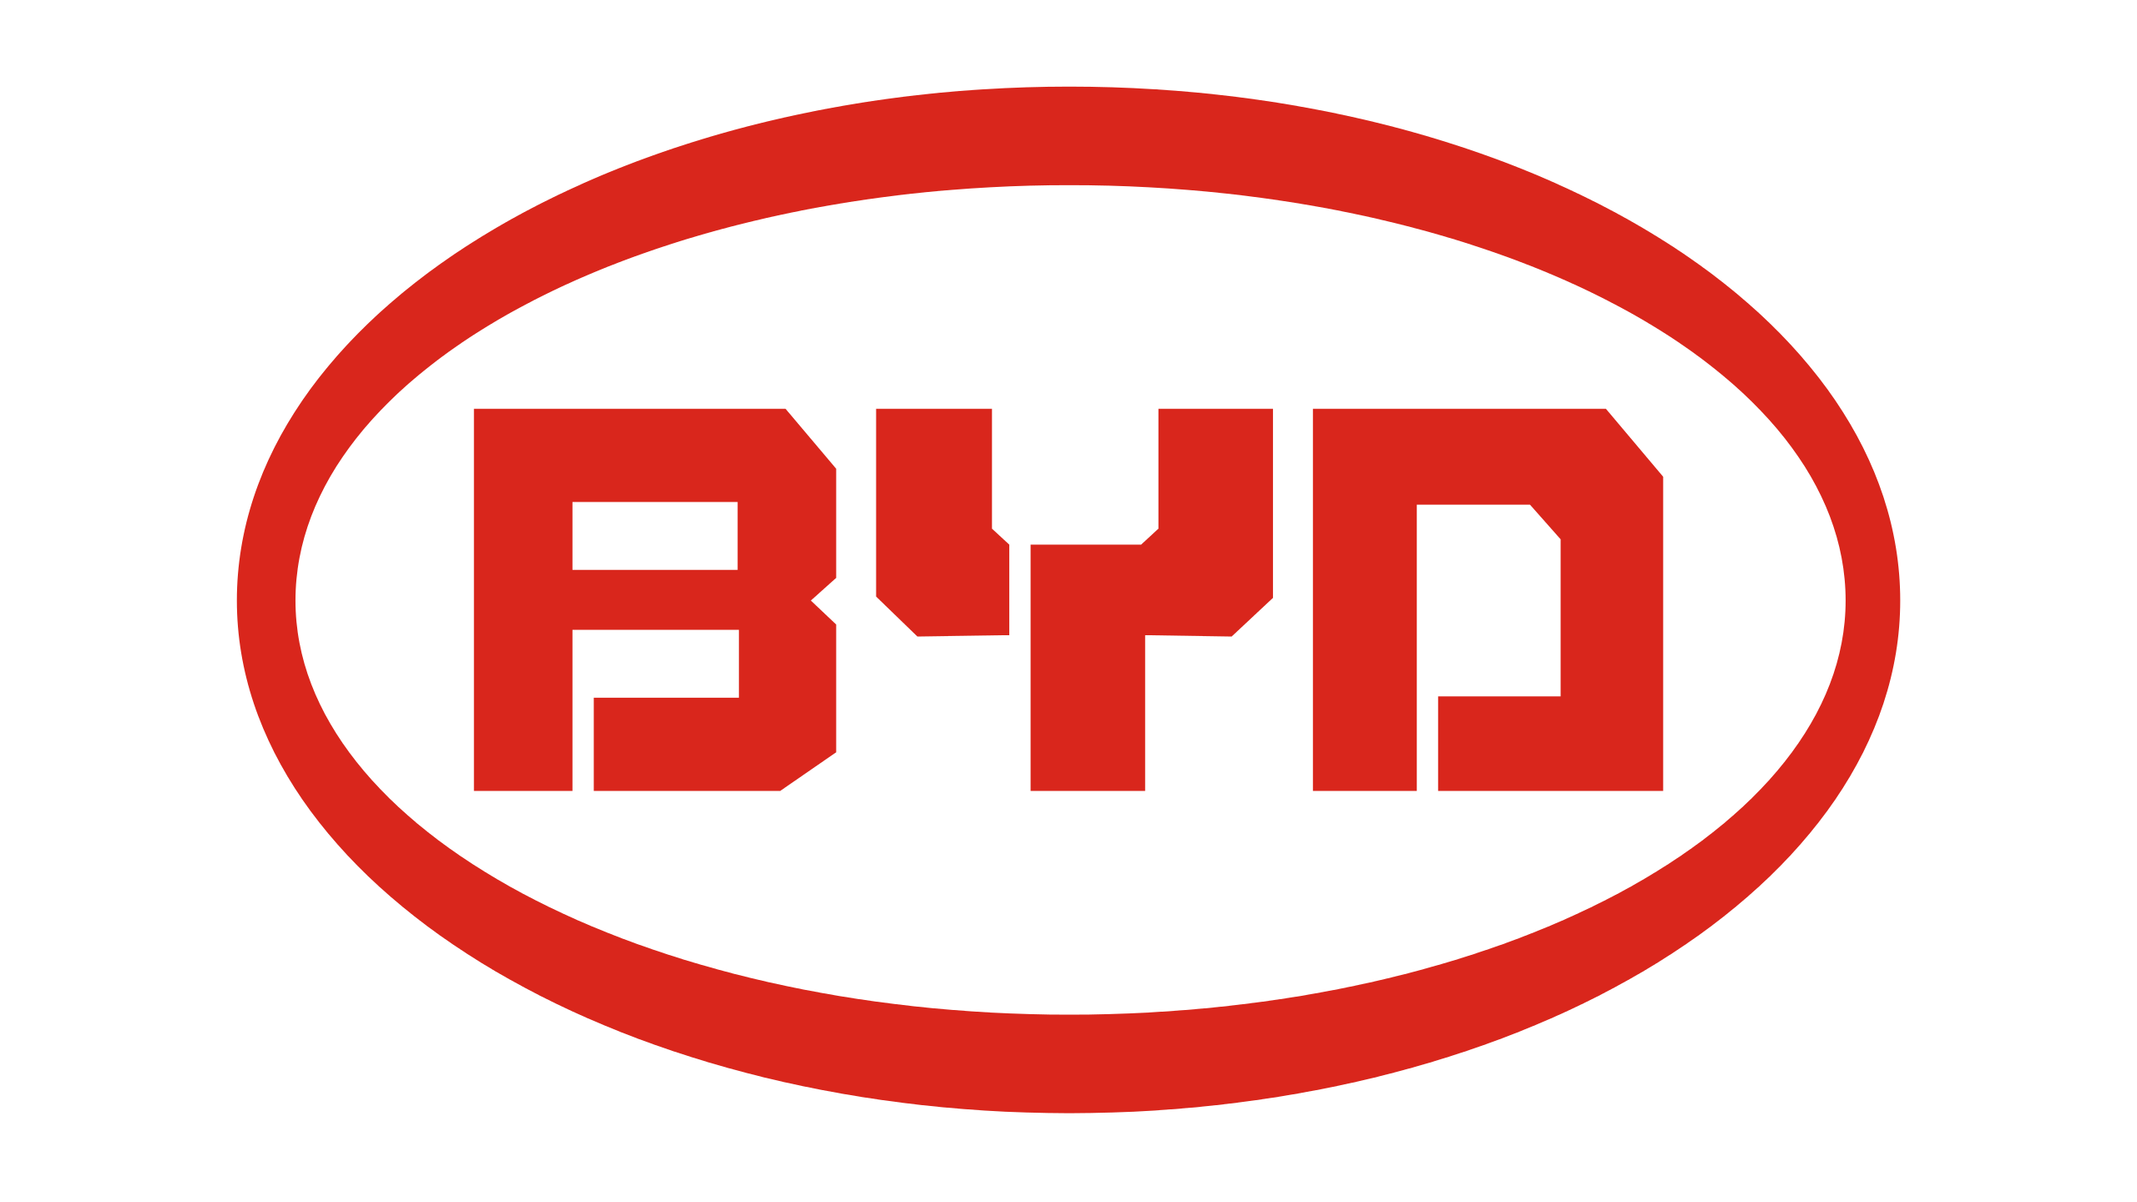




Top 5 EV Makers (4 wheeler) : CAGR Analysis
BYD India
Hyundai Motor
Mahindra & Mahindra
MG Motor
With 566 % CAGR FY 22-24
With 255.48 % % CAGR FY 22-24
With 140.33 % % CAGR FY 22-24
With 131.53 % % CAGR FY 22-24
Tata Motors
With 94.71 % % CAGR FY 22-24

Slide 7
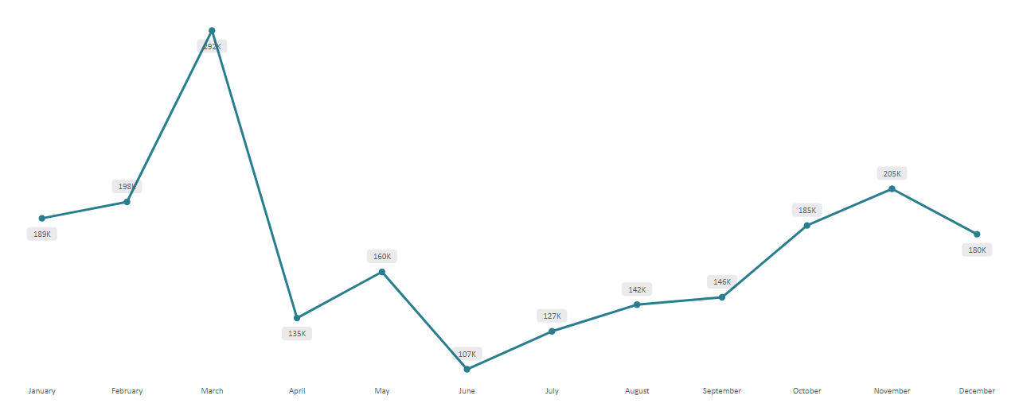



Seasonality: EV Sales Trends
Peak Season
Shoulder Season
Low Season
March, highest demand and adoption rates.
292k unit sold
May, moderate demand for EV.
170k unit sold
June, lowest EV sales.
107k unit sold

Slide 8
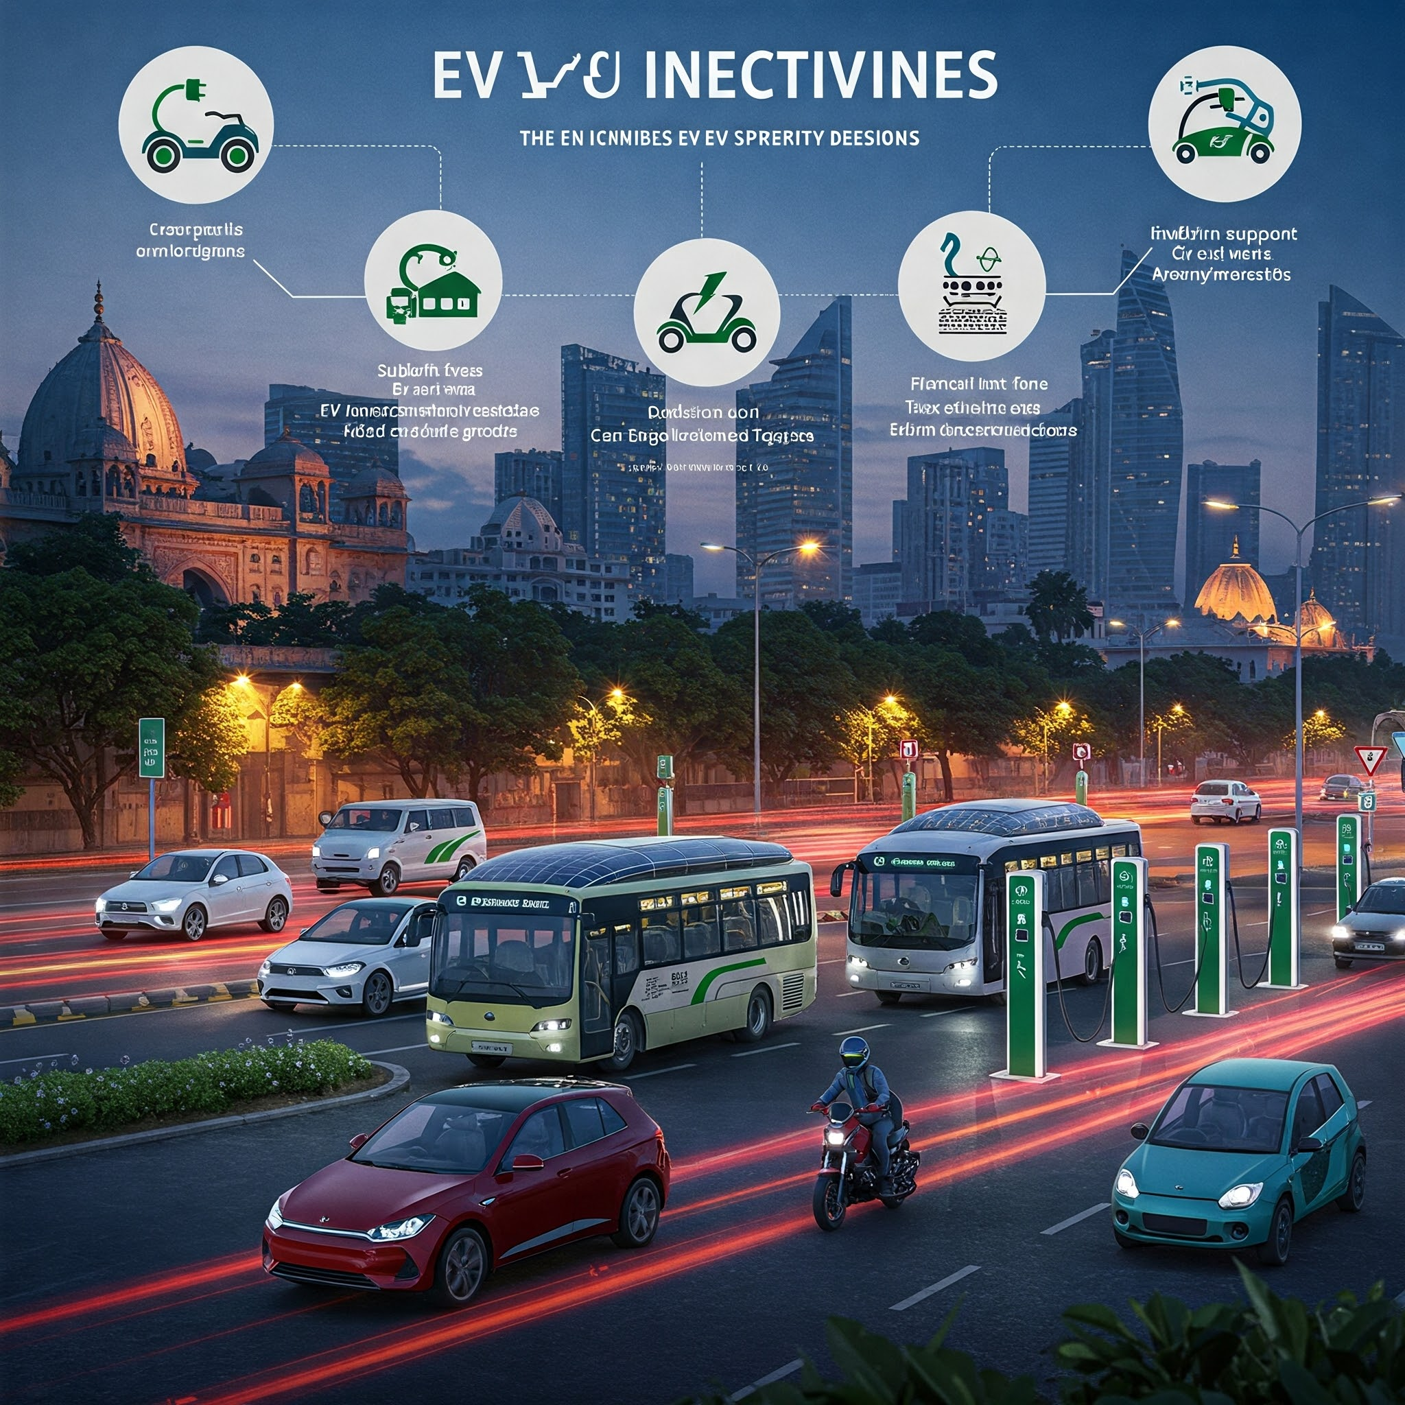
Customer Preferences & Incentives
Cost Savings
Environmental Concerns
Lower running costs, reduced maintenance expenses, savings on fuel have made EVs a cost-effective alternative to traditional vehicles.
Consumers increasingly prioritize sustainable and eco-friendly choices, EVs offer a way to reduce their carbon footprint and support efforts to combat climate change.
Government Incentives
Subsidies, tax benefits, reduced registration fees, and other supportive policies have made EVs more accessible and appealing to a broader audience.

Slide 9
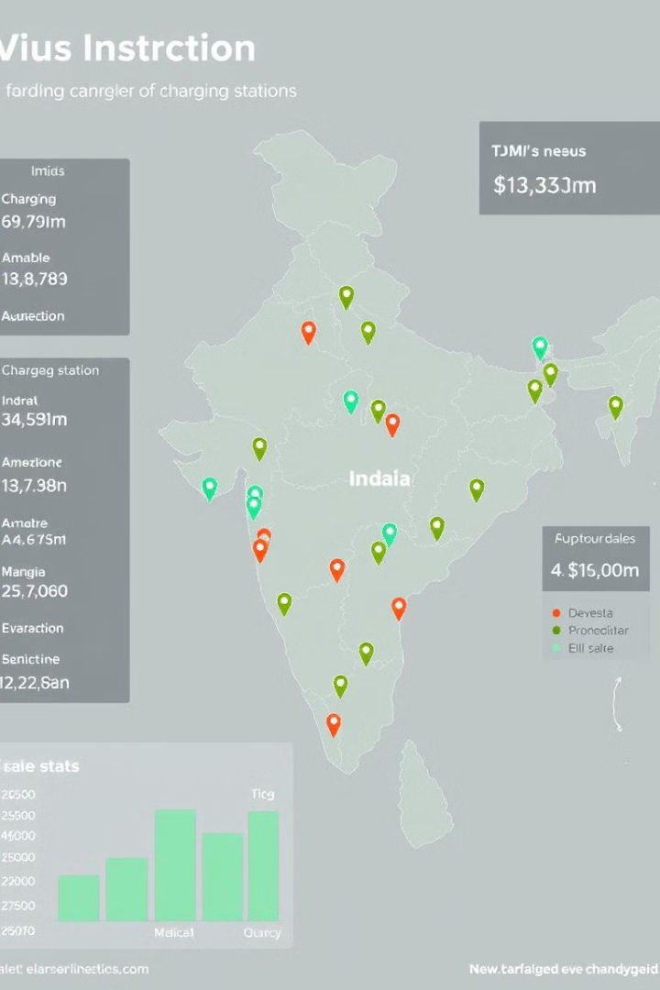
Charging Infrastructure & Sales Correlation
States with more charging stations (e.g., Karnataka, Maharashtra) tend to have higher EV sales, as the availability of charging stations reduces range anxiety and makes EVs more practical. Limited charging infrastructure in states like Gujarat and Rajasthan can hinder adoption, even if there are incentives or policies promoting EVs.

Slide 10

Brand Ambassador & Manufacturing Location
Tanmay Bhat is an excellent choice as a brand ambassador for AtliQ Motors due to his widespread popularity, relatable persona, and alignment with the company’s vision. As a prominent comedian, content creator, and tech enthusiast, Tanmay has a strong digital presence and connects with a diverse, tech-savvy audience, making him ideal for promoting AtliQ's innovative electric vehicles. His values of embracing sustainability and modern technology resonate with AtliQ’s mission to drive eco-friendly mobility. Additionally, his witty and approachable communication style can effectively convey the brand’s message while engaging younger generations, fostering trust and excitement around AtliQ Motors.

Slide 11
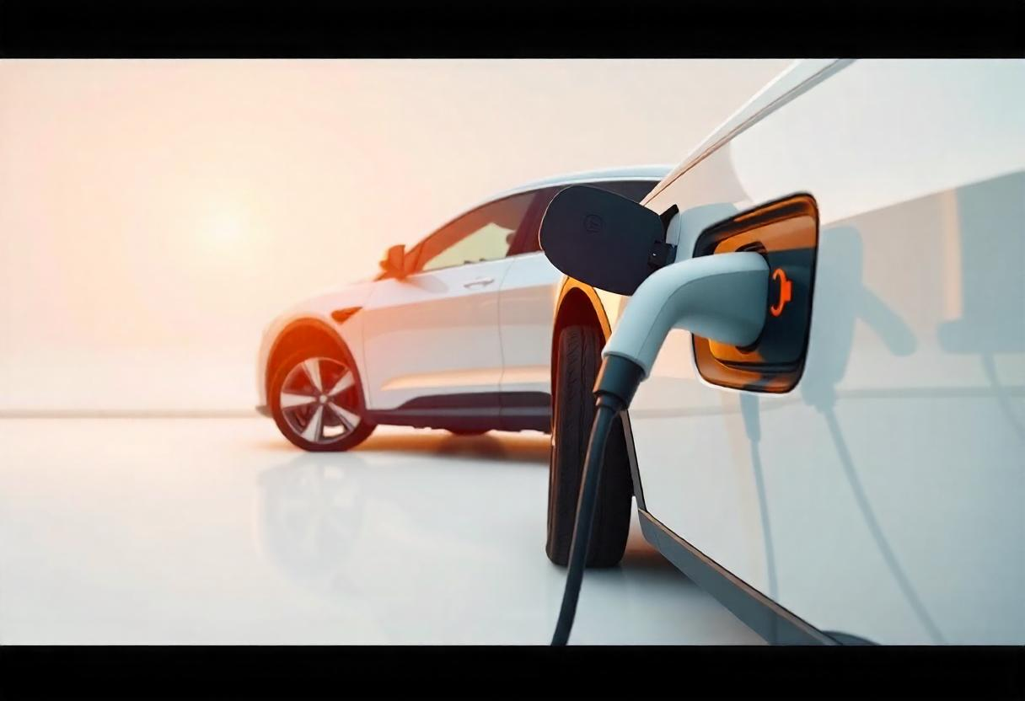


Thank You
https://www.linkedin.com/in/animesh-daniel-2b85b9b0/
https://shorturl.at/TcdIh

