Slide 1
Course: CS 724/824 High Performance Computing and Big Data
Instructor: Mohammad Zubair
Instructional Designer Name: Christy Low
Video Clip Title: Clustering Module Overview – Part I

Slide 2
High Performance Computing and Big Data Module : Clustering Mohammad Zubair Professor of Computer Science Old Dominion University
Slides in this presentation have been adapted from: http://www.mmds.org

Slide 3
The Problem of Clustering
Given a set of points, we like to understand relationship between these points
x
xx x
x x
x x x
x
x x x
x
x
xx x
x x
x x x
x
x x x
x
x
x x
x x x x
x x x x
x x x
x x
x x
x x x x
x x x x
x x x
x x
x x
x x x x
x x x
x
x x
x x x x
x x x
x
x
Notes:
The points could be representing anything. For example, a point could represent a document.

Slide 4
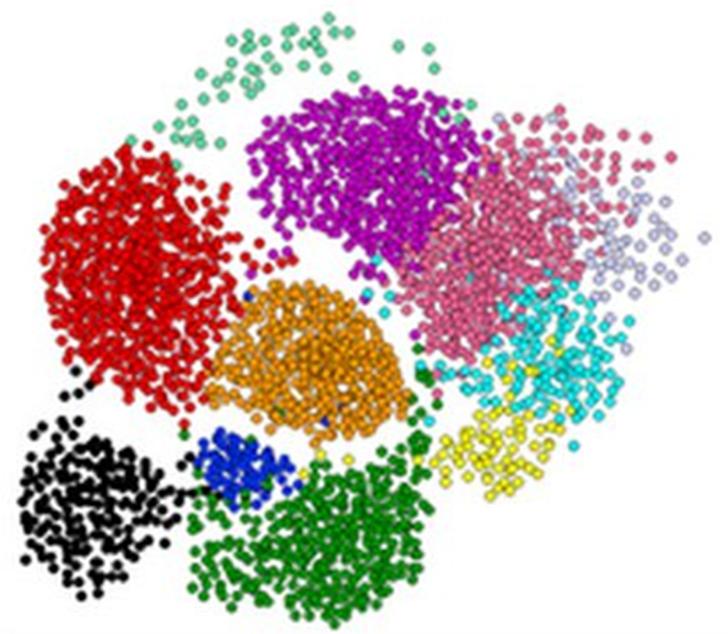
Clustering is hard problem!
Notes:
Not cleanly separated. Overlap clusters. Hard to find boundaries

Slide 5
The Problem of Clustering
Given a set of points, with a notion of distance between points, group the points into some number of clusters, so that
Members of a cluster are close/similar to each other
Members of different clusters are dissimilar
Usually:
Points are in a high-dimensional space
Similarity is defined using a distance measure
Euclidean, Jaccard, …
Notes:
The notion of closeness is not very clear in higher dimension.

Slide 6
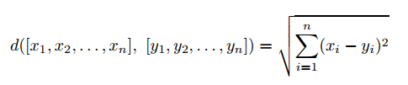
Distance Measure
Euclidean Distance
Notes:
One of the popular measure is a generalization of distance in space to higher dimensions.
1-d example distance between point with x1 = 3 and y1 = 5
2-d example distance between point x1=1, x2=2 and point y1=5, y2=5 sqrt((5-1)^2 + (5-2)^2) = 5

Slide 7
Euclidean Measure Example
Represent a document by a vector
(x₁, x₂,…, x_{k}), where x_{i} = 1 iff the i ^{th} word (in some order) appears in the document
It actually doesn’t matter if k is infinite; i.e., we don’t limit the set of words
Documents with similar sets of words may be about the same topic
Notes:
(0, 1, 0, 0, 1, 0, …)
Words in order: what, the, of , number, network, …..

Slide 8
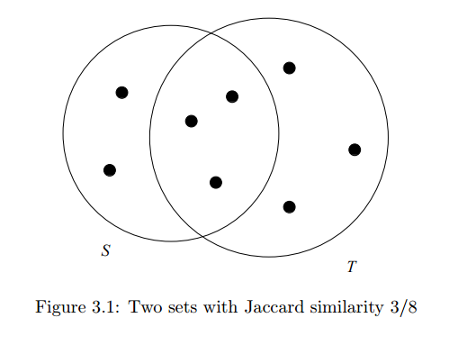


Distance Measure
Jaccard Distance
$$SIM\left(S,T\right)=3/8$$
$$Jaccard distance=1 −SIM(S,T)$$
Example: Finding textual similarity between documents.
Notes:
Jaccard distance is zero when SIM(S,T) = 1. That is when the two documents are identical – they share all the points with each other.

Slide 9
Jaccard Measure Example
Represent a document by a set of words
Fraction of the total number of words that are common in two documents is a measure of similarity.
Documents with similar sets of words may be about the same topic
Notes:
To detect plagiarism

Slide 10
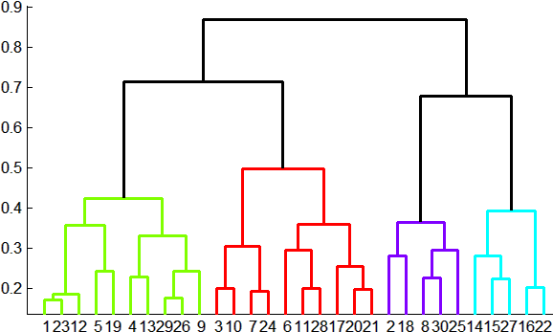
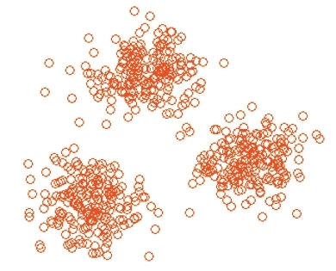
Overview: Methods of Clustering
Hierarchical:
Agglomerative (bottom up):
Initially, each point is a cluster
Repeatedly combine the two “nearest” clusters into one
Divisive (top down):
Start with one cluster and recursively split it
Point assignment:
Maintain a set of clusters
Points belong to “nearest” cluster

Slide 11
Representing Clusters – Euclidean Space
How to represent a cluster of many points?
How do you represent the “location” of each cluster?
Represent each cluster by its centroid (average of its points)
How to measure distance of a point to a cluster?
Measure the distance between the point and the centroid of the cluster
Notes:
Centroid example:
2-d three points in a cluster (0,0), (1,2), (2,1)
Average is (1,1) – Centroid (at
Measure distance between a point (2,2) to the centroid (1,1) is sqrt (2)

Slide 12
k–means Algorithm(s)
Assumes Euclidean space/distance
Start by picking k, the number of clusters
Initialize clusters by picking one point per cluster
Example: Pick one point at random, then k-1 other points, each as far away as possible from the previous points

Slide 13
Populating Clusters
1) For each point, place it in the cluster whose current centroid it is nearest
2) After all points are assigned, update the locations of centroids of the k clusters
3) Reassign all points to their closest centroid
Sometimes moves points between clusters
Repeat 2 and 3 until convergence
Convergence: Points don’t move between clusters and centroids stabilize

Slide 14
Example: Assigning Clusters
x
x
x
x
x
x
x
x
x
x
x
x … data point
… centroid
Clusters after round 1

Slide 15
Example: Assigning Clusters
x
x
x
x
x
x
x
x
x
x
x
x … data point
… centroid
Clusters after round 2

Slide 16
Example: Assigning Clusters
x
x
x
x
x
x
x
x
x
x
x
x … data point
… centroid
Clusters at the end

Slide 17
Getting the k right
How to select k?
Try different k, looking at the change in the average distance to centroid as k increases
Average falls rapidly until right k, then changes little
Best value
of k
Average
distance to
centroid
k
Notes:
Explain average distance to centroid. Two cluster with difference average distances.

Slide 18
Complexity of k-means algorithm
Each round is O(kN) for N points, k cluster
Number of rounds to convergence can be very large
For a very large data set this can be a problem.
Can we cluster in a single pass?

Slide 19
Course: CS 724/824 High Performance Computing and Big Data
Instructor: Mohammad Zubair
Instructional Designer Name: Christy Low
Video Clip Title: Clustering Module Overview – Part II

Slide 20
BFR Algorithm
BFR [Bradley-Fayyad-Reina] is a variant of k-means designed to handle very large (disk-resident) data sets
Assumes that clusters are normally distributed around a centroid in a Euclidean space
Notes:
K mean algorithm requires several passes. If we are working with a large set of points and cannot hold the working data set in memory, we have to read data from hard disk several times. BFR algorithm addresses this problem by processing the data in one pass and in chunks. It makes some assumption about the data points.

Slide 21
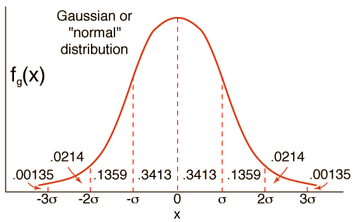
BFR Algorithm
Quantifies the likelihood of a finding a point in the cluster at a given
Distance from the centroid along each dimension.
Standard deviations in different dimensions may vary
Notes:
X is one of the dimensions of the data point. On the Y axis we have the frequency. Sigma is the standard deviation. In the normal distribution most of the values of X are near its mean (which is zero in our example). Around 68% of the values are one standard deviation away from the mean.

Slide 22
BFR Algorithm
Assumption that clusters are normally distributed around a centroid in a Euclidean space with varying standard deviations in different dimension implies:
Clusters are axis-aligned ellipses
y
x
Notes:
Green ellipse represents cluster for points where standard deviation along x dimension is less compared to y dimension.
Pink ellipse represents cluster for points where standard deviation along y dimension is less compared to x dimension.
Blue ellipse represents cluster for points where standard deviation is equal along both the dimensions.

Slide 23
BFR Algorithm Overview
Divide the large data set of point into chunks
Read a chunk of data into memory. Summarize the data in terms of clusters and throw the data.
Summary of data is much smaller than the chunk size
Repeat the process for all the chunks
The key idea is to efficiently summarize the clusters – memory requirement is bounded by the number of clusters and not by the number of data points

Slide 24
BFR Algorithm
To begin, from the initial load we select the initial k centroids by one of the following approaches:
Take a small random sample and cluster optimally
Take a sample; pick a random point, and then k–1 more points, each as far from the previously selected points as possible

Slide 25
Three Classes of Points
While processing a chunk we keep track of 3 sets of points:
Discard set (DS):
Points close enough to a centroid to be summarized
Compression set (CS):
Groups of points that are close together but not close to any existing centroid
These points are summarized, but not assigned to a cluster
Retained set (RS):
Isolated points waiting to be assigned to a compression set
Notes:
In general, at any time of the processing there are three sets of points.
DS: points close enough to a centroid. All points in a set are summarized.
CS: each group of points are summarized (separately)
At the very start we have k points each representing a centroid of a cluster.

Slide 26
BFR: “Galaxies” Picture
Points in
the RS
Compressed sets.
Their points are in
the CS.
A cluster. Its points
are in the DS.
The centroid
Discard set (DS): Close enough to a centroid to be summarized
Compression set (CS): Summarized, but not assigned to a cluster
Retained set (RS): Isolated points

Slide 27
Summarizing Sets of Points
The number of points, N
The vector SUM, whose i^{th} component is the sum of the coordinates of the points in the i^{th} dimension
The vector SUMSQ: i^{th} component = sum of squares of coordinates in i^{th} dimension
A cluster. All its points are in the DS.
The centroid

Slide 28
Summarizing Points: Comments
2d + 1 values represent any size cluster
d = number of dimensions
Average in each dimension (the centroid) can be calculated as SUM_{i} / N
SUM_{i} = i^{th} component of SUM
Variance of a cluster’s discard set in dimension i is:
(SUMSQ_{i} / N) – (SUM_{i} / N)²
And standard deviation is the square root of that
Next step: Actual clustering

Slide 29
Processing a Chunk
Find those points that are “sufficiently close” to a cluster centroid
Add those points to that cluster and then discard the points
Adjust DS sets for all clusters that received new points
Update Ns, SUMs, SUMSQs
Discard set (DS): Close enough to a centroid to be summarized.
Compression set (CS): Summarized, but not assigned to a cluster
Retained set (RS): Isolated points

Slide 30
Processing a Chunk
The remaining points are not close to any cluster
Use any main-memory clustering algorithm to cluster the remaining points and the old RS
Clusters go to the CS; outlying points to the RS
Discard set (DS): Close enough to a centroid to be summarized.
Compression set (CS): Summarized, but not assigned to a cluster
Retained set (RS): Isolated points

Slide 31
Processing a Chunk
Consider merging compressed sets in the CS
If this is the last round, merge all compressed sets in the CS and all RS points into their nearest cluster
Discard set (DS): Close enough to a centroid to be summarized.
Compression set (CS): Summarized, but not assigned to a cluster
Retained set (RS): Isolated points

Slide 32
A Few Details…
Q1) How do we decide if a point is “close enough” to a cluster that we will add the point to that cluster?
Q2) How do we decide whether two compressed sets (CS) deserve to be combined into one?

Slide 33
How Close is Close Enough?
Q1) We need a way to decide whether to put a new point into a cluster (and discard)
BFR approach:
The Mahalanobis distance is less than a threshold
High likelihood of the point belonging to currently nearest centroid

Slide 34
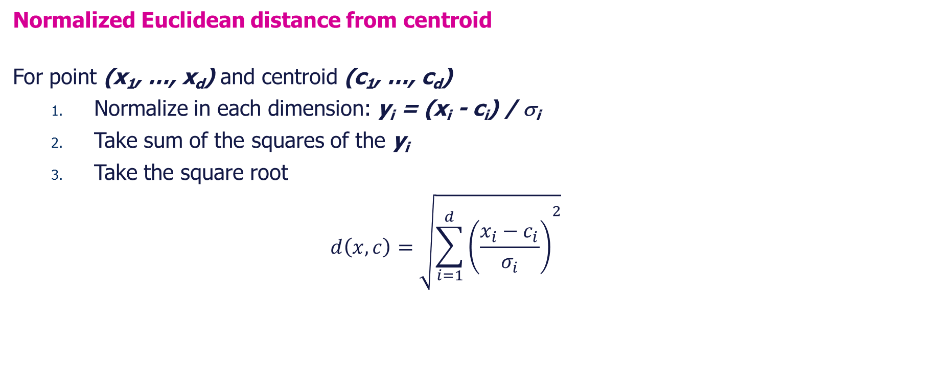
Mahalanobis Distance
Normalized Euclidean distance from centroid
For point (x₁, …, x_{d}) and centroid (c₁, …, c_{d})
Normalize in each dimension: y_{i} = (x_{i} - c_{i}) / σ_{i}
Take sum of the squares of the y_{i}
Take the square root
$$d\left(x,c\right)=\sqrt{{\sum_{i=1}^{d}{\left(\frac{x_{i}−c_{i}}{σ_{i}}\right)}}^{2}}$$
σ_{i} … standard deviation of points in the cluster in the i^{th} dimension
Notes:
X_i – c_i = sigma_i implies y_i = 1

Slide 35
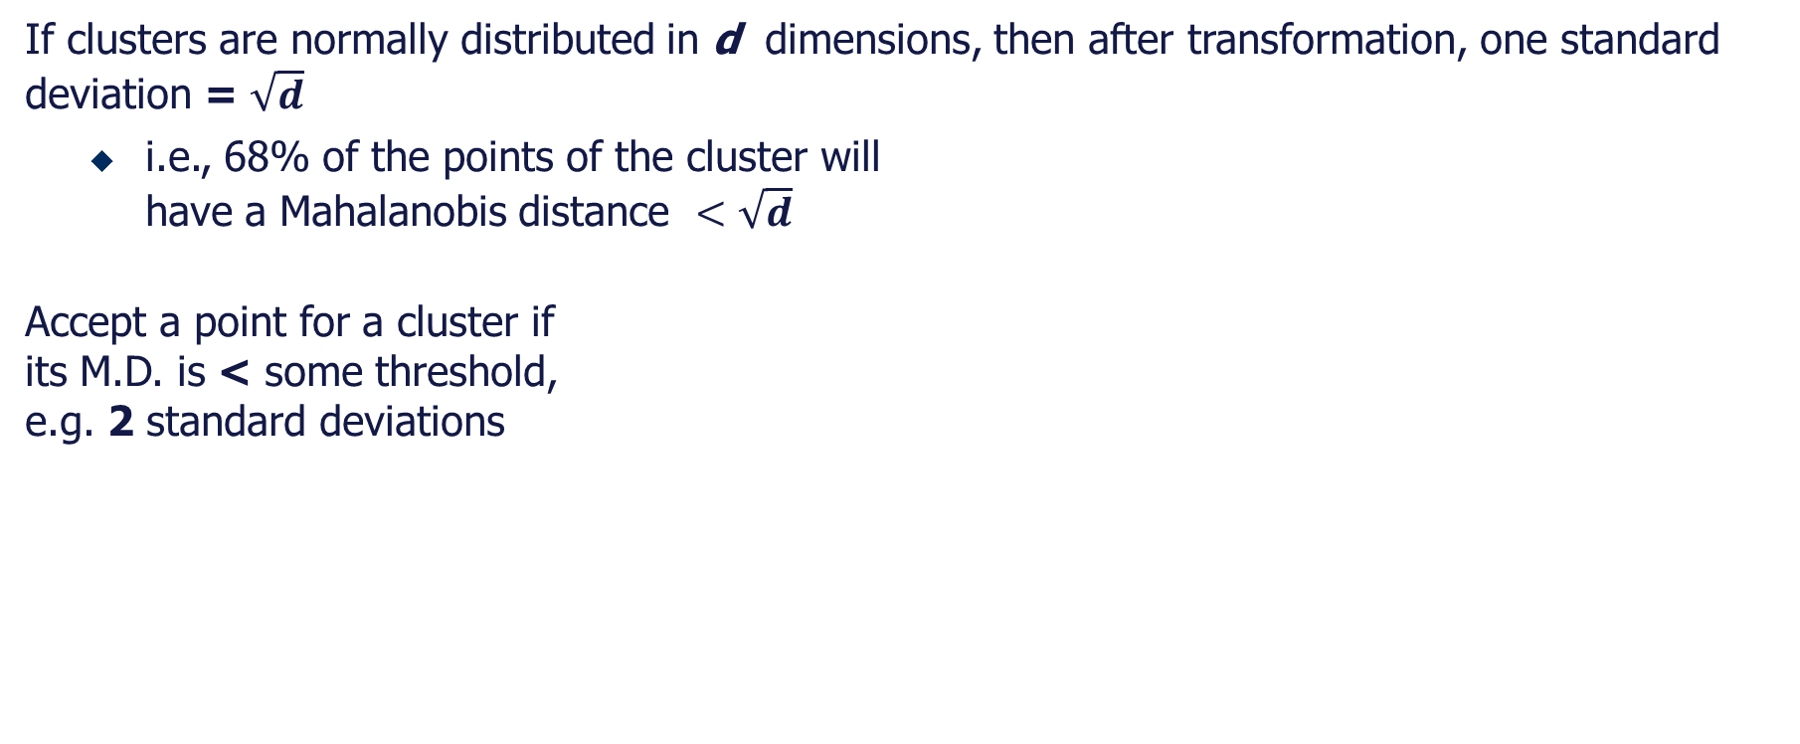
Mahalanobis Distance
If clusters are normally distributed in d dimensions, then after transformation, one standard deviation = $\sqrt{d}$
i.e., 68% of the points of the cluster will have a Mahalanobis distance $<\sqrt{d}$
Accept a point for a cluster if its M.D. is < some threshold, e.g. 2 standard deviations

Slide 36
Should 2 CS clusters be combined?
Q2) Should 2 CS subclusters be combined?
Compute the variance of the combined subcluster
N, SUM, and SUMSQ allow us to make that calculation quickly
Combine if the combined variance is below some threshold

Slide 37
Summary
Clustering is a challenging problem and under certain conditions it can be done efficiently for very large data sets.

