Slide 1

CLASSIFICATION OF RAIN CLOUDS
Start!
Tugce Uzer
Abigail Uchenna Nkama
Sophie Charlotte Loew
Daniel Barkowski

Slide 2
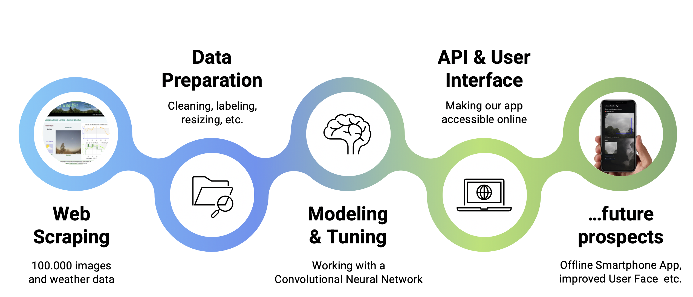
Project roadmap

Slide 3

Thank you, Le Wagon!!
Benjamin Grosse-Rueschkamp
Alireza Habibi
Ali Salem
Sjoerd de Wit
Duc Van Ngo
Ido Azaria
Emma Carballal
Andreea Lila
Leo Cheung
Stefanie Senger
Alessandro Bisiani
Sergey Onoyko
Laia Grobe
Roven Li Goerke
Samuel Drewes
Edmondo Castoldi
Chris Hussein
Maria Camila Urrego
Victor Ruiz
Greg Kappes
Frederik Laubisch
Kelvin Purdom
lovely classmates
Tobias Klein
Ivan Fernandes
Luis Vega
Safia Ahmedou
Kai Standvoß
Richard Hasenfelder
Elaine Pinheiro
Annemarie van Ingen
Andrea Boehnert
Bengana Choi
Patricia Zegarra
Justus Evenschor
Catalina Rojas
Leo Cheung
Wiebke Goldhorn
GueHo Jang
Patrick Dreier
Tabitha Tangherlini
Lucas Picot
Andrei Danila
Giordano Alvitez
Timothée Stassin
Amanda Maurell Lobo Pereira
Alexandru Malina
Guilherme Chacon

