Slide 1
Wireless speakers using tcp/ip + wIfI
Sergio r. Chung correa
Daniel barragán álvarez

Slide 2
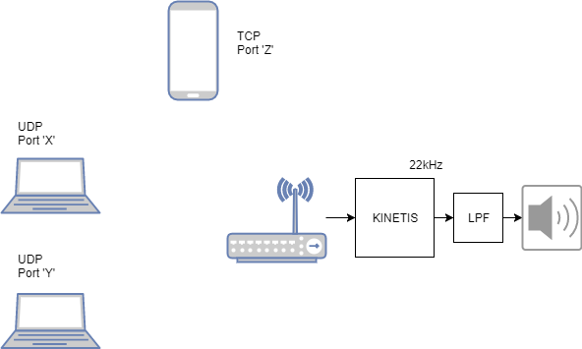
SYSTEM block diagram

Slide 3
tasks
UDP
Receives song data from specific port
TCP
Receives commands for play/pause and changing the working port

Slide 4
Udp task
Receives song values
Copy data from UDP receiving buffer to new buffer for the DAC
PIT Handler for sending data through DAC
PING PONG BUFFER

Slide 5
Tcp task
Check if data received is a number
Check if data received is a letter
Change port or play/pause audio

