Slide 1



HR_Dashboard
View in Power BI
Last data refresh:
2/2/2022 2:23:59 AM UTC
Downloaded at:
2/13/2022 10:15:44 PM UTC

Slide 2
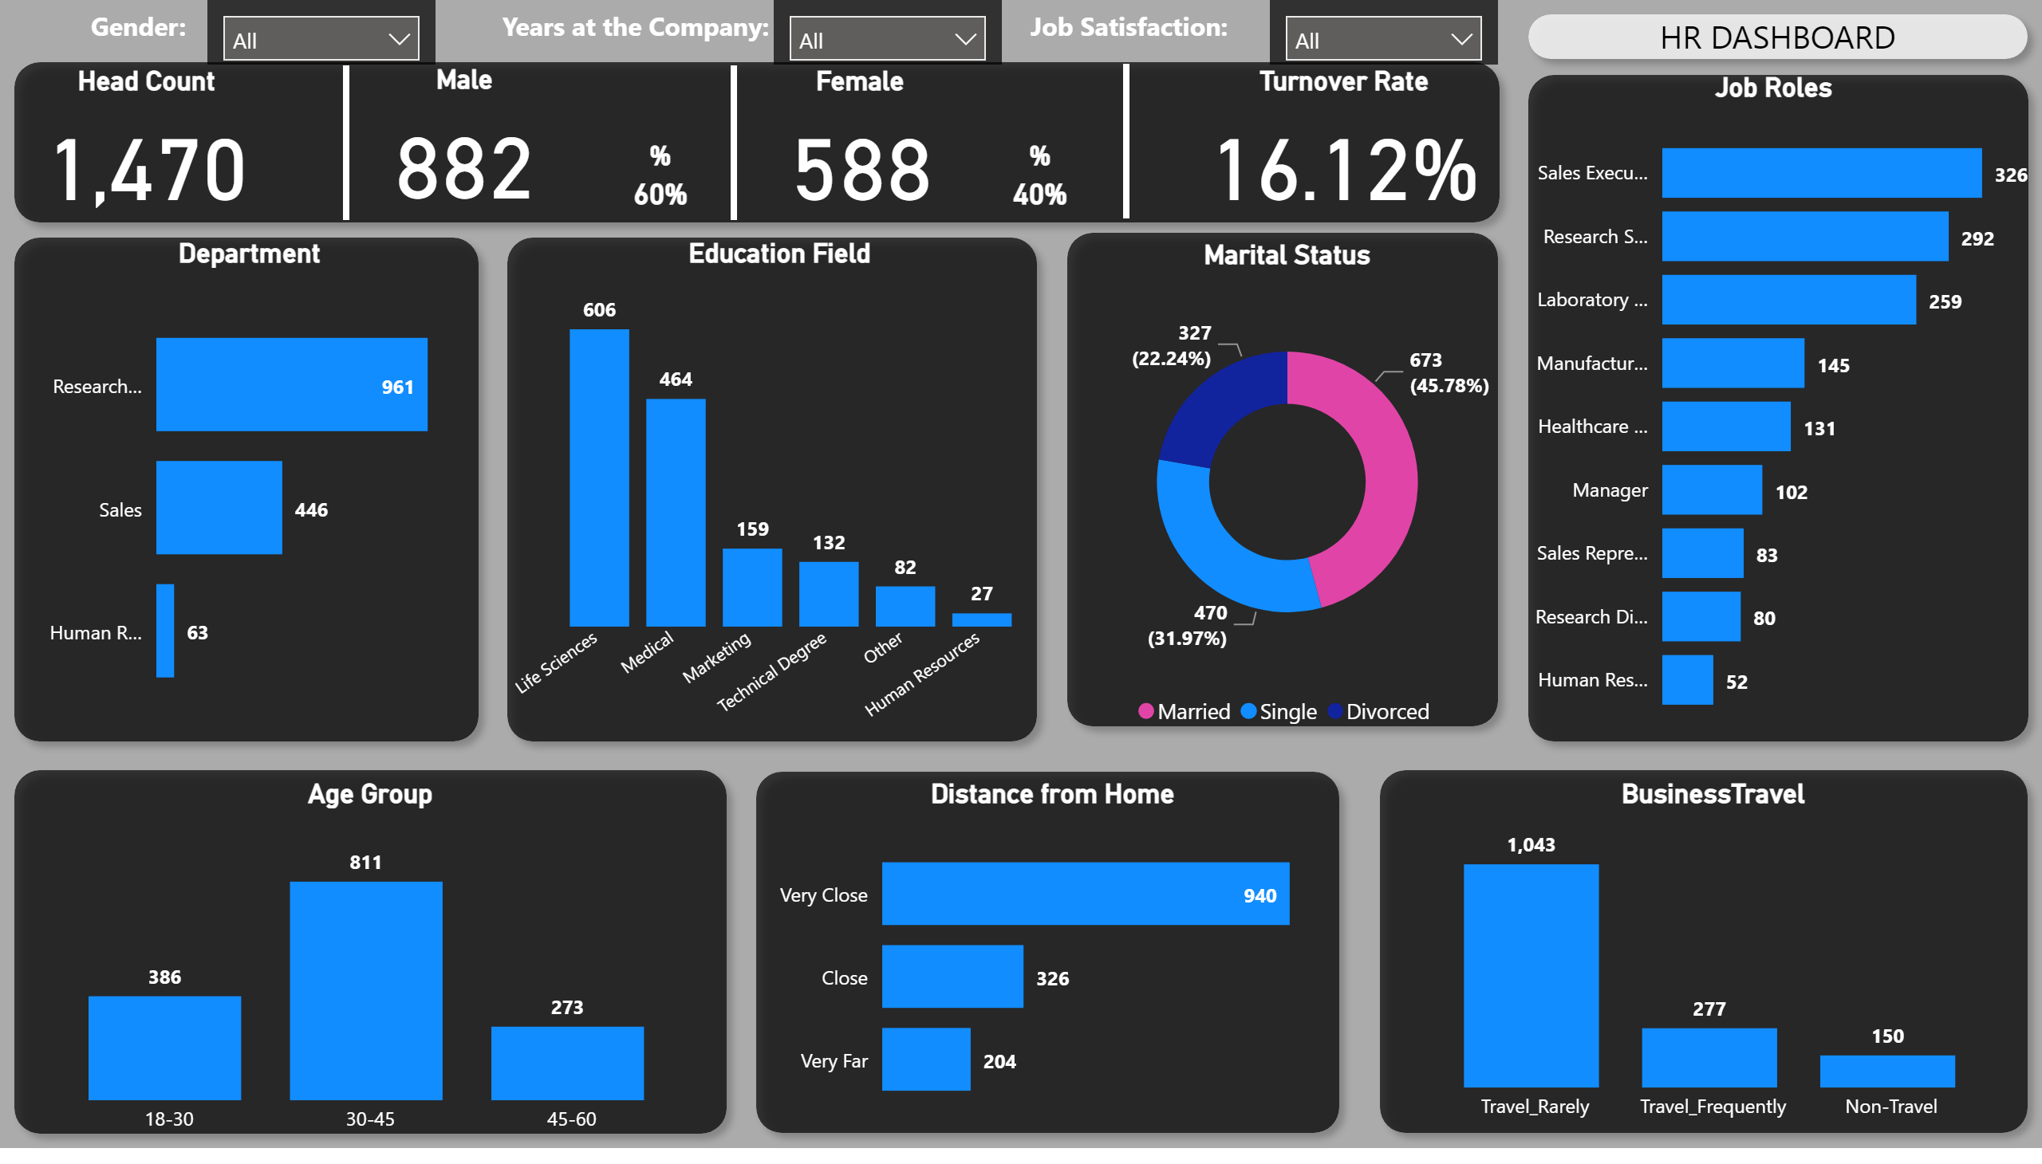
Page 1
Notes:
shape
No alt text provided
Department
No alt text provided
shape
No alt text provided
Job Roles
No alt text provided
shape
No alt text provided
Marital Status
No alt text provided
shape
No alt text provided
Education Field
No alt text provided
shape
No alt text provided
Age Group
No alt text provided
shape
No alt text provided
Distance from Home
No alt text provided
shape
No alt text provided
BusinessTravel
No alt text provided
shape
No alt text provided
%
No alt text provided
shape
No alt text provided
shape
No alt text provided
shape
No alt text provided
shape
No alt text provided
slicer
No alt text provided
textbox
No alt text provided
textbox
No alt text provided
slicer
No alt text provided
textbox
No alt text provided
slicer
No alt text provided
Head Count
No alt text provided
Female
No alt text provided
Male
No alt text provided
%
No alt text provided
Turnover Rate
No alt text provided

