Slide 1
השקופיות של דוד התייחסות לניסויים ומטרות של הסמסטר מה לא עשינו? מה כן החלטנו לעשות

Slide 2

DroNet
Ground System

Slide 3

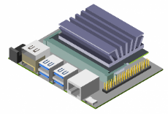


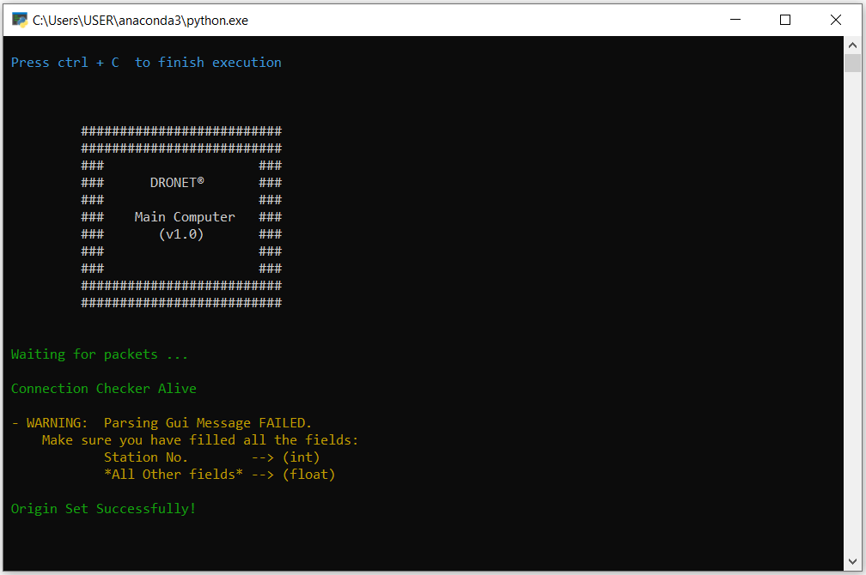

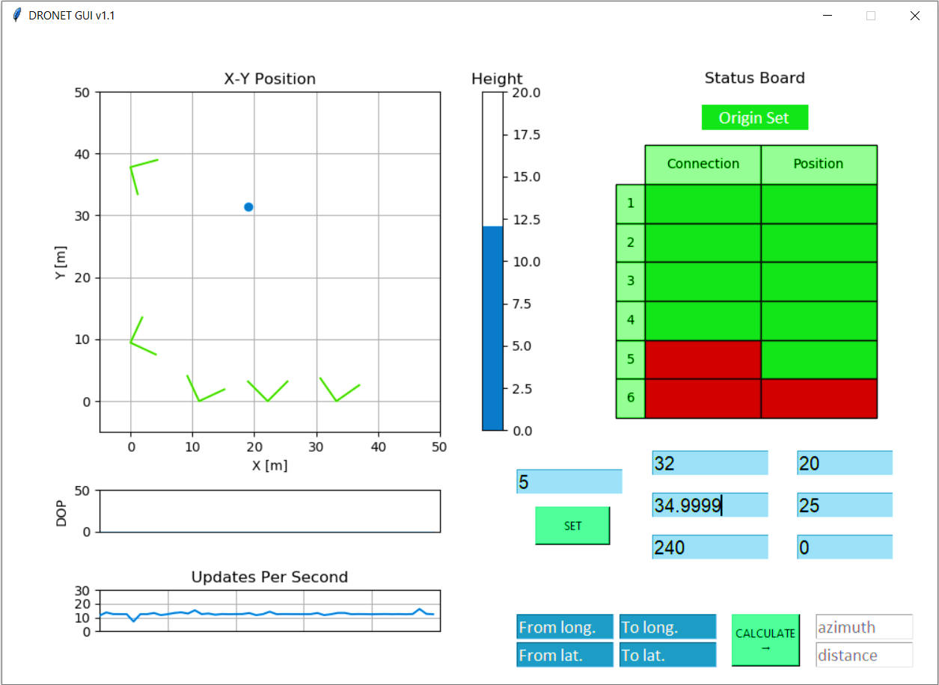
General Architecture

Slide 4
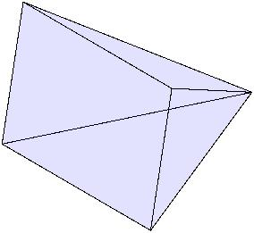

General Architecture
Station No.
Pixel_X Pixel_Y
?

Slide 5
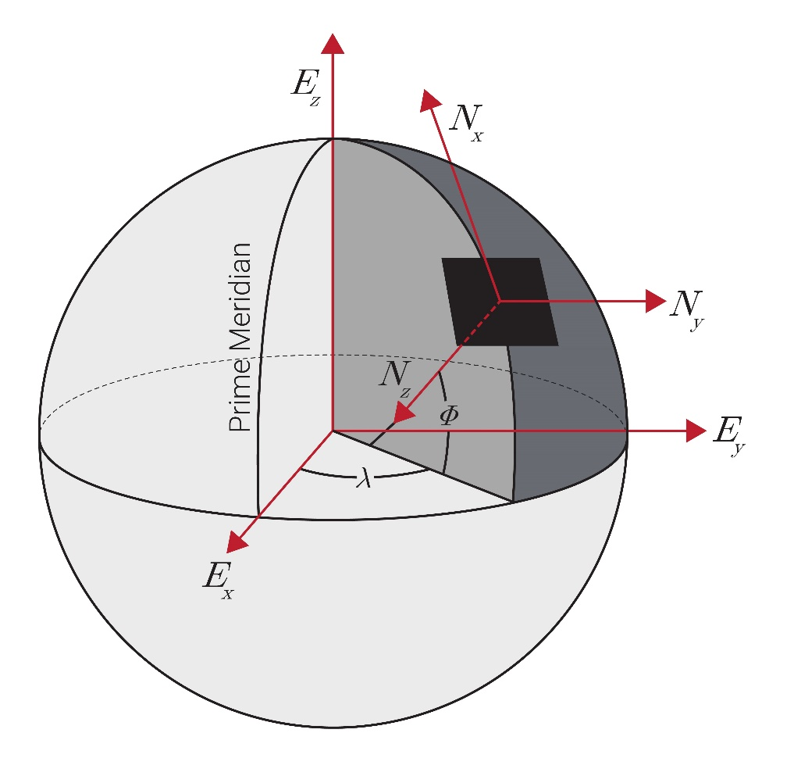
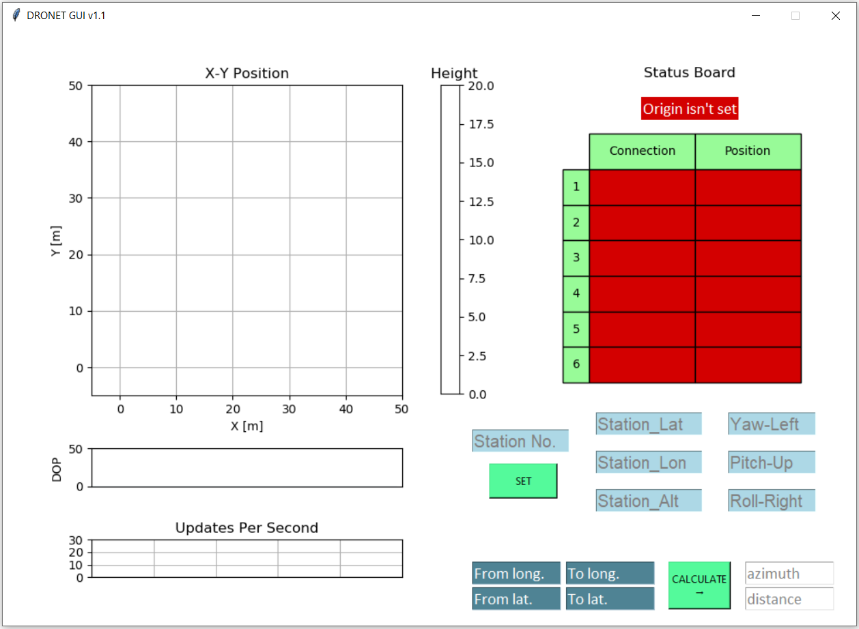
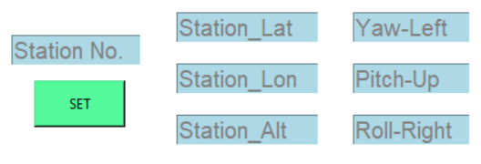
Ground System Initialization
1. Setting up the Origin Coordinate System

Slide 6
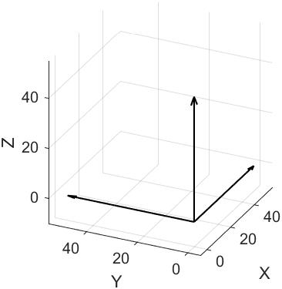


Ground System Initialization
1. Setting up the Origin Coordinate System

Slide 7

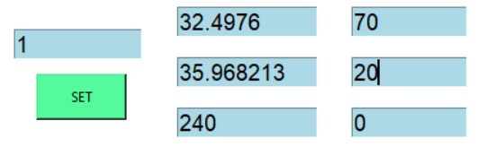




Ground System Initialization
2. Setting up a station
$${\left[long, lat,alt\right]}_{station}$$
$${\left[azimuth, elevation, roll\right]}_{\begin{aligned}w.r.t. \\ Origin\end{aligned}}$$
$${\left[x,y,z\right]}_{Origin Frame}$$
$$DCM_{Origin}^{Station}$$

Slide 8
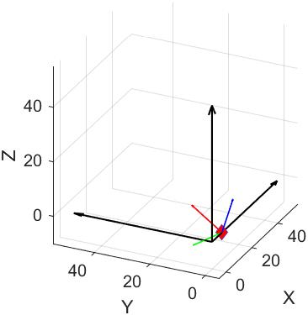
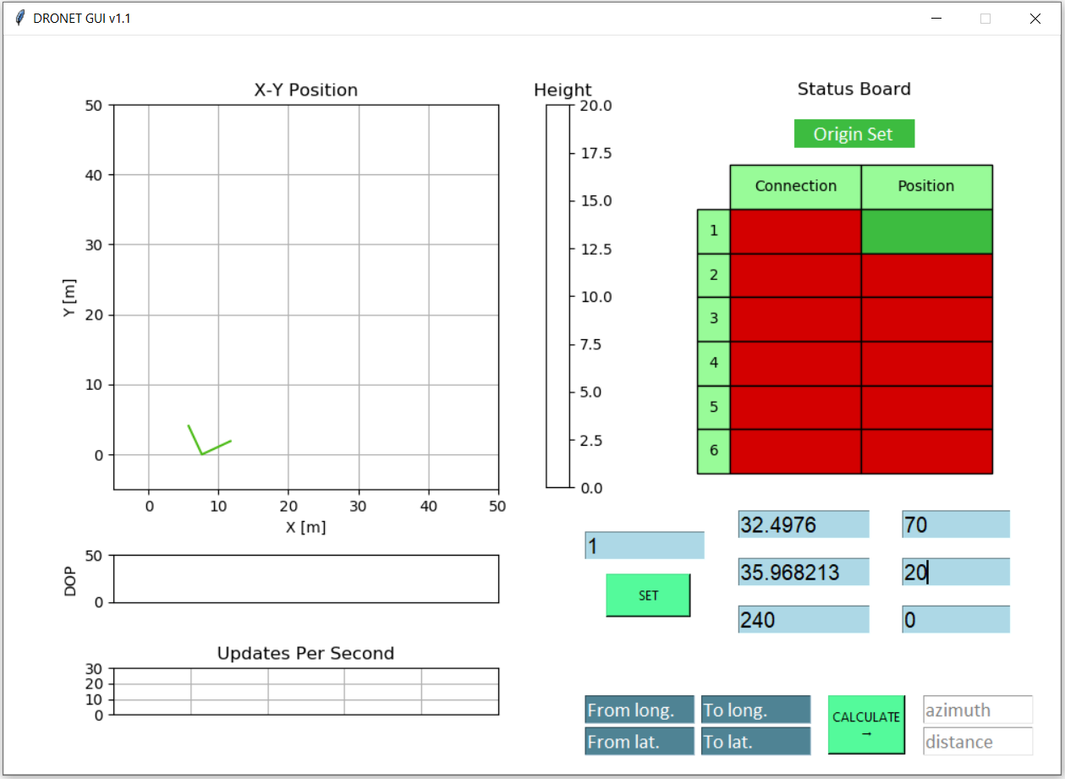
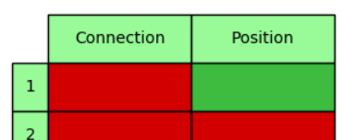
Ground System Initialization
2. Setting up a station

Slide 9
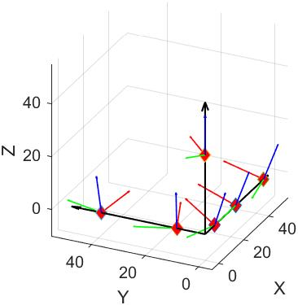
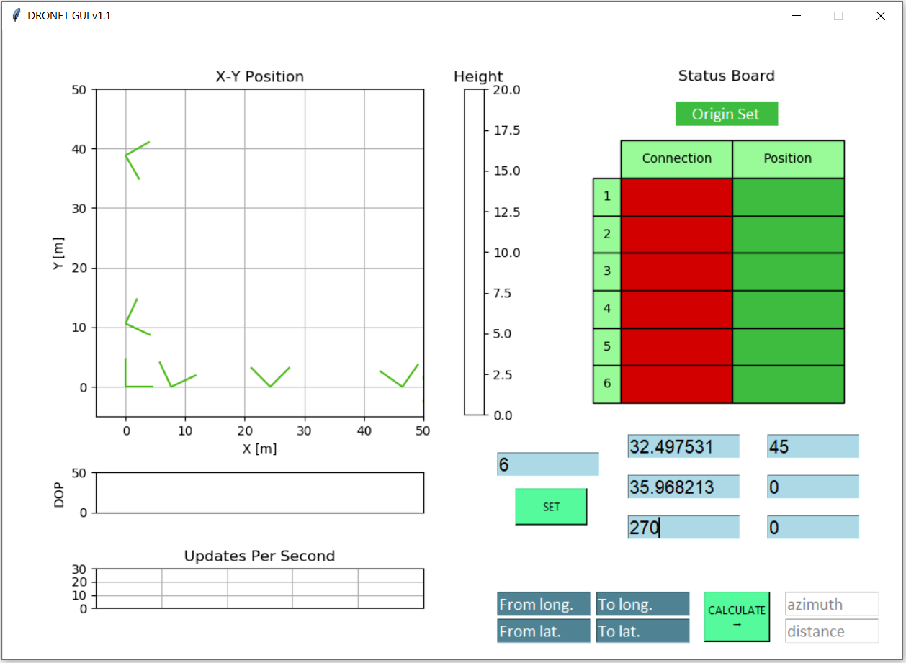
Ground System Initialization
2. Setting up the remaining stations

Slide 10
Ground System Configured!

Slide 11
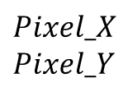
Ground System Data Flow
$$Pixel_X \\ Pixel_Y$$
Calibration

Slide 12
Calibration

Slide 13
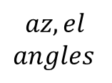
Ground System Data Flow
$$Pixel_X \\ Pixel_Y$$
$$az,el \\ angles$$
Calibration
Generate LOS vector

Slide 14
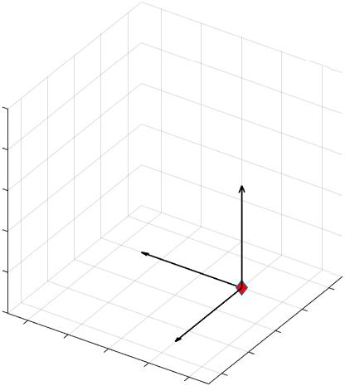
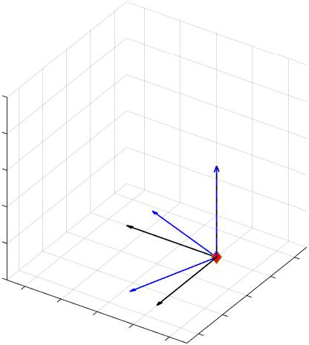
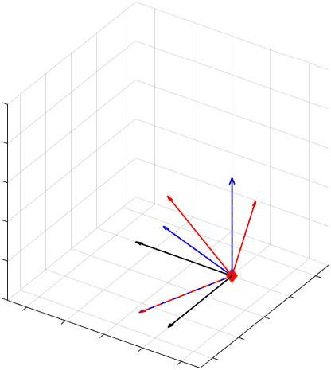
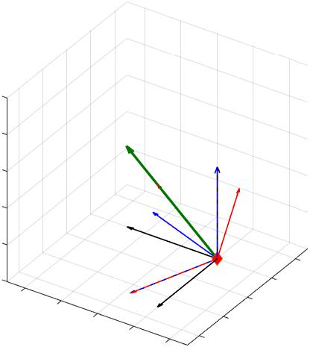
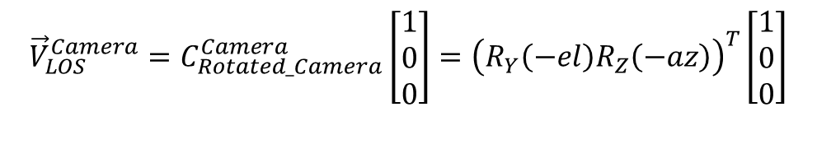

Lines Of Sight
$az, el$ Relative to CAMERA frame!
$$C_{Camera}^{Rotated_Camera}=R_{Y}\left(−el\right)R_{Z}(−az)$$
$${\vec{V}}_{LOS}^{Camera}=C_{Rotated_Camera}^{Camera}\left[\begin{matrix}1 \\ 0 \\ 0\end{matrix}\right]={\left(R_{Y}\left(−el\right)R_{Z}\left(−az\right)\right)}^{T}\left[\begin{matrix}1 \\ 0 \\ 0\end{matrix}\right]$$

Slide 15
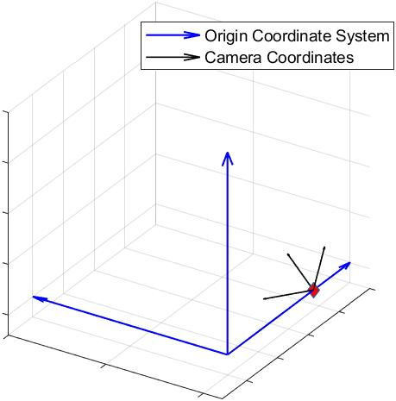

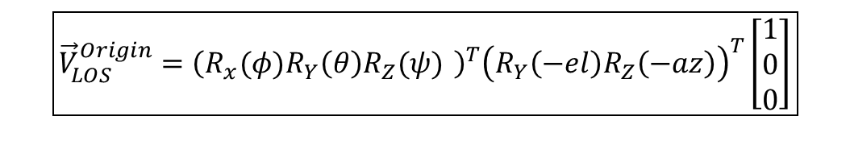
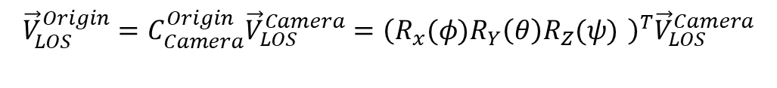
Lines Of Sight
$ψ, θ, φ are the euler anges$ $$between Origin and Camera Frames$$
$$C_{Origin}^{Camera}={R_{x}(φ)R}_{Y}\left(θ\right)R_{Z}(ψ)$$
$${\vec{V}}_{LOS}^{Origin}=C_{Camera}^{Origin}{\vec{V}}_{LOS}^{Camera}={\left({R_{x}(φ)R}_{Y}\left(θ\right)R_{Z}(ψ) \right)}^{T}{\vec{V}}_{LOS}^{Camera}$$
$$\boxed{{\vec{V}}_{LOS}^{Origin}={\left({R_{x}(φ)R}_{Y}\left(θ\right)R_{Z}(ψ) \right)}^{T}{\left(R_{Y}\left(−el\right)R_{Z}\left(−az\right)\right)}^{T}\left[\begin{matrix}1 \\ 0 \\ 0\end{matrix}\right]}$$

Slide 16


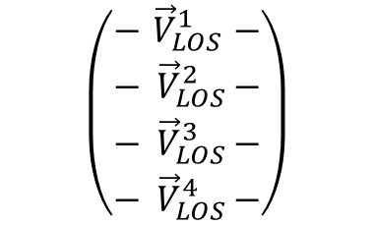



Lines Of Sight
Constructing the Matrix
$${\vec{V}}_{LOS}^{Origin}$$
$$\left(\begin{aligned}\begin{matrix}−{ \vec{V}}_{LOS}^{1} − \\ {− \vec{V}}_{LOS}^{2}− \\ {− \vec{V}}_{LOS}^{3}−\end{matrix} \\ {− \vec{V}}_{LOS}^{4}−\end{aligned}\right)$$
$${\vec{V}}_{LOS}^{Origin}$$
$$Rows==4 ?$$
$${\vec{V}}_{LOS}^{Origin}$$
$${\vec{V}}_{LOS}^{Origin}$$

Slide 17
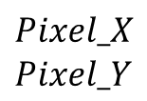
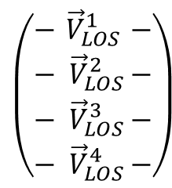
Ground System Data Flow
$$\left(\begin{aligned}\begin{matrix}−{ \vec{V}}_{LOS}^{1} − \\ {− \vec{V}}_{LOS}^{2}− \\ {− \vec{V}}_{LOS}^{3}−\end{matrix} \\ {− \vec{V}}_{LOS}^{4}−\end{aligned}\right)$$
$$Pixel_X \\ Pixel_Y$$
$$az,el \\ angles$$
Calibration
Position & LOS Matrices
LS Solution

Slide 18
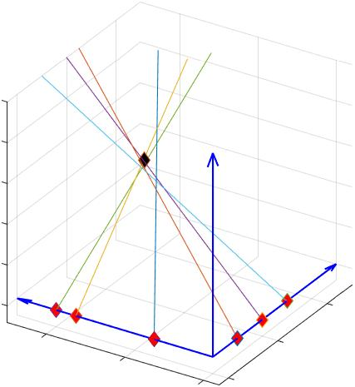
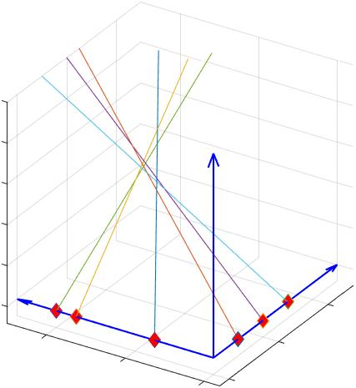
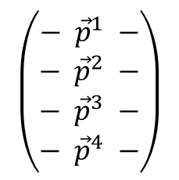

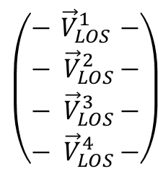

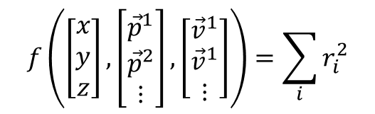
Least Squares
$$\left(\begin{aligned}\begin{matrix}−{ \vec{V}}_{LOS}^{1} − \\ {− \vec{V}}_{LOS}^{2}− \\ {− \vec{V}}_{LOS}^{3}−\end{matrix} \\ {− \vec{V}}_{LOS}^{4}−\end{aligned}\right)$$
1. Construction of lines:
$$\left(\begin{aligned}\begin{matrix}− {\vec{p}}^{1} − \\ − {\vec{p}}^{2} − \\ − {\vec{p}}^{3} −\end{matrix} \\ − {\vec{p}}^{4} −\end{aligned}\right)$$
2. Least Squares:
$$f\left(\left[\begin{matrix}x \\ y \\ z\end{matrix}\right],\left[\begin{matrix}{\vec{p}}^{1} \\ {\vec{p}}^{2} \\ ⋮\end{matrix}\right],\left[\begin{matrix}{\vec{v}}^{1} \\ {\vec{v}}^{1} \\ ⋮\end{matrix}\right]\right)=\sum_{i}{r_{i}^{2}}$$
$$\vec{∇}f\left(x,y,z\right)\overset{!}{=}0$$
$${\left[x,y,z\right]}_{Optimal}$$

Slide 19

Ground System Data Flow
$$\left(\begin{aligned}\begin{matrix}−{ \vec{V}}_{LOS}^{1} − \\ {− \vec{V}}_{LOS}^{2}− \\ {− \vec{V}}_{LOS}^{3}−\end{matrix} \\ {− \vec{V}}_{LOS}^{4}−\end{aligned}\right)$$
$$Pixel_X \\ Pixel_Y$$
$$az,el \\ angles$$
Calibration
Position & LOS Matrices
LS Solution
$$[x,y,z]$$
Estimator
(Logger)

Slide 20
Estimation

Slide 21


Ground System Data Flow
$$\left(\begin{aligned}\begin{matrix}−{ \vec{V}}_{LOS}^{1} − \\ {− \vec{V}}_{LOS}^{2}− \\ {− \vec{V}}_{LOS}^{3}−\end{matrix} \\ {− \vec{V}}_{LOS}^{4}−\end{aligned}\right)$$
$$Pixel_X \\ Pixel_Y$$
$$az,el \\ angles$$
Calibration
Position & LOS Matrices
LS Solution
$$[x,y,z]$$
Estimator
$${\left[x,y,z\right]}_{Filtered}$$
GUI
(Logger)

Slide 22
Trajectory Generation
Describe how we generate the injected data – from trajectory to pixel x/y.

Slide 23

Injection

