Slide 1
BHKShield Project in Ransomware Presentation

Slide 2

Project analysis slide 4
BHKShield
• Front-end service:
• Enabling the user to configure the service, user credentials and cloud storage provider
• Notifies the user when needed
• Back-end service:
• Manage multiple users and their credentials
• Register for notifications from the cloud storage API
• Process the events and detect
• Remediate when needed
• Notify
• Bonus points:
• Detection accuracy
• Manage multiple cloud storage providers
• Add Windows 10 toast notifications
• Add rollback function for the user
• Protect SharePoint and OneDrive for Business
Overview

Slide 3
Project analysis slide 4
BHKShield
• Extension black list
• Content blacklist
• Honeypots
• Entropy
Detection
Rules
Overview

Slide 4
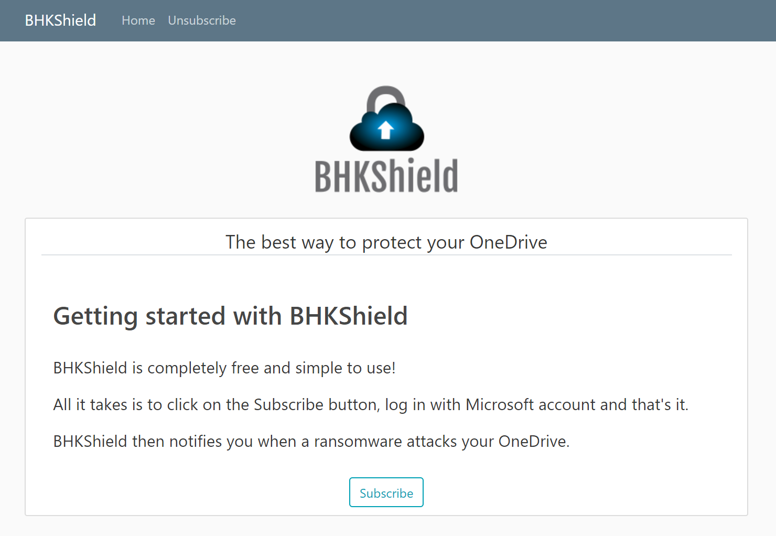
Project analysis slide 4
BHKShield
A python web application that uses Django framework.
The web app enables the user to subscribe to our service and deactivate the service as well.
Login is processed via Microsoft OAuth 2.0 API.
Responsibilities:
Handles un/subscription.
Handles inserting user files into our DB.
Handles spreading honeypots into user's Drive.
Front-end
https://bhkshield-project.azurewebsites.net/

Slide 5
Project analysis slide 4
BHKShield
An Azure Function which uses webhook notifications in order to handle the processing of the changes in user’s OneDrive to detect a ransomware attack.
When ransomware attack is occurring, the function notifies the user by e-mail.
Back-end
Overview

Slide 6
Project analysis slide 4
BHKShield
A python web application that uses Django framework.
The web app enables the user to subscribe to our service and deactivate the service as well.
Login is processed via Microsoft OAuth 2.0 API.
Responsibilities:
Handles un/subscription.
Handles inserting user files into our DB.
Handles spreading honeypots into user's Drive.
Front-end

Slide 7
Project analysis slide 6
BHKShield
Detection Rules
Honeypots
Black list
Entropy
Content Change
Extension Change

Slide 8
Project analysis slide 4
BHKShield
BHKShield uses two kinds of blacklists:
Ransomware extension blacklist
A list which consists of extensions that are known for ransomware attacks.
Ransomware file content blacklist
A list that consists of suspicious contents that might indicate of an encrypted file.
Black list

Slide 9
Project analysis slide 4
BHKShield
General Information
Honeypots name is “__BHKShield.txt”
Honeypots are stored in a different DB
Every folder has a honeypot
Not supposed to be changed by user
How do we use honeypots?
Based on the assumption that the user does not change the honeypots,
when notification of a changed honeypot is received, BHKShield will detect it as a ransomware attack and notify user
Honeypots
Overview

Slide 10
Project analysis slide 4
BHKShield
Regular file
Entropy threshold = 7.99
Compressed file
Entropy threshold = 7.998
Entropy

Slide 11
Project analysis slide 4
BHKShield
New file
Check extension blacklist
Check content blacklist
Check entropy
Existing file
Check extension blacklist
Check content blacklist
Check changed entropy
Maintain counter of suspicious files and total entropy change
File
Inspection
Overview

Slide 12
Project analysis slide 4
BHKShield
Bugs
Realistically, user can change the honeypots and it will lead to false-positive.
The honeypots files are not removed when the user deactivates the service.
Drawbacks
The content of the honeypots is fixed.
Honeypots do not spread dynamically. When user create a new folder/deletes honeypots, honeypots do not spread there.
Size of file does not come into consideration.
Bugs
&
Drawbacks

Slide 13
Video demonstration

Slide 14
Questions?

Slide 15
Thank You

