Slide 1
Machine Learning

Slide 2
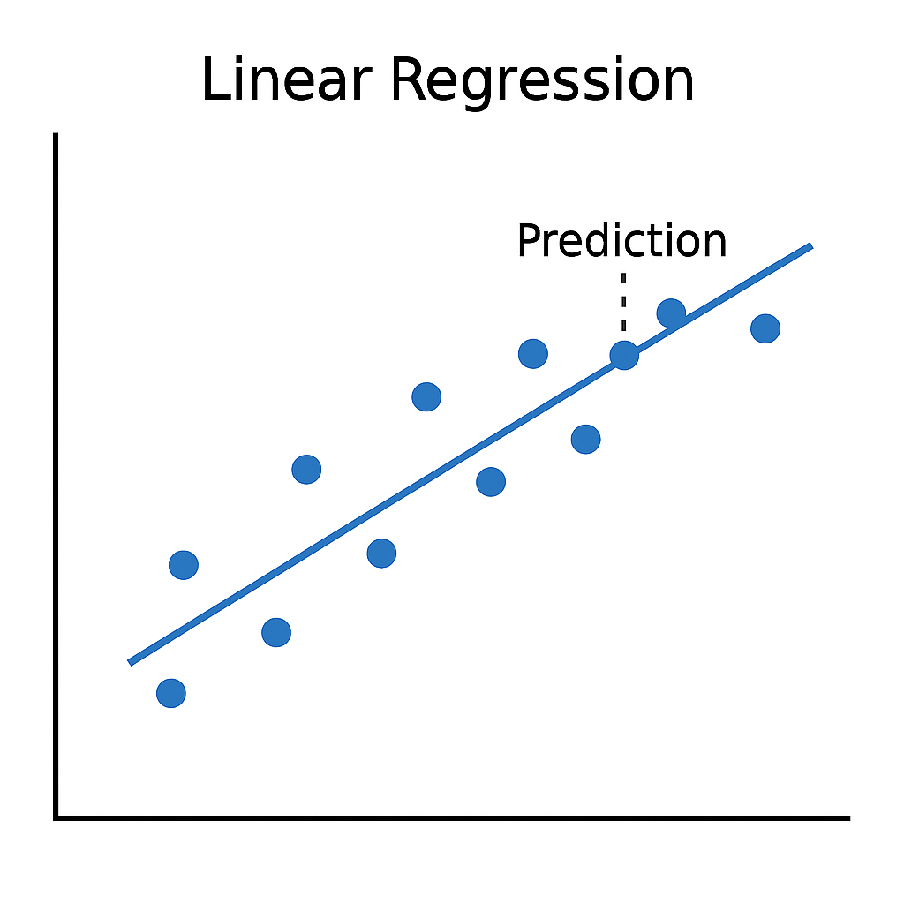
What is machine learning?
Imagine you're collecting data on how temperature changes as pressure changes at constant volume.
Theoretically, there's a linear relationship.
But the data will usually be a bit noisier than that.

Slide 3
What is machine learning?
We can approximate the data using a straight line.
It won't perfectly fit the data, but it captures the main trend.
In the case of a linear function, we can find the "line of best fit" deterministically.

Slide 4
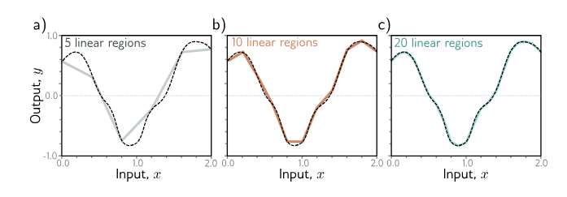
What is machine learning?
Machine learning works similarly – approximation a function using (usually) linear pieces.
Obviously, the functions are much more complex, often many dimensions rather than 1 dimensional curves.
We can't find the approximation deterministically.
Moreover, there is no "best" approximation.
Understanding Deep Learning by Simon Prince, Figure 3.5

Slide 5
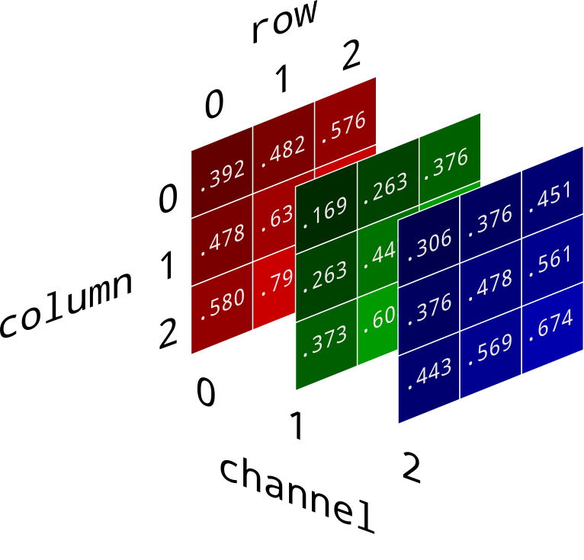
What is machine learning?
How are text generation/image generation/video generation/gaming agents/etc. "just" function approximation?
We can map non-numeric data to a number or vector of numbers.
Text generation -> tokenization (e.g. "a" -> 0, "b" -> 1, …, "z" -> 26)
Image generation -> RGBC + (x, y) position
Video generation -> RGBC + (x, y) position + frame index

Slide 6
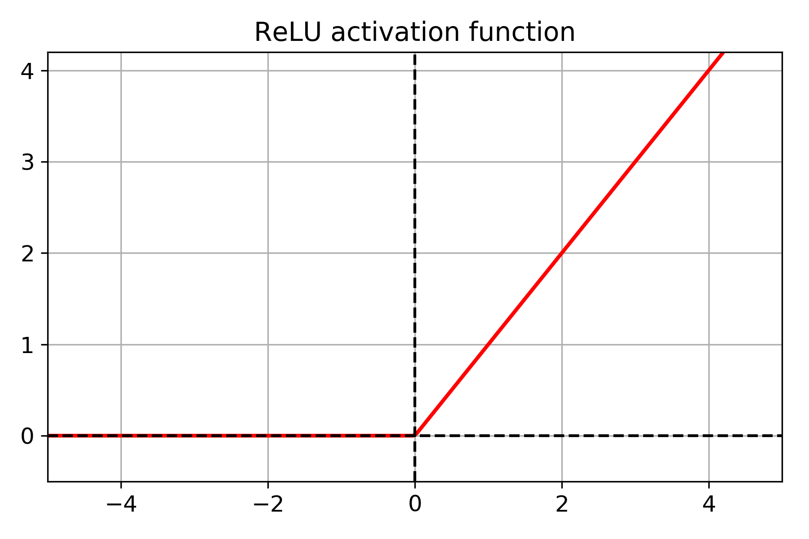
How does machine learning work?
Take your vector of numeric data
Transform it with a linear function (linear layer)
Transform it with a non-linear function(e.g. ReLU)
Repeat the previous two steps many times
Transform from numeric to non-numeric form
Evaluate it against a golden source of truth and update the weights of the linear layers accordingly
Repeat the previous steps until your model is accurate

Slide 7
Why does machine learning work?
Universal Approximation Theorem – Proved that there EXISTS a machine learning model that can approximate any "nicely behaved" function to any degree of accuracy we desire if we add enough layers.
In theory:
No guarantee that our data corresponds to a "nicely behaved" function
No guarantee that we can FIND that approximation.
No guarantee that the approximation can generalize to new data.
In practice:
Data is often "nicely behaved" or can be preprocessed into such.
The approximations we find are often good enough.
The approximations tend to have some good generalization behavior.

Slide 8
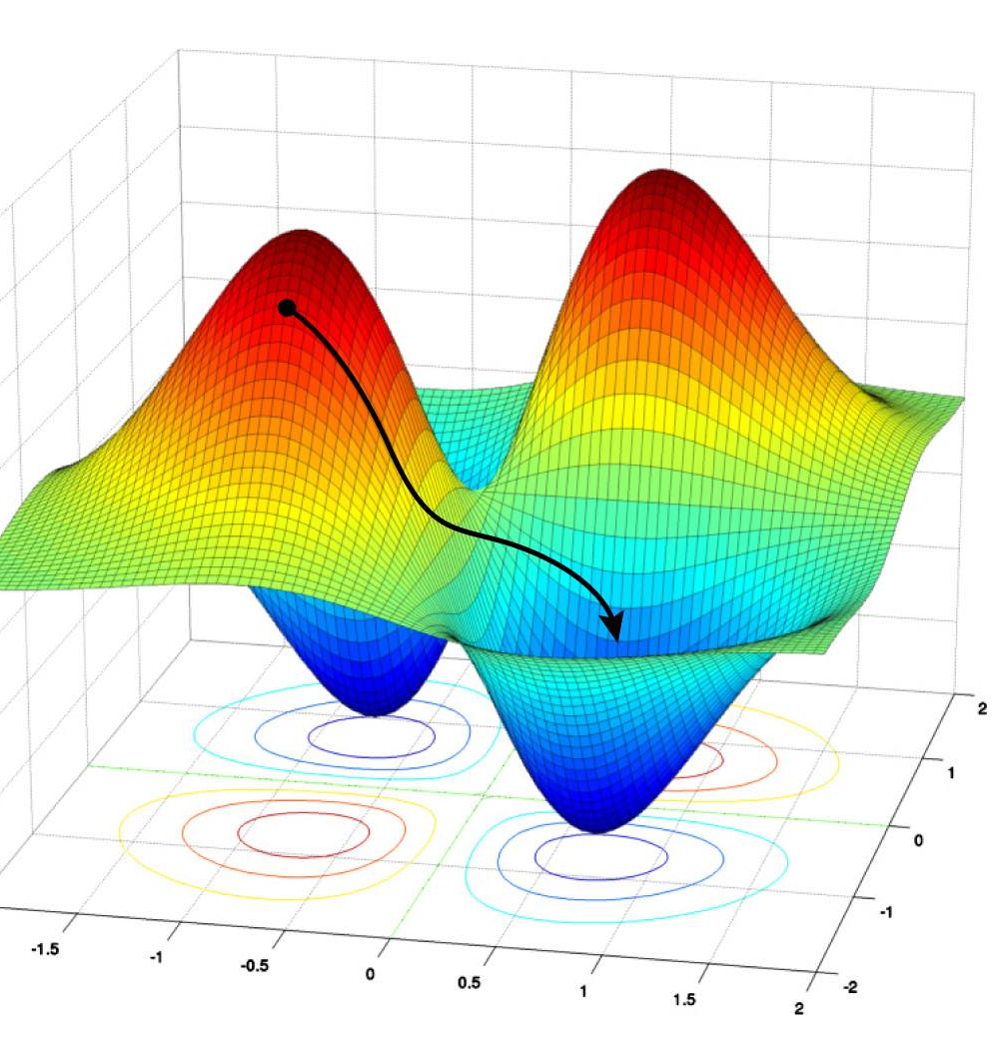
How do we train machine learning models?
Loss function – a function that evaluates the performance of our model based on training data, is a function of the model's parameters
Optimization – We want to find values for the model's parameters that minimize the loss function
Gradient descent – Greedy algorithm for finding those parameters. In "parameter-space", follow the path of greatest decline.
Backpropagation – Allows us to efficiently update the weights of our model using values calculated by gradient descent.

Slide 9
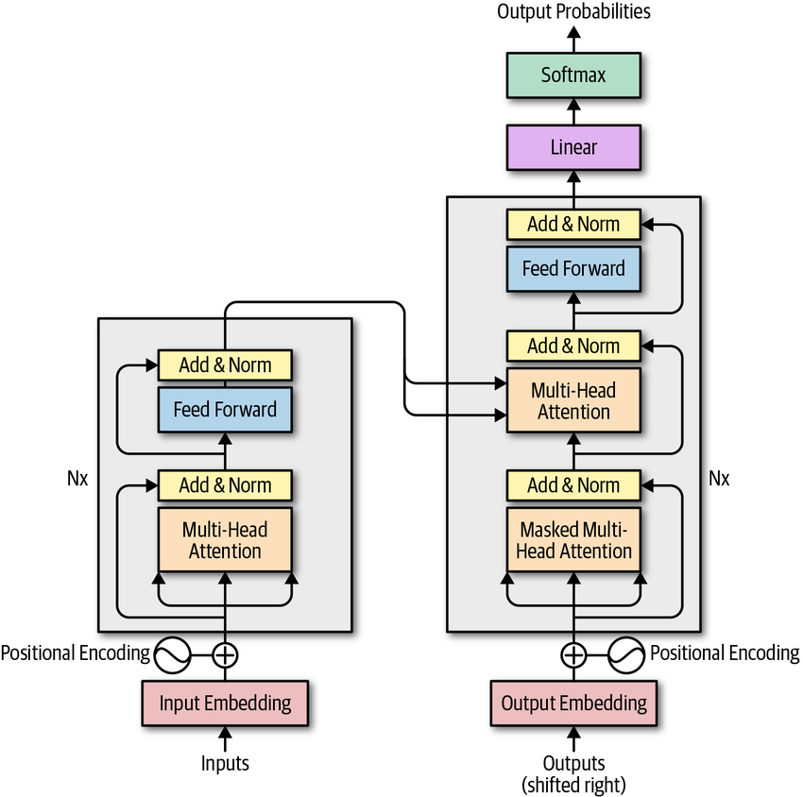
Transformer Architecture
Introduced in the famous "Attention is All You Need" paper
Uses an encoder to process context for variable length sequences
Uses a decoder to generate a target sequence (usually labels or next word prediction)

Slide 10
BERT
Bidirectional Encoder Representations from Transformers
Pre-trained on corpus using masked language modeling and next sentence prediction
Take a sentence, mask a word, and ask BERT to predict it
Allows BERT models to understand context from both directions

