Slide 1
Traceable Predictive Maintenance for NASA C-MAPSS
4-minute overview of the deployed PHM application
Benchmark: NASA C-MAPSS turbofan degradation
Goal: turn RUL prediction into usable PHM decisions
Focus: deployment, traceability, and system integration
CMAPSS PHM App
April 2026
Slide 1 | Sources: doc/paper/main.tex; README.md
Notes:
This talk presents the project as a complete PHM application, not just a benchmark model. The key idea is to connect prediction, decision logic, and user-facing traceability in one system.

Slide 2
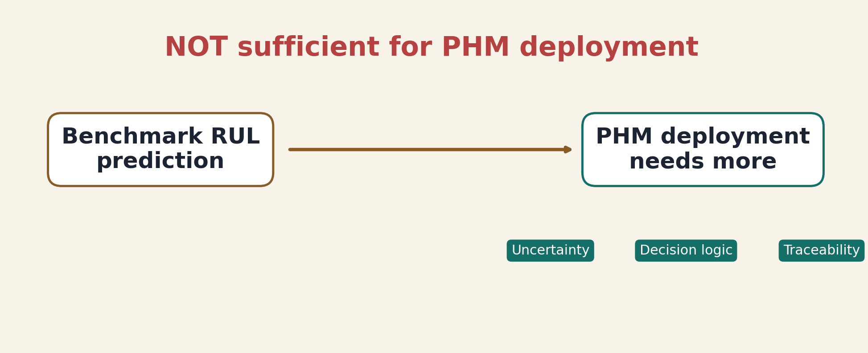
Problem
Why benchmark prediction alone is not enough
Benchmark RUL models produce point predictions.
Real PHM systems also need uncertainty, decision logic, and traceability.
Prediction alone is NOT sufficient for PHM deployment.
NOT sufficient for PHM deployment
Slide 2 | Sources: doc/ppt/02_slide_content_4m.md; doc/paper/04_discussion.md
Notes:
This is the core motivation slide. A low error score is useful, but it still does not tell an operator how confident the system is, what action to take, or how to audit the decision. That gap is what this project addresses.

Slide 3
Task Context
NASA C-MAPSS defines the prediction setting
Run-to-failure engine trajectories
Multivariate sensor + operational data
Goal: predict Remaining Useful Life
Slide 3 | Sources: data/readme.txt; doc/paper/main.tex
Notes:
C-MAPSS gives us degradation trajectories at the engine-unit level. Each row combines cycle context, operational settings, and sensors, and the task is to estimate remaining useful life before failure.

Slide 4
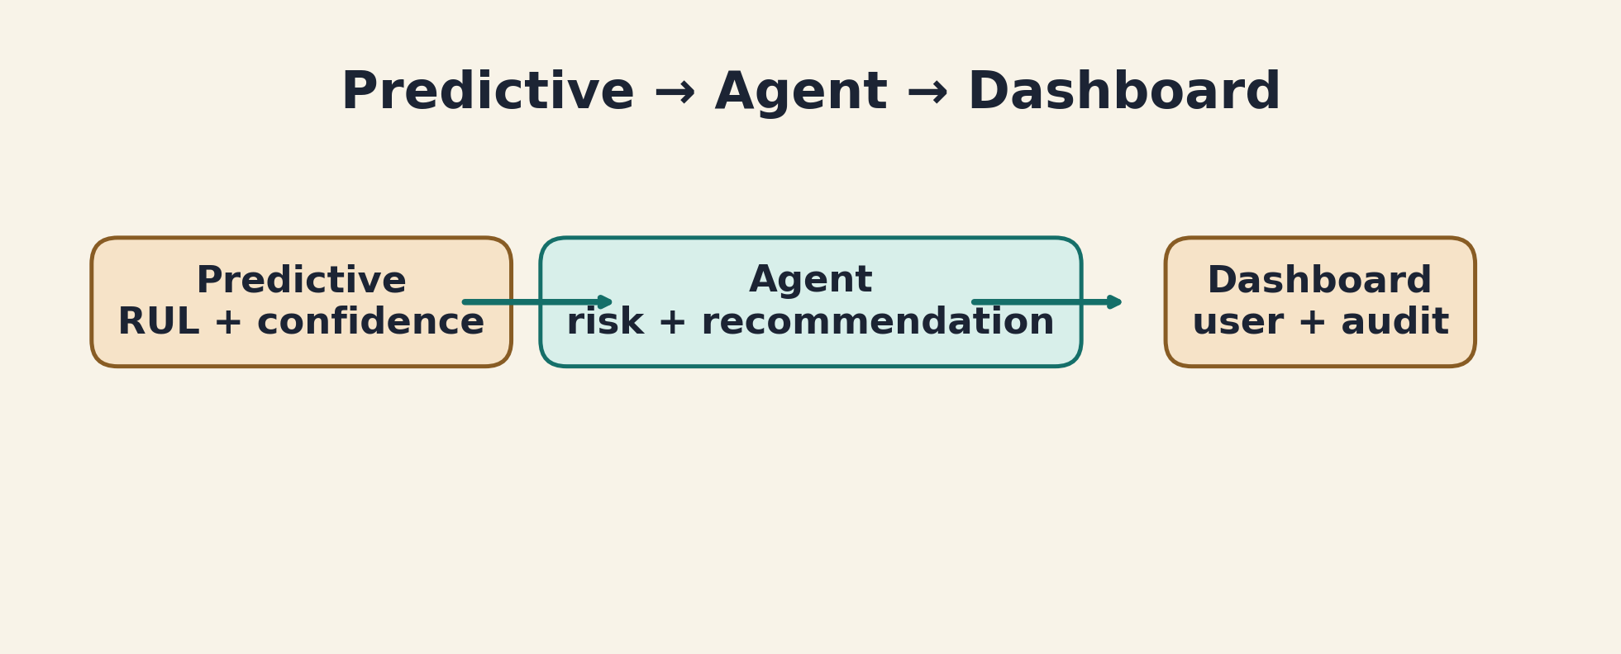
System Idea
Not just a model, but a system
Predictive → Agent → Dashboard
Predictive: RUL + confidence
Agent: risk + recommendation
Dashboard: user + audit
Predictive → Agent → Dashboard
Slide 4 | Sources: doc/paper/main.tex; out/dashboard_layer/01_ui_backend_contract_v1.json
Notes:
This is the system-level contribution in one line. The predictive layer estimates RUL, the agent layer turns that into deterministic decision support, and the dashboard exposes both operator and audit views.

Slide 5
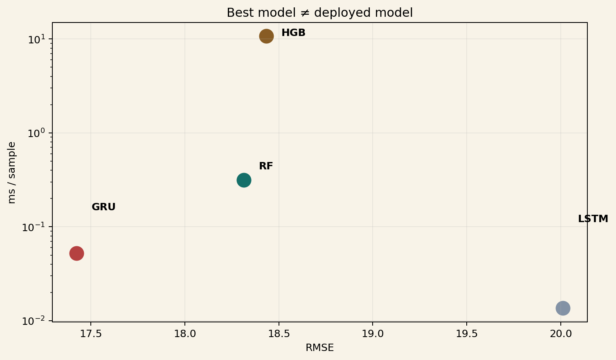
Predictive Layer
Best model ≠ deployed model
Multiple models tested: RF, HGB, LSTM, GRU
GRU achieved the best raw RMSE
RF was deployed as champion
Deployment needs stability, latency, and robustness
Best model ≠ deployed model
Slide 5 | Sources: out/predictive_layer/champion_record.json; out/predictive_layer/04_metrics_global_by_model.csv
Notes:
This is the main predictive insight of the project. Even though GRU had the best benchmark score, RF was the better deployed choice because the system also had to satisfy stability and operational constraints.

Slide 6
Agent Layer
Prediction becomes decision support
Inputs: RUL, confidence, service status
Outputs: risk level, risk score, recommendation
Deterministic and auditable
LLM optional, never controls decisions
Slide 6 | Sources: src/agent_layer/risk_engine.py; src/agent_layer/orchestrator.py
Notes:
The agent layer is what turns model output into something operationally meaningful. Importantly, the logic is deterministic, and the LLM is only optional support for interpretation rather than the source of truth.

Slide 7
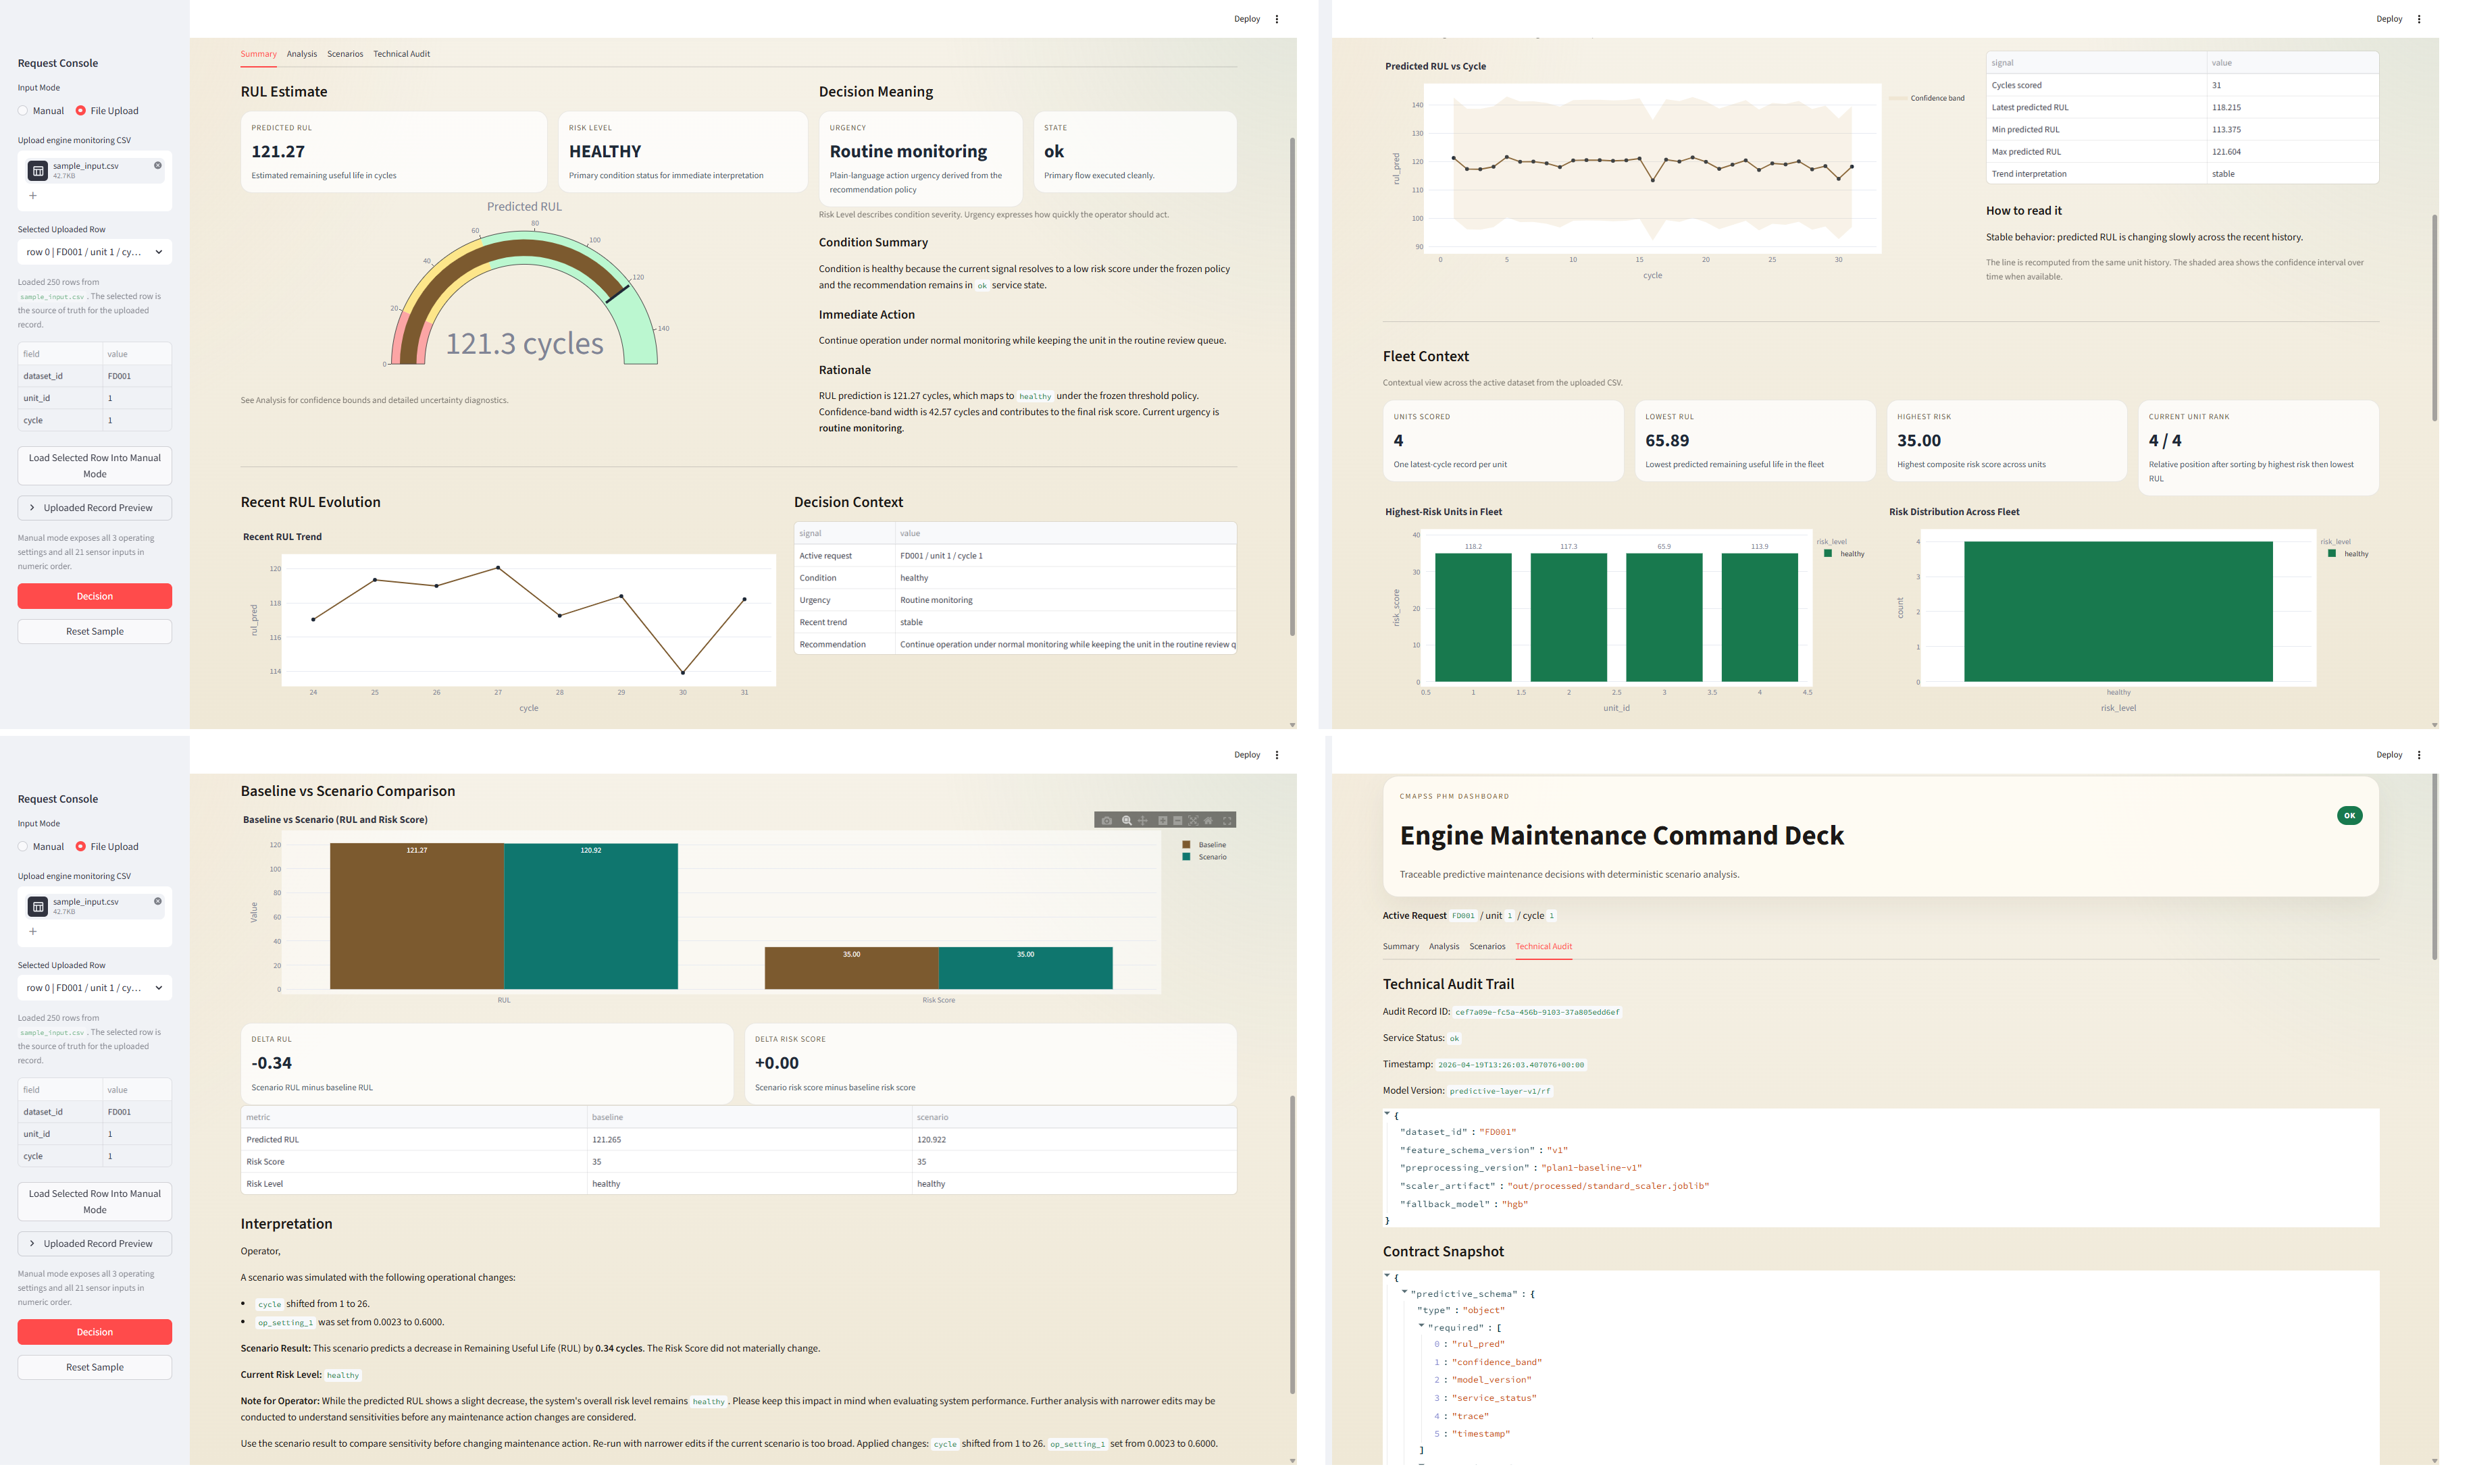
Dashboard
The integrated user-facing system
Summary
→ decision
Analysis
→ uncertainty
Scenarios
→ what-if comparison
Audit
→ traceability
Slide 7 | Sources: fig/dashboard/dashboard_v1_4.png; fig/dashboard/dashboard_v1_5.png
Notes:
The dashboard is where the three-layer architecture becomes visible to users. It exposes a fast decision view, a deeper explanation layer, deterministic scenario comparisons, and a technical audit path.

Slide 8
Results
Engineering constraints matter
GRU → best accuracy
RF → best system behavior
Best model ≠ deployed model
PHM quality is not RMSE alone
Best model ≠ deployed model
Slide 8 | Sources: out/predictive_layer/champion_record.json; out/predictive_layer/04_metrics_global_by_model.csv
Notes:
This slide reinforces the central result from a system perspective. A deployable PHM system has to optimize for more than leaderboard performance, and that is why the final model choice differs from the best raw benchmark model.

Slide 9
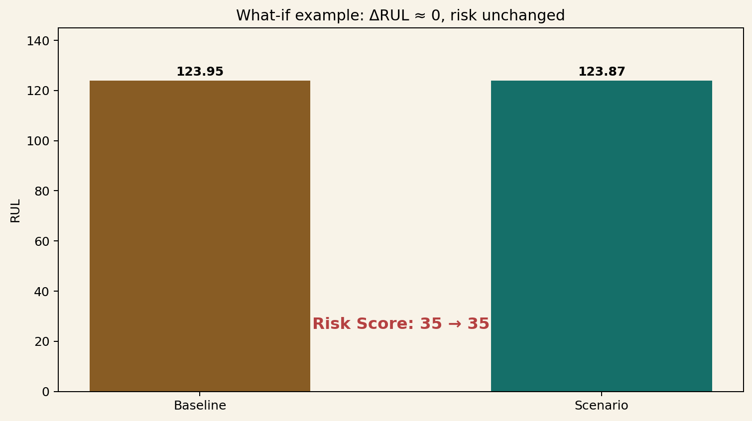
Scenarios
Interpretability through what-if analysis
Example: ΔRUL ≈ 0
Risk unchanged
Not all changes matter
The system reveals sensitivity, not just prediction
Slide 9 | Sources: out/agent_layer/05_scenario_examples.json; data/test_input_reference.md
Notes:
Scenario analysis is useful because it shows how the deployed model responds to controlled changes. In some cases the effect is very small, which tells us that the edited variables are locally insensitive or not central to the deployed model behavior.

Slide 10
Conclusion
A deployable PHM system, not just a model
Calibrated prediction
Deterministic decisions
Traceability and auditability
Main lesson: PHM quality ≠ RMSE alone
Slide 10 | Sources: doc/paper/main.tex; doc/paper/04_conclusion.md
Notes:
The final takeaway is that this project combines scientific modeling with engineering deployment discipline. What matters is not only predicting RUL, but making that prediction usable, explainable, and auditable in a real PHM workflow.

