Slide 1
Predictive Maintenance for NASA C-MAPSS
An end-to-end PHM application with calibrated RUL prediction, risk logic, and scenarios
Benchmark: NASA C-MAPSS
System: Predictive Layer -> Agent Layer -> Dashboard Layer
Focus: deployable PHM decision support rather than benchmark scores alone
CMAPSS PHM Presentation Deck
April 2026
Slide 1 | Sources: doc/paper/main.tex; README.md
Notes:
Open by framing the project as both a PHM study and a working AI system.
Sources: doc/paper/main.tex; README.md

Slide 2
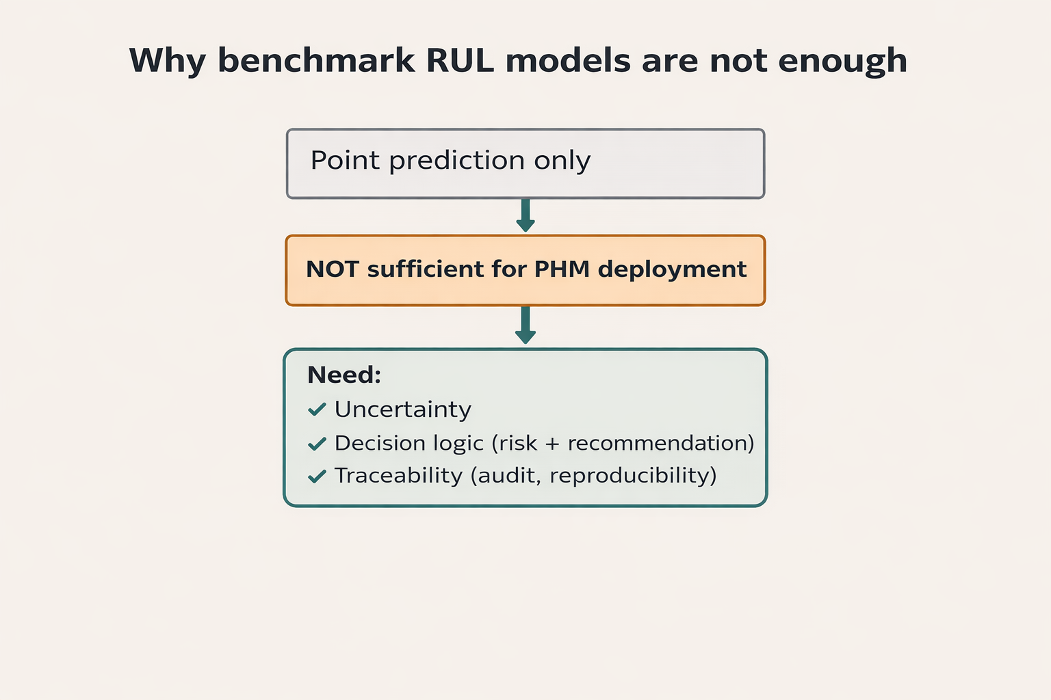
Motivation and Problem
Why point RUL prediction alone is not enough
Maintenance decisions require uncertainty, severity, and actionability.
Benchmark optimization does not automatically produce a usable PHM application.
This project closes that gap with calibrated prediction, deterministic decision logic, and traceable interaction.
Slide 2 | Sources: doc/paper/main.tex; doc/paper/04_discussion.md
Notes:
Use this slide to motivate the move from model-only research to system-level PHM support.
Sources: doc/paper/main.tex; doc/paper/04_discussion.md

Slide 3
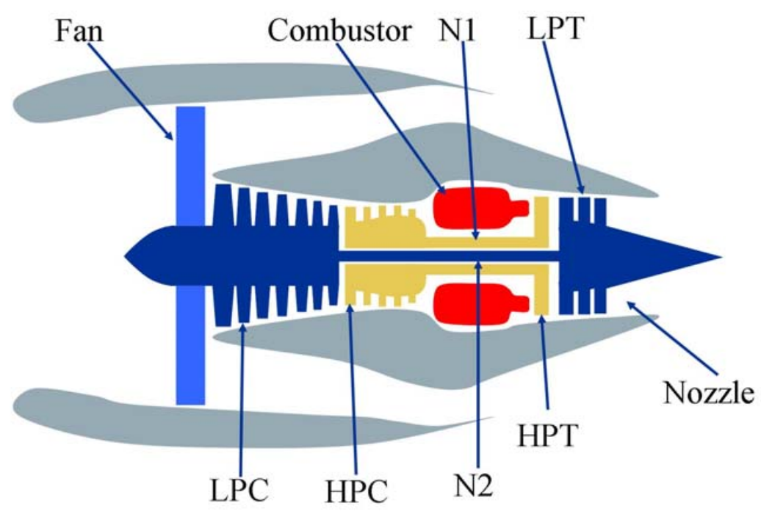
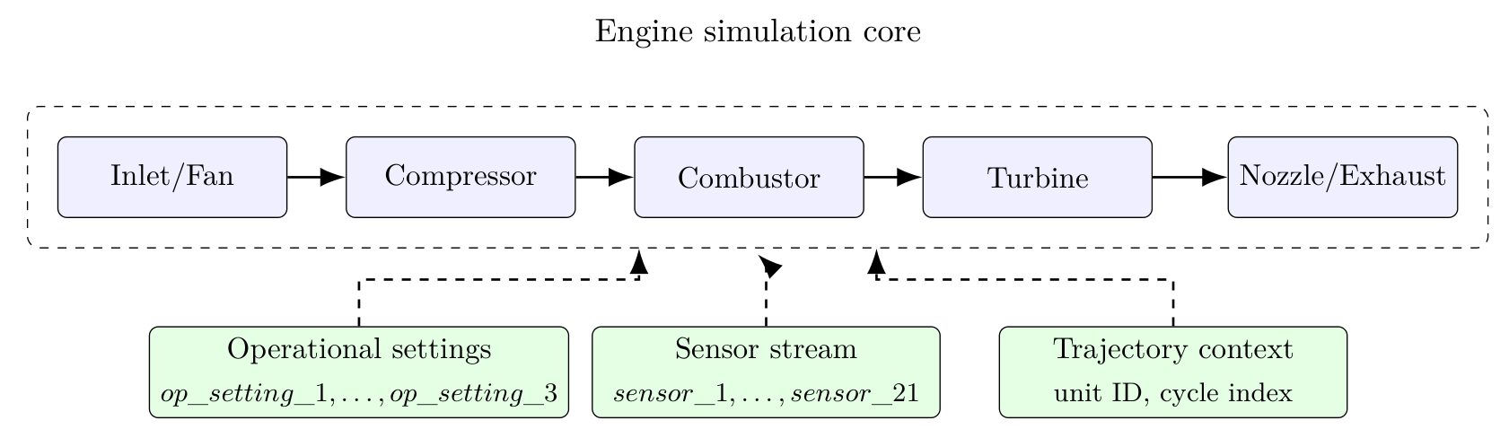
NASA C-MAPSS Context
Run-to-failure trajectories across four benchmark subsets
FD001-FD004 vary in operating conditions and fault complexity.
Each unit is a multivariate cycle trajectory with operational settings and sensor measurements.
The task is to estimate Remaining Useful Life before failure.
Slide 3 | Sources: data/readme.txt; doc/paper/main.tex
Notes:
Summarize the benchmark and remind the audience this is a cycle-based degradation problem.
Sources: data/readme.txt; doc/paper/main.tex

Slide 4
Project Objectives and Contributions
What this system adds beyond benchmark prediction
A calibrated predictive layer with frozen preprocessing and champion selection.
A deterministic agent layer for risk, recommendation, and scenario comparison.
A dashboard with Summary, Analysis, Scenarios, and Technical Audit workflows.
A reproducible artifact chain linking data, code, models, contracts, and audit traces.
Slide 4 | Sources: doc/paper/main.tex; doc/paper/03_results.md
Notes:
Make the contribution split explicit: prediction, decision support, user interface, and traceability.
Sources: doc/paper/main.tex; doc/paper/03_results.md

Slide 5
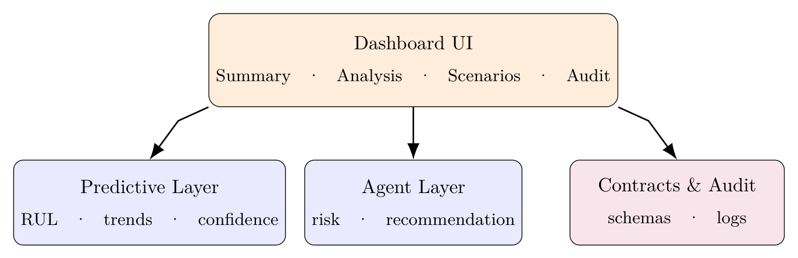
System Architecture
Contract-driven Predictive -> Agent -> Dashboard stack
The dashboard collects manual or CSV-driven requests.
The agent layer trims payloads, computes deterministic risk and recommendations, and manages scenarios.
The predictive layer serves the champion model with a calibrated confidence band and trace metadata.
Slide 5 | Sources: doc/paper/main.tex; out/dashboard_layer/01_ui_backend_contract_v1.json
Notes:
Explain the layer boundaries and stress that contracts and service states are explicit.
Sources: doc/paper/main.tex; out/dashboard_layer/01_ui_backend_contract_v1.json

Slide 6
Data and Preprocessing
From raw C-MAPSS rows to model-ready features
The deployed predictive model uses 16 selected features after low-variance filtering.
Training uses a training-only StandardScaler reused at serving time.
The operational target is capped RUL with cap 125, while raw RUL remains available for audit and ablations.
Slide 6 | Sources: out/eda/05_preprocessing_config.json; out/eda/04_target_definition.txt
Notes:
Keep this practical: feature selection, scaling, and target policy are what matter for the deployed system.
Sources: out/eda/05_preprocessing_config.json; out/eda/04_target_definition.txt

Slide 7
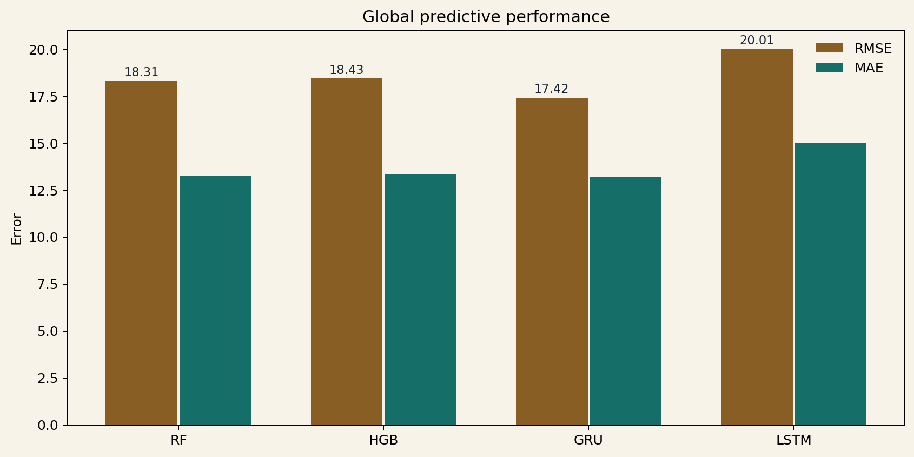
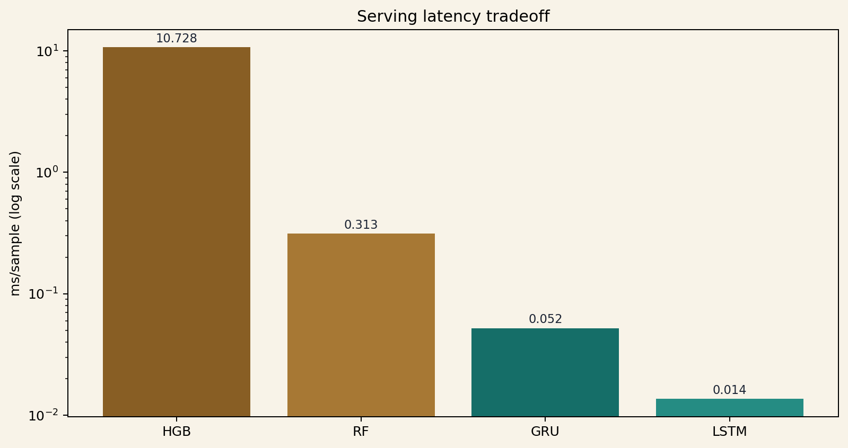
Predictive Layer and Champion Selection
RF deployed despite GRU best raw RMSE (17.42 vs RF 18.31)
Candidate models: RF, HGB, LSTM, and GRU.
Champion: rf | Fallback: hgb.
Selection reason: Best stable baseline selected for integration readiness.
The deployed choice balances quality, stability spread, latency, and integration readiness.
Slide 7 | Sources: out/predictive_layer/champion_record.json; out/predictive_layer/04_metrics_global_by_model.csv
Notes:
The main lesson is that the best benchmark model was not automatically the best deployed system model.
Sources: out/predictive_layer/champion_record.json; out/predictive_layer/04_metrics_global_by_model.csv; out/predictive_layer/04_latency_by_model.csv

Slide 8
Agent Layer and Deterministic Decision Logic
How RUL becomes risk, recommendations, and auditable scenario behavior
Risk logic uses predicted RUL, confidence-band width, and service status.
Recommendations are deterministic and aligned with the risk state.
The LLM is optional and non-central: it may assist interpretation, but never controls execution or comparison values.
Slide 8 | Sources: src/agent_layer/risk_engine.py; src/agent_layer/orchestrator.py
Notes:
Stress that the decision layer remains deterministic even when an LLM is available.
Sources: src/agent_layer/risk_engine.py; src/agent_layer/orchestrator.py; out/agent_layer/06_scenario_assistant_policy.txt

Slide 9
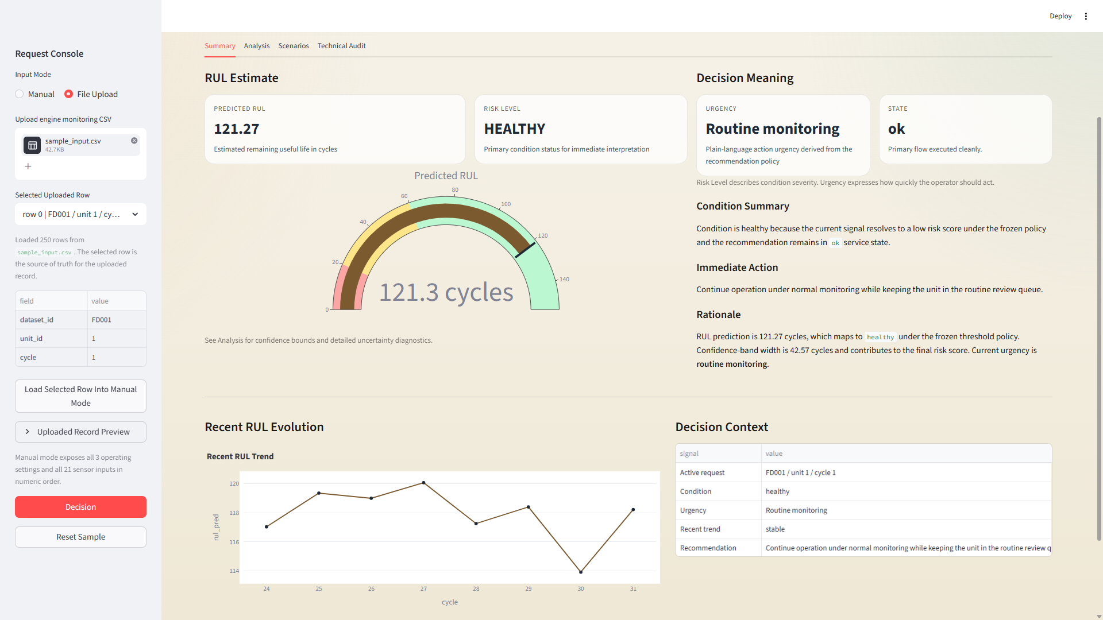
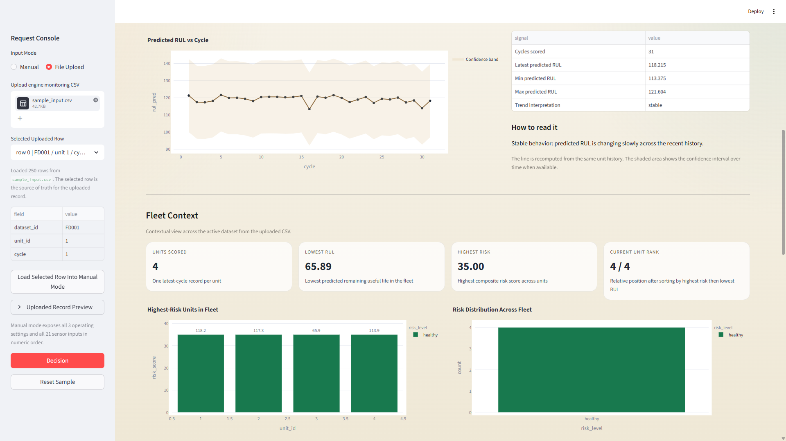
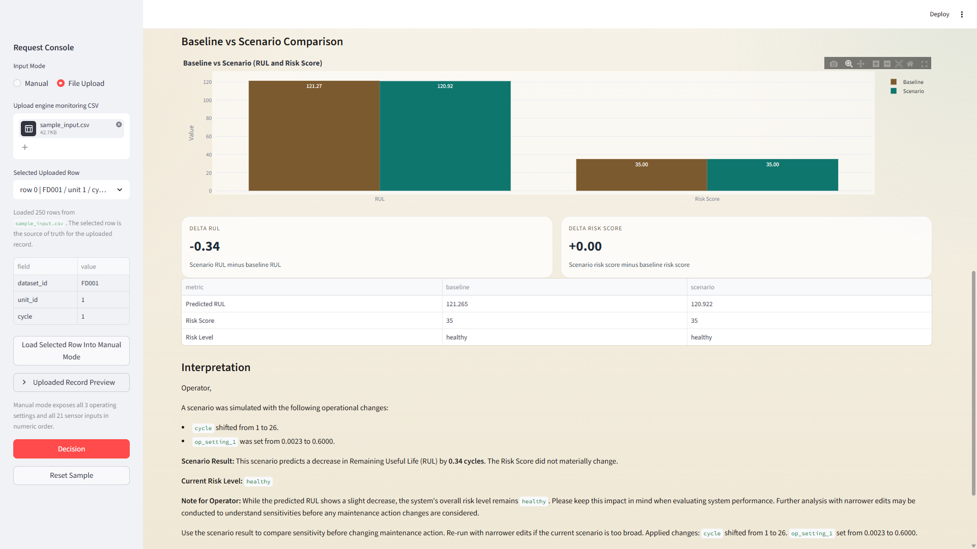
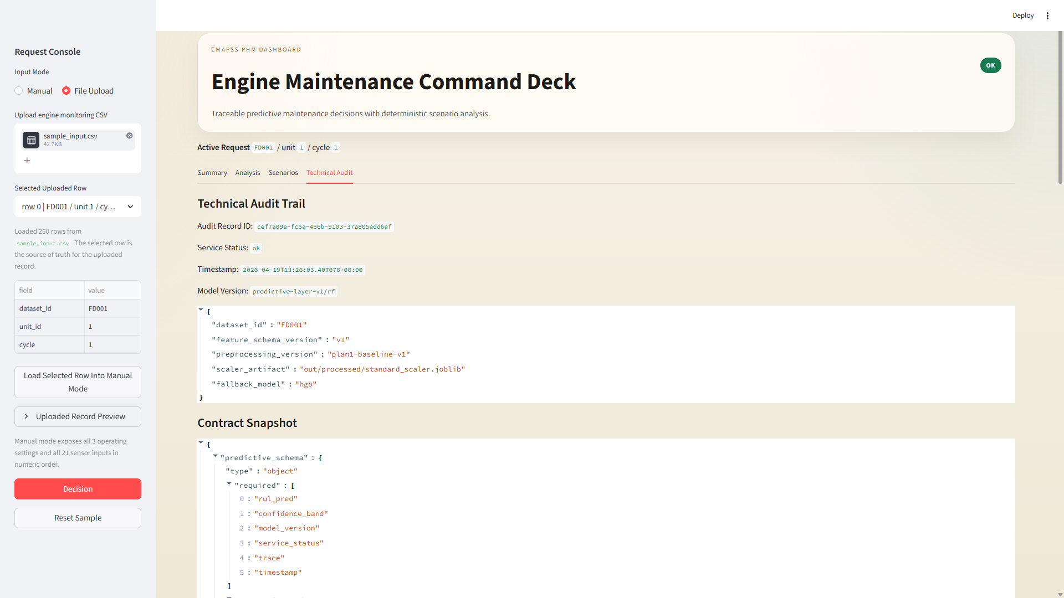
Dashboard Layer and User Workflow
The UI operationalizes prediction, explanation, scenarios, and auditability
Summary: decision-level RUL, risk, urgency, and action.
Analysis: explanation, uncertainty, temporal behavior, and fleet context.
Scenarios: deterministic baseline-vs-scenario comparison.
Technical Audit: trace fields, model version, service state, and contracts.
Slide 9 | Sources: fig/dashboard/dashboard_v1_4.png; fig/dashboard/dashboard_v1_5.png
Notes:
Use the screenshots as evidence that the integrated system is implemented, not only described.
Sources: fig/dashboard/dashboard_v1_4.png; fig/dashboard/dashboard_v1_5.png; fig/dashboard/dashboard_v1_8.png; fig/dashboard/dashboard_v1_9.png

Slide 10
Experiments and Results
Evidence combines prediction quality, stability, and engineering tradeoffs
Global metrics: GRU best raw RMSE; RF strongest stable tabular baseline.
Per-dataset metrics show why stability spread matters for deployment.
Latency and fallback behavior are treated as first-class engineering evidence.
Slide 10 | Sources: out/predictive_layer/04_metrics_global_by_model.csv; out/predictive_layer/04_metrics_by_dataset_by_model.csv
Notes:
Keep the framing evidence-based: show both performance and deployability tradeoffs.
Sources: out/predictive_layer/04_metrics_global_by_model.csv; out/predictive_layer/04_metrics_by_dataset_by_model.csv; out/predictive_layer/04_latency_by_model.csv

Slide 11
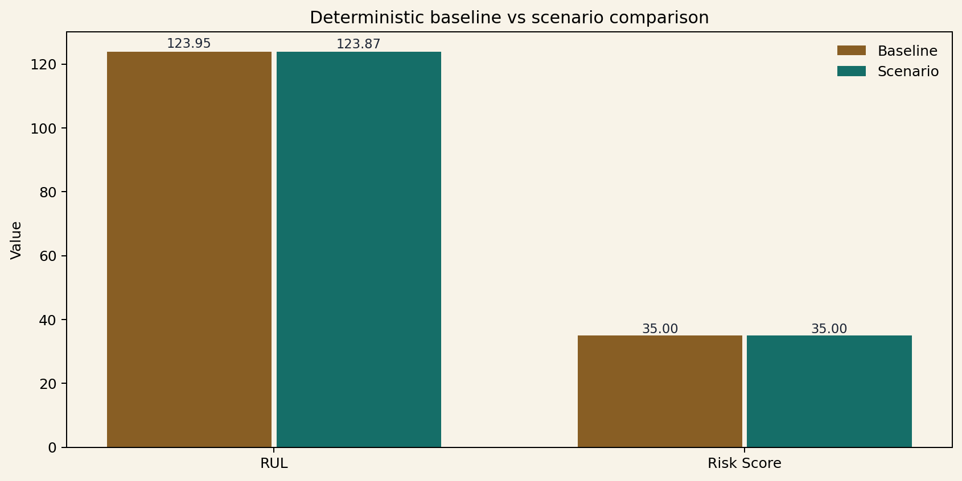
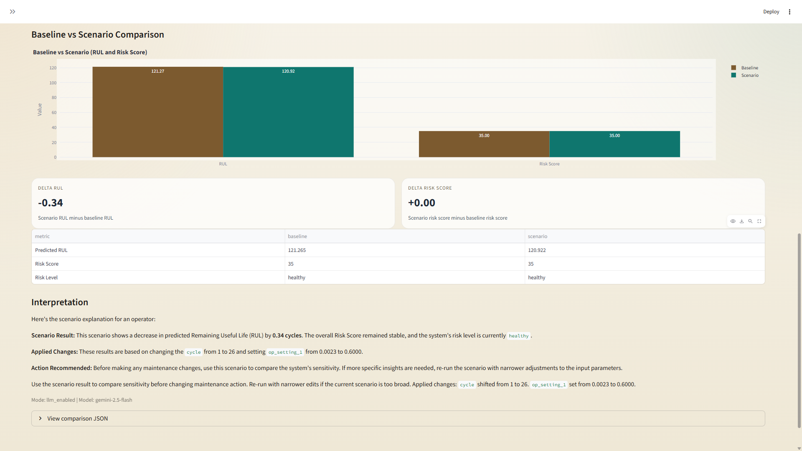
Scenarios and Interpretability
Deterministic what-if analysis with optional non-central LLM assistance
Scenario parsing is deterministic-first and only uses the LLM as a fallback for intent interpretation.
Example scenario: baseline vs scenario delta RUL = -0.081 cycles.
Risk score remained 35 -> 35, showing how some edits have low local impact.
This makes scenario outputs useful for comparative sensitivity analysis rather than speculative control.
Slide 11 | Sources: out/agent_layer/05_scenario_examples.json; data/test_input_reference.md
Notes:
Explain that low-impact scenario outcomes are often a model-feature and local-sensitivity issue, not a parser failure.
Sources: out/agent_layer/05_scenario_examples.json; data/test_input_reference.md

Slide 12
Engineering Constraints
Deployment decisions were shaped by cost, latency, safety, reliability, and traceability
Cost: the LLM remains optional and non-central.
Latency: the deployed RF path is simple and fast to serve.
Safety: validation rules and protected identifiers constrain scenario execution.
Reliability: explicit fallback and service-state propagation are surfaced end-to-end.
Traceability: audit records and contracts support debugging and review.
Slide 12 | Sources: out/agent_layer/08_failure_modes.txt; out/predictive_layer/08_deploy_checklist.txt
Notes:
This slide is where the engineering maturity of the project should become obvious.
Sources: out/agent_layer/08_failure_modes.txt; out/predictive_layer/08_deploy_checklist.txt; out/dashboard_layer/08_state_handling_guide.txt

Slide 13
Limitations and Future Work
What the current system does well and where it still needs extension
The deployed champion is a single-row tabular model rather than a temporal serving model.
Some scenario edits have low local sensitivity because they target non-features or weak local directions.
The confidence-band policy is useful but relatively simple.
Future work: richer local explanation, broader scenario libraries, stronger fleet analytics, and live deployment experiments.
Slide 13 | Sources: doc/paper/04_discussion.md; out/predictive_layer/08_residual_risks.md
Notes:
Be explicit and honest here; it strengthens the credibility of the rest of the deck.
Sources: doc/paper/04_discussion.md; out/predictive_layer/08_residual_risks.md

Slide 14
Conclusion
The project demonstrates a deployable and traceable PHM system, not only a benchmark model
Scientifically: calibrated RUL modeling with documented champion selection.
Engineering-wise: deterministic decision support, scenarios, and traceability integrated into one user-facing system.
Main lesson: deployment quality depends on more than raw RMSE.
Slide 14 | Sources: doc/paper/main.tex; doc/paper/04_conclusion.md
Notes:
Close by joining the scientific and engineering contributions into one claim.
Sources: doc/paper/main.tex; doc/paper/04_conclusion.md

