Slide 1
The size of the paper is 17 in x 22 in (C size) Keep that in mind with the font /image sizes. Use the layout of the next page as a guideline to include relevant information. Change the background color and rearrange the sections as you see fit. You can use the poster as presentation prop. You need the poster printed on the day of the presentation. All group members need to participate!

Slide 2

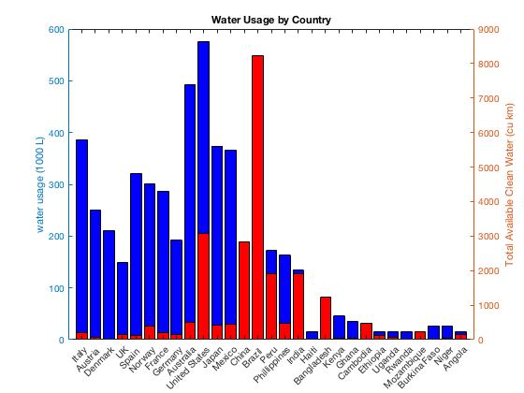
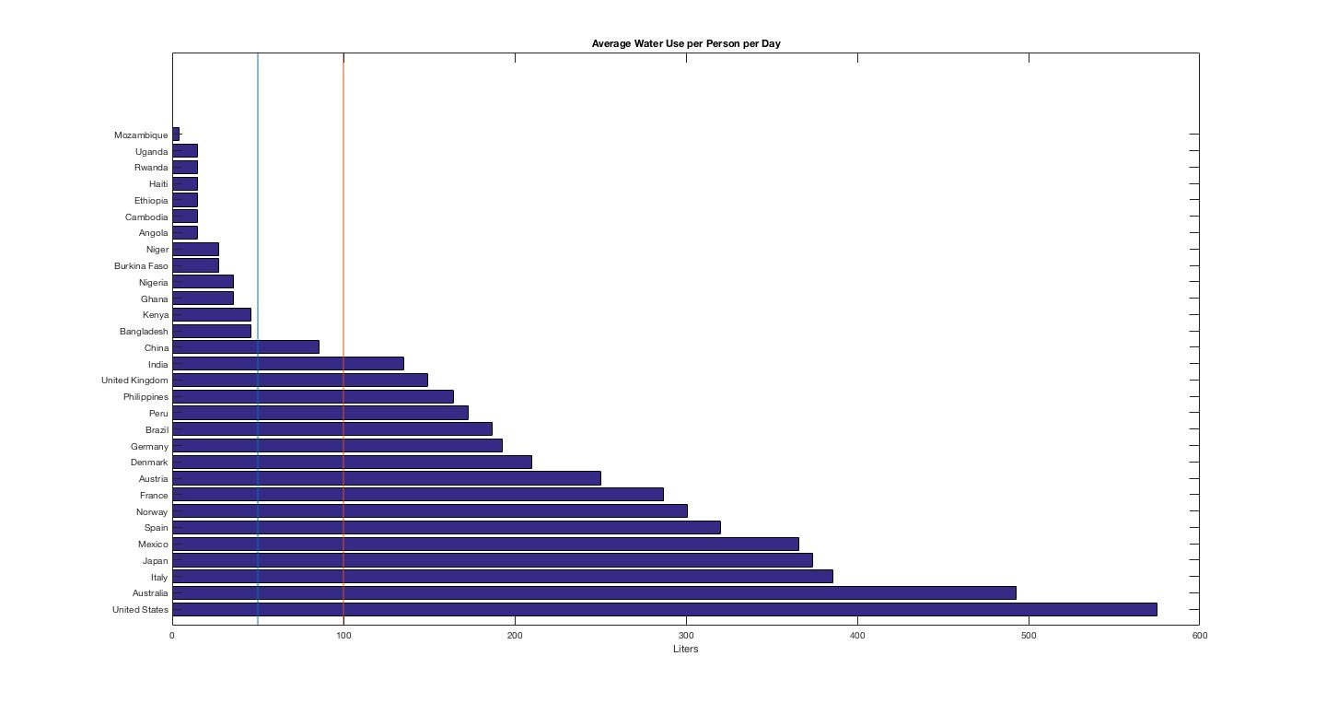
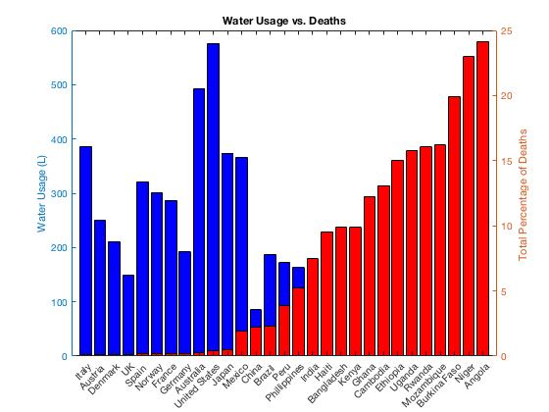
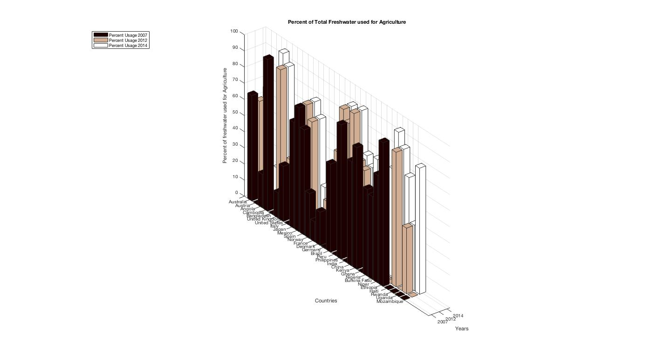
Addressing the World’s Water Deficiency Issue
Travis Merrill , Yessica Nelson, Daniel Silva and Jason Morales
Context: Water is a necessity for survival
Problem: Water is not readily available to everyone
Results: Developing and Developed countries have a continuous growing demand for freshwater, but availability is dwindling

