Slide 1

SACADA
AI-Powered Inventory Optimization for Fashion Retail
Reduce overstock. Maximize sales. Free up capital.

Slide 2
The Fashion Retail Inventory Problem
We analyzed 7,603 inventory decisions across 28 stores and 13 product lines. The pattern is clear: fashion retailers systematically overstock.
STOCK-TO-SALES RATIO
4.0×
Stocking 4.0× what they sell
SKUs OVERSTOCKED
97%
7,393 of 7,603 decisions
TOTAL EXCESS STOCK
225,653 units
Units sitting unsold, tying up capital
For every unit sold, roughly 4 extra units sit in inventory — tying up working capital and warehouse space.

Slide 3
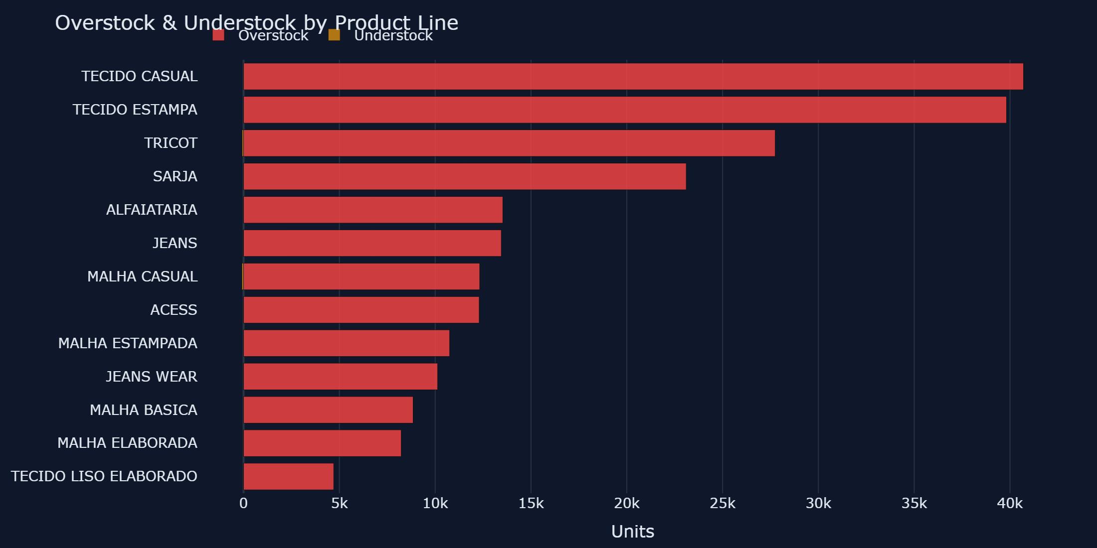
Where It Hurts Most

Slide 4
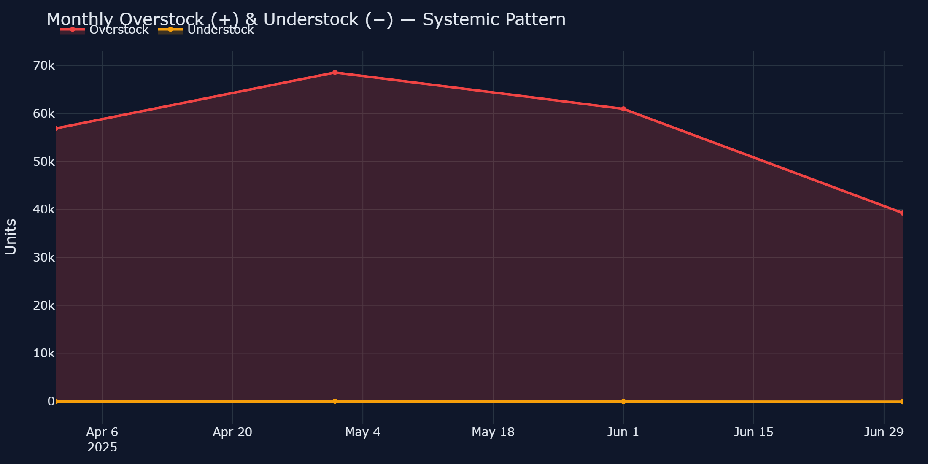
The Pattern Is Systemic
This isn't a seasonal blip — overstock is consistently high every month. It's a planning process failure that machine learning can fix.

Slide 5
Our Solution: SACADA
A 3-step AI-powered approach to inventory optimization
Step 1
Analyze Historical Demand
We ingest your sales and inventory data to identify demand patterns, seasonality, and product-level trends across all stores.
Step 2
Probabilistic Forecasting
XGBoost Quantile Regression produces not just a single prediction, but calibrated confidence intervals — so you know the range of likely demand.
Step 3
Tier-Based Stocking Strategy
Products are classified by volume (Low / Medium / High). Each tier gets an optimized confidence level, balancing cost vs availability.

Slide 6
Proven Results
Real metrics from a fashion retail success case
STOCK REDUCTION
175,973 units
+58.7% less inventory
OVERSTOCK ELIMINATED
174,378 units
+77.3% less excess
FILL RATE
97.5%
-2.2pp vs company (99.7%)
ACCURACY IMPROVEMENT
+76.5%
MAE: 7.0 vs 29.7 units
Company vs Model Comparison
Metric | Company | SACADA Model | Improvement
Total Stock | 299,553 | 123,580 | +58.7%
Overstock | 225,653 | 51,275 | +77.3%
Understock | 236 | 1,831 | +1,595
Fill Rate | 99.7% | 97.5% | -2.2pp
Avg Error/SKU | 29.7 | 7.0 | +76.5%

Slide 7
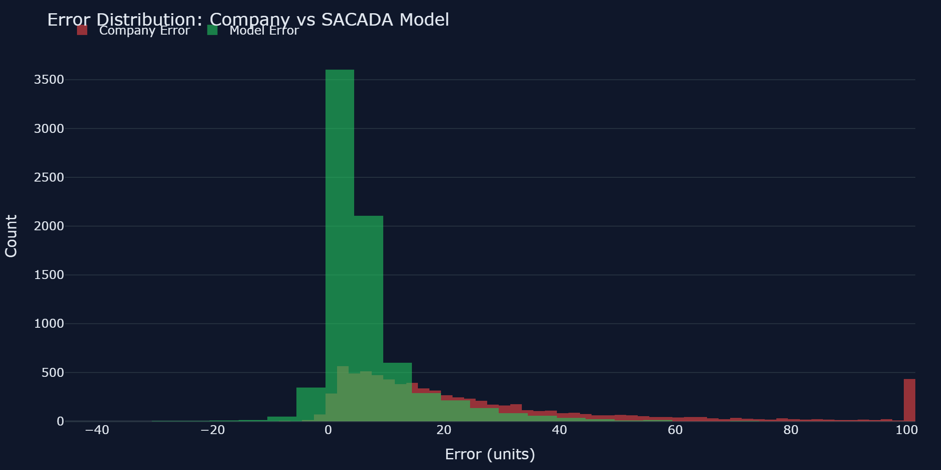
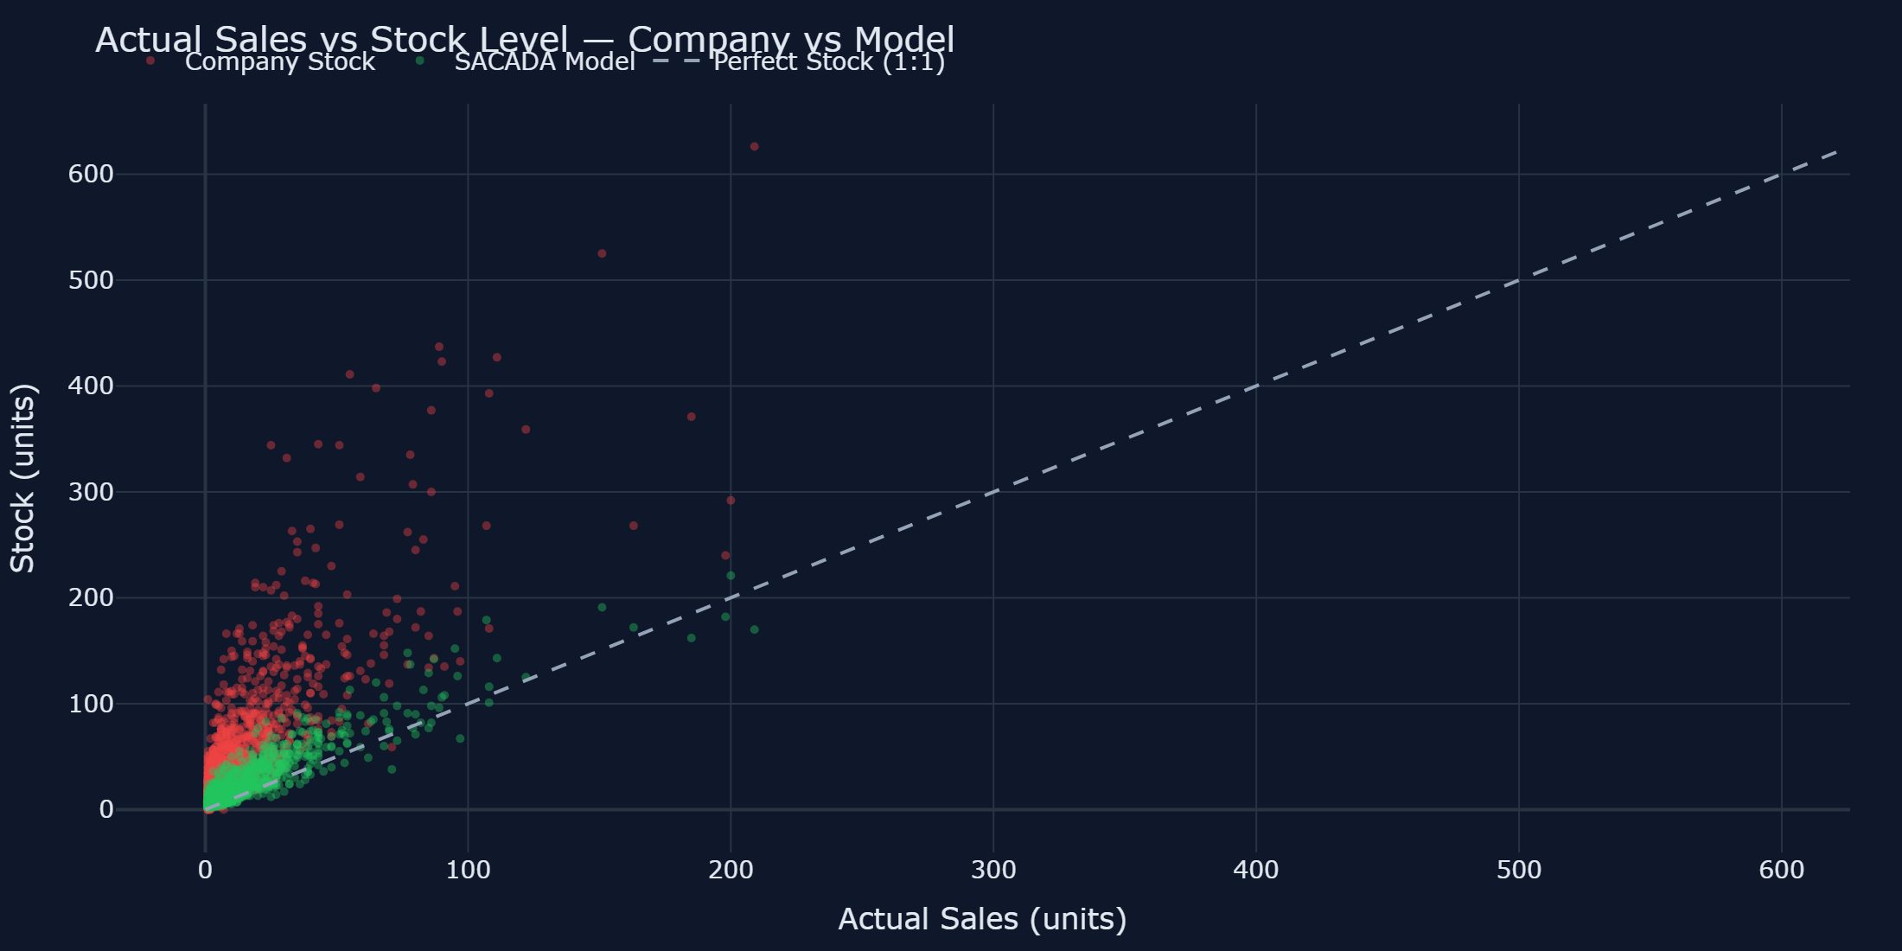
Visual Proof: Before vs After

Slide 8
Financial Impact
Assuming 50% profit margin (industry standard for fashion retail)
COMPANY TOTAL WASTE
225,889 units
Overstock + understock combined
MODEL TOTAL WASTE
53,106 units
Optimized with SACADA
WASTE REDUCTION
172,783 units
76.5% improvement
Example R$ Calculation
If average retail price = R$200, unit cost = R$100
→ 172,783 units saved × R$100 = R$17,278,300 in freed capital
This is per forecast cycle — annualized savings multiply by 12.

Slide 9
Next Steps
How we can optimize your inventory in 4 weeks
Week 1
Data Integration
Share your historical sales and inventory data. We handle ingestion, cleaning, and feature engineering.
Week 2
Model Training
Train XGBoost Quantile Regression on your data. Cross-validate to ensure robust, calibrated predictions.
Week 3
Dashboard & Analysis
Deploy your custom SACADA dashboard. Identify top savings opportunities by store and product line.
Week 4
Pilot Rollout
Start with your top 3 stores. Measure results. Scale across the entire network.
Ready to optimize your inventory? Let's talk.
[Your contact email / website here]

