Slide 1

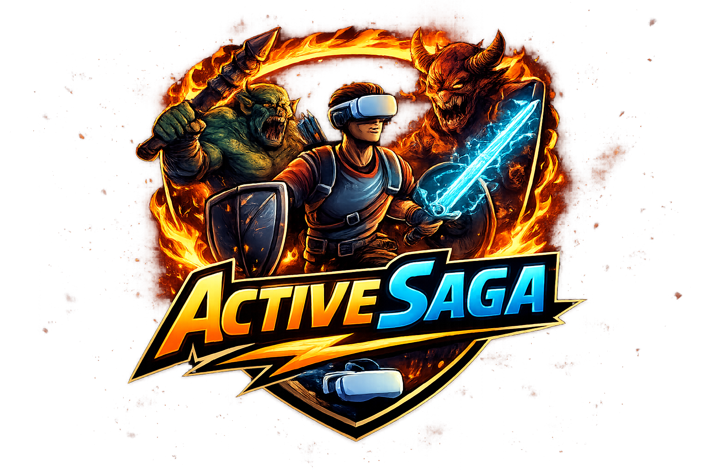
VR Sport Game ActiveSaga
Capstone Project Phase A
Daniel Chernov & Alexandra Belkind
Supervisor: Dr Moshe Sulamy

Slide 2

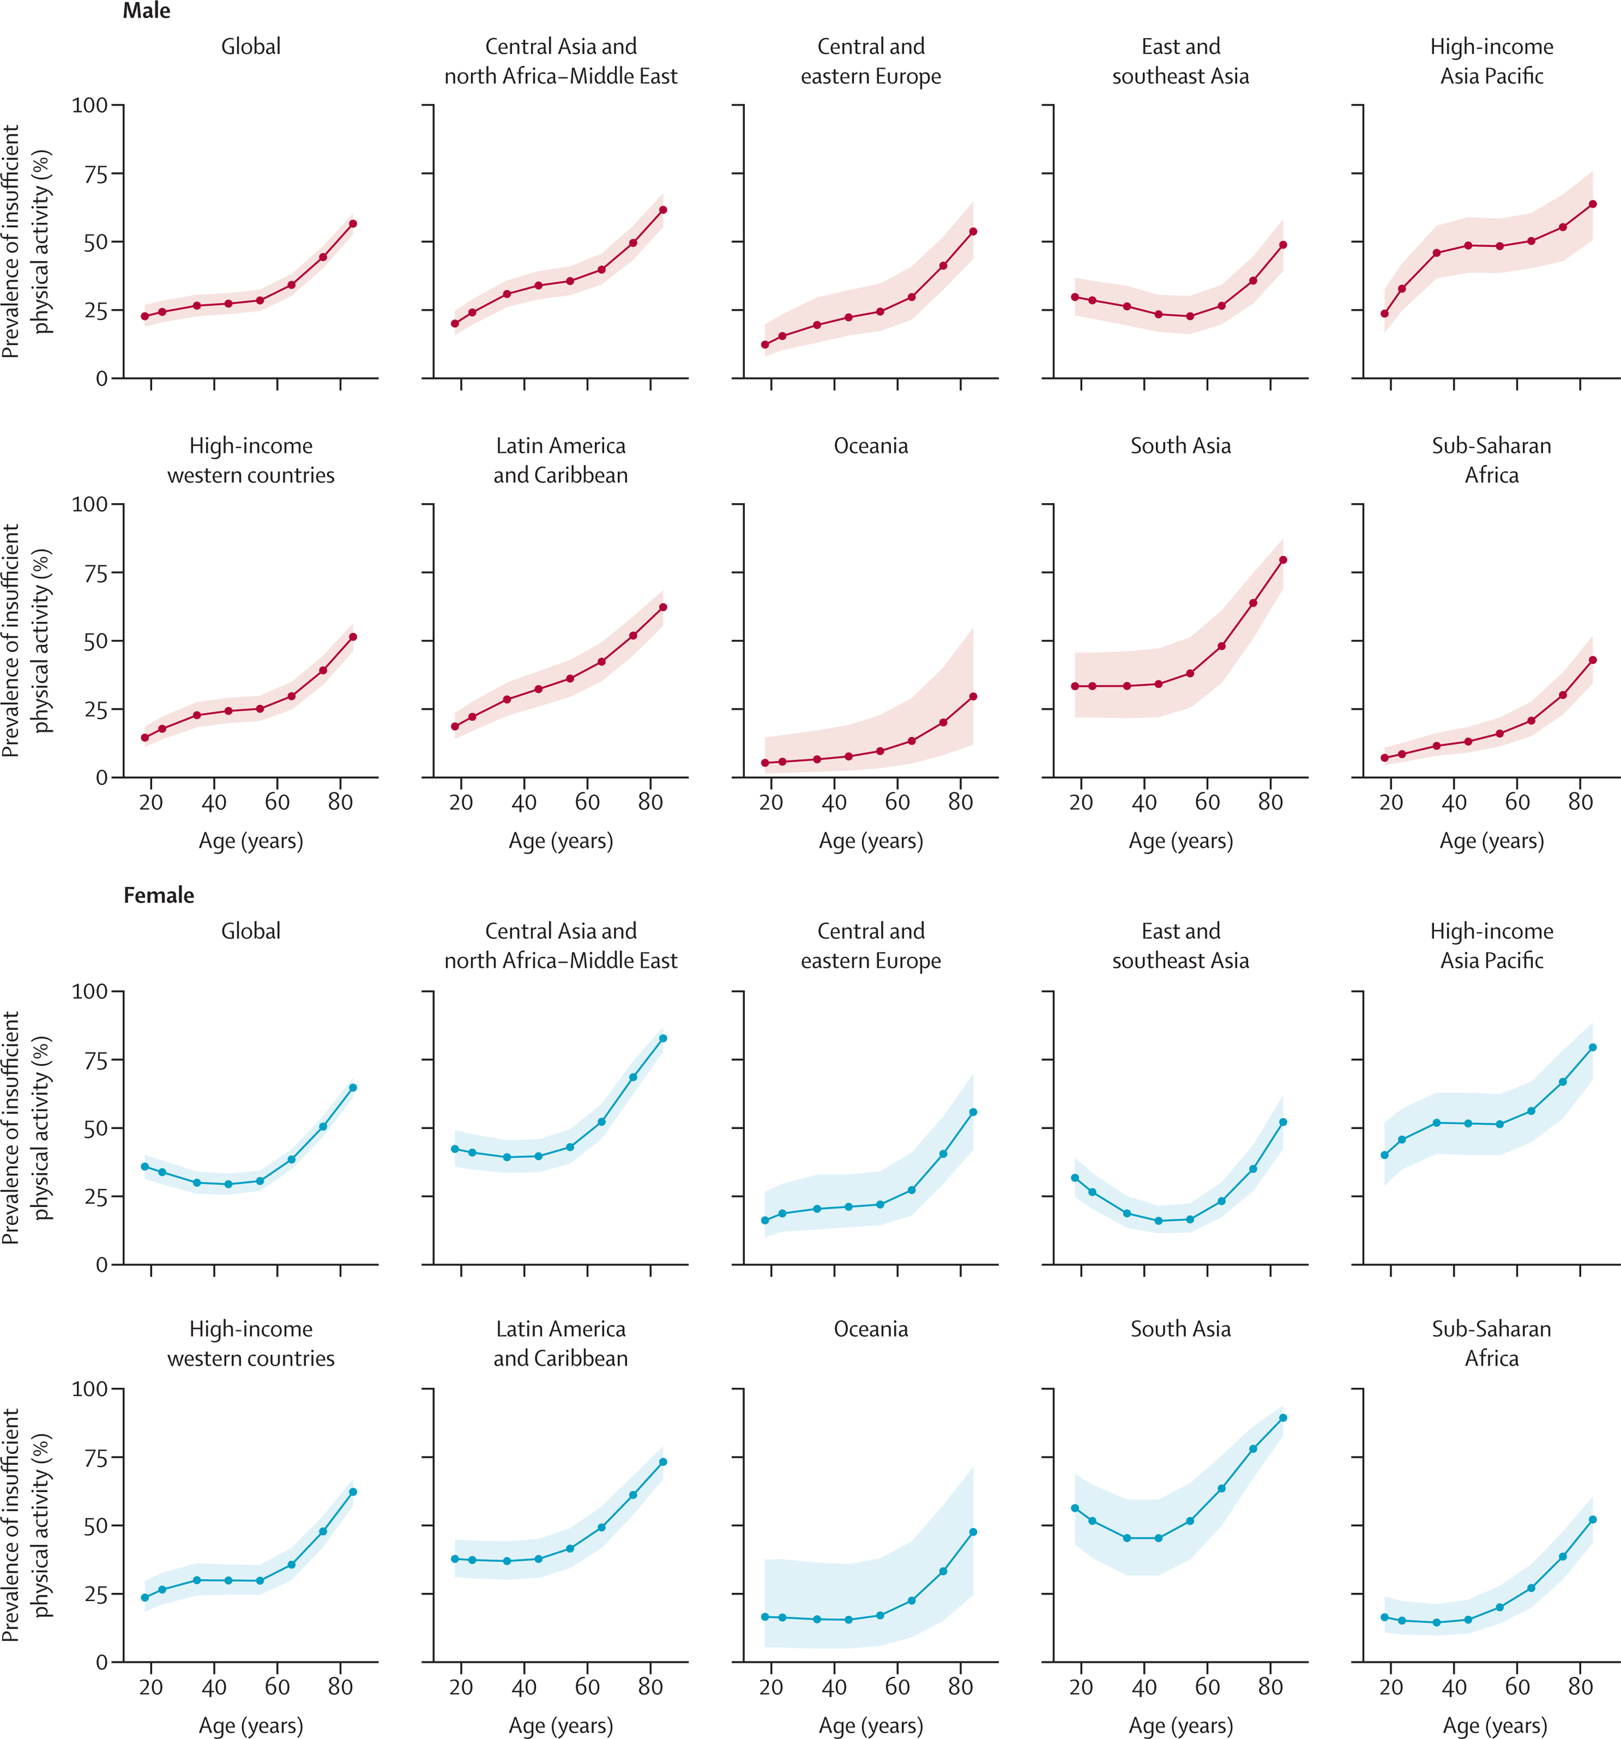
Motivation & Problem
Global Health Crisis
Global physical inactivity is increasing due to sedentary lifestyles
Notes:
המאמר של הגרפים:
https://www.thelancet.com/journals/langlo/article/PIIS2214-109X%2824%2900150-5/fulltext#fig3

Slide 3
Motivation & Problem
Low Exercise Adherence
Limitations of Current Solutions
Many people struggle to maintain exercise routines over time
Existing home fitness solutions are often repetitive and lead to low adherence

Slide 4


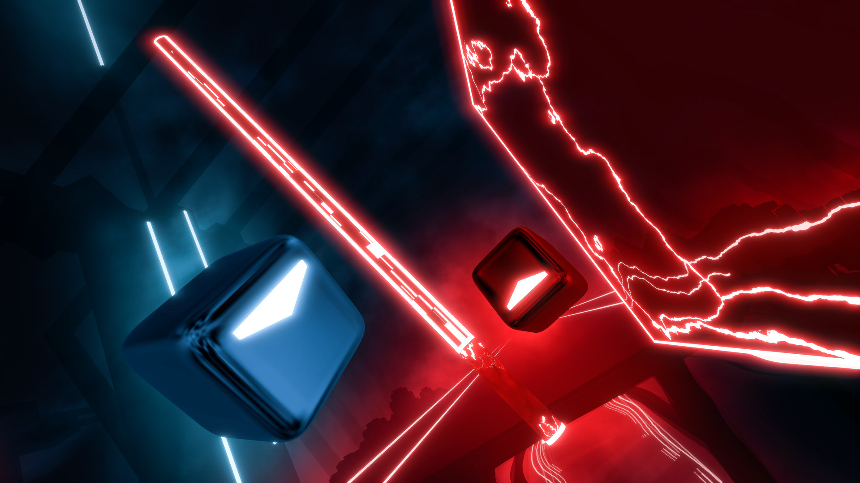
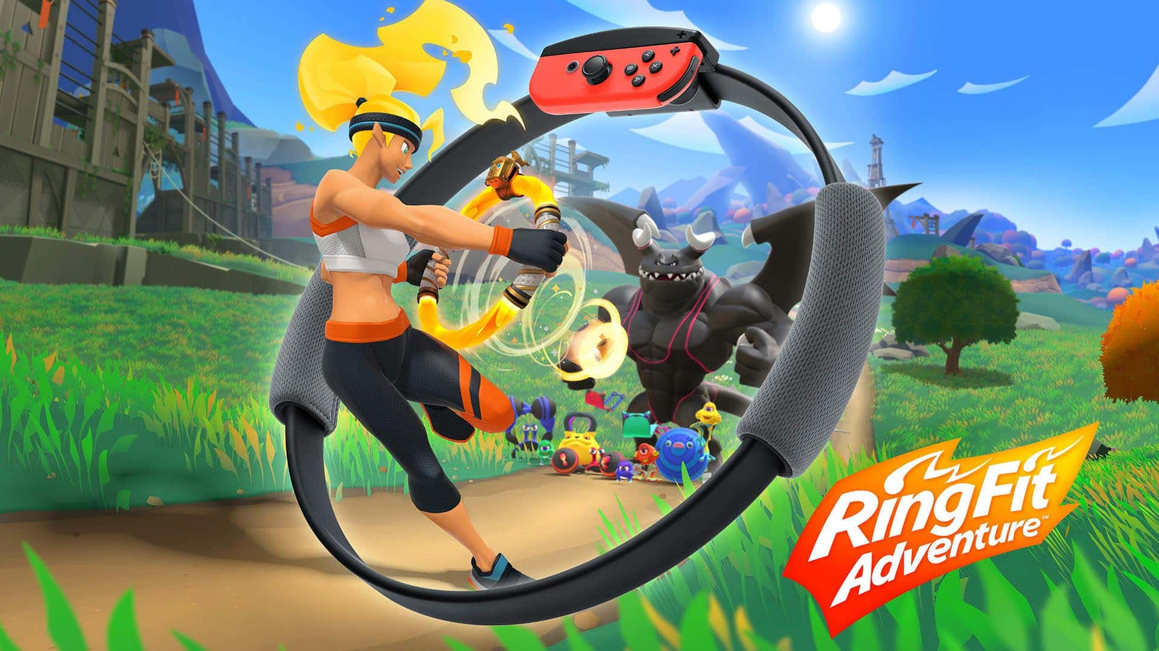
Existing Solutions & Gaps
Beat Saber
Ring Fit Adventure
promotes physical activity through rhythm-based upper-body movement but lacks full-body engagement and long-term progression mechanics
encourages structured exercise, but its limited immersion and non-VR experience reduce long-term engagement and motivation.

Slide 5
Our Solution: ActiveSaga
ActiveSaga is a VR-based adventure game that transforms physical activity into core gameplay mechanics. Real-world movements such as running, squatting, and jumping directly control in-game actions. By shifting the user’s focus from effort to gameplay, the system reduces the Perceived Rating of Exertion.

Slide 6
Project Objectives & Innovation
Activity Goals
Core Innovation
Encourage consistent daily physical activity through gameplay
Promote at least five short exercise sessions per week
Lower-body locomotion without external sensors
Movement detection based solely on head-mounted display data

Slide 7




Technology Stack
1
2
3
4
Meta Quest 3S
Unity + C#
MongoDB
GitHub

Slide 8
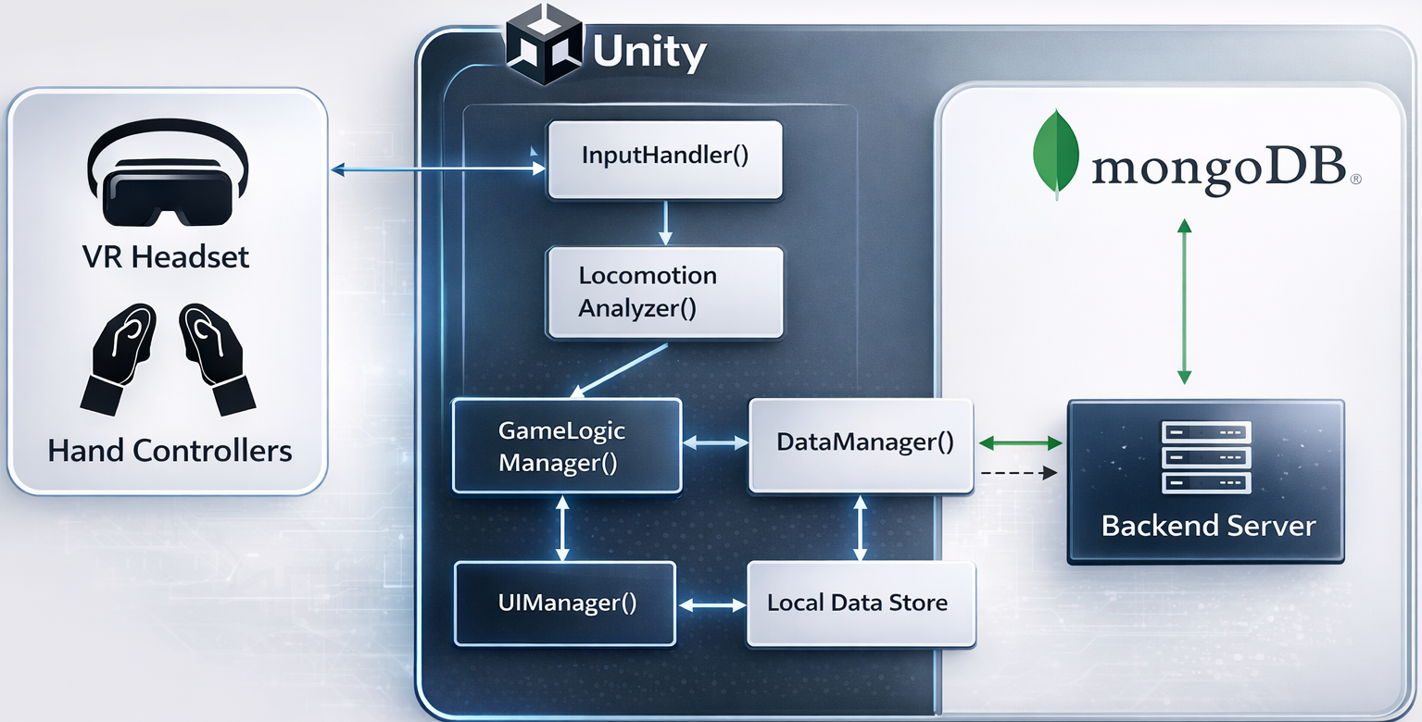
Architecture
The system combines local real-time processing with cloud-based data synchronization to ensure performance and scalability.

Slide 9
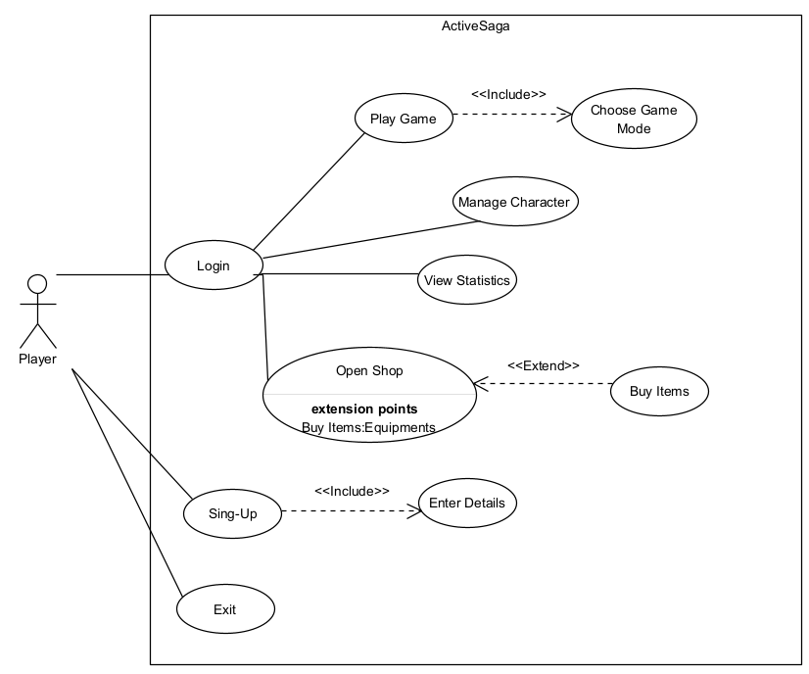
Use State

Slide 10
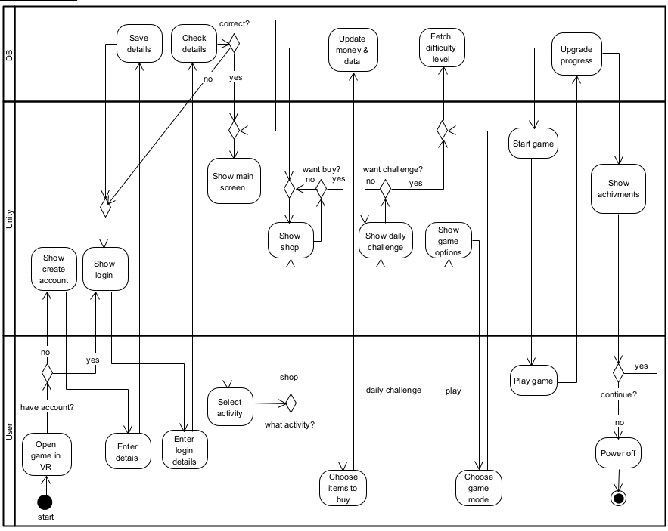
Activity Diagram

Slide 11
Core Algorithm: Movement Analysis
Real-time detection of running, squatting, and jumping.
Uses vertical position and velocity patterns.
Head-mounted display data only (no external sensors).

Slide 12




Gamification & Progression System
XP
Currency
Rewards players for physical activity and progression.
Enables purchasing upgrades and in-game items
Habit formation
Daily / Weekly Rewards
Encourages consistent engagement through timed challenges.
Supports long-term exercise routine formation.

Slide 13
Success Metrics & Evaluation Plan
Accuracy
Performance
Precision of movement detection.
Stable and smooth frame rate.
User Retention
Usability
Continued user engagement over time.
User comfort and ease of use.

Slide 14
Testing & Safety
Area | Test Focus | Expected Outcome
System Testing | Core gameplay & movement detection | Stable and correct system behaviour
Cybersickness | Frame rate & motion alignment | Reduced discomfort and nausea
Safety | Guardian boundary detection | User remains within safe play area

Slide 15
POC Video

Slide 16
POC

Slide 17
Challenges & Future Work
Optimization – Improving performance and stability on standalone VR hardware.
Accuracy – Enhancing movement detection and reducing false positives.
Content – Expanding levels, challenges, and gameplay variety.

Slide 18
Summary

Slide 19
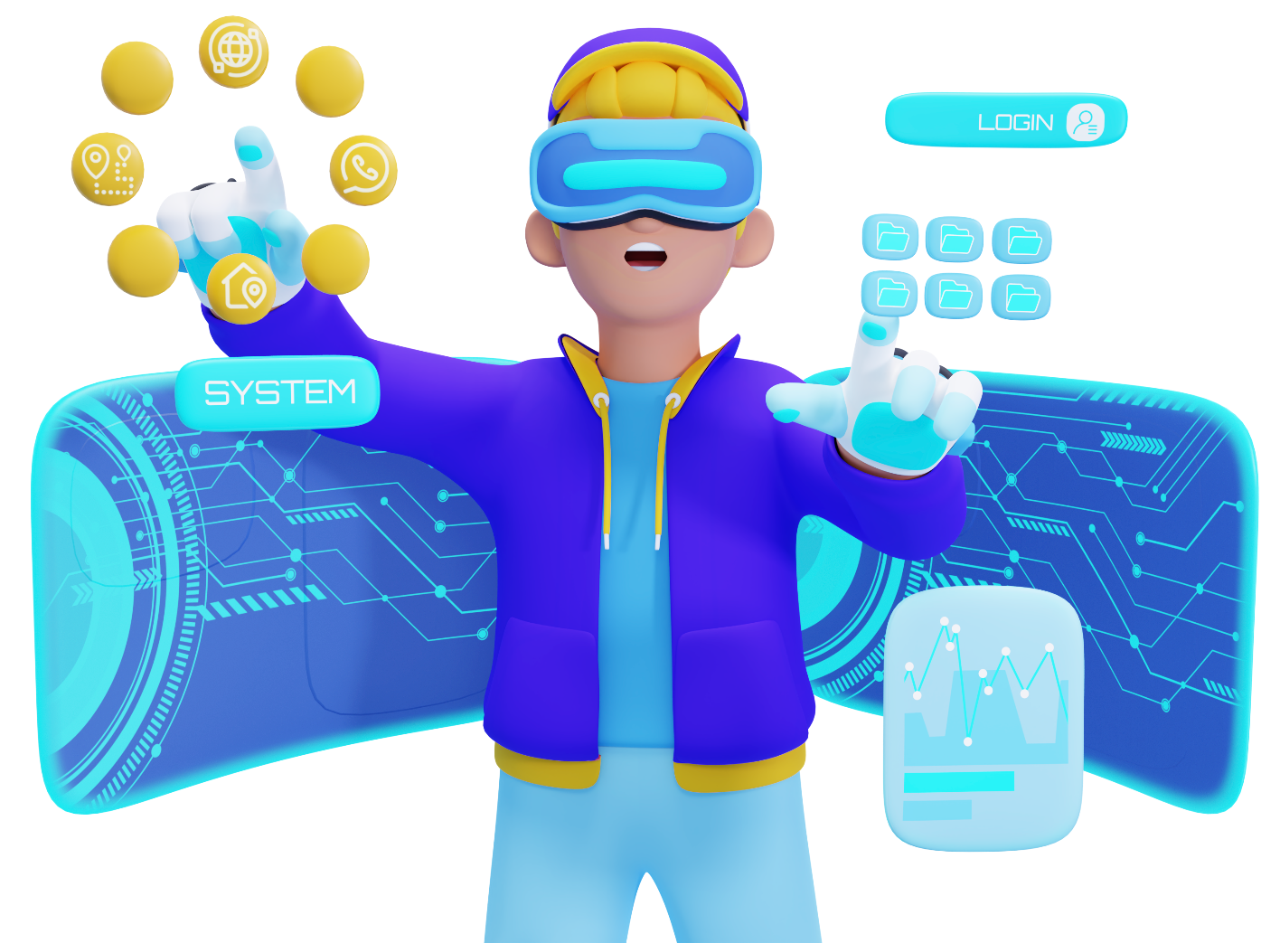
Thank You!
Daniel Chernov & Alexandra Belkind

