Slide 1
Automated Prompt Engineering for Traceability Link Recovery
Proposal Presentation by Daniel Schwab

Slide 2
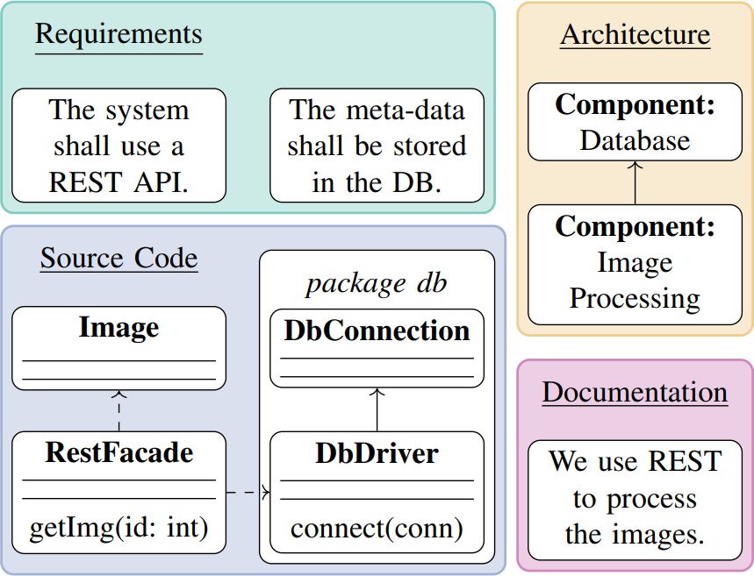
What is Trace Link Recovery
Many different artifacts are created during software development
Often inconsistencies will be present, such as naming
Goal: Link elements across multiple domains or versions to ensure consistency and validation

Slide 3
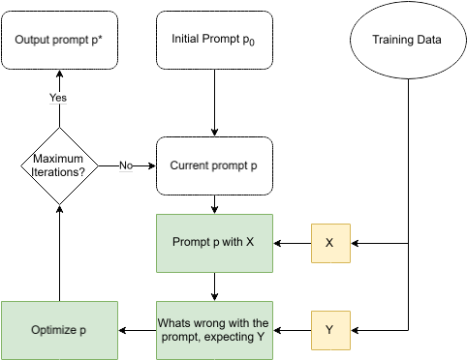
What is Automated Prompt Engineering
Use the LLM to refine prompts instead of manually formulating them
Improve initial prompt by training with a subset of the actual data
Optimization prompt to fix previous shortcommings

Slide 4
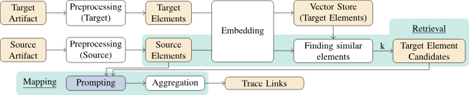
The LiSSA-Framework
My work will add to the prompting step of the LiSSA framework

Slide 5
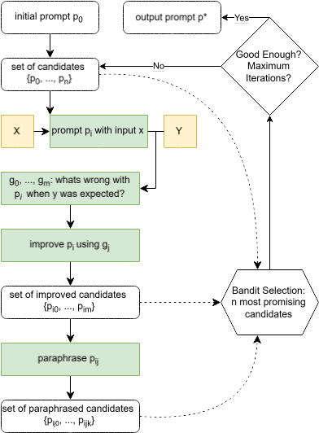
APE with Gradient Descent
Generate many new prompt candidates on each layer
Steer them against the error direction using gradients
Select most promising candidates cheaply using a well studied multiple-armed-bandit algorithm

Slide 6
Evaluation
Compare performance (precision, recall, F1-score, F2-score) against current manually designed zero-shot and chain-of-thought prompt
Apply variations of different initial prompts and different LLMs to the optimization problem and compare outputs

Slide 7
Sources

