Slide 1
E.D.A.: UNEMPLOYMENT & SUICIDE
43 COUNTRIES
2000-2016
By: Daniel Del Valle González

Slide 2


HYPOTHESIS
There is a correlation, positive or negative, between Unemployment & Suicide Rates.
Let’s try to figure it out….

Slide 3
STEPS BRIEFING:
1 – Data Searching
2 – Data Understanding, Cleaning, Normalising, Synchronising (x2 CSV)
3 – Tendencies each DataFrame
4 – Graphs each DataFrame
5 – Merge & Correlations Graphs
6 – Time Effort PieChart

Slide 4
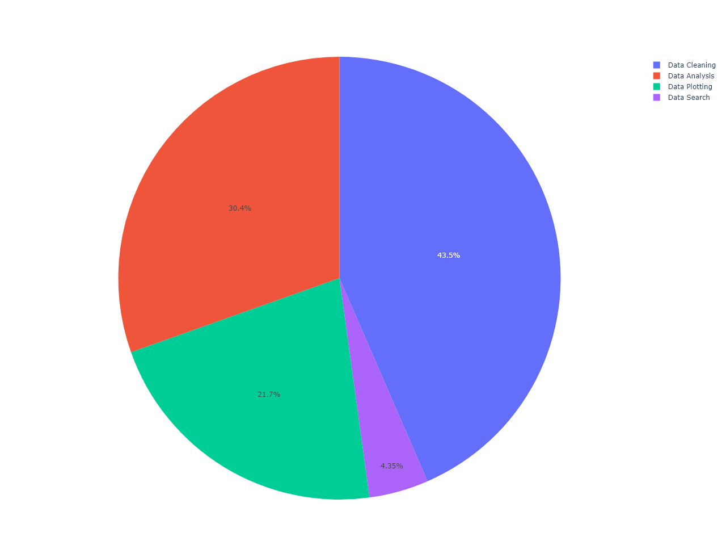
TIME EFFORT PIECHART

Slide 5

UNEMPLOYMENT TRENDS

Slide 6
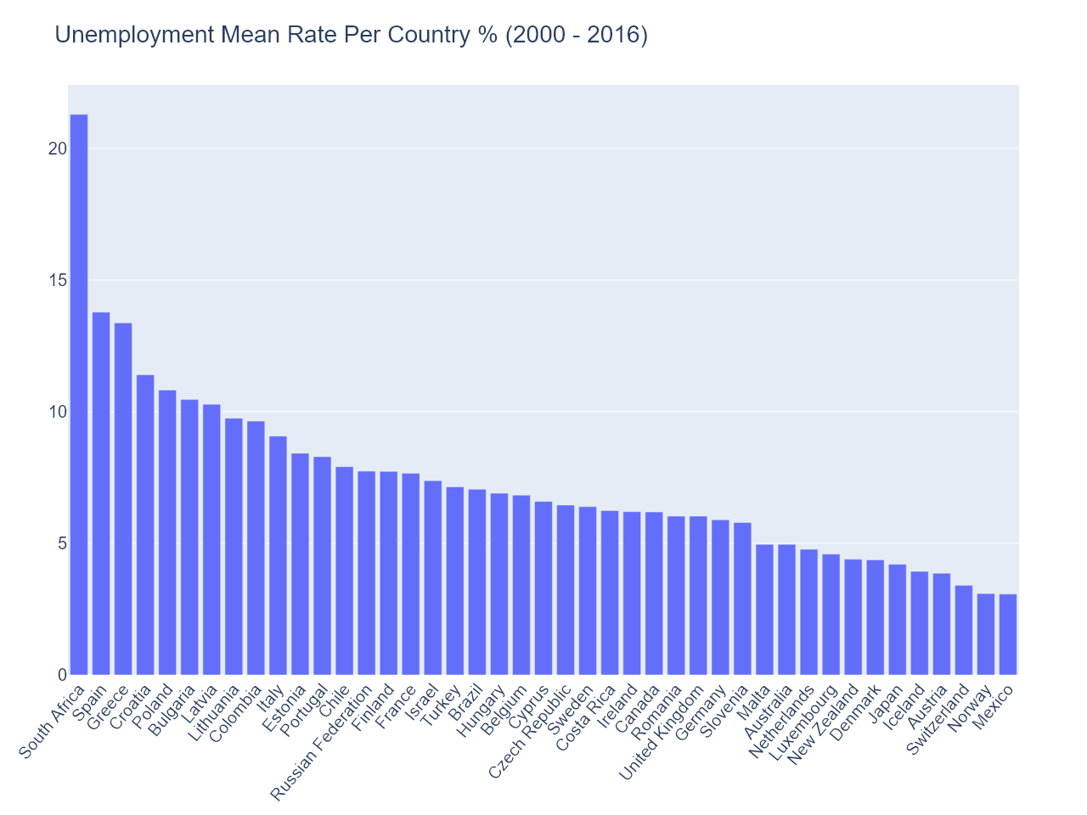

Slide 7
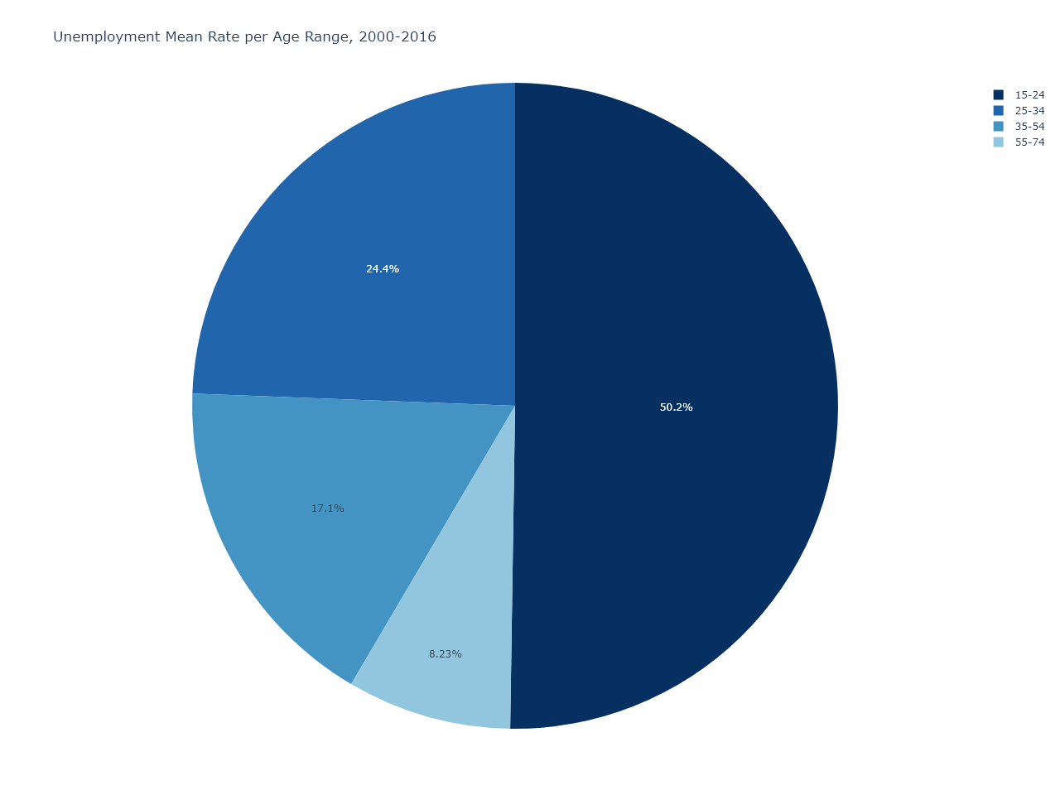

Slide 8
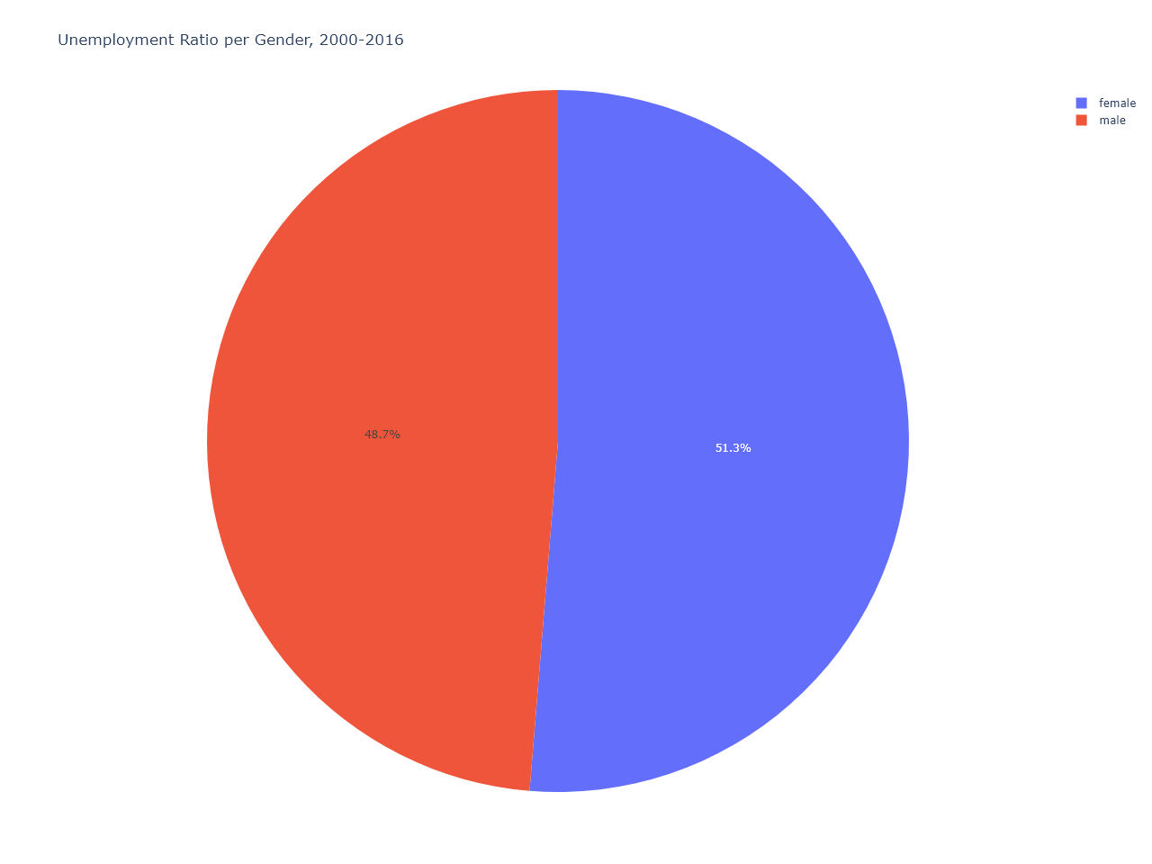
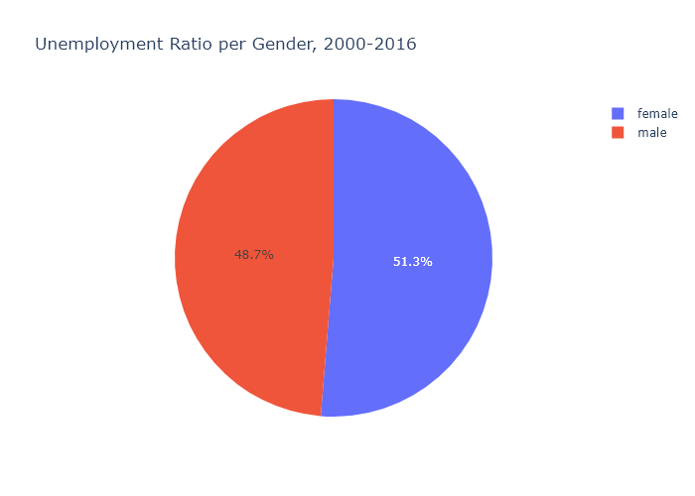

Slide 9
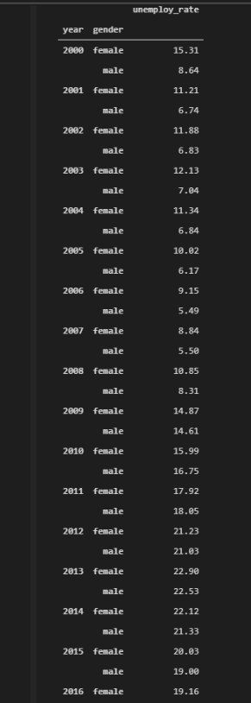
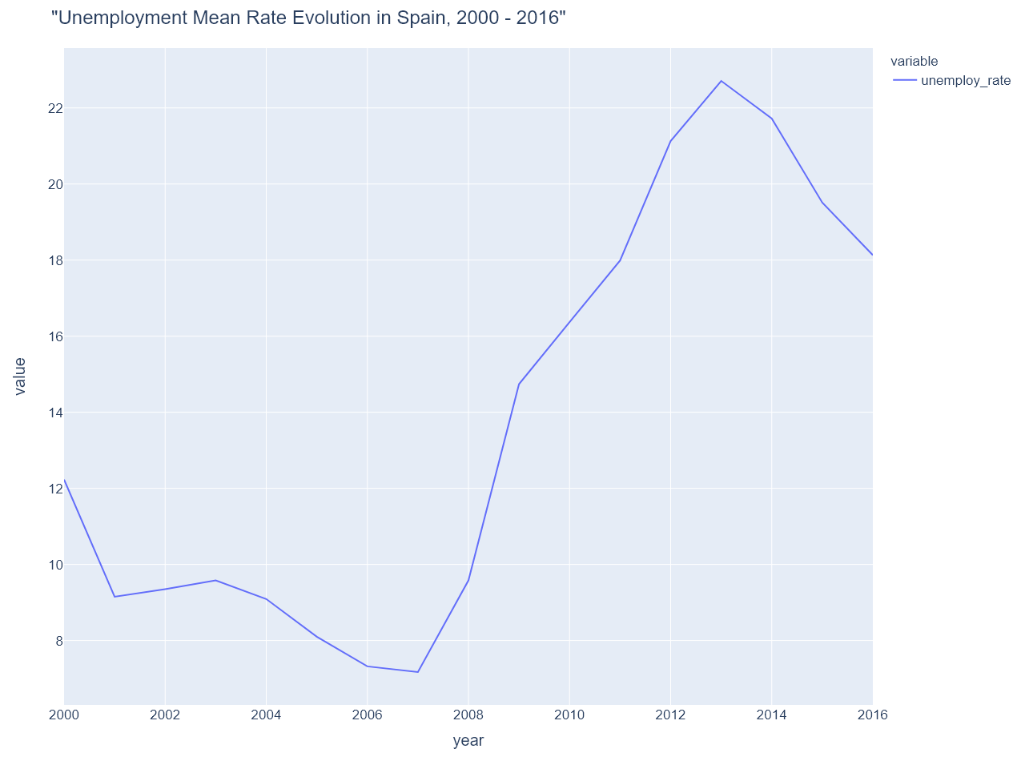

Slide 10

SUICIDE TRENDS

Slide 11
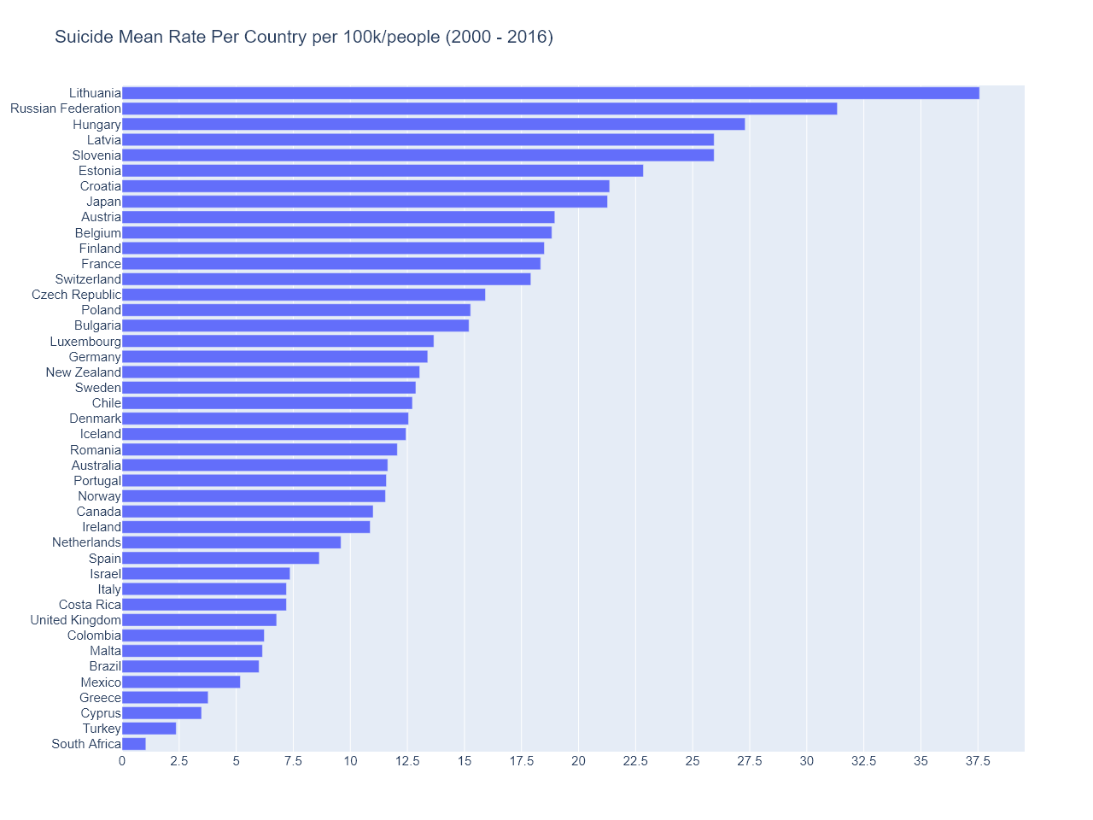

Slide 12
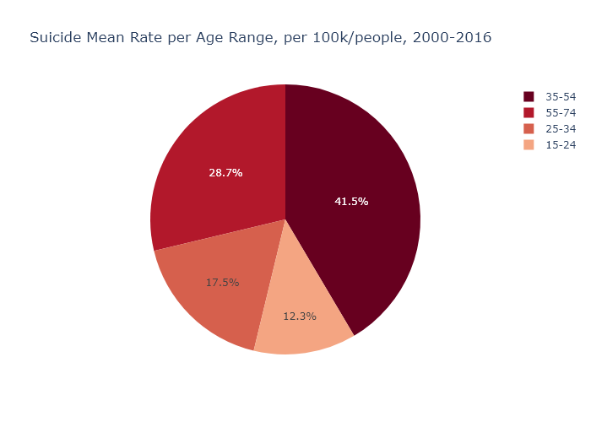

Slide 13
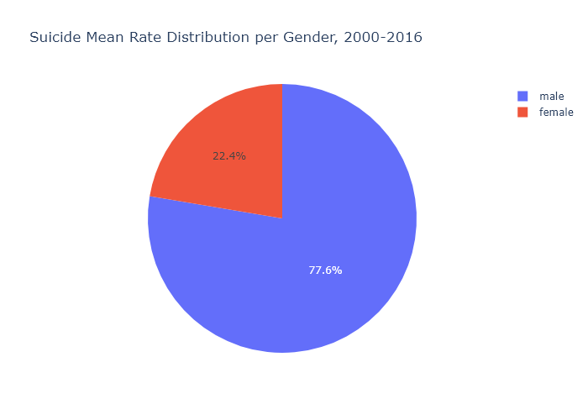
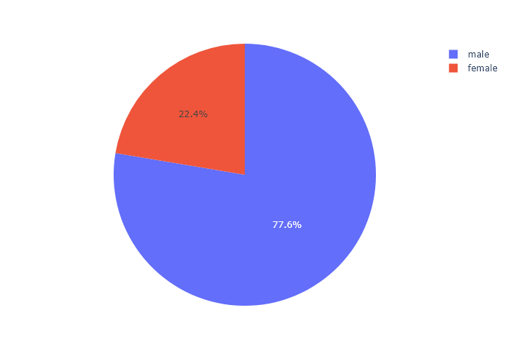

Slide 14

CONTRASTING BOTH TRENDS

Slide 15
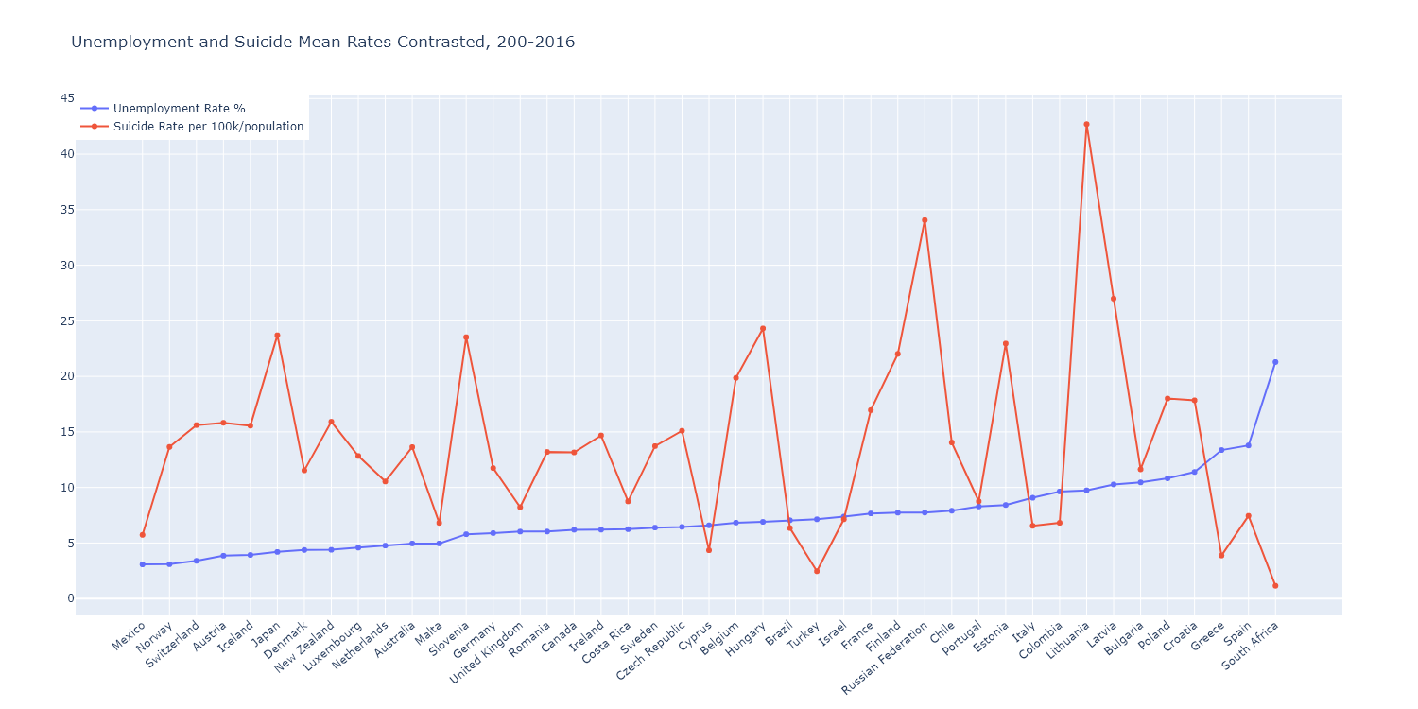

Slide 16
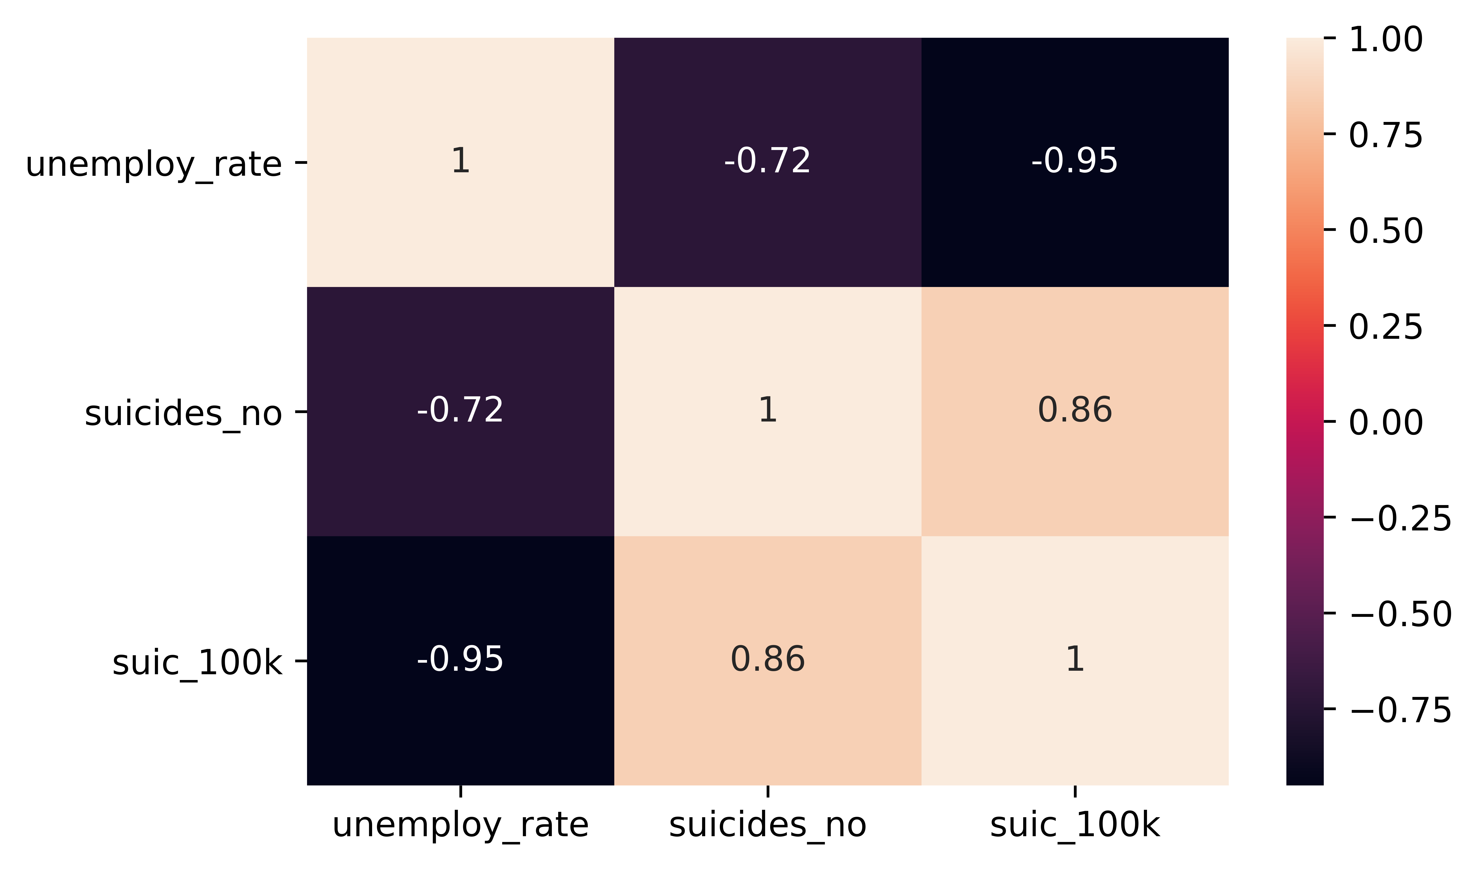

Slide 17
CONCLUSIONS
THERE IS NEGATIVE CORRELATION BETWEEN UNEMPLOYMENT AND SUICIDE
SUICIDE HITS MALE MORE OFTEN, IN A PROPORTION OF ALMOST 5 TO 1
AGE AND UNEMPLOYMENT HAVE A NEGATIVE CORRELATION
AGE AND SUICIDE HAVE A POSITIVE CORRELATION
UNEMPLOYMENT IS ALMOST EQUAL BETWEEN GENDERS

Slide 18
BIBLIOGRAPHY:
https://www.kaggle.com/szamil/who-suicide-statistics
Csv with suicides register from 2000
https://stats.oecd.org/Index.aspx?QueryId=64198#
Csv with unemployment rates:
added some countries that by defect are not included

Slide 19
SYSTEM CONFIGURATION:
PYTHON 3.9.4 64-BIT
VISUAL CODE STUDIO 1.52.1
PANDAS, NUMPY LIBRARIES (DATA TREATMENT)
PLOTLY, SEABORN LIBRARIES (GRAPHIC REPRESENTATION)

