Slide 1
HACKATHON
IN COLLABORATION WITH CYEINT

Slide 2
TEAM DETAILS
TEAM NAME: (Propose a good name for your team)
TEAM MEMBER 1:Siddhardha MAILID: CONTACT NO:
TEAM MEMBER 2: Dominic MAILID: CONTACT NO:
TEAM MEMBER 3:Varsha MAILID: CONTACT NO:
TEAM MEMBER 4:Kausthub MAILID: CONTACT NO:
COLLEGE NAME: Sreyas Institute of Engineering and technology
REGISTRATION ID:

Slide 3
INTRODUCTION
Did you know that the products that we use in out day to day life is causing harm to the nature?
From a pen to the tooth brush everything is made of plastic which we all know is an enemy to the environment
So what is the solution to this problem?
To tackle this problem we can use other sustainable products that can be used as a replacement to there harmful products.
What are sustainable products?
Sustainable products can be anything from food and clothing to furniture and appliances. They are designed to reduce energy and water use, reduce the use of hazardous materials, and reduce waste. Sustainable products can be found in all industries, from construction and manufacturing to retail and hospitality.

Slide 4
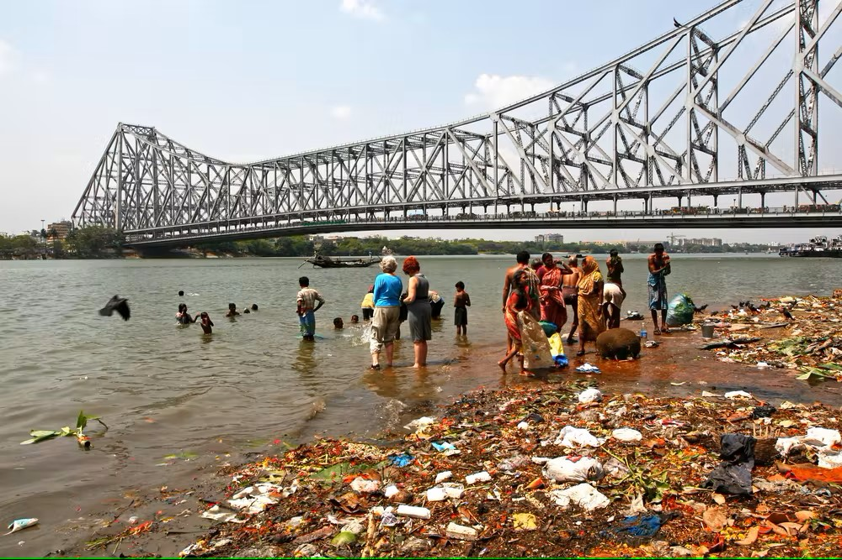
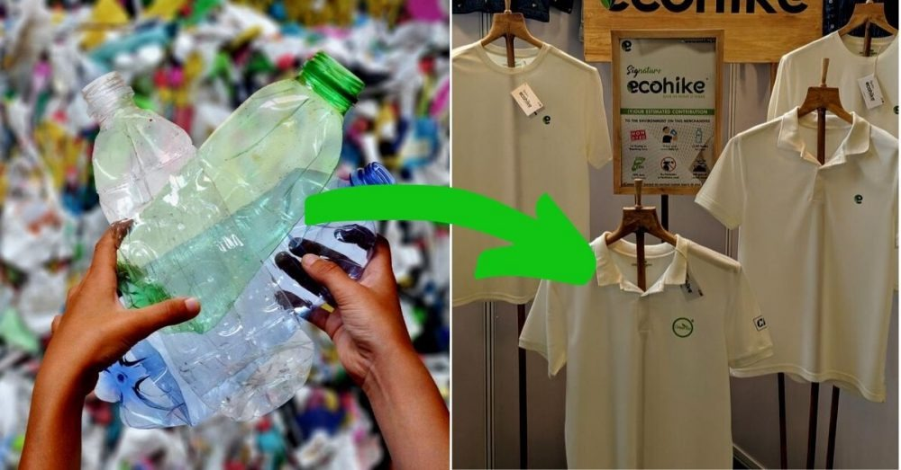
It is easy to say not to use any unsustainable products such as a plastic bag or anything of that sort but that can’t be the solution for the problem.
What we can do is to find other alternatives for the products.
The best part is that there are already many products that can be used as an alternative.
It’s just that people are not aware about them.
Through Eco-frie we are trying to make the people aware about the other alternative sustainable products that they can use.

Slide 5
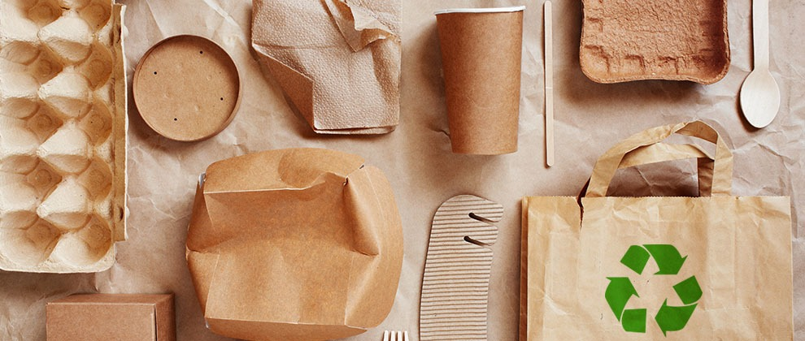
EXISTING SOLUTIONS FOR THE PROBLEM
The already existing solution is that there are many websites in the internet which consist information regarding the alternatives but there exist no such website single which can act on users query and generate the eco friendly alternatives.

Slide 6
OBJECTIVES OF THE WORK
Increase awareness and knowledge.
Identify sustainable innovations.
Raise awareness on worker treatment.
Promote sustainable market growth.
Protecting the environment.

Slide 7
PROBLEM STATEMENT
Environmental issues are a growing concern, and consumer choices play a significant role in creating a sustainable future. However, many people are unaware of the impact of their purchasing decisions on the environment. This lack of awareness leads to the continued use of products that harm the environment and contribute to global issues such as climate change. Our website aims to address this problem by showcasing a range of sustainable alternatives for various everyday items, thereby raising awareness and promoting more sustainable choices. Through our website, we hope to encourage individuals to adopt more eco-friendly and sustainable lifestyles, contributing to a better future for both people and the planet.

Slide 8
IDEAS / SOLUTION / METHODS
To tackle the given problem we decided to come-up with Eco-Frie.
Eco-frie is a website which is going to generate the eco friendly alternatives for the given query of the user.
We are making a dynamic website which can process the users query and act accordingly.
It is going to bring awareness among the users about the about the other alternatives of the products used by them in their daily life.

Slide 9
UNIQUENESS OF THE IDEA?
Comprehensive platform for alternative sustainable products.
Centralized location for eco-friendly purchasing decisions.
Personalized recommendations based on user preferences.
Focus on promoting a circular economy by showcasing products made from recycled materials or that can be recycled at the end of their life.
Instead of just providing the alternatives Eco-frie also provides the links to the users which directs them to the platforms where they can purchase the eco-friendly products and use them is they daily life.

Slide 10
NOVELTY IN IDEA / CONTRIBUTION?
It is easy to say not to use any unsustainable products such as a plastic bag or anything of that sort but that can’t be the solution for the problem.
What we can do is to find other alternatives for the products.
The best part is that there are already many products that can be used as an alternative.
It’s just that people are not aware about them.
Through Eco-frie we are trying to make the people aware about the other alternative sustainable products that they can use.

Slide 11
TECH STACK / IMPLEMENTATION DETAILS
List the tech stack of your application
Frontend
HTML CSS JS BOOTSTRAP
Backend
Django

Slide 12
EXPECTED OUTPUT / OUTCOME OF THE WORK
Through this website we are trying to bring the awareness among the users about the other alternative products that they can use instead of the unsustainable products.
Instead of just suggesting the other alternatives we are also providing the hyperlinks that direct them to the platforms where they can purchase these.
Through Eco-frie we are trying to build a society where people can continue with their regular life without harming the environment.

Slide 13
FUTURE ENHANCEMENTS
As the future scope we are trying to use image classification through which the users can just scan the products and get the other eco friendly alternatives for it.
We have also planned to send awareness to the email of the users whenever an alternative sustainable product arrives at the market.

Slide 14
CONCLUSION
In conclusion, promoting sustainable products and creating awareness about their benefits is crucial for protecting the environment, preserving natural resources, and promoting human health and well-being.
Through our sustainable product website, we aim to encourage people to make more sustainable choices and reduce the negative impact of traditional products on the environment. Our website serves as a valuable resource for anyone looking to make eco-friendly choices in their daily lives.

Slide 15
THANK YOU

