Slide 1
Introduction to Version Control Unit Testing Test Driven Development

Slide 2
What does Version Control Do
Provides an un-do button.
Allows multiple developers to work on the same code.
Keeps a record of changes
Provides support for multiple releases

Slide 3
How does it Work
There are different systems.
Some keep a master copy on a central server
E.G. Subversion and CVS
Others do not have a central server, but the repository is distributed.
E.G. Mercurial, Bzaar, GIT

Slide 4
Subversion
A master copy is kept on a central server and in a hidden sub-directories (.svn).
A record of changes is also maintained.
Each change creates a new version of a file/directory.
Individual developers work with a local copy and then “commit” changes.

Slide 5
GIT
The repository lives in the working directory in a (hidden) subdirectory named .git
Unlike subversion, there is only one hidden directory at the root of the working directory.
GIT was developed by Linus Torvalds to maintain the Linux source code repository
Command-line tools for windows use unix-like shell.
Netbeans integration.

Slide 6
Working with Netbeans
Netbeans has integrated support for git.
The following shows how to use Netbeans and git for a simple project.

Slide 7
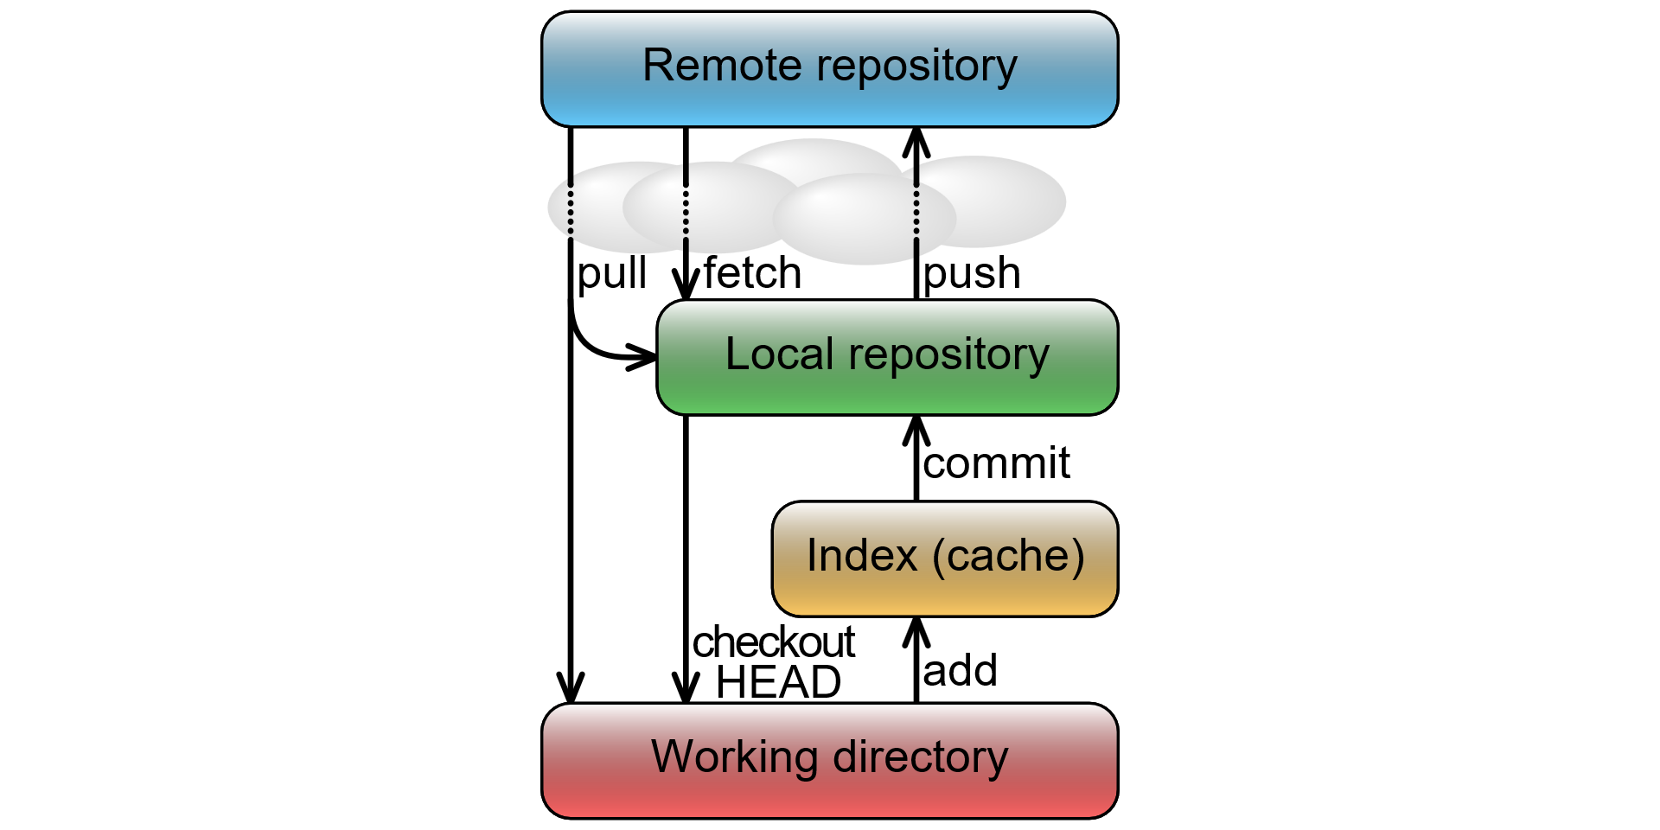
Git Data Flow
Source: https://www.youtube.com/playlist?list=PL1F56EA413018EEE1

Slide 8
Version Control
Introduction to Version Control Unit Testing Test Driven Development
Git and GitHub Version Control Tutorial on Youtube (view the video as homework)
https://www.youtube.com/watch?v=mYjZtU1-u9Y&list=PLcaPT6_oTzIclQQjRLU6t3sm5vvWIlrG2

Slide 9
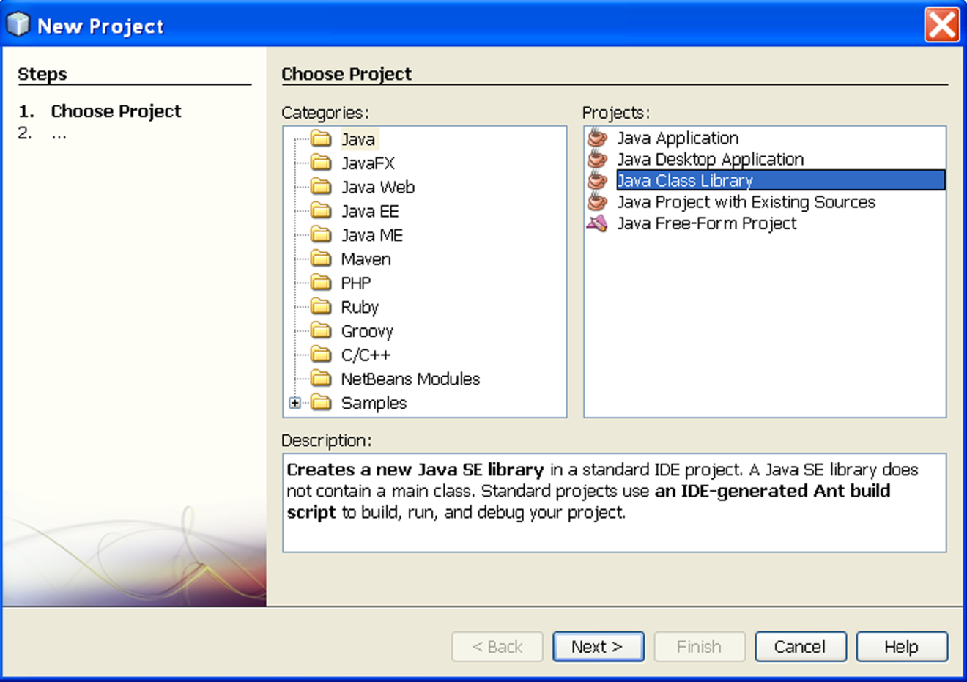
Create a New Project

Slide 10
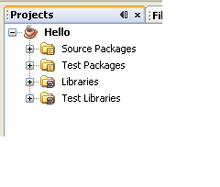
Project Window

Slide 11
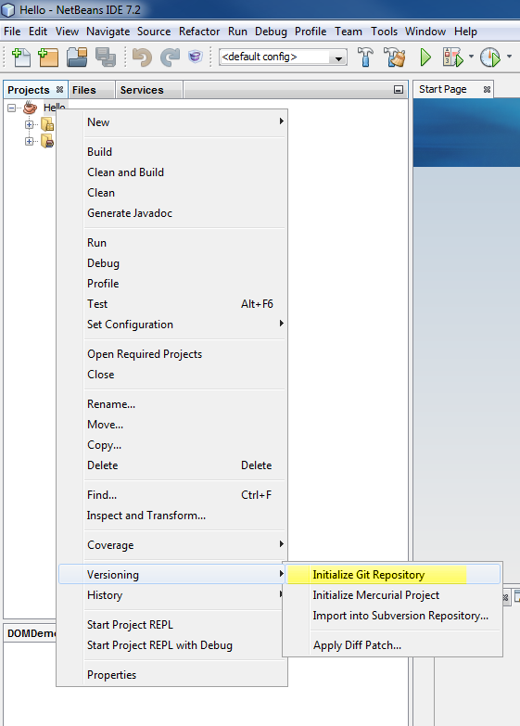
Select Versioning → Initialize Git Repository

Slide 12
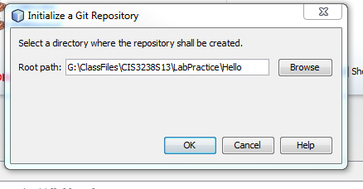
Click on OK

Slide 13
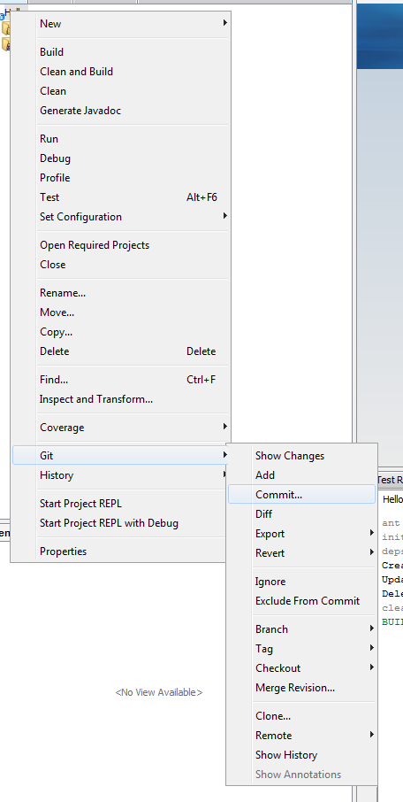
Select Git → Commit

Slide 14
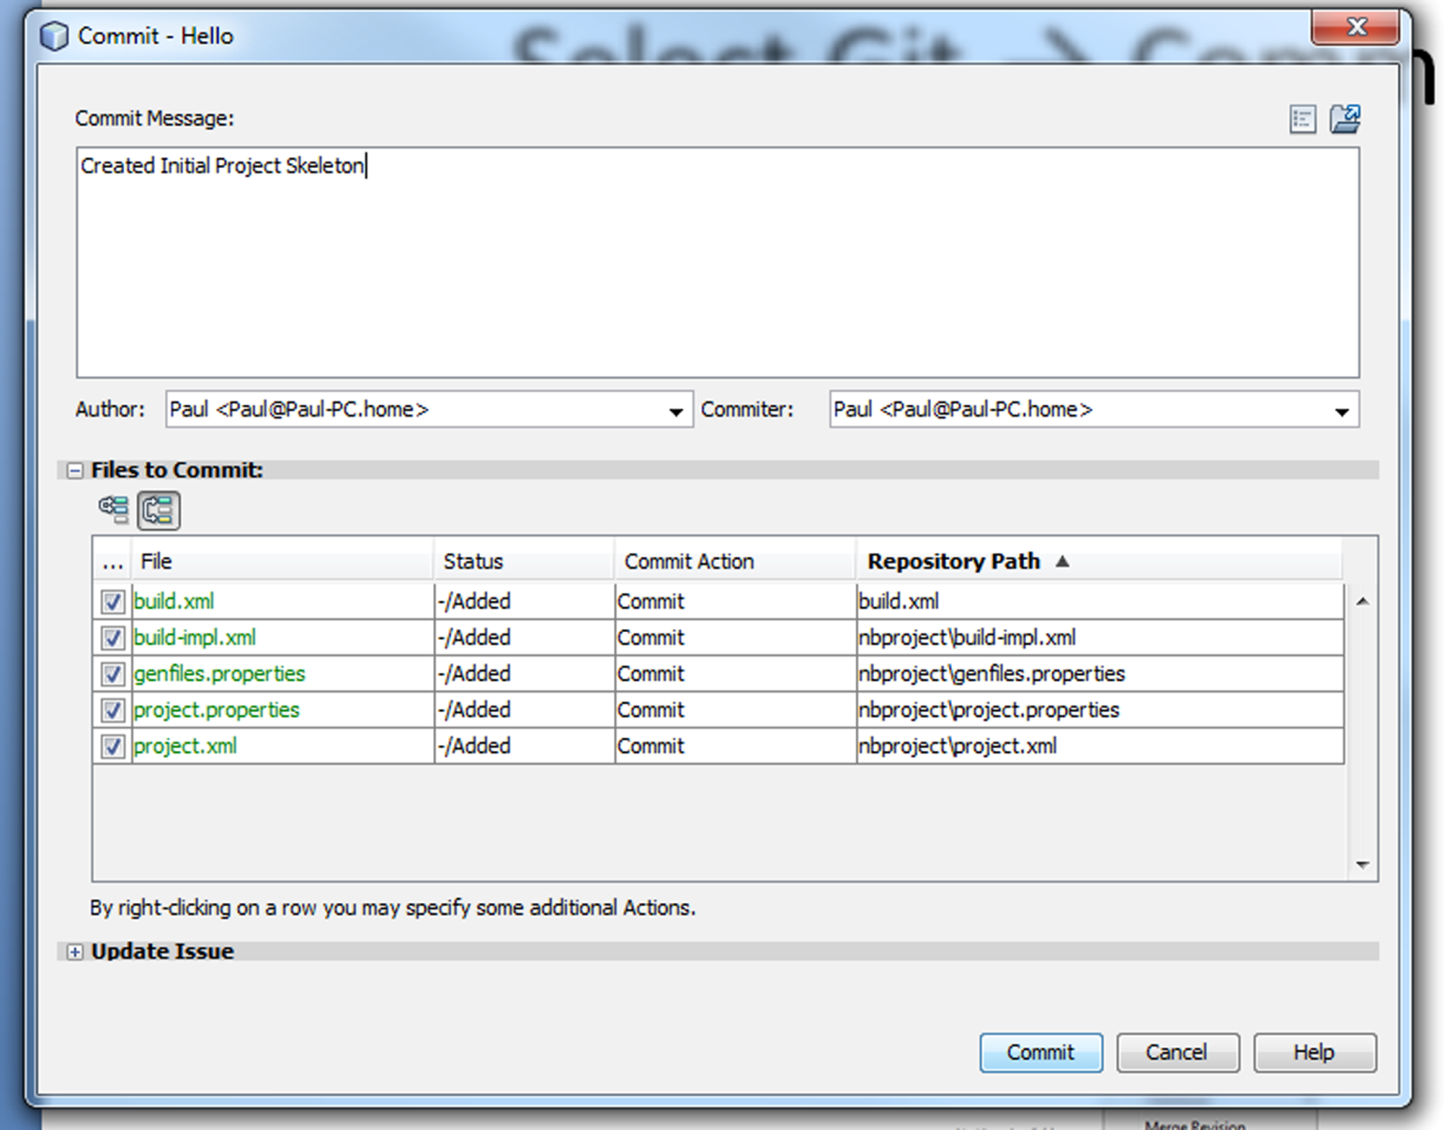
Enter Commit Message and Select Commit

Slide 15
Create New Package
In the project window, right-click on SoucePackages
Select new → Java Package
Enter the package name edu.temple.cis.c3238.hello

Slide 16
Create New Class
In the project window
Expand Source Packages
Right-Click on the edu.temple.cis.c3238.hello package
Select new → class
Name the class Hello

Slide 17
Add The Method Skeleton
Enter the following:
/**
* Method to return a greeting.
* @return The String "Hello"
*/
public String speak() {
//TODO: Add code to compute result
return null;
}

Slide 18
Create Unit Test
Under Tools Select
Create JUnit Tests
On the menu click SELECT
On the menu click OK

Slide 19
Nominal Test Case Is Generated
@Test
public void testSpeak() {
System.out.println("speak");
Hello instance = new Hello();
String expResult = "";
String result = instance.speak();
assertEquals(expResult, result);
// TODO review the generated test code and remove the default call to fail.
fail("The test case is a prototype.");
}

Slide 20
Make Into Real Test
@Test
public void testSpeak() {
System.out.println("speak");
Hello instance = new Hello();
String expResult = "Hello";
String result = instance.speak();
assertEquals(expResult, result);
// TODO review the generated test code and remove the default call to fail.
fail("The test case is a prototype.");
}

Slide 21
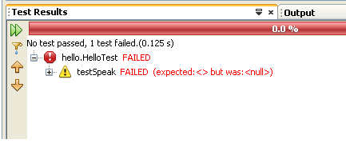
Run the Test
Select Run → Test Project
The test will fail

Slide 22
Fix the Code
/**
* Method to return a greeting.
* @return The String "Hello"
*/
public String speak() {
//TODO: Add code to compute result
return null "Hello";
}

Slide 23
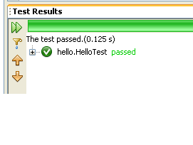
Run The Test
Test Passes

Slide 24
Commit

Slide 25
Test Driven Development
Create a shell for the method:
Create the javadoc comments documenting the
Purpose
Parameters (pre-conditions)
Result (post-conditions)
Write an empty method. (Return 0 or null as required.
Design one or more test methods to verify post-conditions. (test fails)
Write the code for the method. (test passes)

Slide 26
First Example
Write a method to find the largest value (int) in an array.

Slide 27
Function Prototype
/**
* Method to find the largest int value in an array
* of int.
* @param list An array of integers.
* @return The largest integer in the given list.
* @throws Null pointer exception if list is null.
* @throws ArrayIndexOutOfBoundsException if list
* is of zero length.
*/
public static int largest(int[] list) {
return 0;
}

Slide 28
Test Cases to Consider
Single value
The target is
first
middle
last
Multiple largest values
Values are all negative
Empty list
Null list

Slide 29
JUnit
JUnit is a test framework.
It provides methods to
Run unit tests.
Report the result of unit tests.

Slide 30
To Use JUnit
You need the appropriate jar file
junit-4.5.jar
Import the following:
import org.junit.Test;
import static org.junit.Assert.*;
Precede each test method with the annotation
@Test
Use the assert methods to report pass/fail
Note: JUnit is integrated with NetBeans and other IDEs.

Slide 31
Test Single
/**
* Test of Util.largest.
* This test to see if the method works with a single
* item in the array.
*/
@Test
public void single() {
System.out.println("single");
assertEquals(9, Util.largest(new int[] {9}));
}

Slide 32
Pass the Test
public static int largest(int[] list) {
return 9;
}

Slide 33
Refactor to Remove Duplication
public static int largest(int[] list) {
int largest = list[0];
return largest;
}

Slide 34
Test first
/**
* Test of Util.largest.
* This test to see that the largest value can be
* located in the first element.
*/
@Test
public void firstItemIsLargest() {
System.out.println("first");
assertEquals(9, Util.largest(new int[]{9, 8, 7}));
}

Slide 35
Test Last
/**
* Test of Util.largest.
* This test to see that the largest value can be
* located in the first element.
*/
@Test
public void lastItemIsLargest() {
System.out.println("last");
assertEquals(9, Util.largest(new int[]{7, 8, 9}));
}

Slide 36
Pass the Test
public static int largest(int[] list) {
int largest = list[0];
for (int i = 1; i < list.length; i++) {
if (largest < list[i]) {
largest = list[i];
}
}
return largest;
}

Slide 37
Test Order
/**
* Test of Util.largest.
* This test to see that the largest value can be
* located in the first, middle, or last element.
*/
@Test
public void order() {
System.out.println("order");
assertEquals(9, Util.largest(new int[]{7, 8, 9}));
assertEquals(9, Util.largest(new int[]{7, 9, 8}));
assertEquals(9, Util.largest(new int[]{8, 7, 9}));
assertEquals(9, Util.largest(new int[]{8, 9, 7}));
assertEquals(9, Util.largest(new int[]{9, 7, 8}));
assertEquals(9, Util.largest(new int[]{9, 8, 7}));
}

Slide 38
Test Duplicate
/**
* Test of Util.largest.
* This test to see if duplicate largest elements
* work.
*/
@Test
public void dup() {
System.out.println("dup");
assertEquals(9, Util.largest(new int[]{7, 8, 9, 9}));
}

Slide 39
Test for Empty Array
/**
* Test of Util.largest
* This test to see if an empty array throws the
* expected exception.
*/
@Test(expected=ArrayIndexOutOfBoundsException.class)
public void empty() {
System.out.println("empty");
int x = Util.largest(new int[0]);
fail("Exception should have been thrown");
}

Slide 40
Test for null
/**
* Test of Util.largest
* This test to see if a null array throws the
* expected exception.
*/
@Test(expected=NullPointerException.class)
public void testNull() {
System.out.println("testNull");
int x = Util.largest(null);
fail("Exception should have been thrown");
}

Slide 41
What About Negative Values
/**
* Test of Util.largest
* This test to see if the correct value is returned
* if all items are negative.
*/
@Test
public void testNegative() {
System.out.println("testNegative");
assertEquals(-7, Util.largest(new int[]{-7, -8, -9}));
}

Slide 42
Assert for Equality
assertEquals([message,]expected,actual)
Tests to see if expected and actual are equal. This method is overloaded for the primitive types and Object. To test Objects the .equals method is used.
assertArrayEquals([message,]expected,actual)
Tests to see if the contents of the two array parameters expected and actual are equal. This method is overloaded for arrays of the primitive types and Object. Arrays of Objects are tested with the .equals method applied to the corresponding elements. If an unequal pair is found, an AssertionError is thrown.

Slide 43
Assert for Truth
assertTrue([message,]condition)
Test to see if the boolean expression condition is true.
assertFalse([message,]condition)
Test to see if the boolean expression condition is false.

Slide 44
Assert for Same
assertSame([message,]expected,actual)
Test to see if expected and actual are the same object. (Applies the == operator).
assertNotSame([message,]expected,actual)
Test to see if expected and actual are not the same object. (Applies the != operator).

Slide 45
Assert for Null
assertNull([message,]object)
Test to see if the Object object is null.
assertNotNull([message,]object)
Test to see if the Object object is not null.

Slide 46
Indicate Failure
fail([message])
Always throws AssertionError

Slide 47
The [message,]
Each of the assert methods takes an optional message parameter.
If the assertion fails, the message is passed to the AssertionError object.
If the message is omitted, a message that describes the discrepancy is generated.

Slide 48
Limitations on Testing
Testing can only show the presence of a defect (“bug”).
No amount of testing can show their complete absence.
A solution to this dilemma is logic.
References:
Jon Bently. “Programming Pearls – Writing Correct Programs” Communications of the ACM, Vol 26, No. 12 (Dec. 1983) pp 1040-1045.
C. A. R. Hoare. “An Axiomatic Basis for Computer Programming” Communications of the ACM, Vol 12, No. 10 (Oct. 1969) pp 576-583

