Slide 1
Configuration Management

Slide 2
Configuration Management
Version
Management
(1)
System
Building
(2)
Configuration
Management
Change
Management
(3)
Release
Management
(not cover)
Configuration management (CM) is concerned with the policies, processes and tools for managing changing software systems and the related documentation

Slide 3
Version Management

Slide 4
Version Management
Version management (VM) is the process of keeping track of different versions of software components or configuration items (CIs) and the systems in which these components are used.
It also involves ensuring that changes made by different developers to these versions do not interfere with each other.
Therefore version management can be thought of as the process of managing codelines and baselines.
CI Version Codeline Change Baseline

Slide 5
Baselines in CM
Baseline A (developmental)
Baseline B (functional, first prototype)
Baseline C (functional, beta test)
Official Release
How do we manage changes in the baselines?
Time

Slide 6
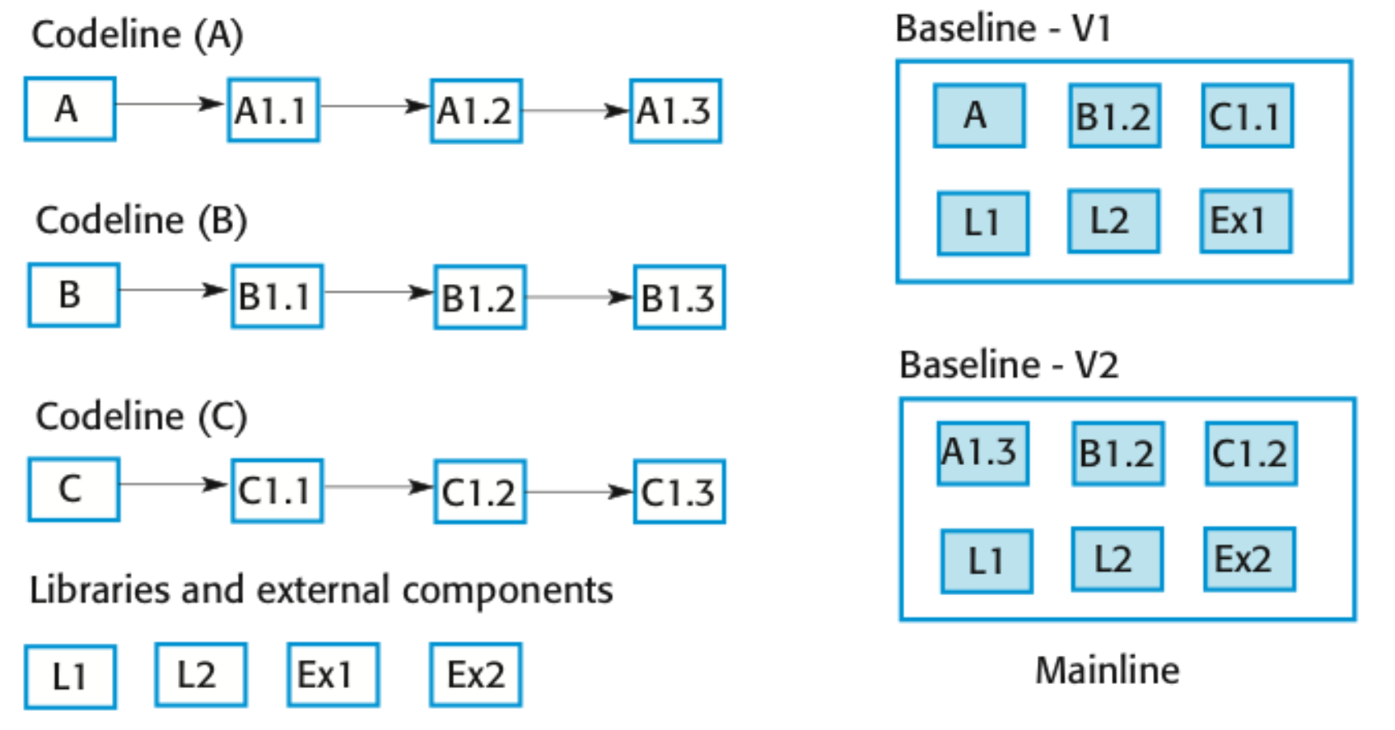
Codelines and Baselines
Should be A.something
CI
Change
Version

Slide 7
Codelines and Baselines
A codeline is a sequence of versions of source code with later versions in the sequence derived from earlier versions.
Codelines normally apply to components of systems so that there are different versions of each component.
A baseline is a definition of a specific system.
The baseline therefore specifies the component versions that are included in the system plus a specification of the libraries used, configuration files, etc.

Slide 8
Terminology: Version vs. Revision vs. Release
Version:
  An initial release or re-release of a configuration item associated with a complete compilation or recompilation of the item. Different versions have different functionality.
Revision:
  Change to a version that corrects only errors in the design/code, but does not affect the documented functionality.
Release:
  The formal distribution of an approved version.
7.5.5
Release
(Customer)
Version
(Developer)
Revision
(Developer)

Slide 9
Version Management Systems
Version and release identification
Storage Management
Change history recording
Independent development by different developers
SVN Git

Slide 10
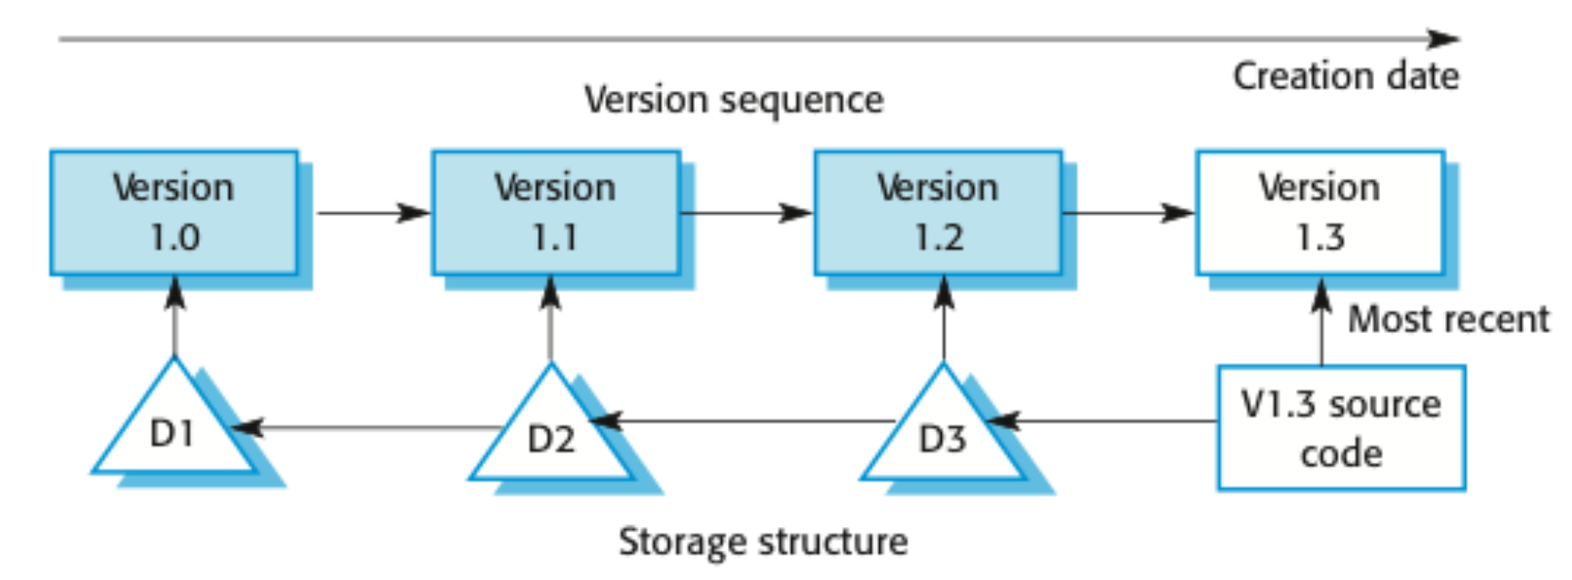
Storage management

Slide 11
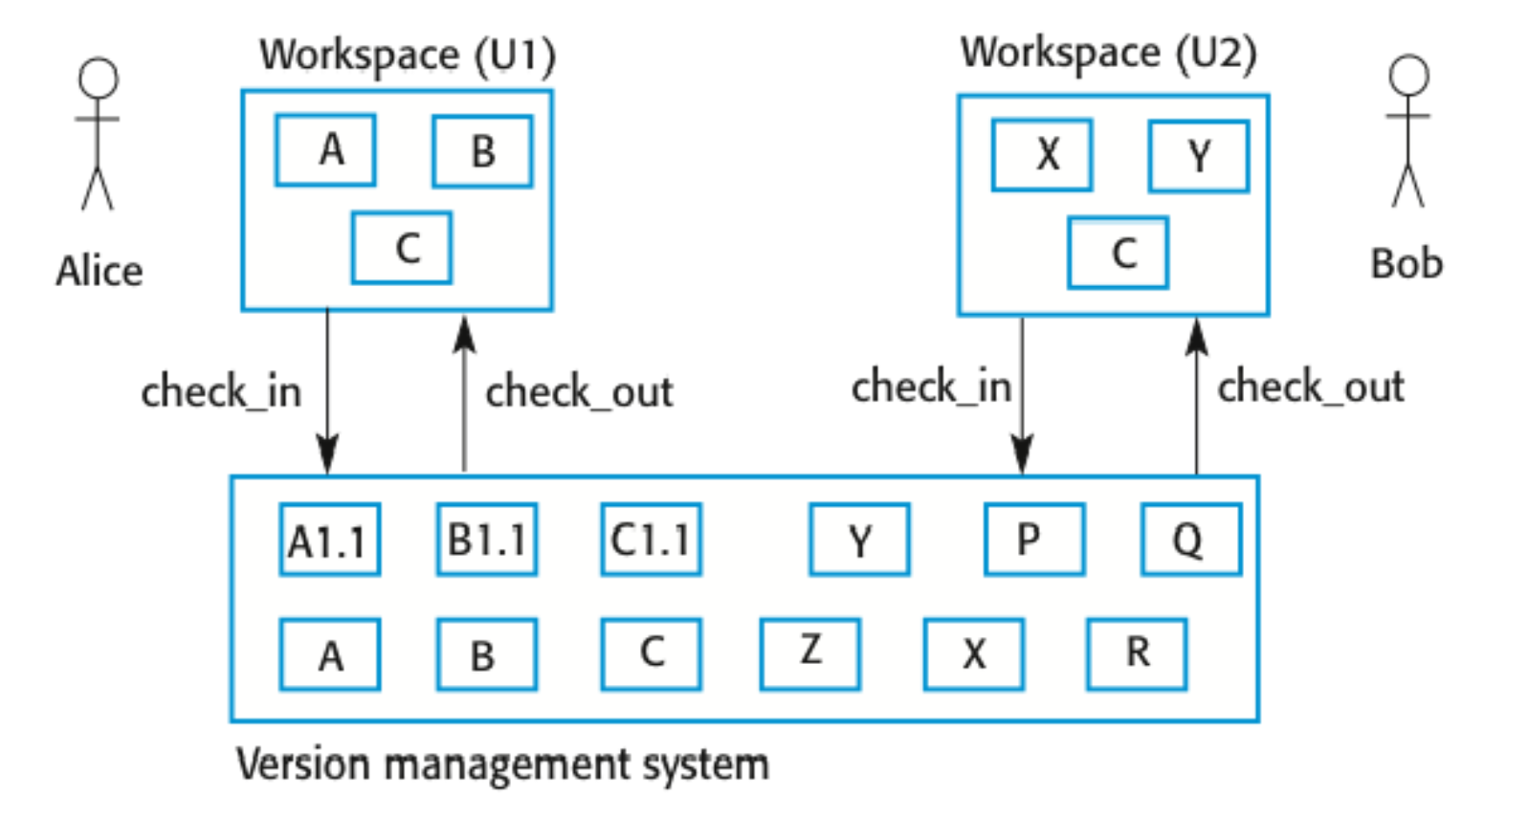
Check-in and check-out from a version repository
Independent development by diff devs
Storage Management
https://rogerdudler.github.io/git-guide/files/git_cheat_sheet.pdf

Slide 12
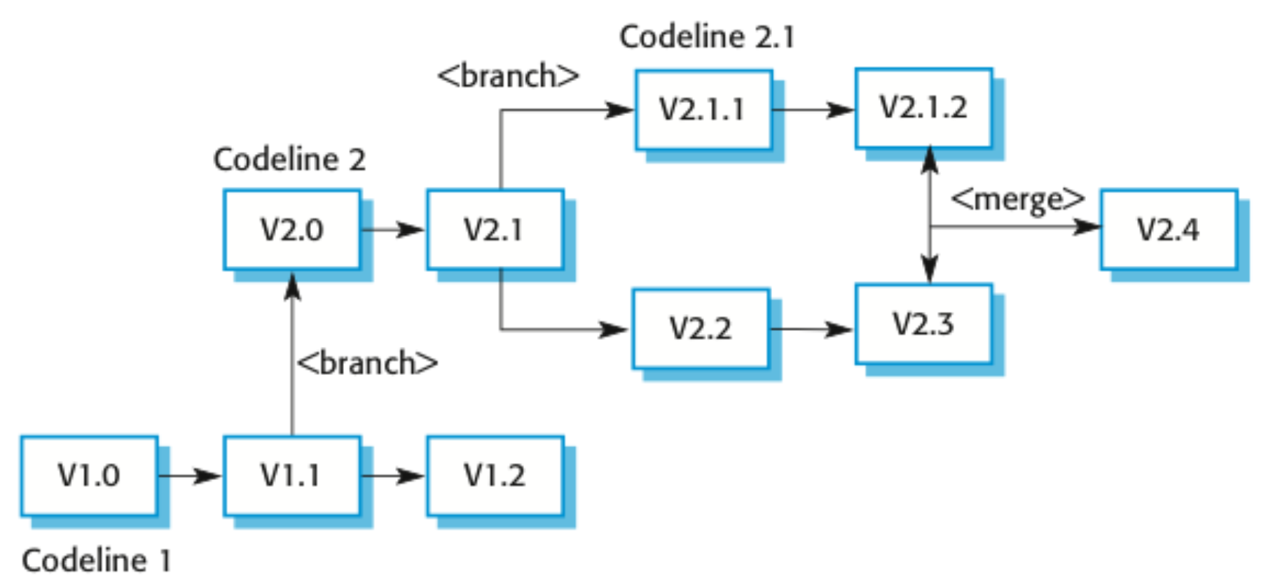
Branching and Merging

Slide 13
System Building

Slide 14
System Building
System building is the process of creating a complete, executable system by compiling and linking the system components, external libraries, configuration files, etc.
System building tools and version management tools must communicate as the build process involves checking out component versions from the repository managed by the version management system.
The configuration description used to identify a baseline is also used by the system building tool.

Slide 15
Build Platforms
The development system, which includes development tools such as compilers, source code editors, etc.
  Developers check out code from the version management system into a private workspace before making changes to the system.
The build server, which is used to build definitive, executable versions of the system.
  Developers check-in code to the version management system before it is built. The system build may rely on external libraries that are not included in the version management system.
The target environment, which is the platform on which the system executes.

Slide 16
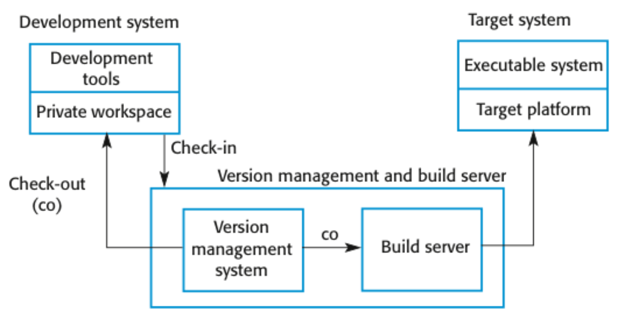
Development, build, and target platforms

Slide 17
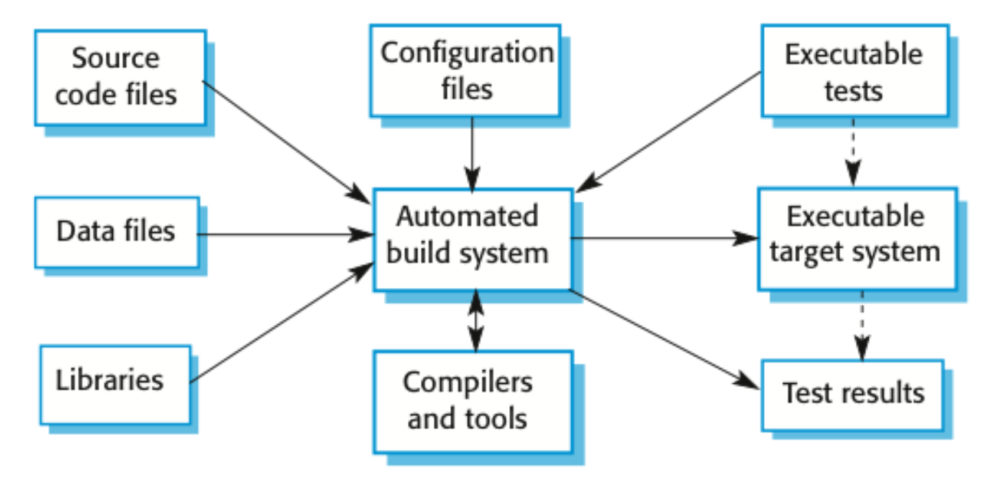
System Building

Slide 18
Change Management

Slide 19
Change Management
Organizational needs and requirements change during the lifetime of a system, bugs have to be repaired and systems have to adapt to changes in their environment.
Change management is intended to ensure that system evolution is a managed process and that priority is given to the most urgent and cost-effective changes.
The change management process is concerned with analyzing the costs and benefits of proposed changes, approving those changes that are worthwhile and tracking which components in the system have been changed.

Slide 20


Mind set of Change Management
Changes
Definition Phase
Implementation Phase
Integration/Verification
Changes
possible but more
costly in dollars &
schedule impact
Changes are
extremely costly
& often cause
late delivery
Changes
are controlled
but allowable

Slide 21
Change Management Process Model
Current Baseline
New Current Baseline
Need for
Change
Change
Identification
Approved
Change
Evaluation &
Coordination
Documented
Change
Request
Implementation
& Verification
Adapted from EIA 649

Slide 22
Change Decisions Require a Baseline
Change management begins with a stable point in system development
A baseline is a well-defined, well- documented reference point for change management
Changed system products must be placed under CM
Next baseline incorporates the changed products

Slide 23
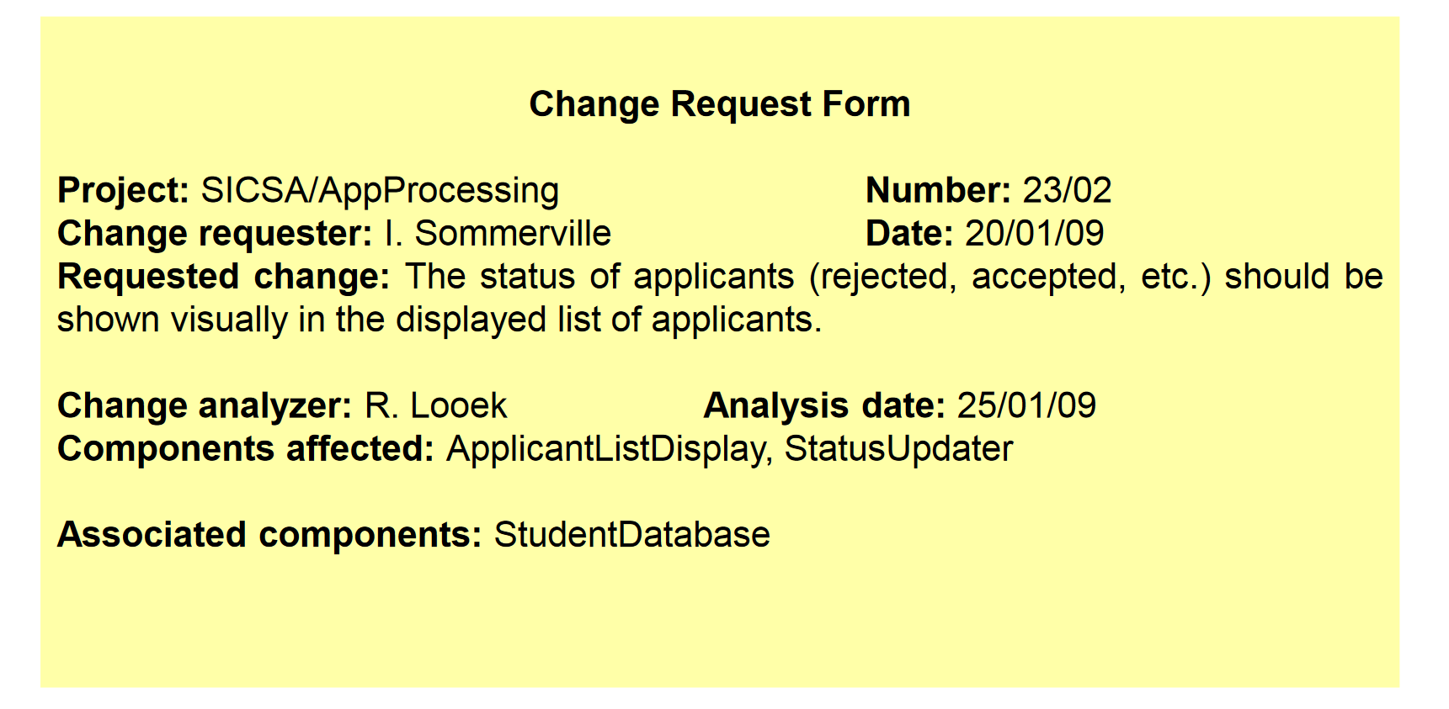
A partially completed change request form (a)

Slide 24
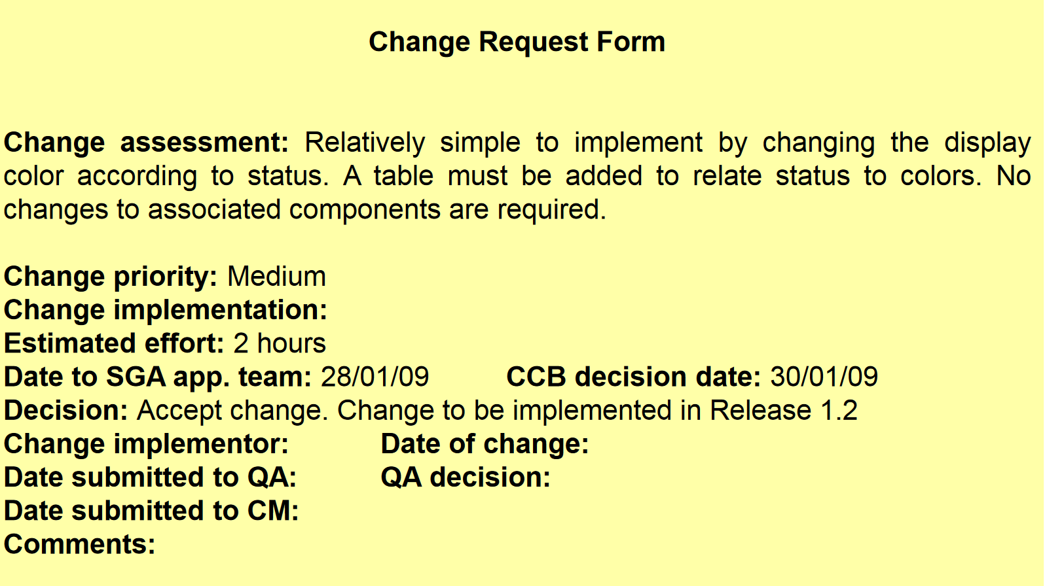
A partially completed change request form (b)

Slide 25
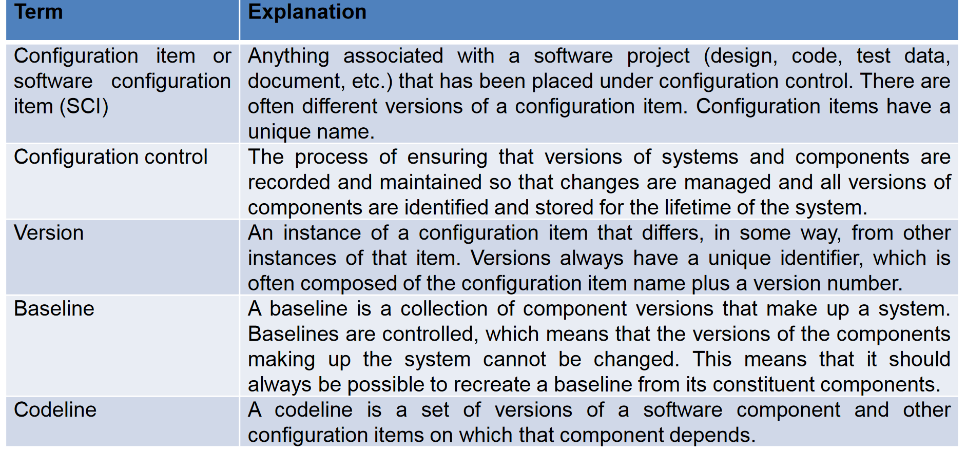
CM Terminologies

Slide 26
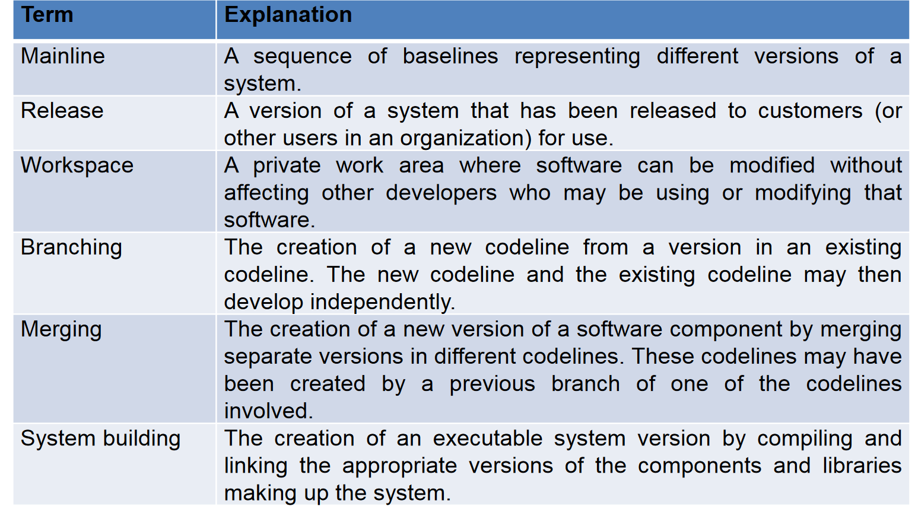
CM Terminologies

