Slide 1
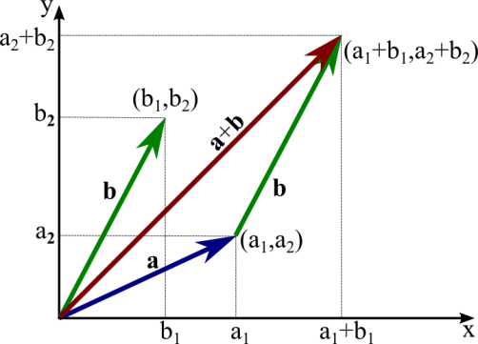
Vectors
Press escape to return
A feature I am very proud of in this game, is the use of vectors. Using vectors I am able to determine a constant velocity and an altering direction for each object type, and arrow shot from the player or a zombie. I was able to use vectors in this game thanks to the floating point unit (‘fpu’) which gives access to floating point operations.
As for the arrows, I used the trigonometric function tangent to get the angle the arrow was shot from in relation to the positive x axis. I then used the sine and cosine functions and a variable for the velocity to determine the X and Y components of the velocity for the arrow.
As for the zombies, I used the same process described with the arrows, only this time I updated each zombie so that his goal was to reach the player at any given time.
This technique taught me many things as I was trying to implement it, such as the reason for the difference between a float type number and a double type number in higher level programming languages.

