Slide 1
Full Stack Developer
day by day
Zhaokunpeng
Since 2 weeks ago

Slide 2


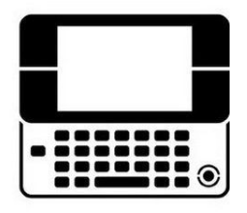
Data
Img/video/music/Text
Event
Operation
http://iami.xyz
Internet
http://iami.xyz
User
http://iami.xyz

Slide 3
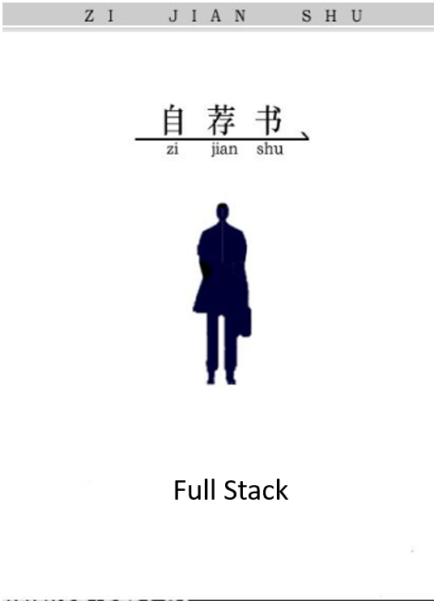
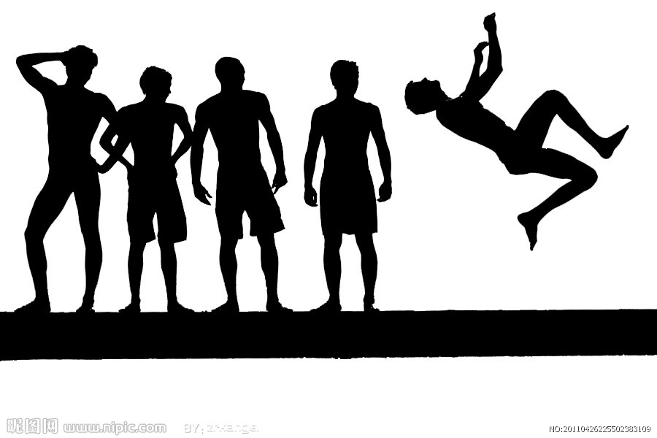
Defination: Full Stack
WEB
UI
SERVER
Brower

Slide 4
Javascript
NodeJS
asynchronous event driven JavaScript runtime
JQuery
$(“cssslector”).event(“change”)
Express
Socket.IO
Other

Slide 5
HTTP
Get
Post
Del
Put
…
..
.
Next()
Passport
URL2
Next()
URL1
URL…
URL3
userOperation
ROUTER
app.get(/a/, function(req, res) { res.send('/a/'); });
router.get('/', function(req, res) { res.send('Birds home page'); });
Chain Syntax:
People.kick.target(“ball”);

Slide 6
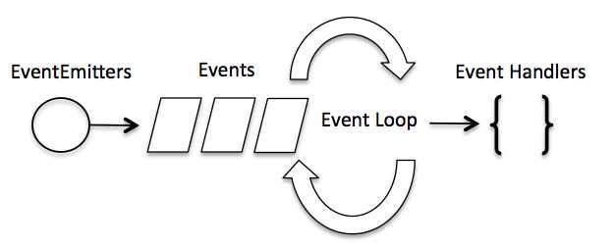
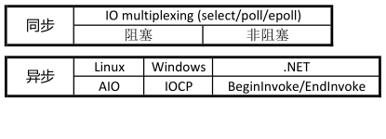

Slide 7
HTML5
<img>
<video>
<input type=“email/password/file/phone”>
<button>
margin
color
height
width
position
text-align
background
font
Bootstrap
文件引用先后覆盖
样式定义先后覆盖
CSS3
modal({keyboard: false, backdrop: 'static'})
btn btn-danger btn-success btn-info
dropdown-menu

Slide 8
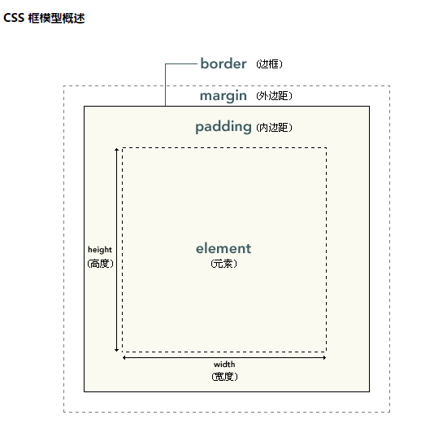
HTML --- StyleSheets
DOM TREE
Style&Rules
RENDER/FRAME TREE
Painting --> Display(ASAP)

Slide 9
Thank U
20160726

