Slide 1

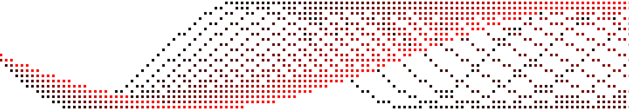
Visual checksums for document validation
Based on an analysis of passport security
Daniel Harvey

Slide 2
What is a visual checksum
A checksum is a value which is printed onto a document or other object, used to verify integrity of data which is associated with it.
The difference between a traditional (number, letter) checksum and a visual checksum being that a visual checksum is a part of the background/geometry of the document, to blend in more.
It is usually harder to fake this kind of checksum, because it is harder to understand the structure of data involved (x, y, rotation, colours), and has more "turbulance" involved (stains, dirt) to consider than simply a byte value.

Slide 3
Why is this used?
Checksums ensure the data given is an exact replica, and has not been changed in any way. To achieve this, hashing algorithms are great due to the avalanche effect; which makes the output uniquely disproportionate to the input.
In other words very minute changes to the input will affect the output drastically:
The ability to detect intentional forgeries becomes trivial, because the checksum values become so distinct when the data is modified. This same concept is used to check login details on online services; the login details are put through a hashing algorithm and checked against the existing hash digest to verify the information is correct.
Another use for hashes is to have a known checksum for an unknown piece of data. Hashes cannot be reversed back into their original data, so we can use them to keep a record of what a piece of data should be without the data itself, this concept allows servers to hold login credentials without storing them in any way.

Slide 4
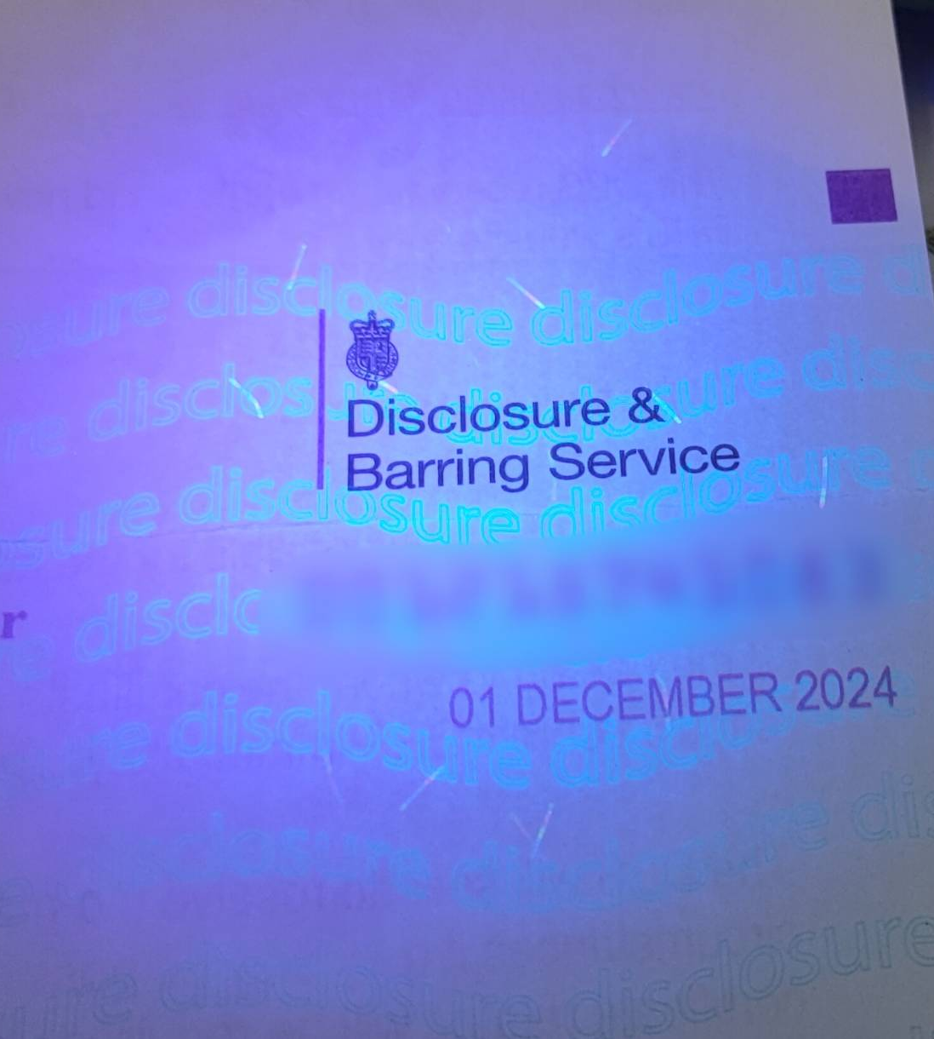
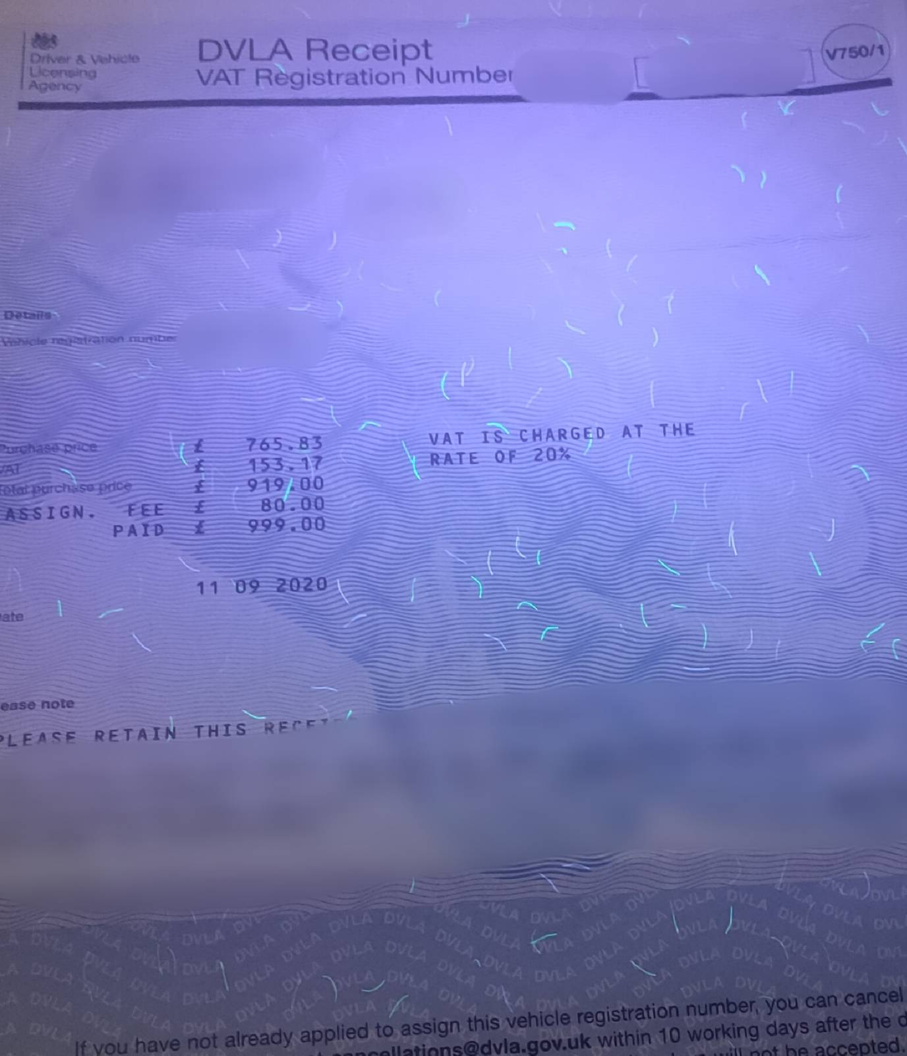

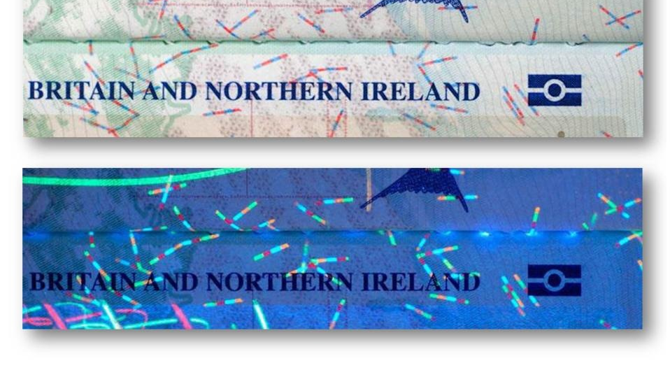
Overview
To my knowledge, the UK passport has a form of visual checksum, which is pictured here.
These lines could be used to identify whether a passport belongs to a specific person, and can identify if the information of the passport is valid.
This must be done such that a counterfeiter cannot recreate these markings correctly.
I have some ideas as to how this can be done cryptographically.

Slide 5
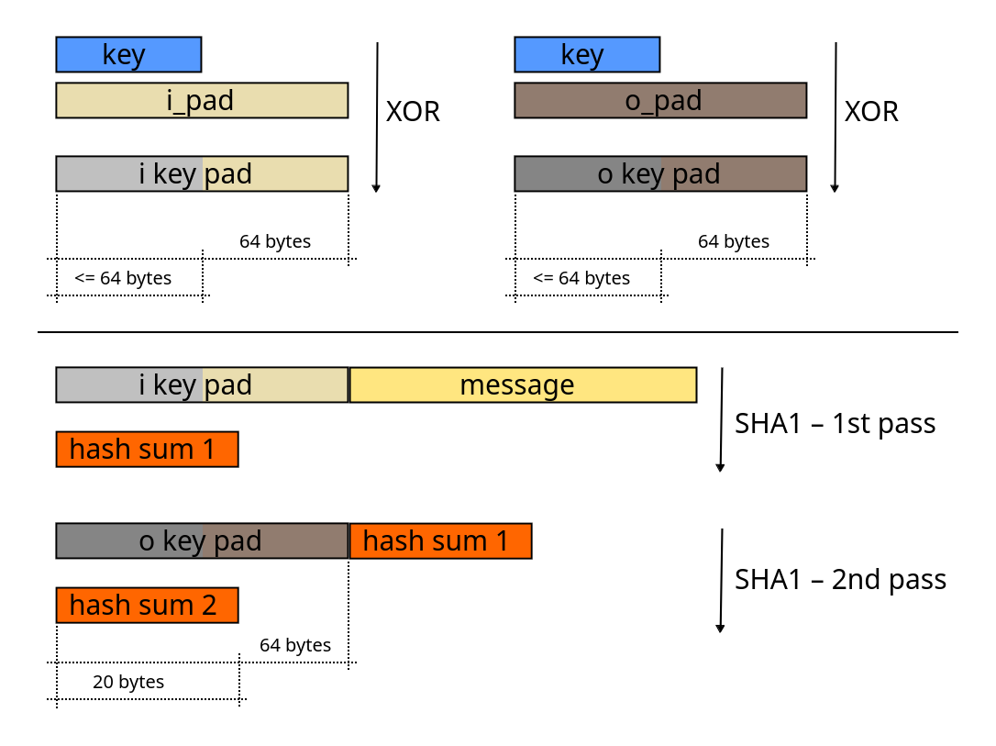
HMAC'd checksums
A hashing algorithm can have something known as a HMAC (pictured here) attached to the algorithm, which allows up to 512 bit keys to be used to modify the output of hashing algorithms.
The HMAC key entirely and securely changes the output of the hashing algorithm, such that the digest cannot be re-created feasibly with the same data (assuming the attacker does not have the key)
A useful side-effect of using HMAC is that it increases the amount of entropy in the output significantly.
The idea is to have a sort of "password" for the checksum which is hard to guess for attackers, so re-creating the same checksum is extremely difficult, and could take several centuries.

Slide 6
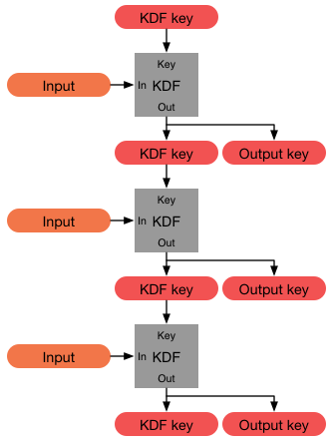
Key derivation
When keys are generated, sub-keys can be generated using a KDF (key derivation function), which can create sub-keys in various ways, and based on various inputs.
Derived keys can be derived again, and again, as many times as wanted, and the key will always be unique*.
The HKDF algorithm is a KDF which requires an already complex input, such as the output from a hashing algorithm, HKDF is my choice for this instance (pictured here).

Slide 7
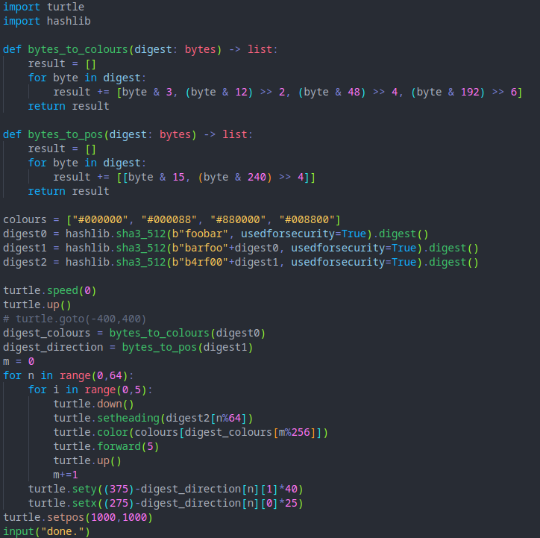
My implementation
I have used python3's "hashlib" and "turtle" libraries to create a quick, simple mock-up of how I think this technology might be implemented.
The code draws to a blank white window, and has 4 colours, 256 angles, and 256 different positions in the selected area.
Each hash controls a different attribute separately.

Slide 8
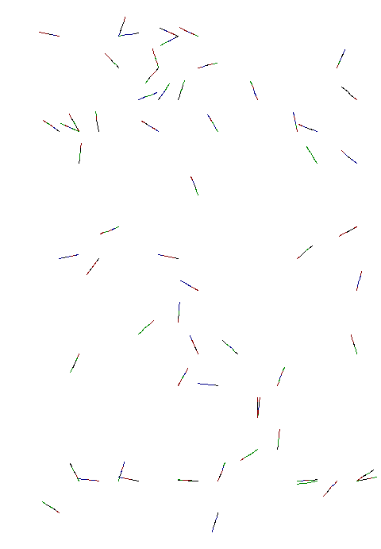
The result
This appears to be very similar to the look of the marks on other documents.
I believe this may be evidence that this is the true purpose of these markings.

Slide 9
Thank you for listening
If there are any questions, please feel free to ask now

